Slide 1
Activities at UON
Paul Kimani,
University of Nairobi, Kenya
DLB Workshop, 29-30 April 2019, Addis Ababa, Ethiopia
UNIVERSITY OF NAIROBI

Slide 2
Contents
Introduction
Capacity building
Application of DLB
Outreach Activities and Links with Industry
Future Directions

Slide 3
Overview of DLB phase 2
Encouraging connectivity between breeders and seed organisations, seed regulatory bodies, food business chains
Additional partner engagement

Slide 4
Phase 2 programme
Variety design
Individual breeders
Alumni/educator
community
Market research
Foresight
Identifying
Promising varieties
Portfolio of
public varieties
Setting standards
Target
product
profiles
Variety promotion
Creating
compelling
investment
cases
Promotion
pitch
Technical
datasheets
Scaling and adoption
Connecting with seed organisations
Value chain actors

Slide 5
Transitioning
Phase 1 → Phase 2
Inputs
Outputs
Outcomes
Impact/smallholders
Information
Products
Behaviour
changes
People/environment
Phase 1
Phase 2
DLB training and community building
Identifying, accelerating and connecting promising varieties with private sector

Slide 6
Capacity Building
DLB integrated in MSc Plant Breeding and Biotechnology program
Part of ACB 604 – Advanced Plant Breeding and therefore examinable
Training conducted in partnership with BECA
  21-23 November 2018
  22-23 Oct 2018

Slide 7
DLB training at BecA, Oct 2018

Slide 8

Graduation

Slide 9
…….And they graduated

Slide 10
Application
Grad students encouraged to apply DLB in their thesis projects
Five new projects started
  Tomato breeding and genetics (with Continental Seeds Ltd)
  Rice breeding and genetics (with South Sudan )
  Soy bean breeding and genetics (with DR Congo)
  Marker assisted gamete selection in dry common bean
    Mesoamerican
    Andean populations

Slide 11
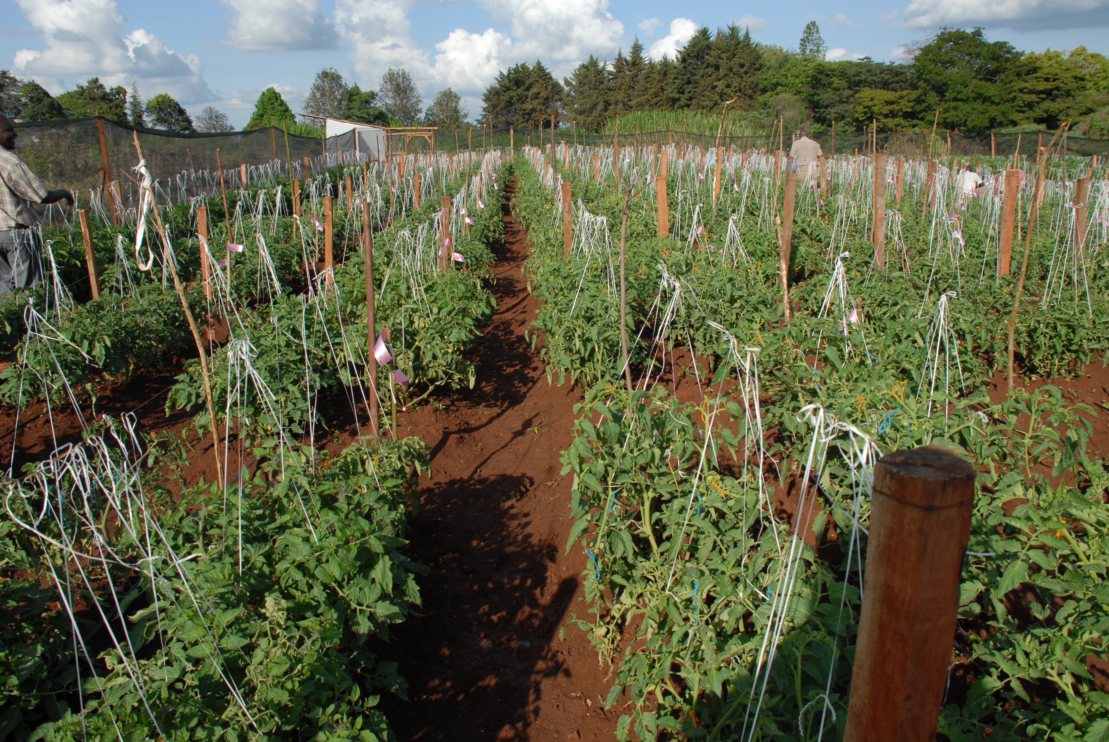
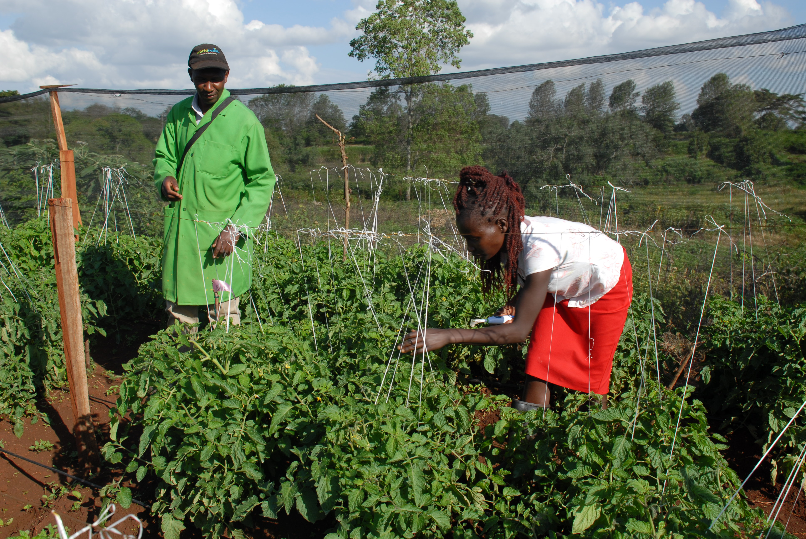
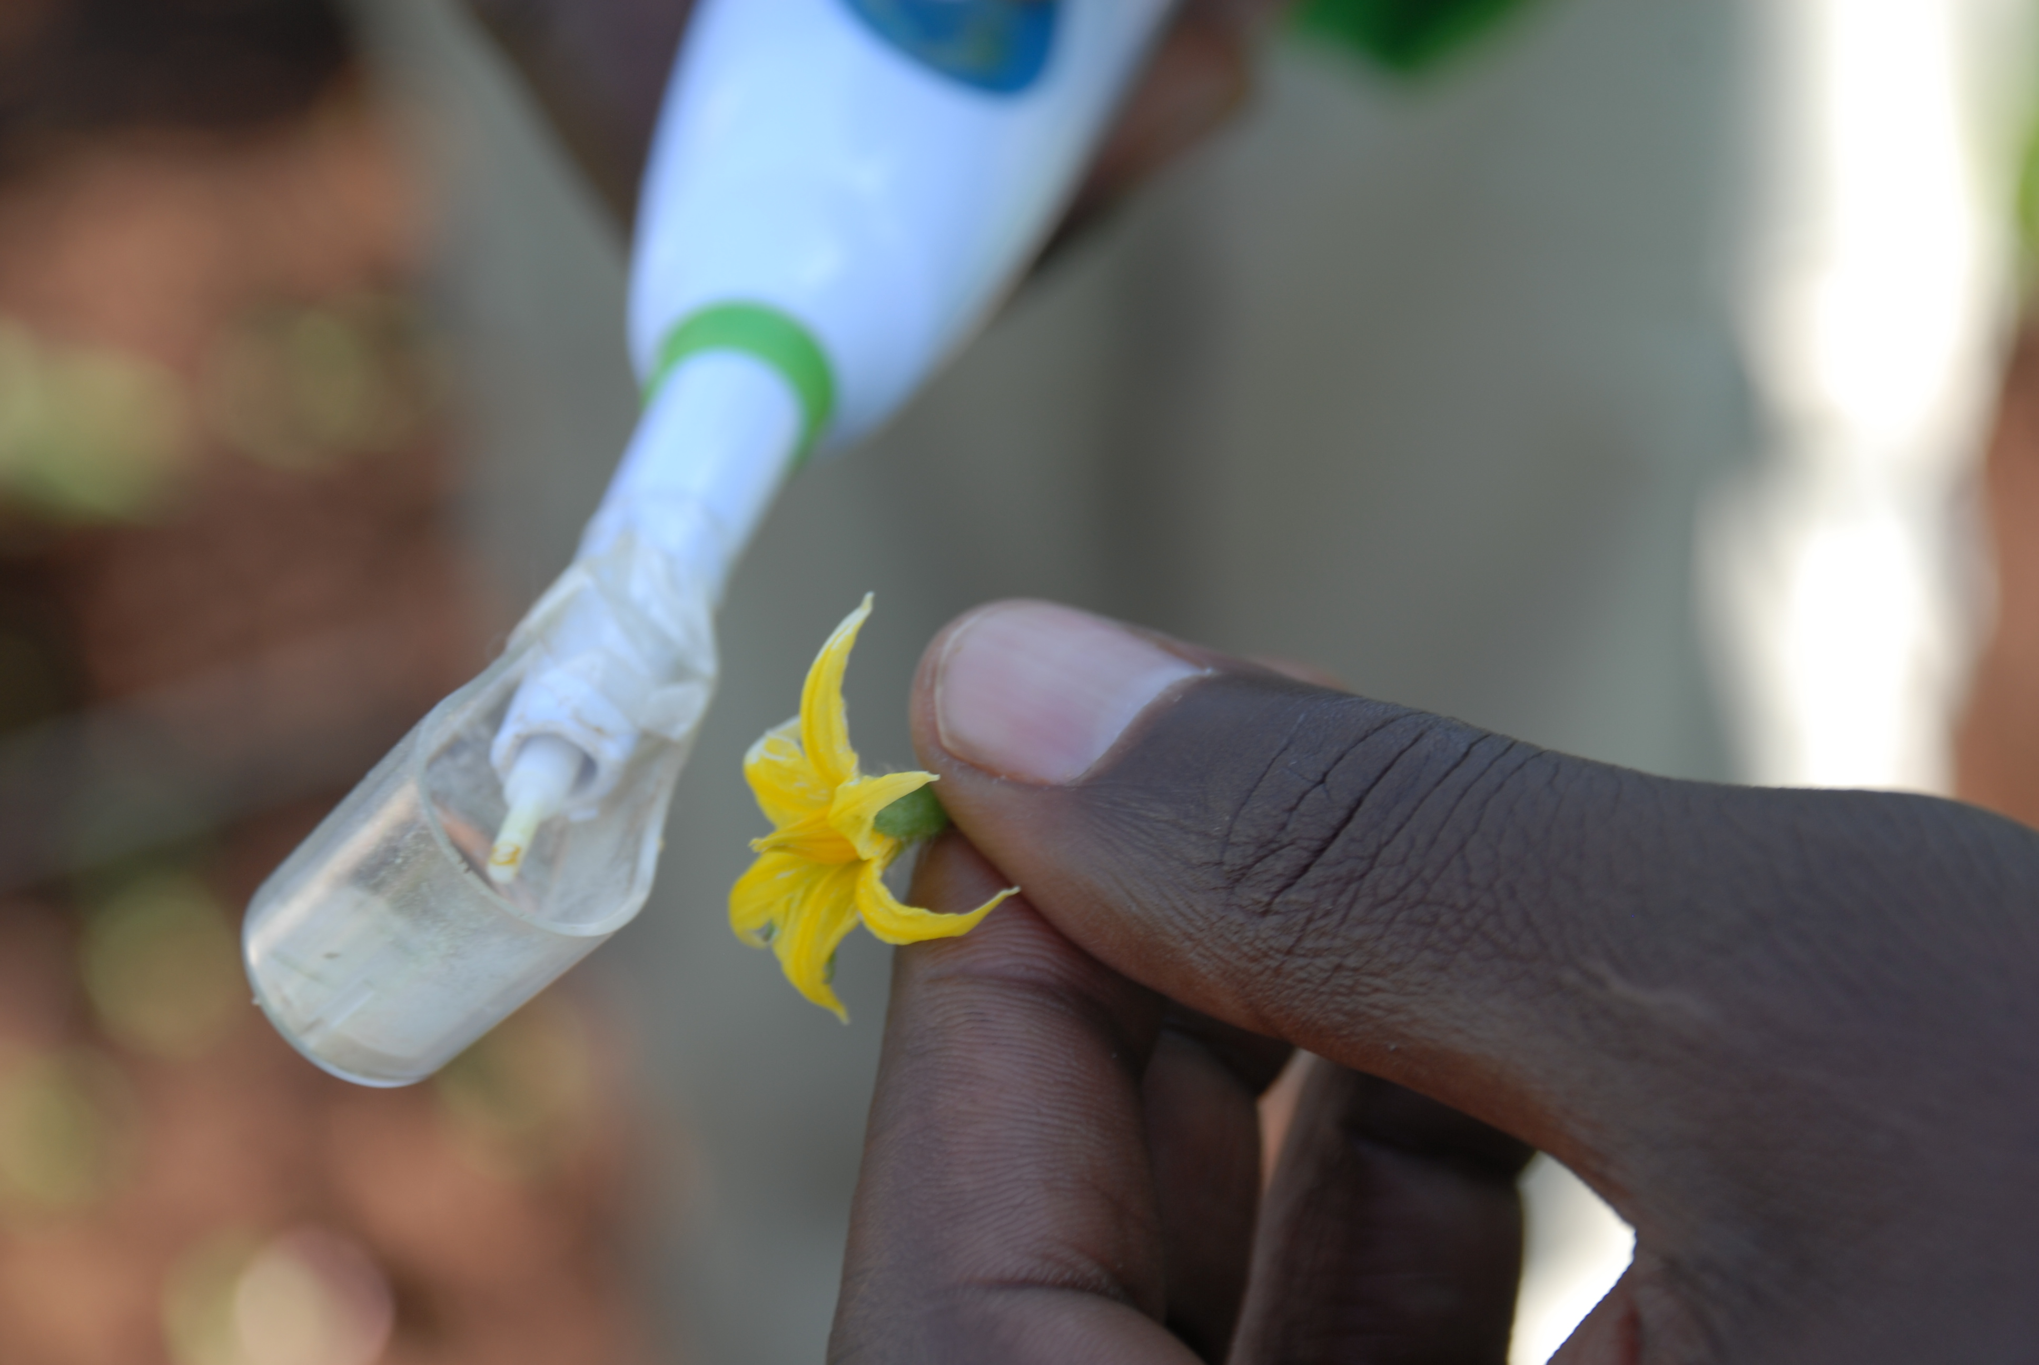
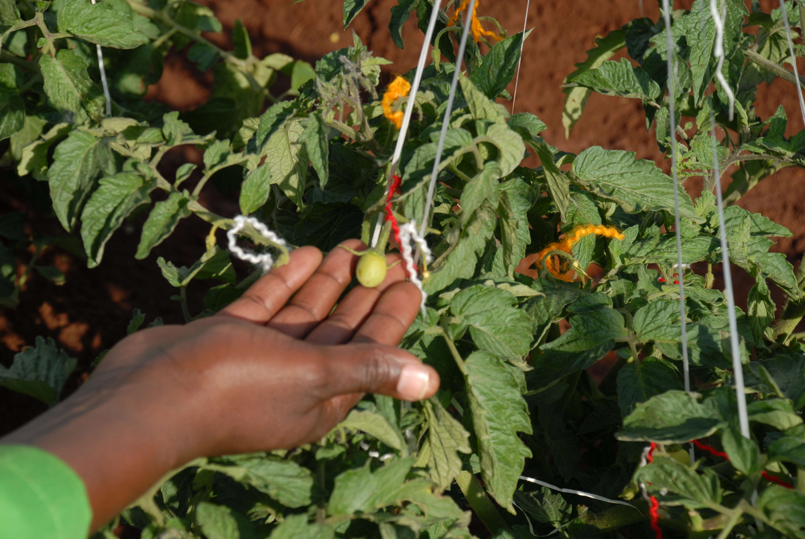
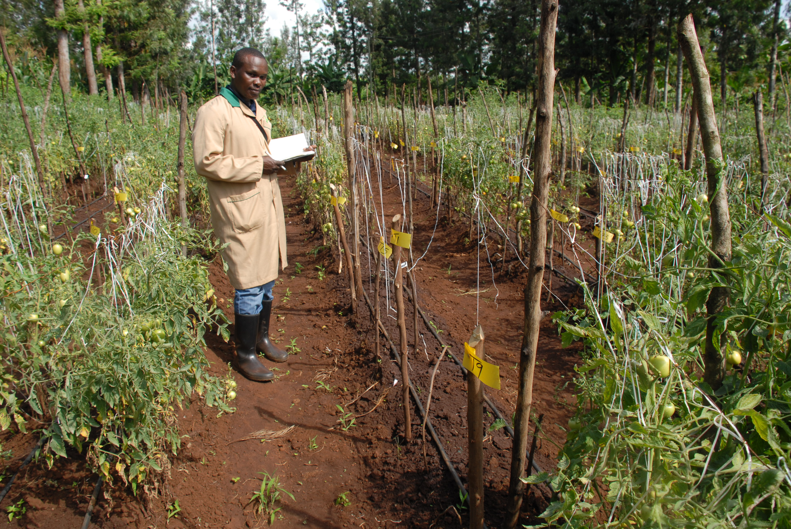
Tomato breeding, Kabete 2018
Partnership between University of Nairobi and Continental Seeds Ltd

Slide 12
Outreach Activities and Links with Industry
New links established with industry
  Meru Greens – in export processing zone for canned snap beans
  Frigoken- fresh market and processing snap beans
  Premier Food Industries – for canned dry beans (navy beans)
  Njoro Canning Factory- canned beans
  Trufoods Ltd – canned beans
  Continental Seeds Ltd – tomato breeding

Slide 13
Seed Industry
Kenya Seed Company
  Joint observation trials
Elgon Kenya Ltd
Western Seed Company
Ultravetis –dry beans
Suera Ltd- canning beans and runner beans
Gicheha Farms Ltd- dry bean
Simlaw Seeds Ltds- climbing beans and bush beans
Seedco- EOI

Slide 14

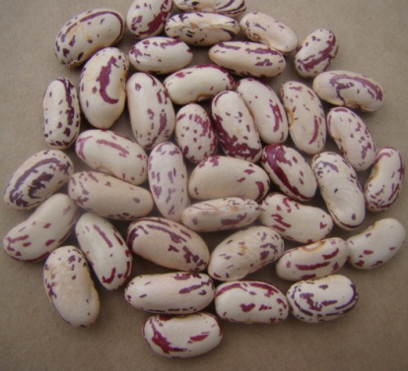
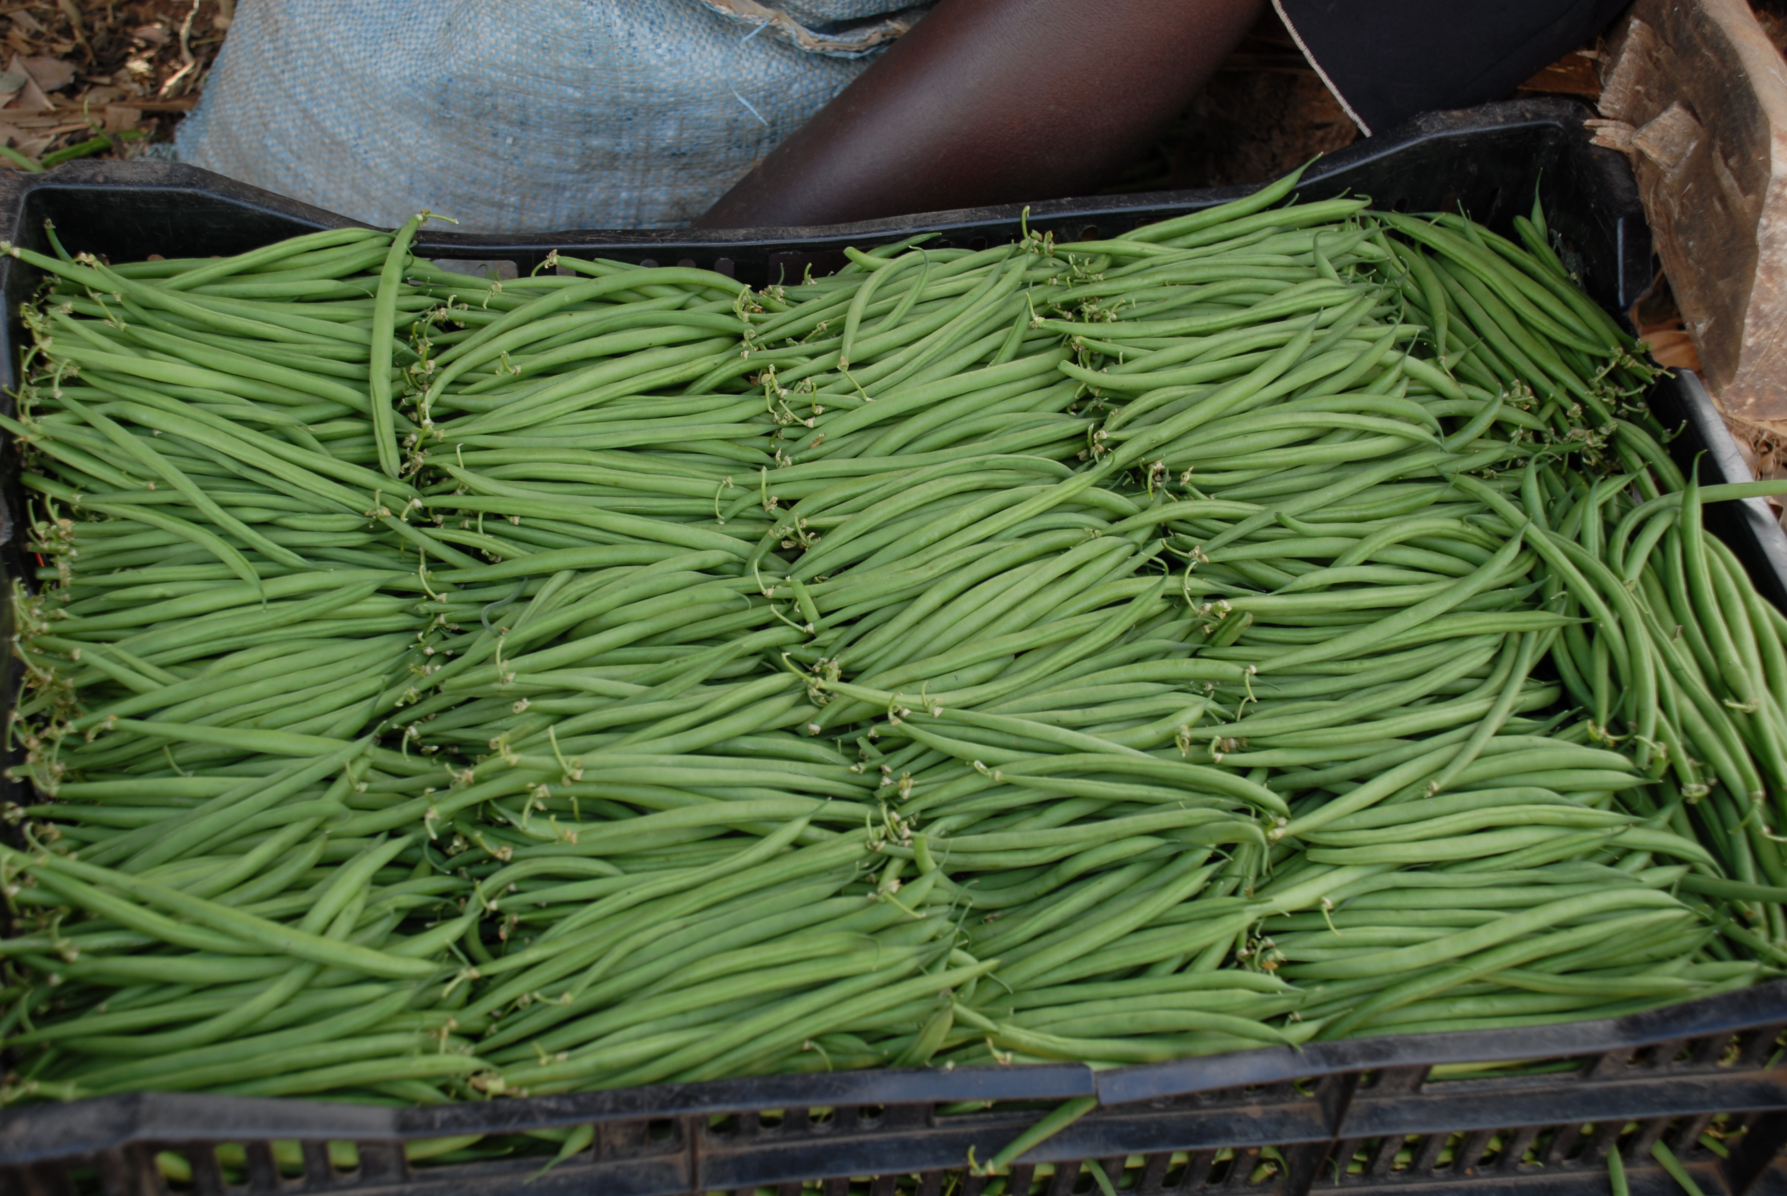
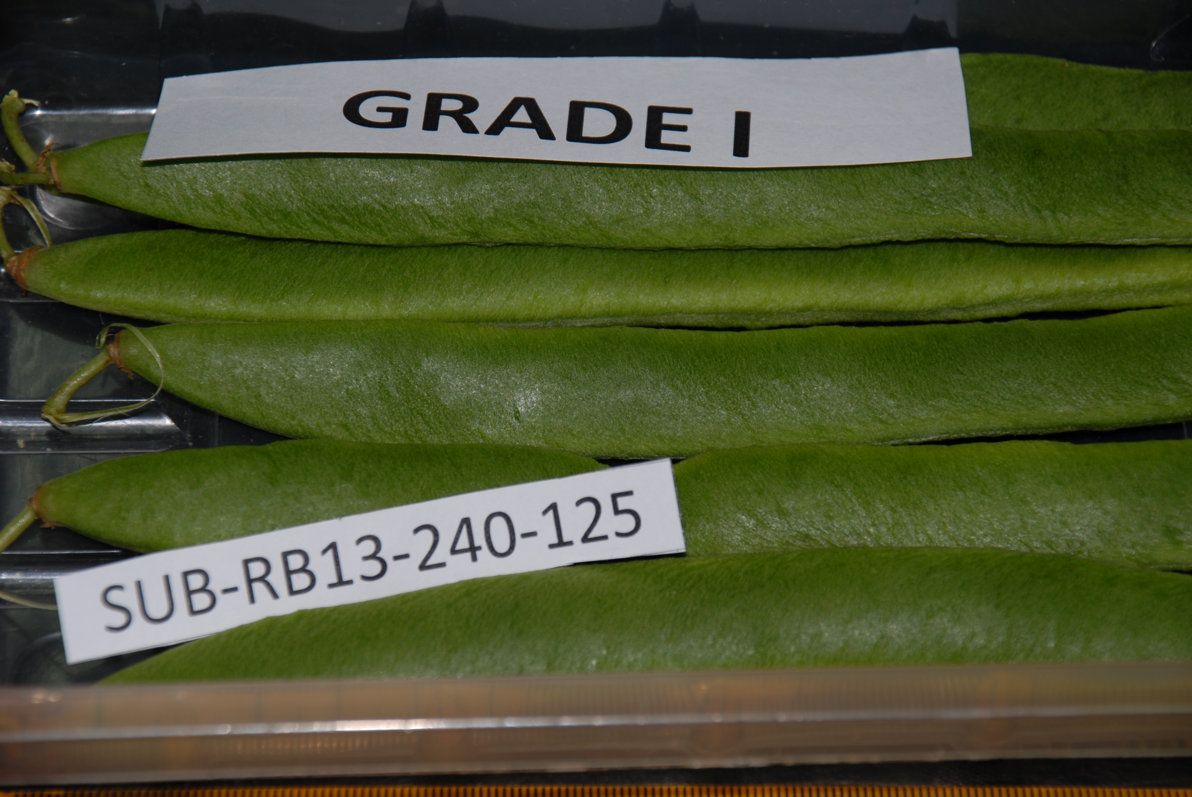
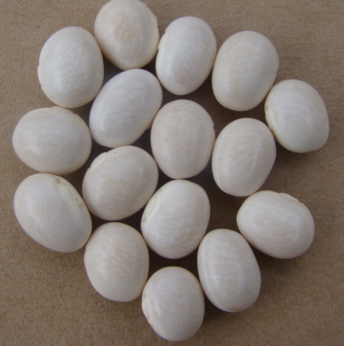
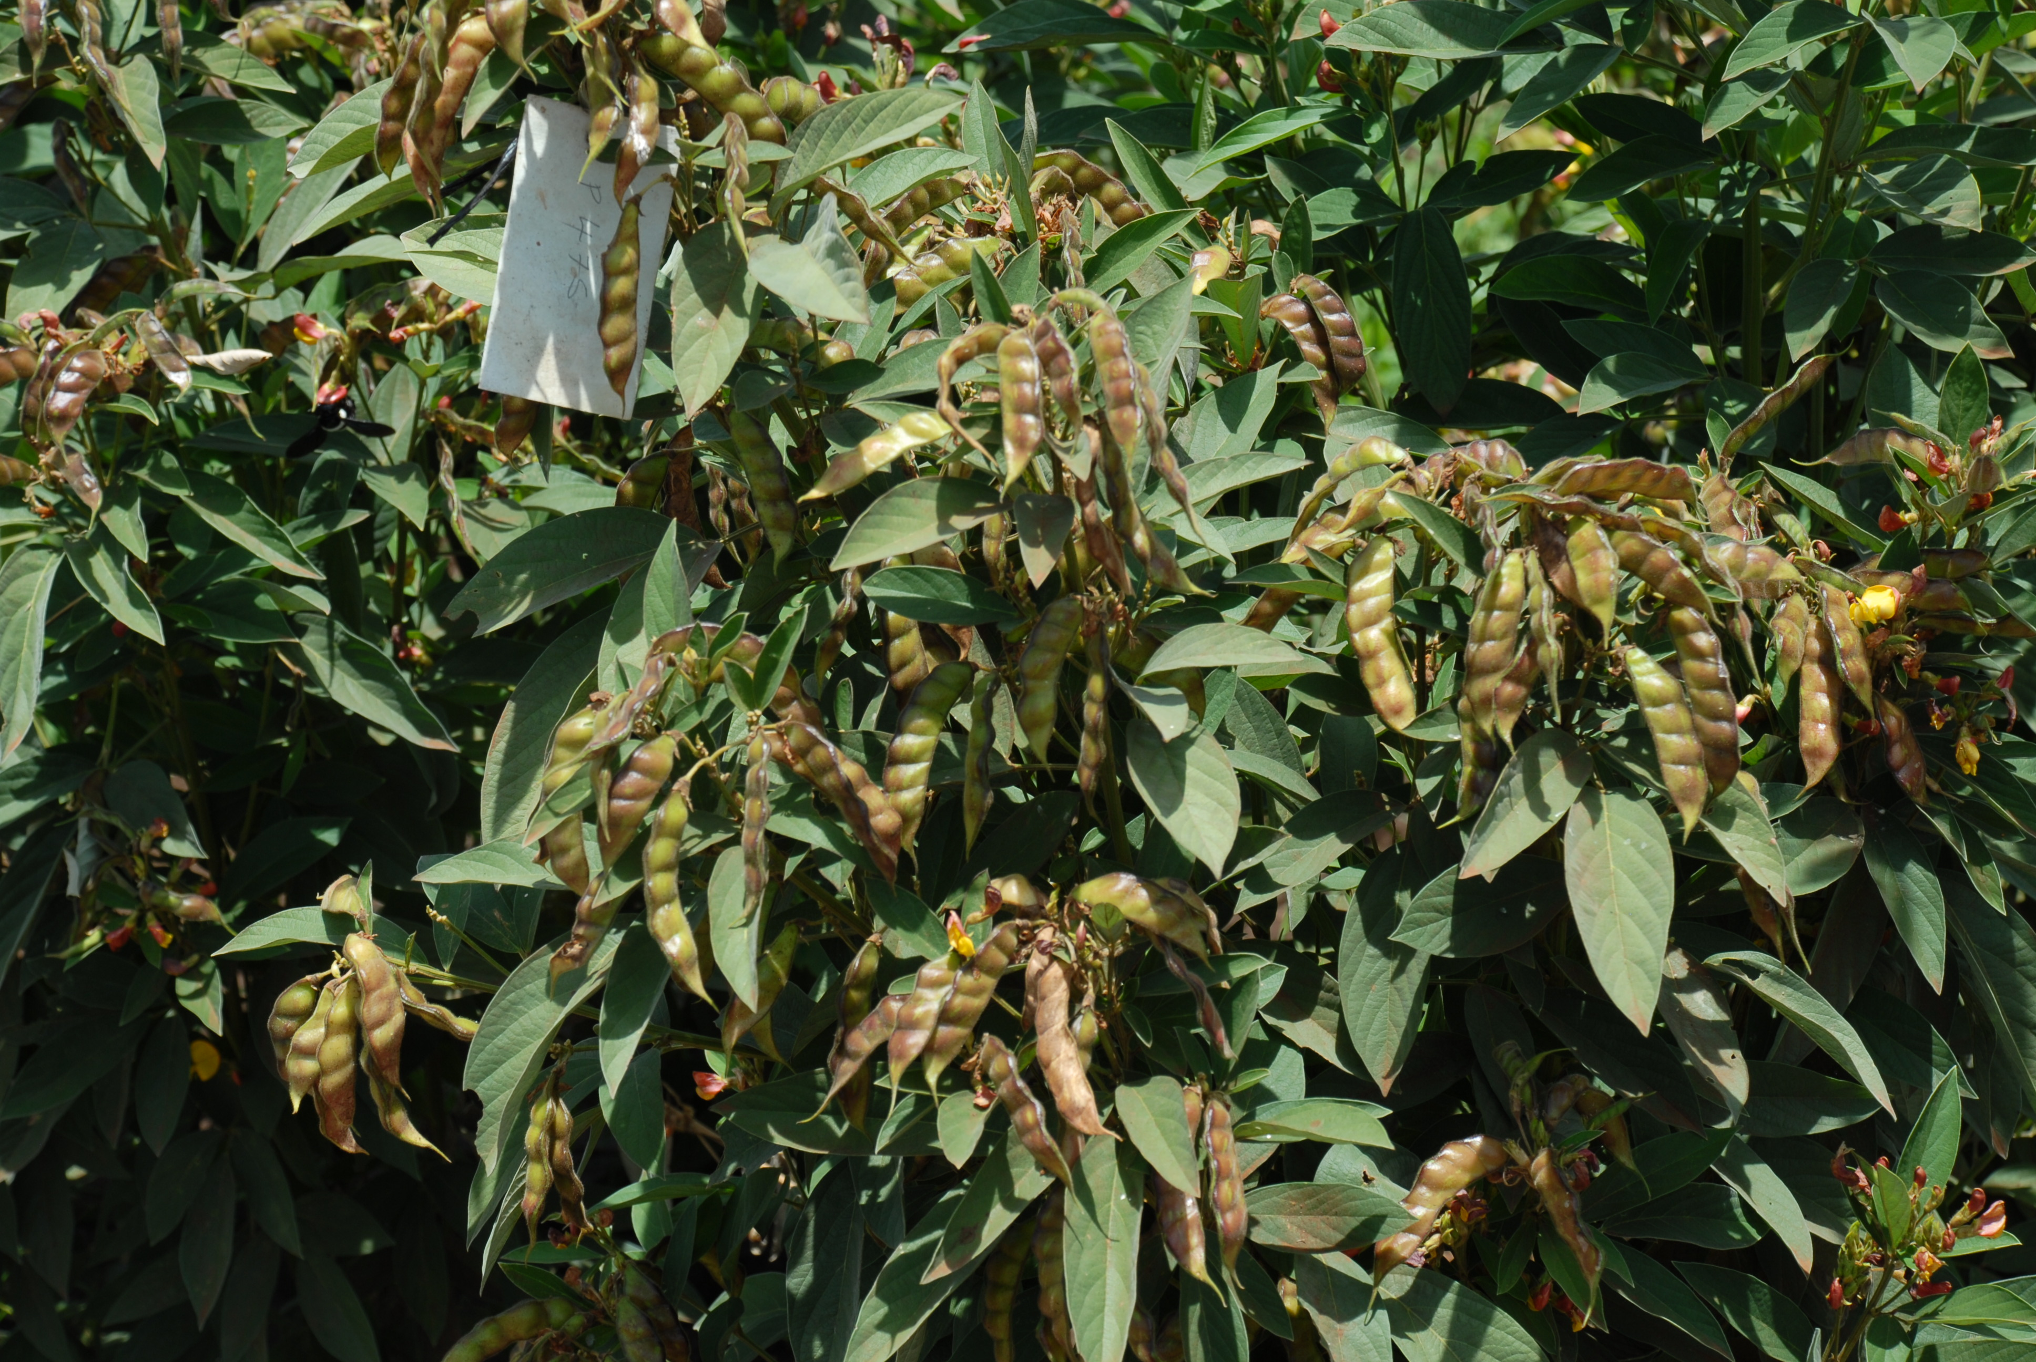
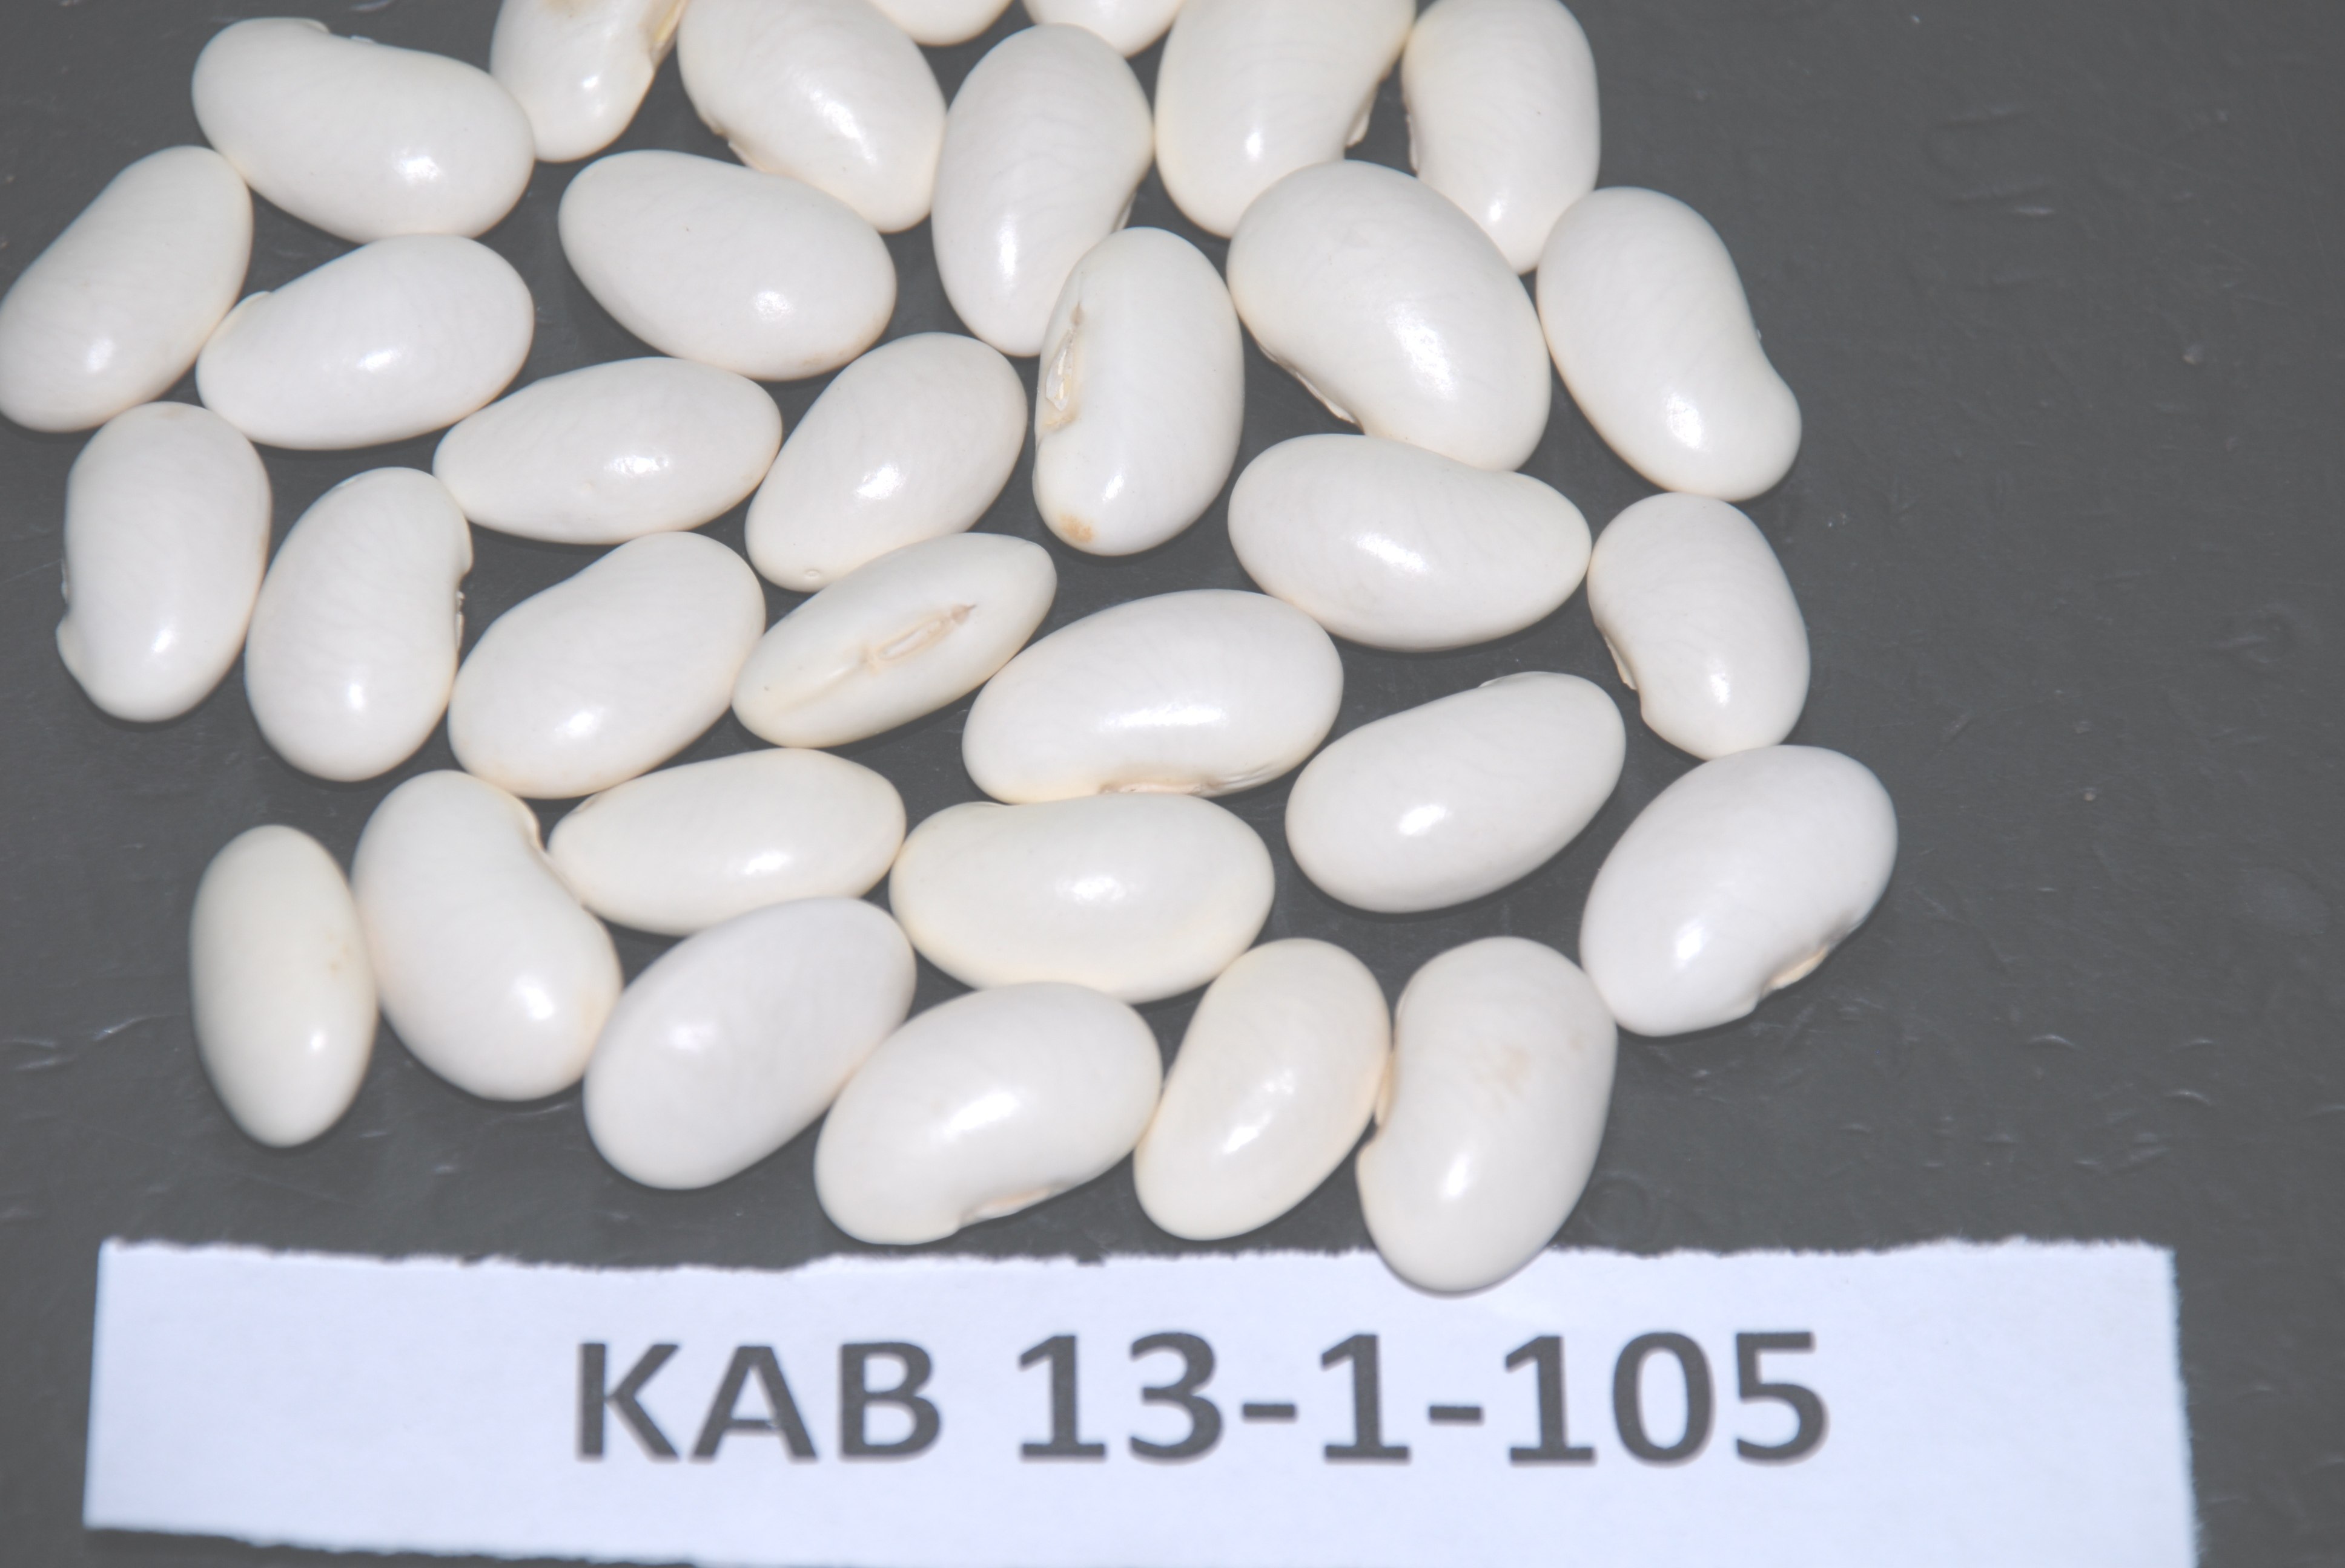
UNISEED KENYA LTD
-Product portifolio
UNIVERSITY OF NAIROBI
Your preferred supplier of High Quality Certified Breeder Seed for:
Dry beans
Climbing beans
Biofortified beans-iron and zinc rich
Canning beans
Vegetable runner (butter) beans
Dry grain runner beans
Snap beans for fresh produce markets
Snap beans for canning
Runner bean dry grain for canning
Pigeonpea (mbaazi) – early maturing
For further information contact: Principal, College of Agriculture and Veterinary Sciences, University of Nairobi, P.O Box 29053-00625 Nairobi, KENYA
< principal-cavs@uonbi.ac.ke > or <pmkimani@uonbi.ac.ke>

Slide 15
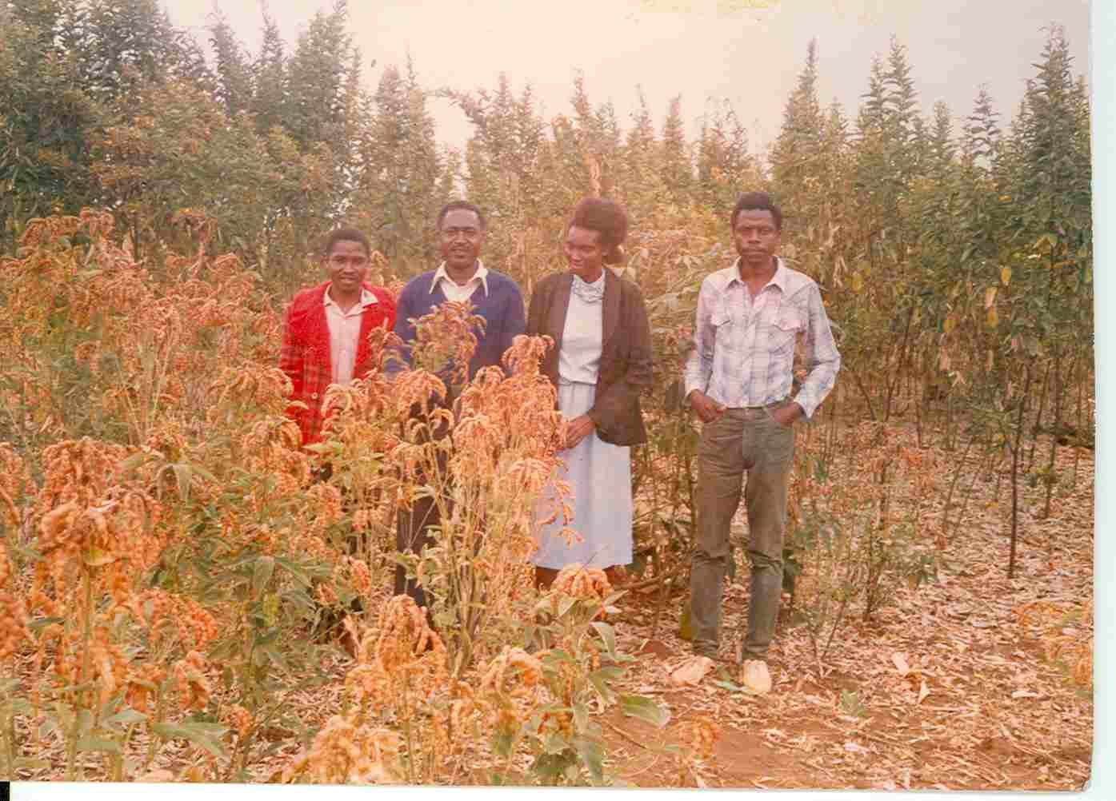
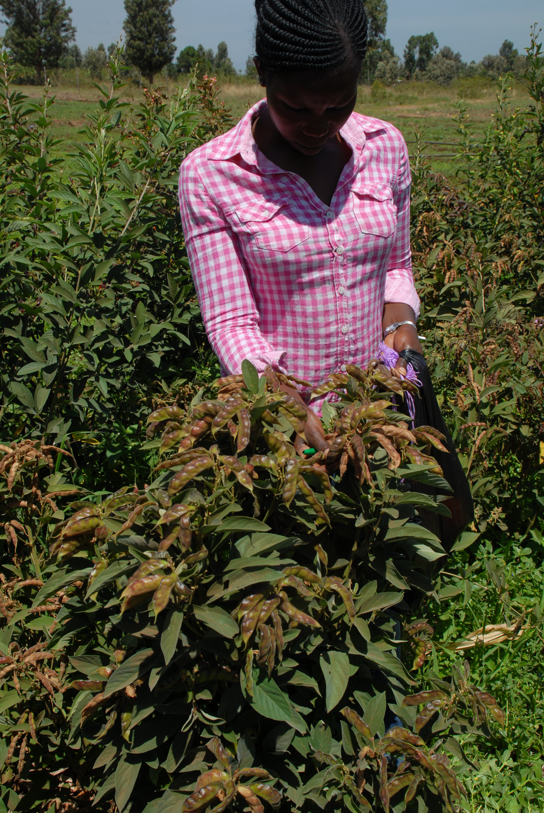
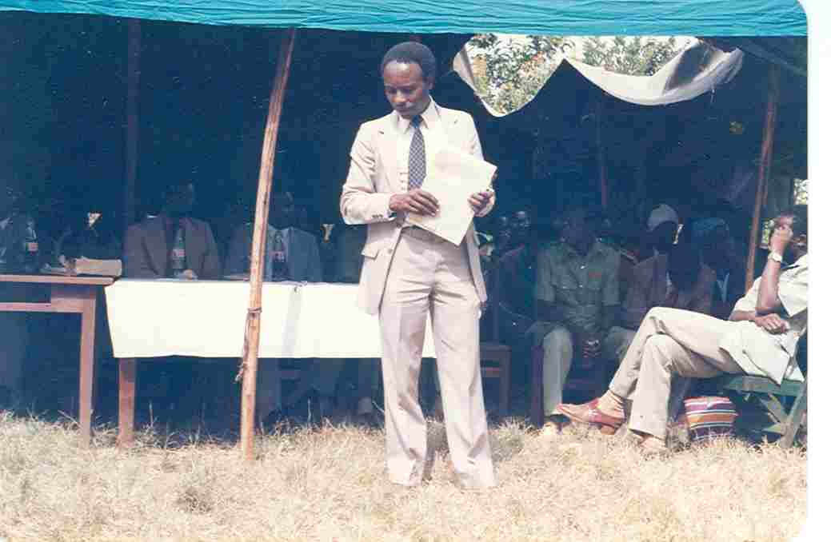
Pigeonpea- NPP670
1986
2016
Adoption rate: >78% (Jones et al 2001)

Slide 16

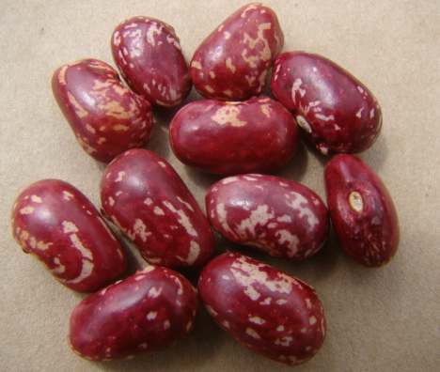
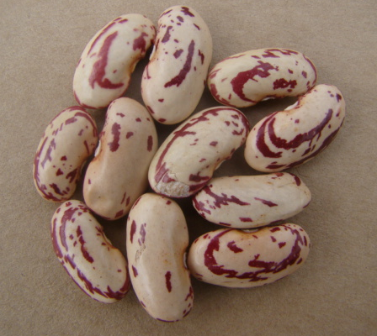
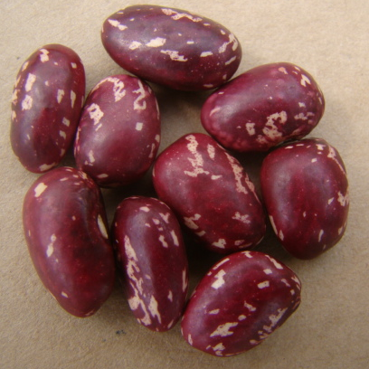
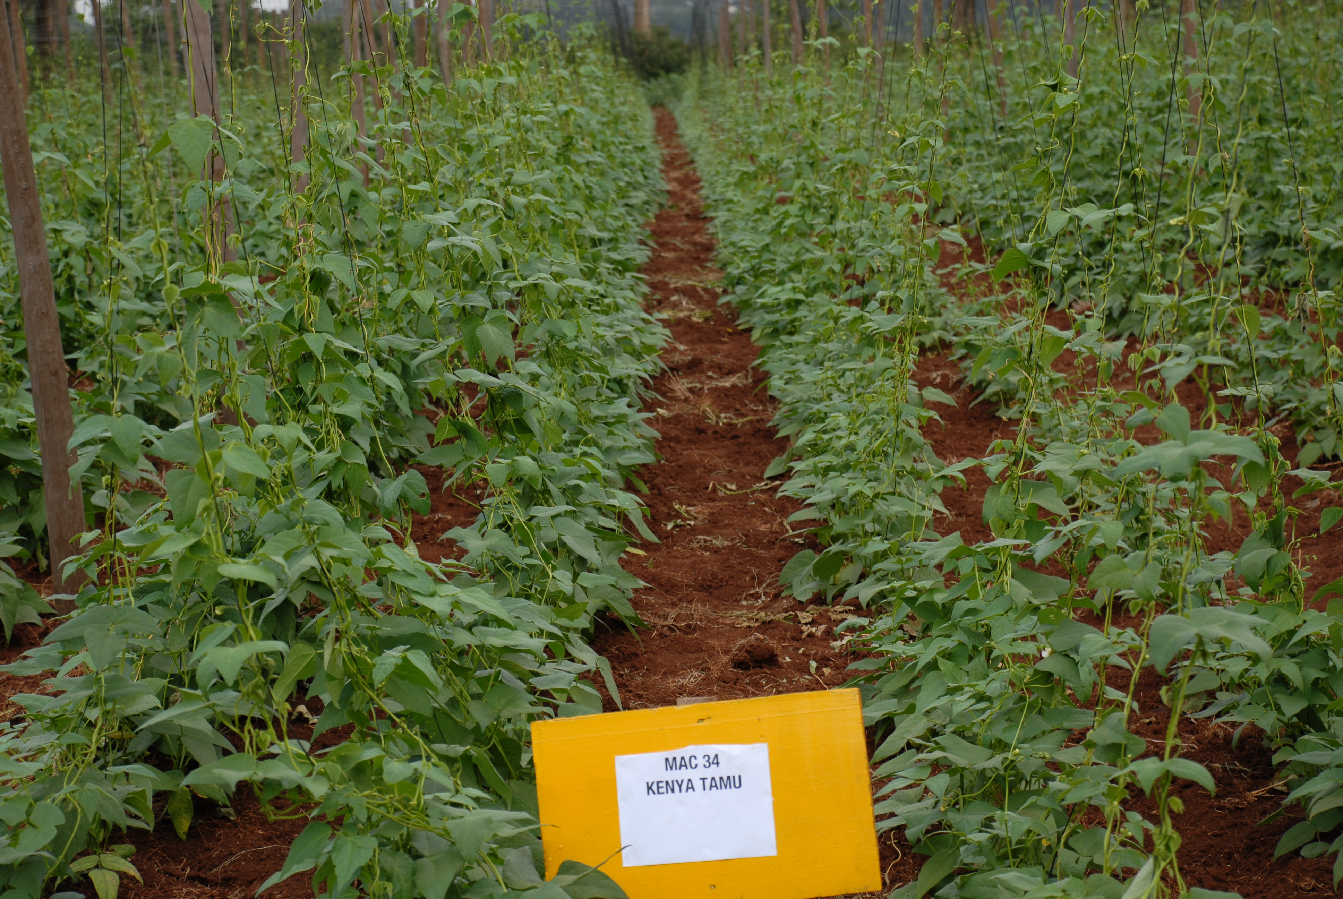
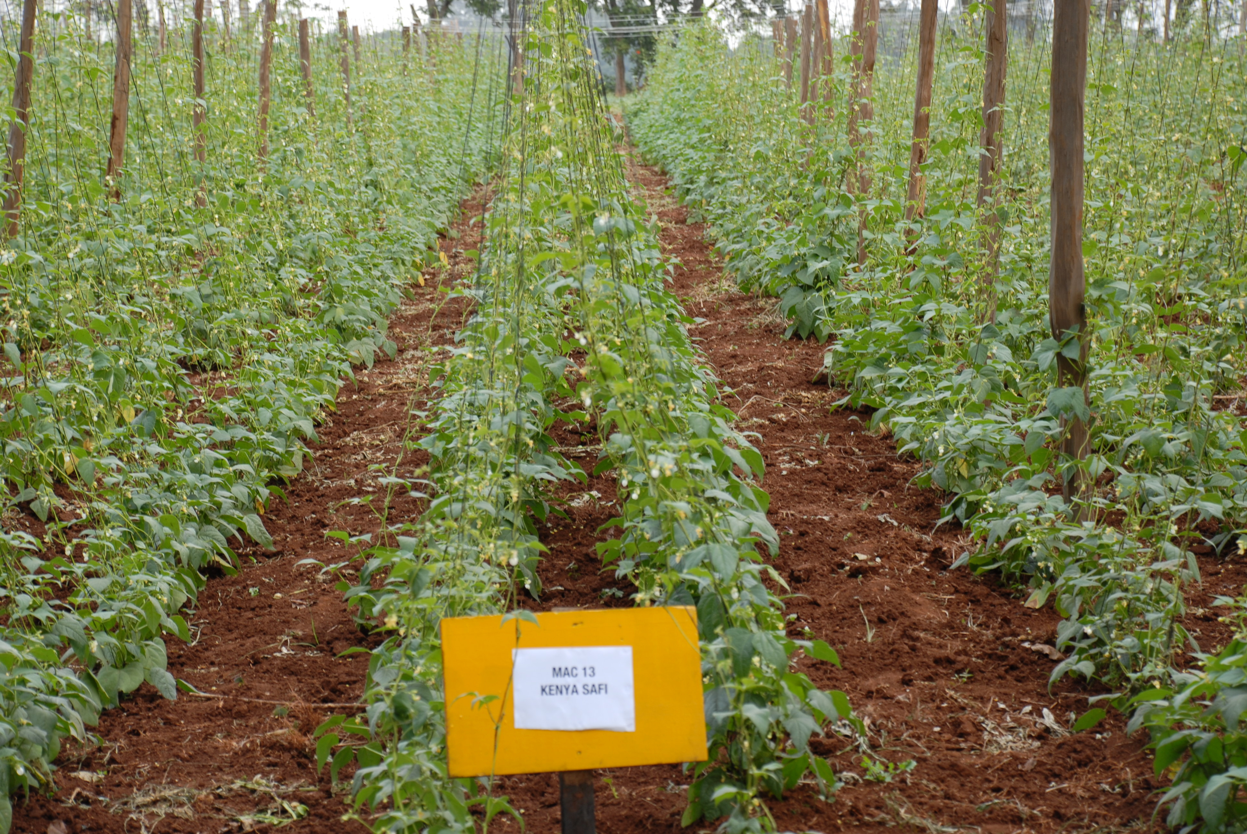
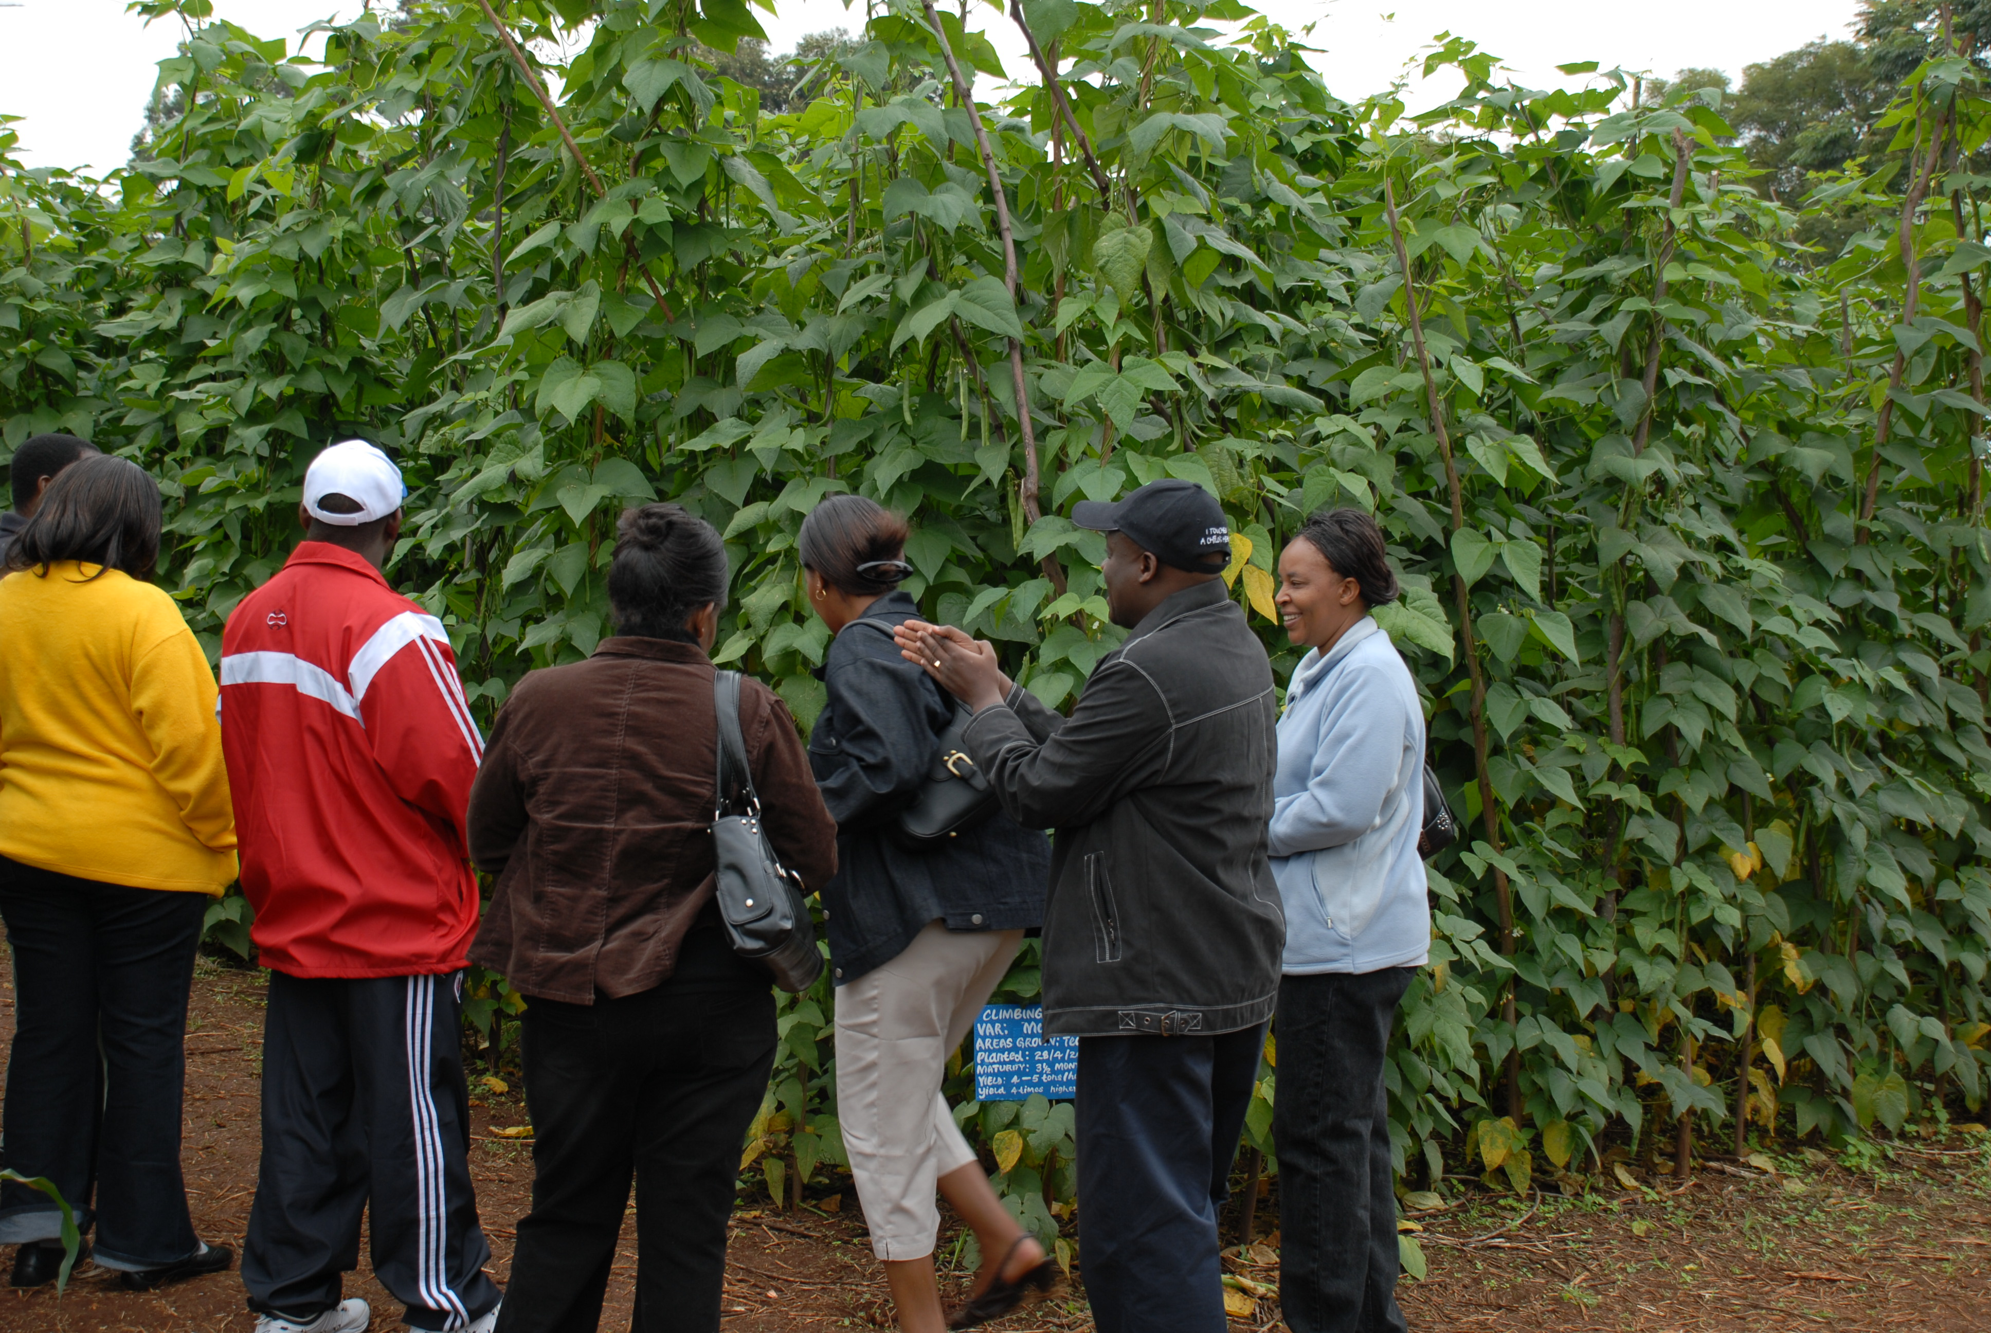
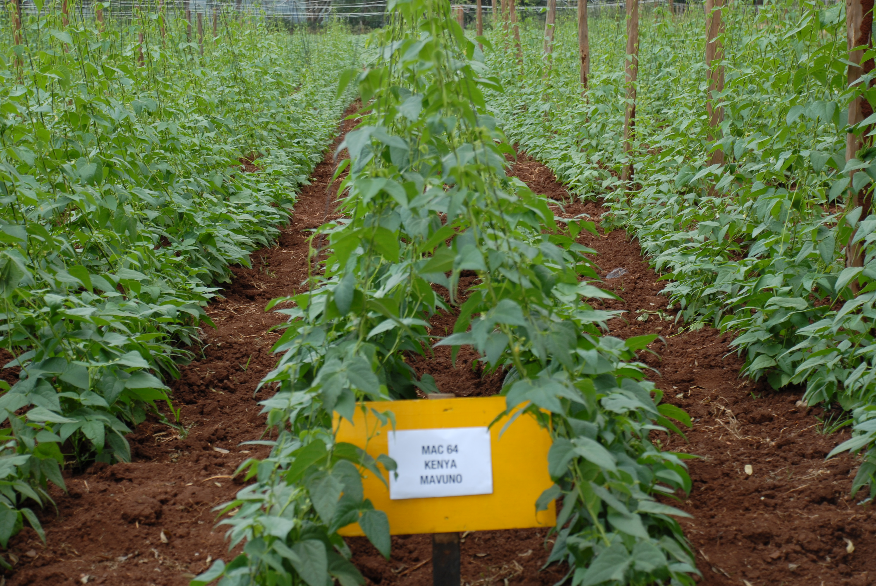
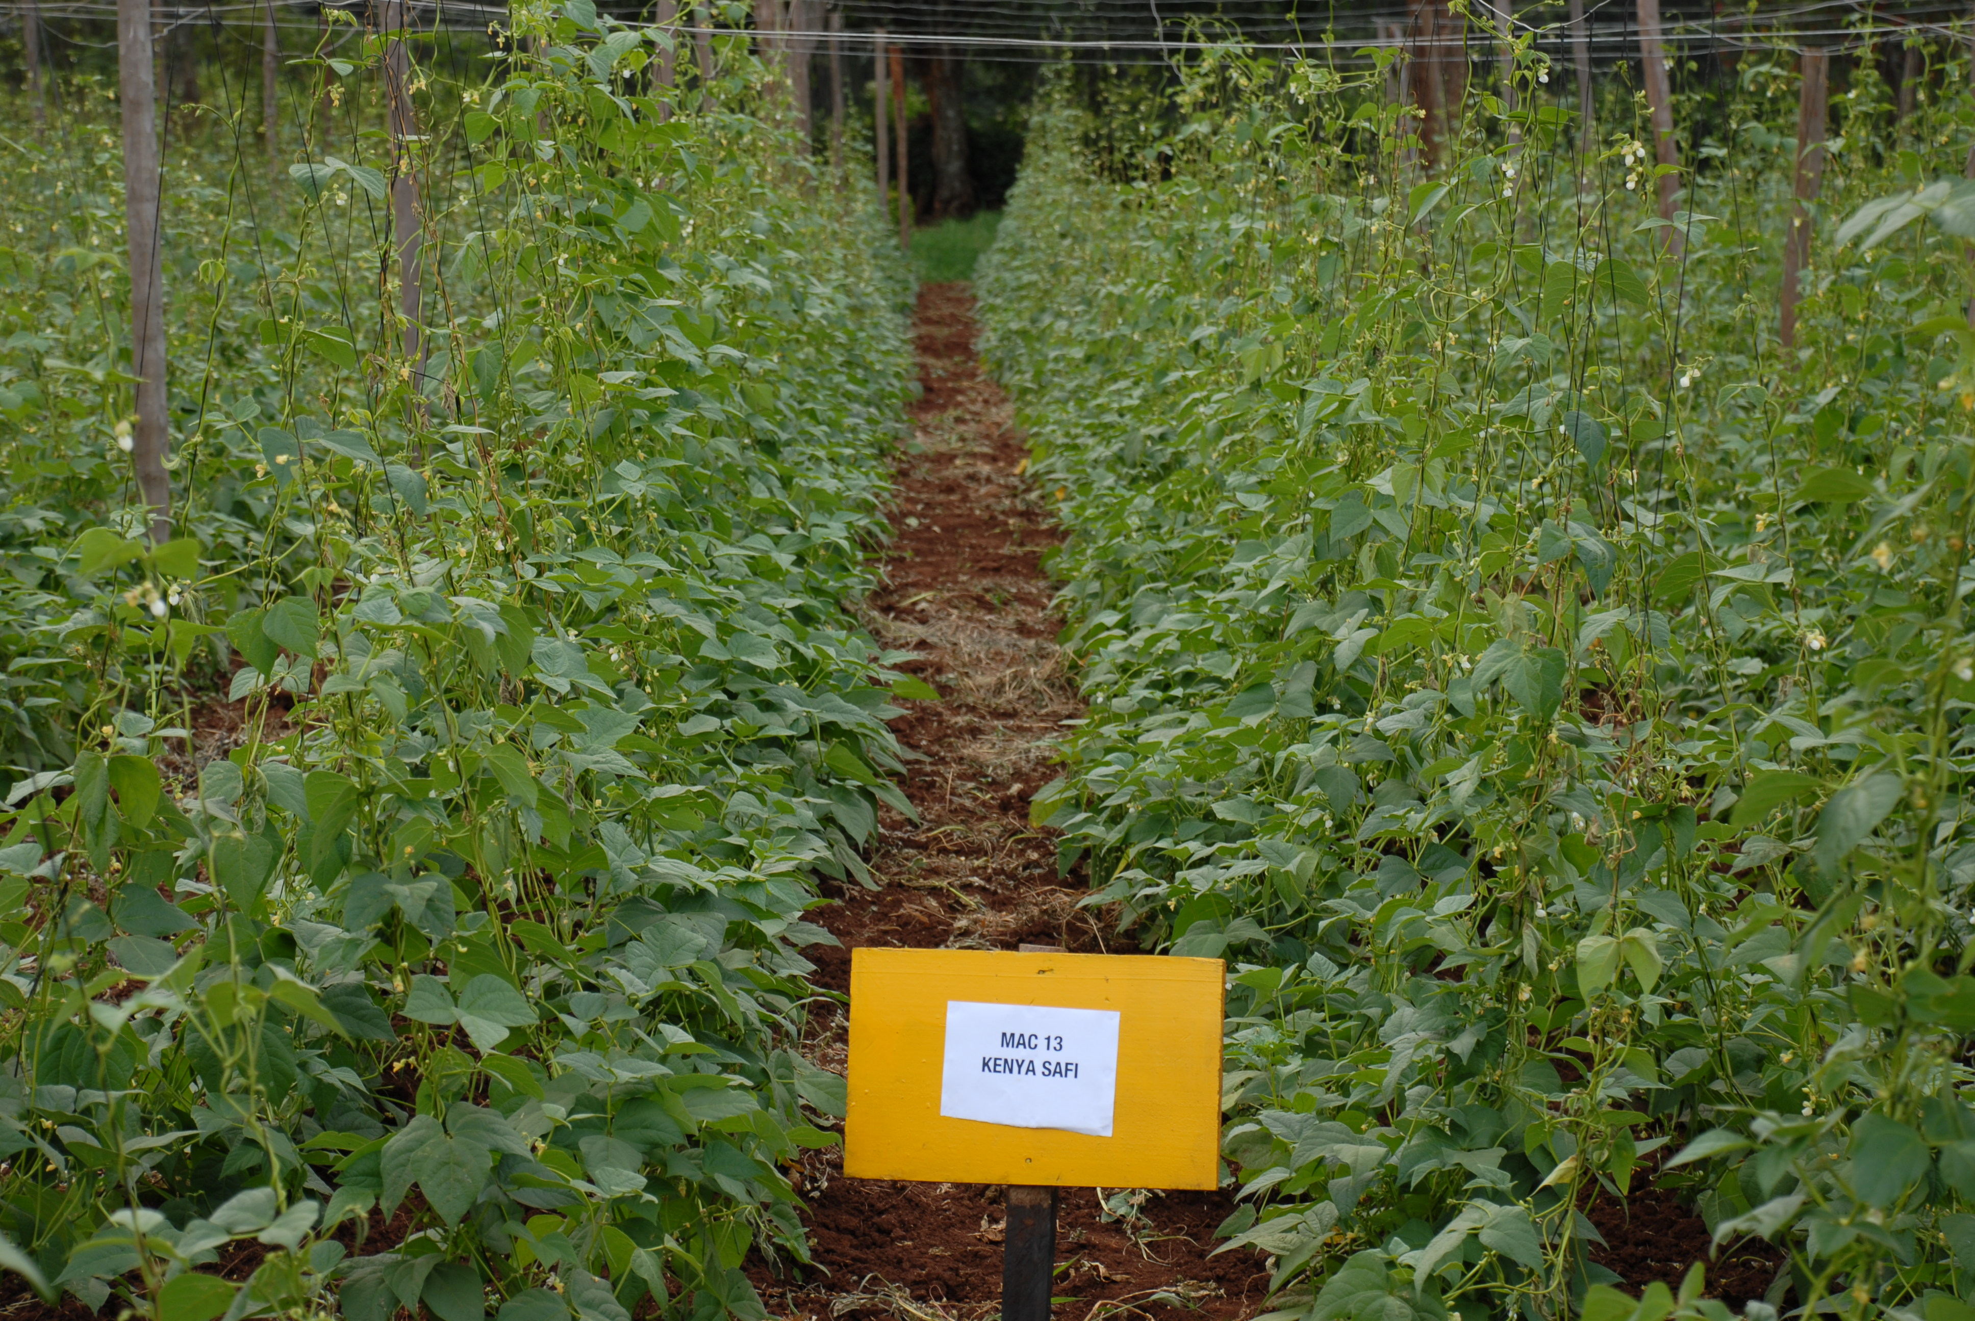

UNISEED KENYA LTD
CLIMBING BEAN PRODUCTS
Your preferred supplier of High Quality Certified Breeder Seed
Lab Logo
2
KENYA TAMU
1
KENYA SAFI
UNIVERSITY OF NAIROBI
3
KENYA MAVUNO
Figure 2. Red mottled MARKET CLASS
FIGURE 1. Speckled sugar grain type
4
High yield potential – 3 times that of bush varieties
Resistant to diseases
Popular commercial grain types
Highly marketable
Excellent cooking and eating quality
Improves soil fertility- good nitrogen fixer

Slide 17
New Canning bean varieties
Variety | Market class | Maturity | Yield (t ha-1)
Kenya Mamboleo | Red mottled | 75-85 d | 2.5
Kenya Salama | Navy | 80-95 d | 2.7
KenStar | Navy | 80-95 d | 3.1
Kenya Cheupe | Navy | 80-95 d | 2.8
Kenya Red kidney | Red kidney | 85-95 | 2.7

Slide 18

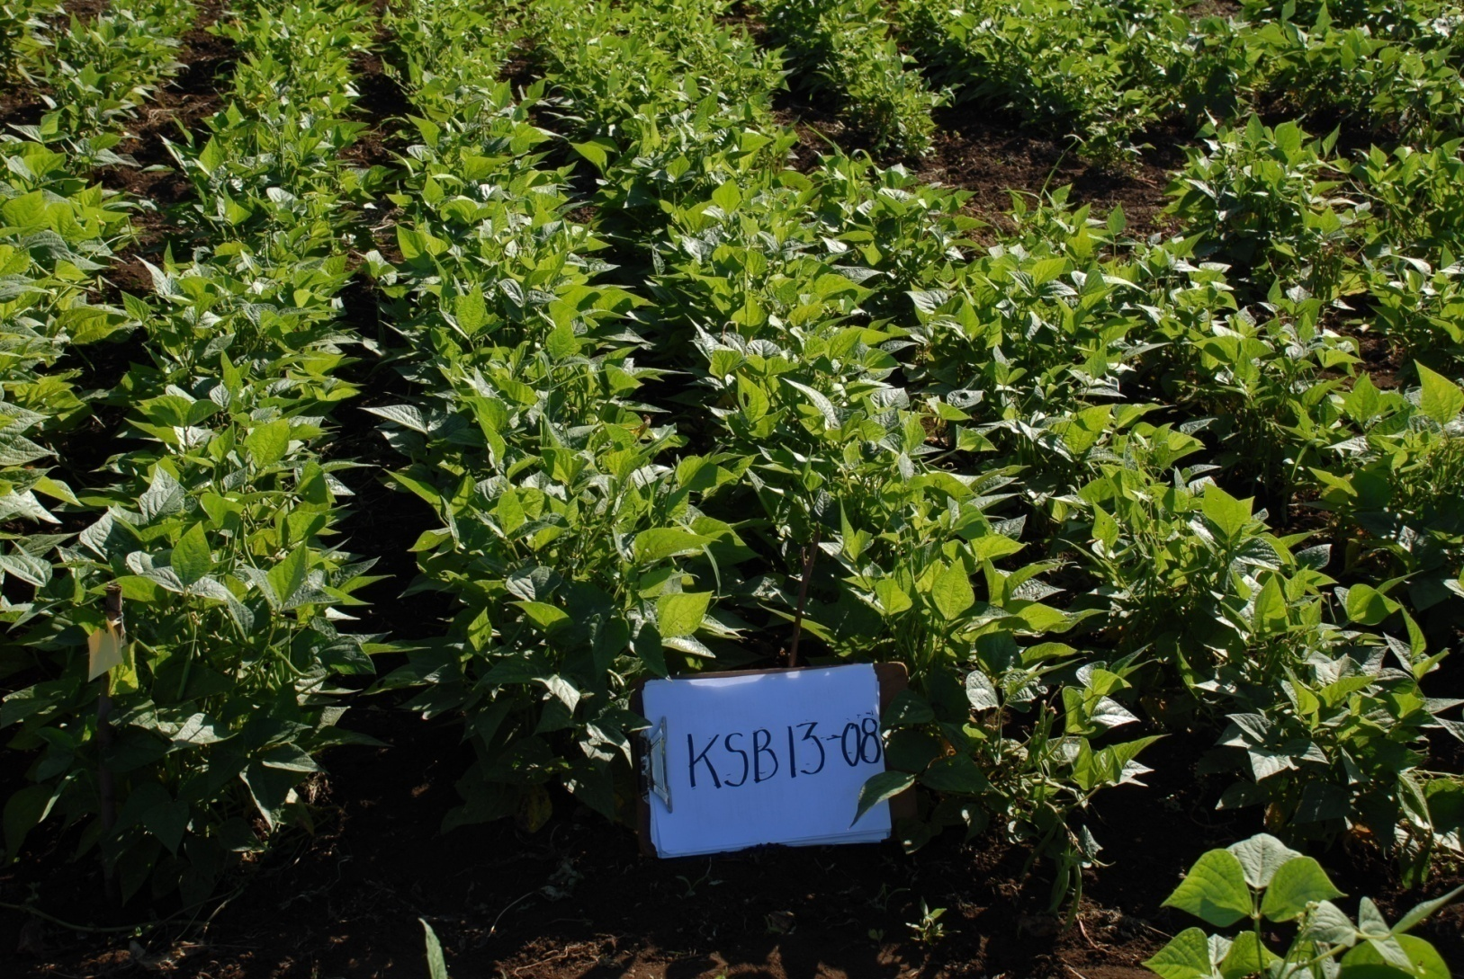

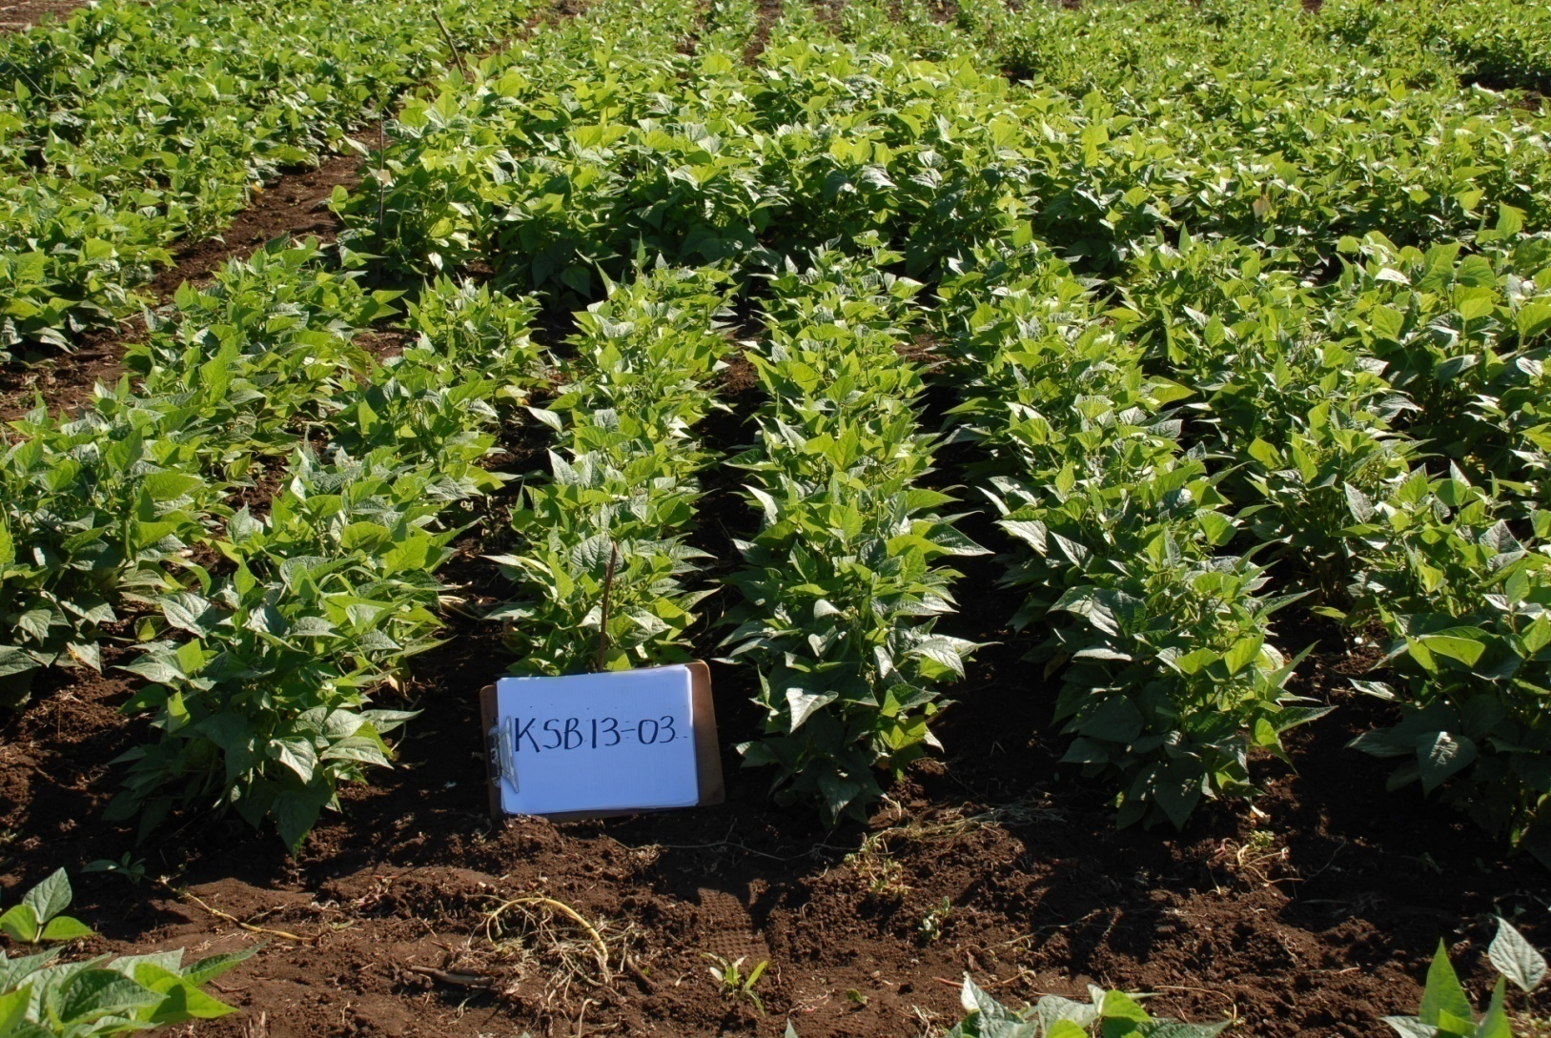
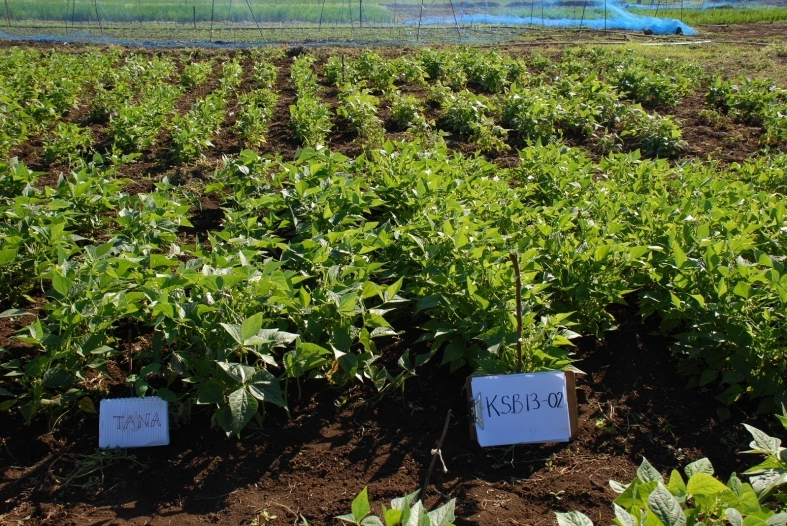
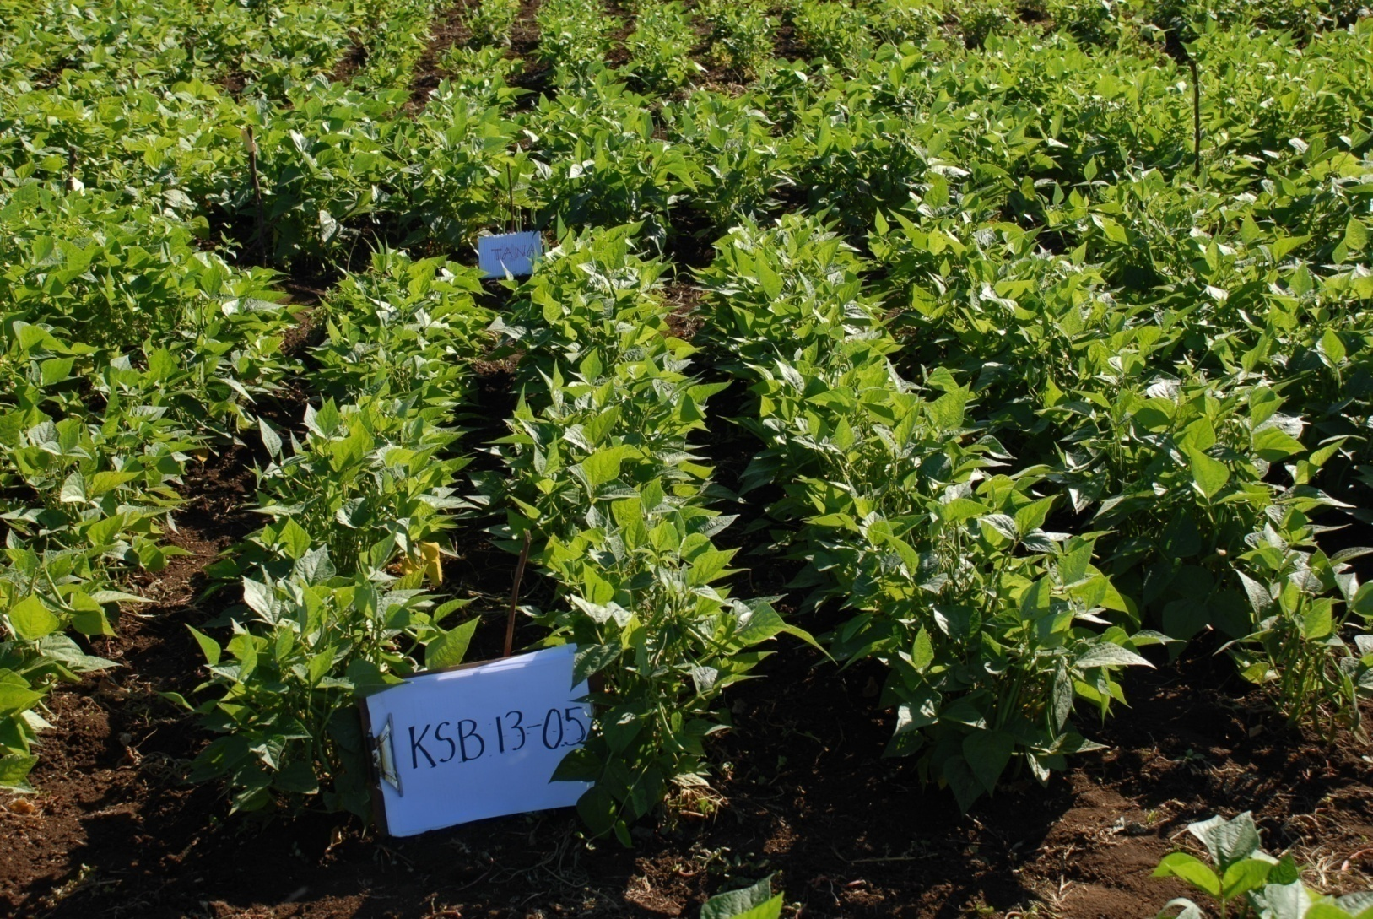
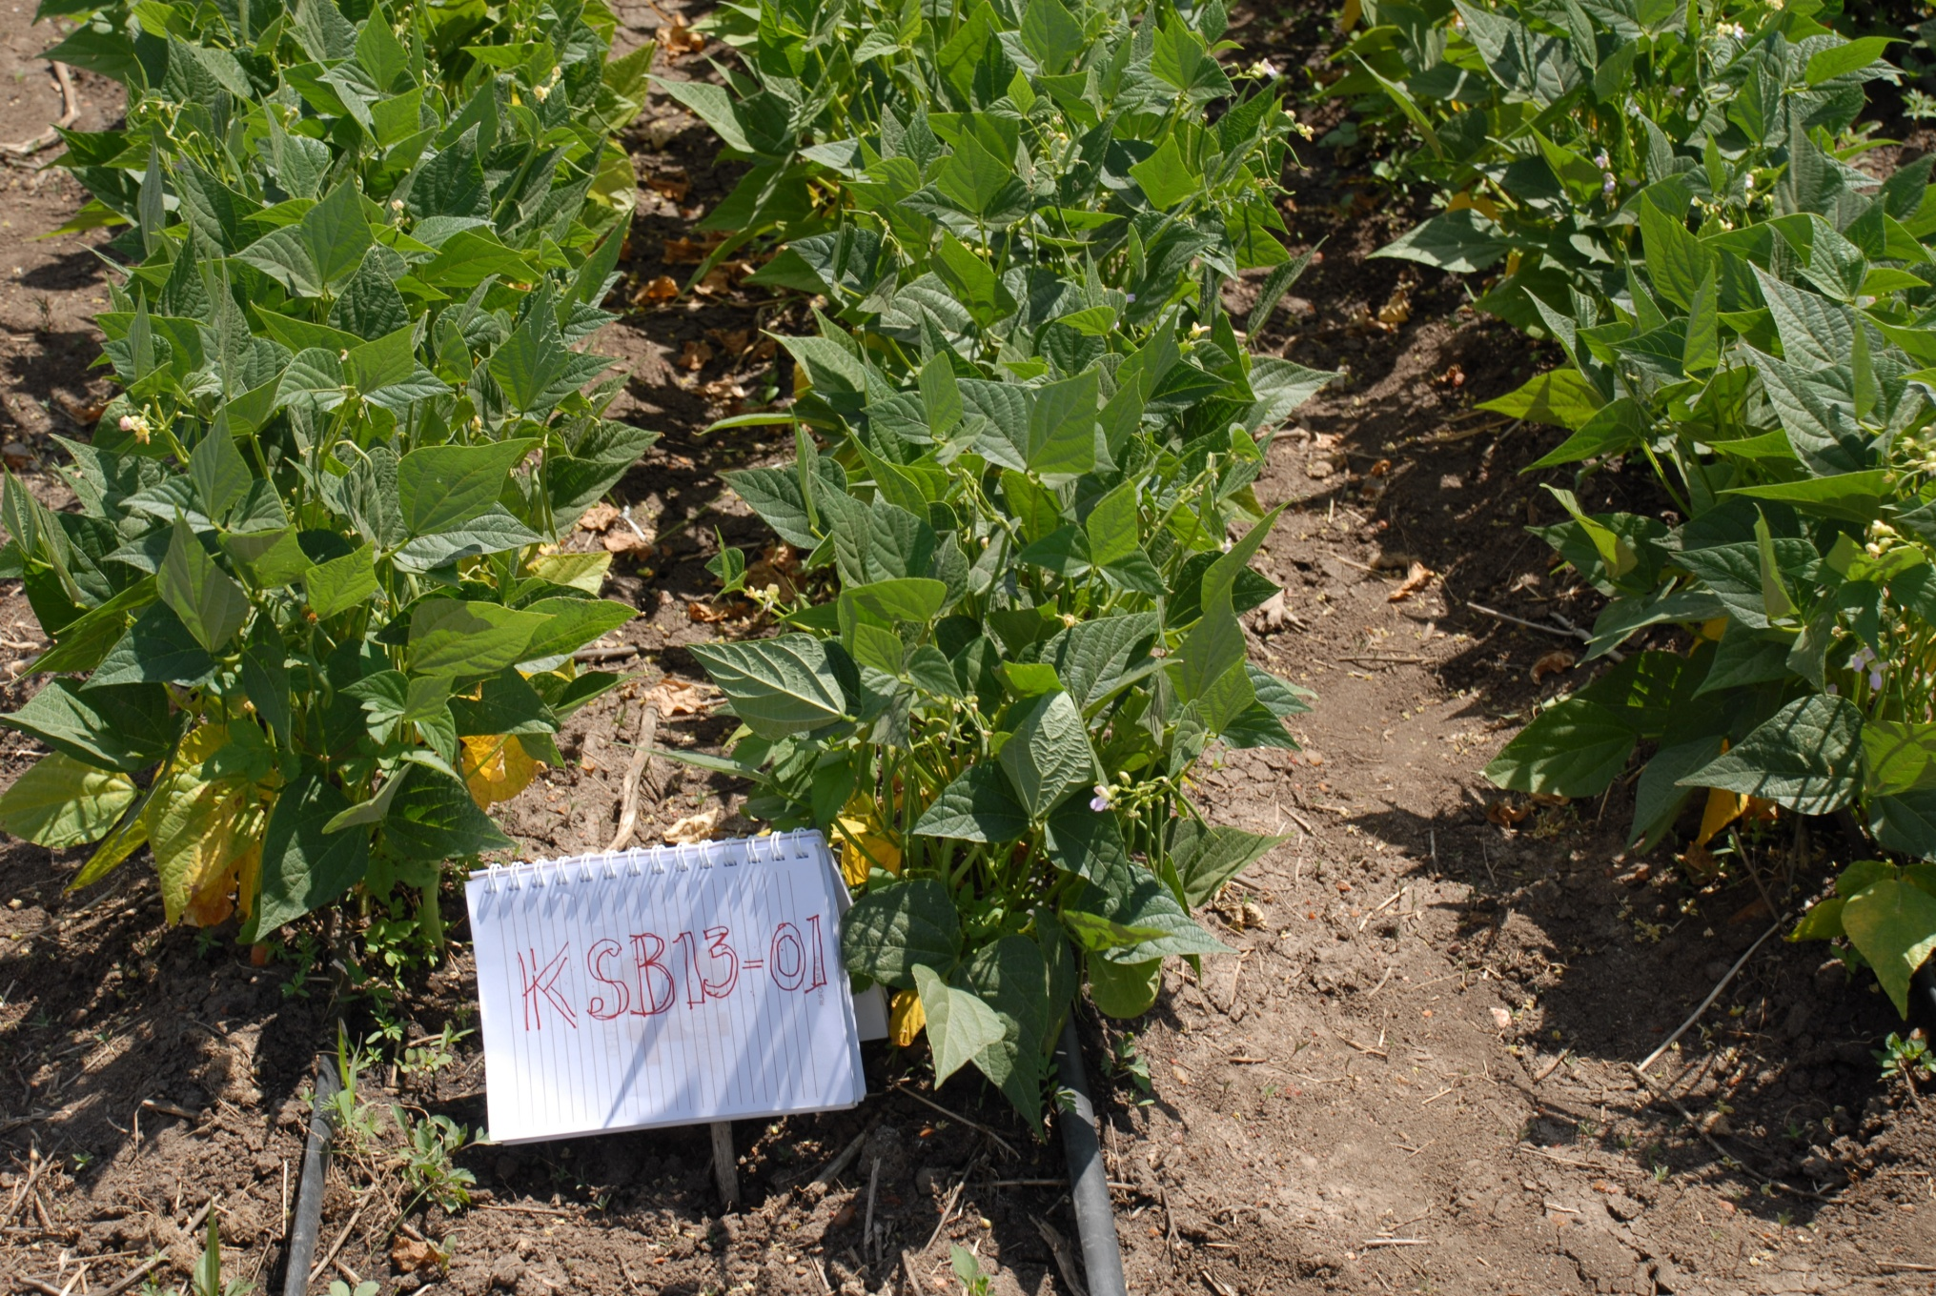
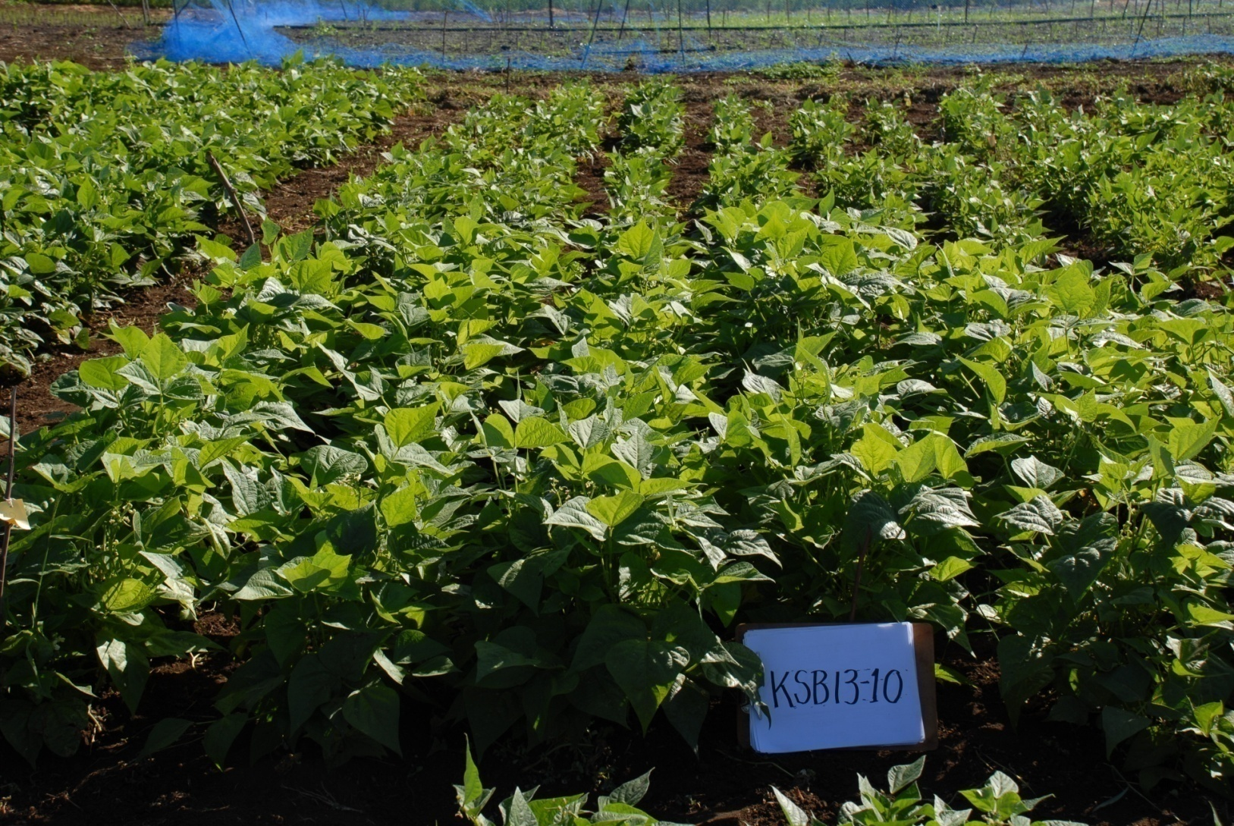
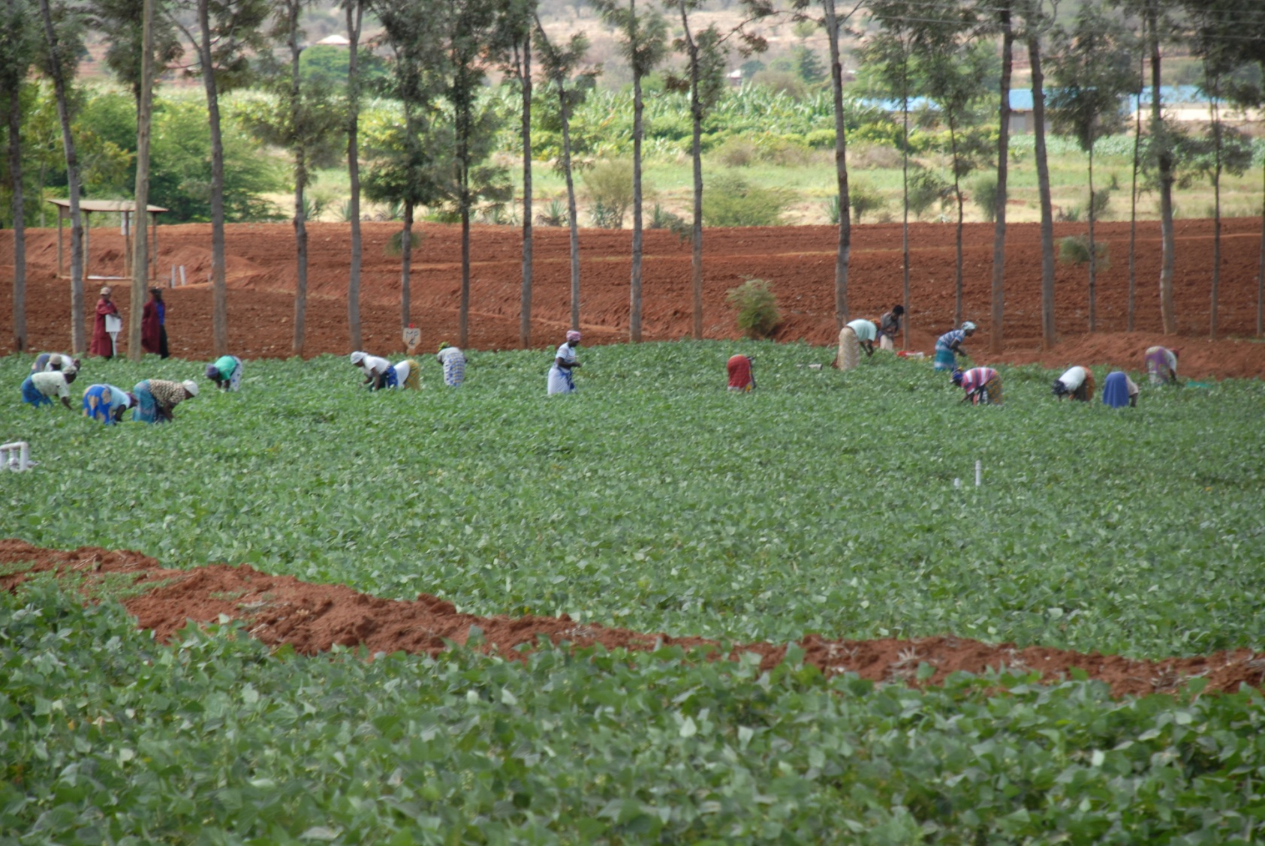
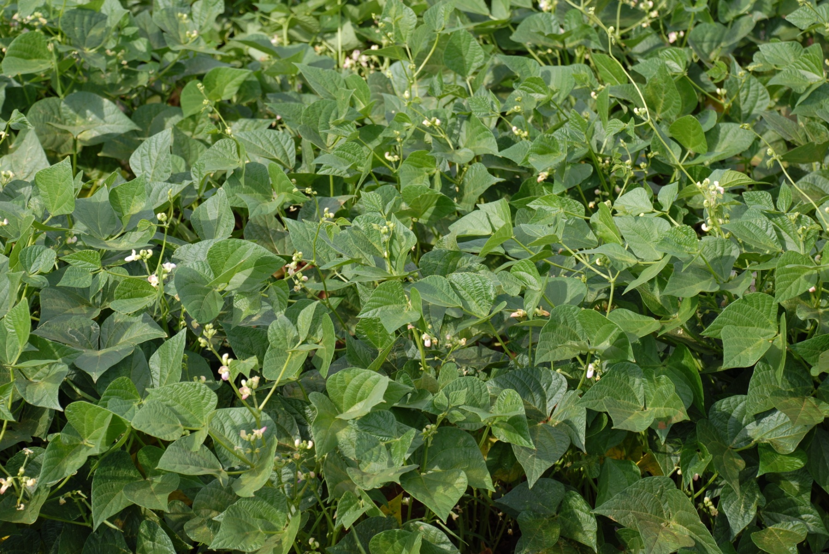
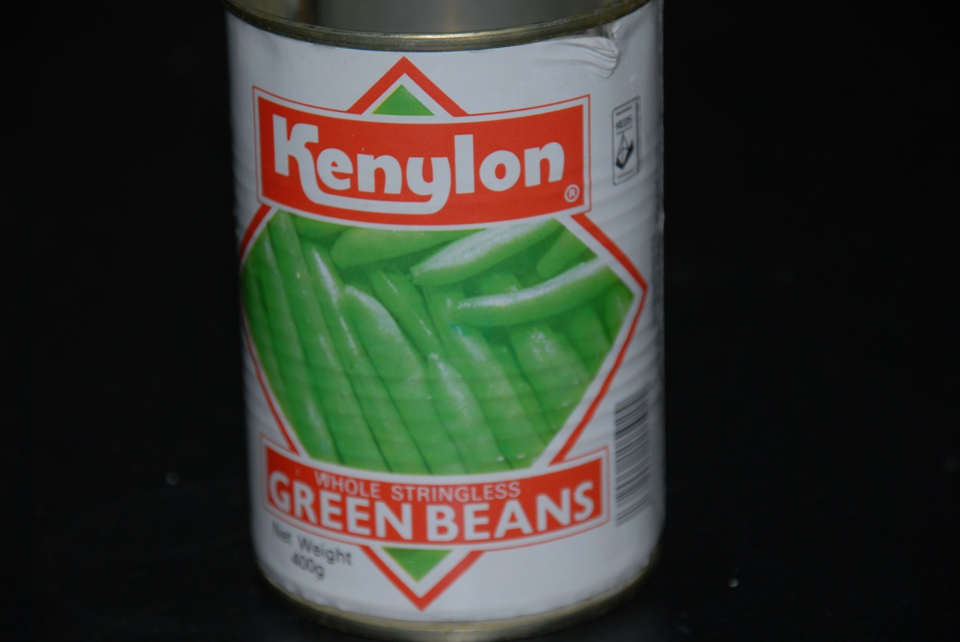
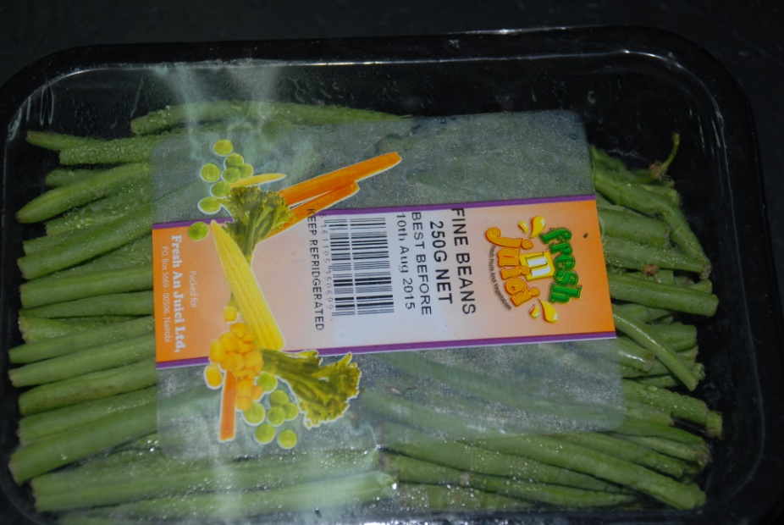
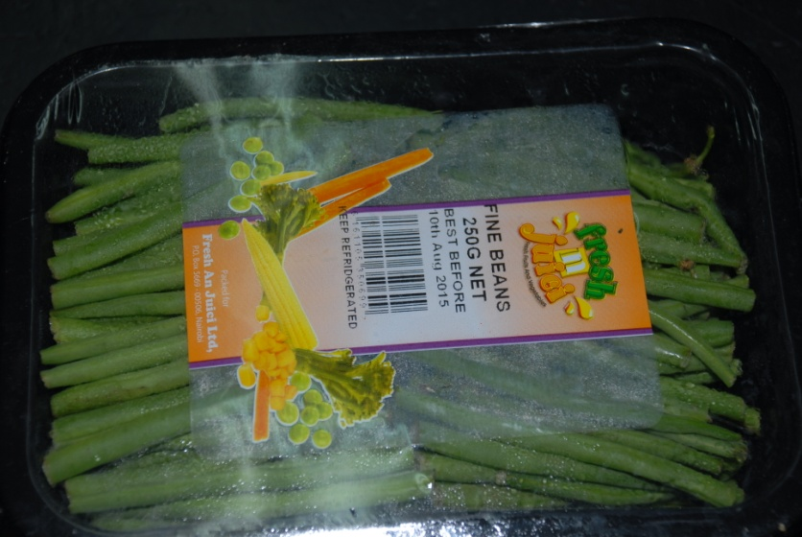
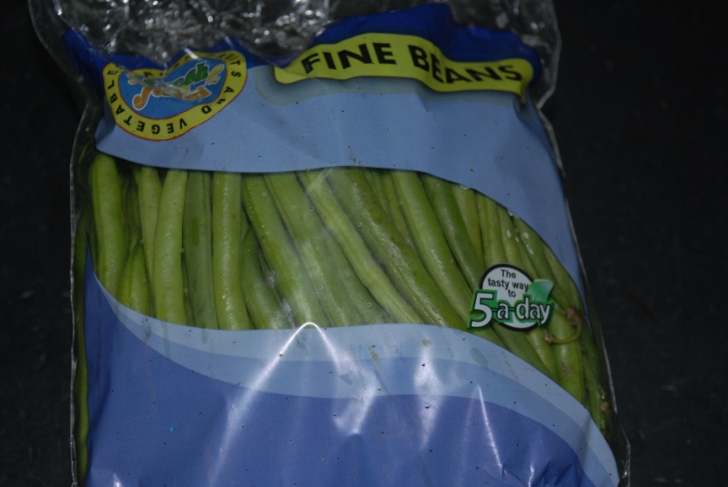
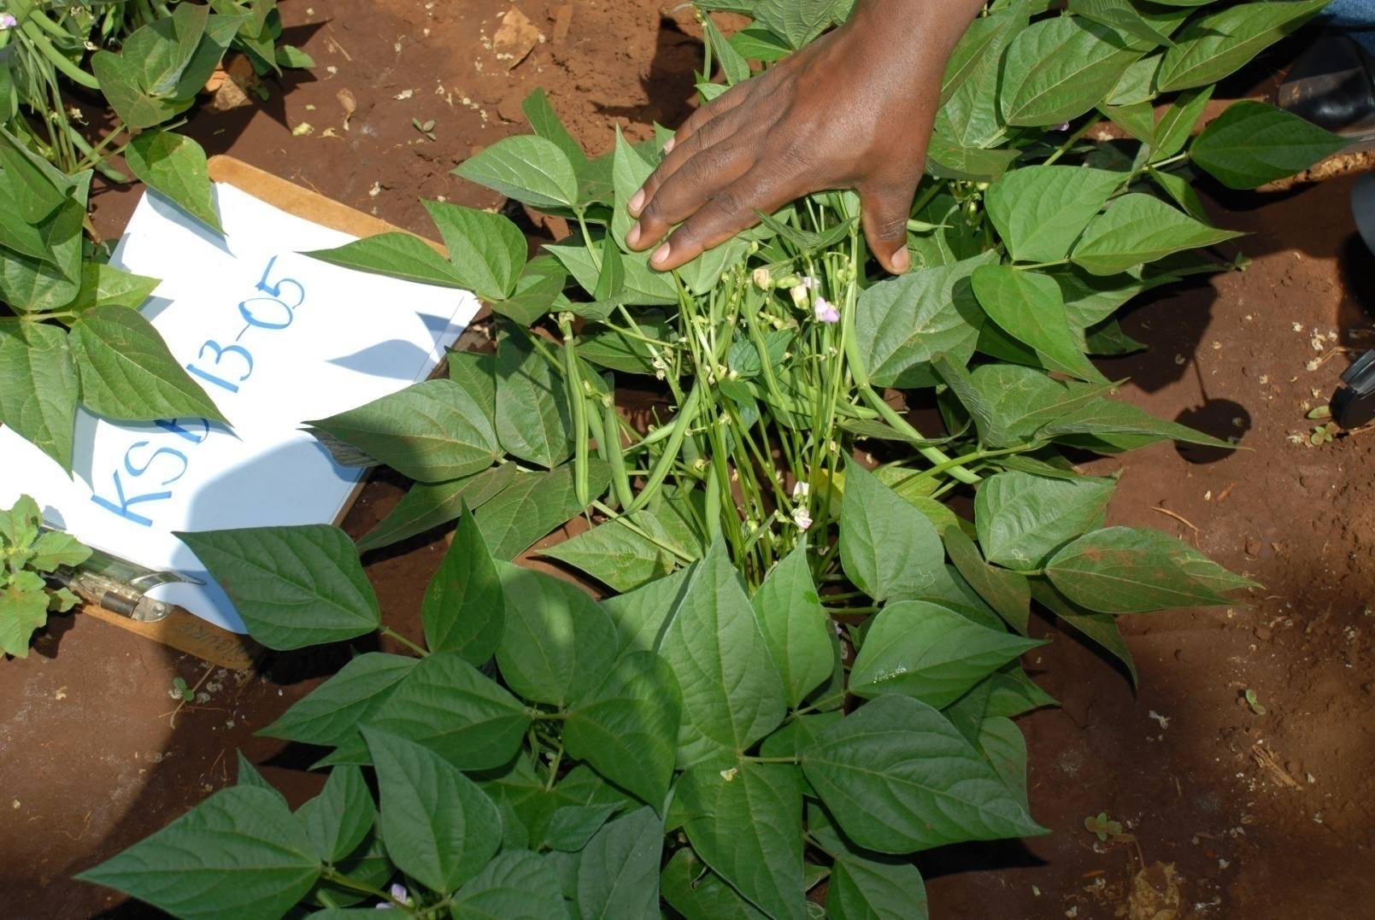
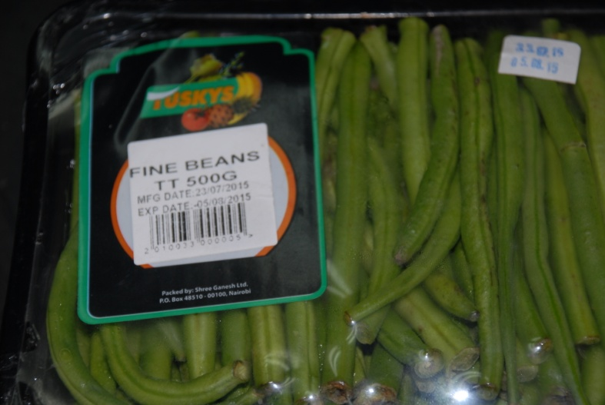
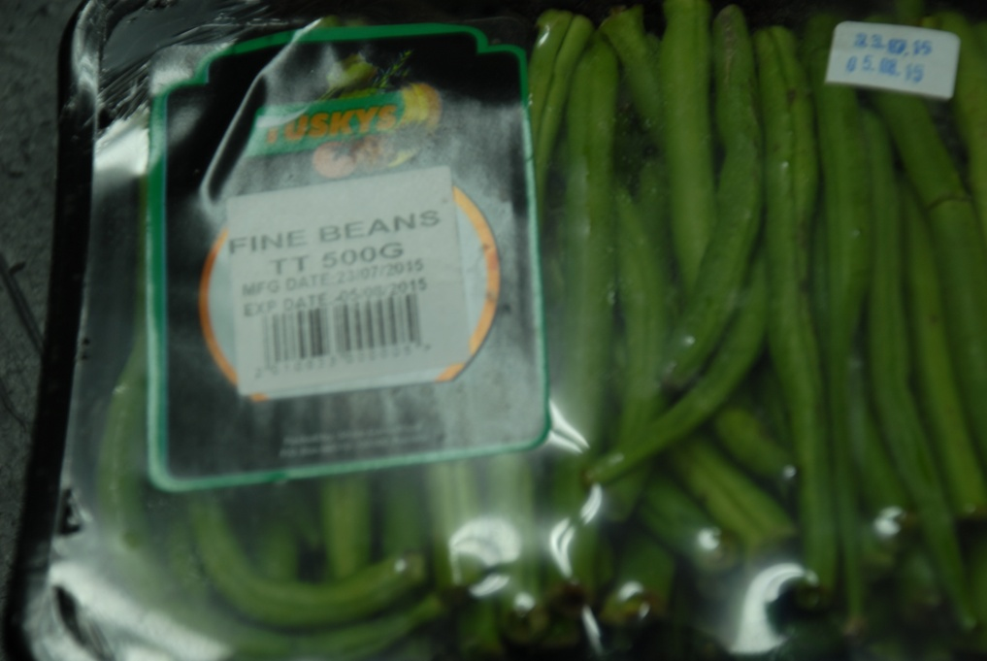
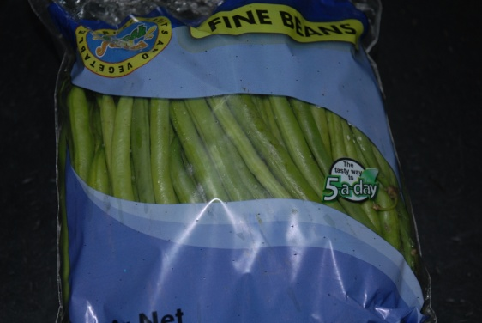
UNISEED KENYA LTD
Your preferred supplier of High Quality Certified Breeder Seed of Canning Beans
UNIVERSITY OF NAIROBI
SNAP BEAN PRODUCTS
SUPERIOR PERFORMANCE IN FARMERS FIELDS
KENYA FIRST LOCALLY BRED SNAP BEANS
Kenya’s first snap bean canning bean varieties
NEW VARIETIES BRED BY UON BREEDERS
Kenya Salama
New varieties are more vigorous, uniform and productive than current commercial varieties
KSB 13-05, Mwea, Kirinyaga County
KSB 13-01 in a farmers field in Isinya, Kajiado County
.
SUPERIOR PERFORMANCE IN FARMER’S FIELDS
VALUED ADDED PRODUCTS
In a commercial field, Kabaa, Machakos County
KCB13-05
Creating new opportunities in domestic, regional and international
markets
ADVANTAGES OF NEW SNAP VARIETIES COMPARED WITH EXISTING COMMERCIAL VARIETIES
KSB 13-07 at Kabaa, Machakos County
High pod yields
Resistant to rust, anthracnose and angular leaf spot
Excellent sensory qualities taste, flavour, aroma, texture and self-life
High proportion of extra fine and fine beans
Processing types tested in partnership with processing factories industry exceeded expectations
Excellent plant architecture for easy picking
For the first time, seed is locally available
KSB 13-05 at Mbogoini, Tharaka-Nithi County
For further information contact:
P .M. Kimani
Plant Breeding and Biotechnology Program
Department of Plant Science and Crop Protection,
College of Agriculture and Veterinary Sciences, University of Nairobi, P.O Box 29053-00625 Nairobi, KENYA
<pmkimani@uonbi.ac.ke>
TUSKYS
Growing demand in domestic markets
Acknowledgements
NAKUMATT
Support for this research provided by ASARECA, RUFORUM, Njoro Canning Factory, Trufoods Ltd and the Government of Kenya is gratefully acknowledged.

Slide 19
Policy and advocacy
Ministry of Agriculture, Livestock and Fisheries
  High level meeting @ ICRAF/WAC
  Program recognized by GOK- First Research Awards
Nairobi International Trade Fair- Oct 2018
  Exhibition of demand led products
  Our products won several awards
KEPHIS- joint observation trials, variety testing and release (NVRC)
Publications
  Journal [Mauritius meeting- in JES)
  DLB Book2
  Promotional materials
UPOV- TWA participation- KEPHIS-UON (2018)
WIPO- World Intellection Property Organization –UON(2018)

Slide 20
DLB partners
Expert organizations creating business case, benefits cases and ex ante impact assessments
EiB – meet in Amsterdam in November 2018
Syngenta Foundation
Private seed companies

Slide 21
Future Directions
Product development
  Tomato and rice with Continental and KARLO
  Snap beans for processing and fresh market
  Runner bean- dry grain for canning industry
  Vegetable runner bean
  New range of major market classes with multiple resistance and commercial grain types
Scaling up and commercialization
  Partnering with Syngenta Foundation, KEPHIS, County Governments, Seed companies and Food industry and exporters

