Slide 1
Updates from CIAT-PABRA
Clare M. and JC Rubyogo.

Slide 2
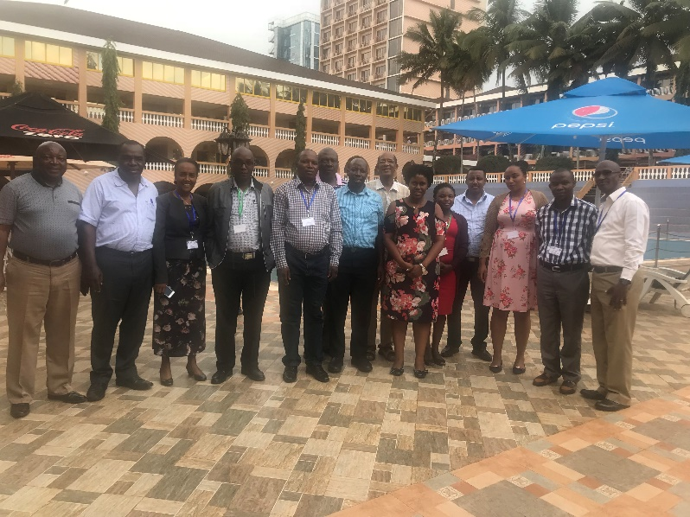
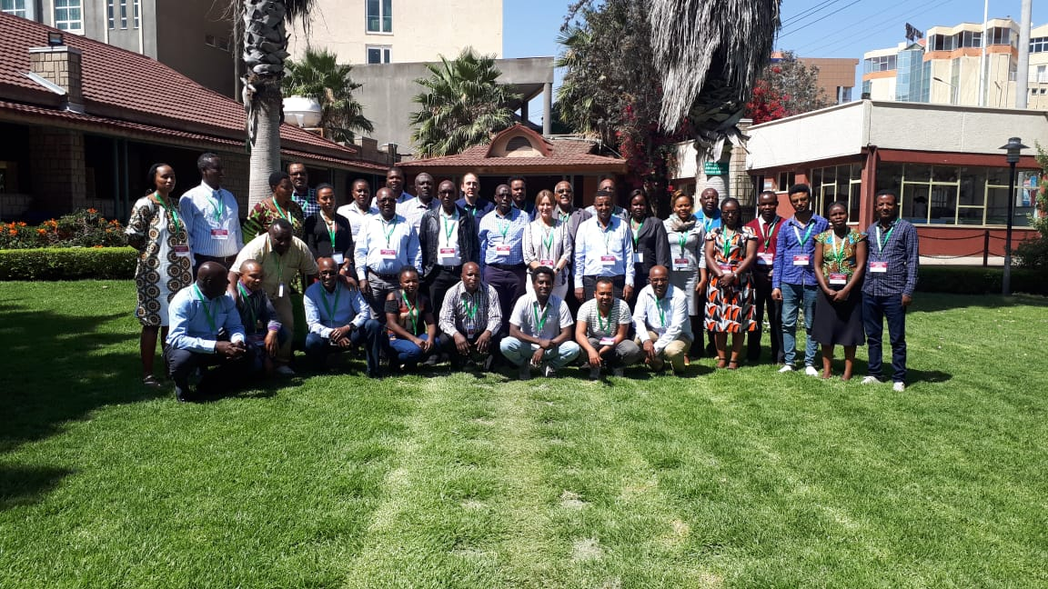
Outline
Product profiling
Technical data sheets
Gender integration
Business case development
ECABREN Breeders Workshop (13th - 14 Th September 2018, Kampala Uganda)
ECABREN Breeders’ Meeting on Demand Led Breeding and Stage Gate Testing System 2-4 February, 2019 I Nazareth-Ethiopia

Slide 3
Product profiling
The development of Product Profiles (PP) in CIAT started some time ago with the market led breeding strategy of PABRA and recently the DLB project and currently it is being strengthened through the Excellence in Breeding Platform (EiB).
The EIB module 1 developed norms for product profiles. A website was developed to collect PPs, however, this first version of CG wide PPs is still not very specific, it represents a version 1.0 to get a rough impression of what products different programs are planning to work on
  For common bean, seven, PP’s were selected, based on most commonly used grain types and shared in March, 2019
  PPs were developed based on interaction with NARS partners, farmer organizations, traders, market analysts, gender expert, seed systems specialists, and breeders.
The PP’s will likely be further subdivided when a draft of the TPE analysis (planned under the AVISA project), and will include further market intelligence

Slide 4
PP’s in EiB website
Product | large red mottled | large sugar type | med large yellow | large red kidney | small red | small white | Black
Variety to replace | NABE4 | Uyole03 | KATB1 | Selian 97 | SER 125 | Awash 2 | ICTA Ligero
Agroecology | EAREM: NTnz, WTnz, Uga Kya, Rwa | TAZAMA: STnz Mwi Zimbabwe Zambia Ug | ECABREN: : NTnz, WTnz, Uga Kya, Rwa | ECABREN AND SABRN: Tz, Et, Ug, Kya | Latin America: Nic, Honduras, ES Africa: Et, Rwa Kya, | Eth, Zimbabwe Rwa, Zambia | Latin America Guat, Haiti ES Africa: Ug, Moz
Basic traits | red mottled grain type with commercial grain quality Metrics: accepted based on NARS partner consultation | sugar (cranberry cream mottled) grain type with commercial grain quality. Metrics: accepted based on NARS partner consultation | yellow grain type with dark hilum of commercial grain quality Metrics: accepted based on NARS partner consultation | red kidney grain type with commercial grain quality Metrics: accepted based on NARS partner consultation | medium small red grain type with commercial grain quality Metrics: accepted based on NARS partner consultation | small white grain type with commercial grain quality Metrics: accepted based on NARS partner consultation | small black grain type with commercial grain quality Metrics: accepted based on NARS partner consultation
 | medium-early maturity Metrics: earlier than K132 | medium-early maturity Metrics: <= Uyole03 | medium-early maturity Metrics: Similar to KatB1 | drought tolerance Metrics: equal or better than mean of AFR298, DAB494, RAA34, 2 drt trials (Yd <= half in K132 in irrig trial) | drought tolerance Metrics: equal or better than SER125 | drought tolerance Metrics: equal or better than SER125 | drought tolerance Metrics: equal or better than SER125
 | early Cooking time Metrics: <5min above positive check mean SAA10, LPA556, DAB449, KATB1 | ALS Metrics: <4 on scale | early Cooking time Metrics: <= KATB1 | early Cooking time Metrics: <= Selian97 | Rust Metrics: <4 on scale | canning quality Metrics: appearance score (low breakage) better than 1.5, HC > 1.5, low starch leakage - in # trials, leakage color retention, storage time 2-6 months low starch | BGYMV Metrics: <4 on scale
 | moderate ALS resistance Metrics: <5 on scale | early Cooking time Metrics: <= Uyole03 | moderate ANT resistance Metrics: <5 on scale | moderate ANT resistance Metrics: <5 on scale | BCMV Metrics: bc-3 and I gene marker | moderate CBB resistance Metrics: <5 on scale | BCMV Metrics: bc-3 and I gene marker
Value added traits | ALS Metrics: rating <4 in inoculated trial in Uganda | high Fe Metrics: 22ppm above K132 check, mean over three locations | Root rot resistance Metrics: rating <4 in inoculated trial in Uganda | ALS Metrics: rating <4 in inoculated trial in Uganda | medium-early maturity Metrics: 3 days < SER125 | medium-early maturity Metrics: <= Awash2 | high Fe Metrics: 22ppm above K132 check, mean over three locations
 | Drought tolerance Metrics: equal or better than mean of AFR298, DAB494, RAA34, 2 drt trials (Yd <= half in K132 in irrig trial) | BCMNV Metrics: bc-3 and I gene marker | Drought tolerance Metrics: equal or better than mean of AFR298, DAB494, RAA34, 2 drt trials (Yd <= half in K132 in irrig trial) | High Fe Metrics: 22ppm above K132 check, mean over three locations | CBB Metrics: <4 on scale | Rust Metrics: <4 on scale | Heat tolerance Metrics: better or equal than SEF60 in heat trials
 | BCMNV Metrics: bc-3 and I gene marker | bruchid resistance Metrics: <4 on scale | BCMNV Metrics: bc-3 and I gene marker | low soil fert Metrics: = mean of DAB610, LPA513, BFS81 in low P trial | ALS Metrics: rating <4 in inoculated trial in Uganda | bruchid resistance Metrics: <4 on scale

Slide 5
Country specific product profiles
Ethiopia and Uganda as well as a few other PABRA countries have developed PP’s
These too require refinement with market information and TPE’s information
Product | Production area (ha) | No. HH | %of total bean area
Large white bean for export with drought and disease resistance Target: low to mid altitude; 1000-1900masl, rainfall; min 500mm/year) | 1,437 | 11,047 | 0.45
Small white bean for export with drought and disease resistance Target: low to mid altitude; 1000-1900masl, rainfall; min 500mm/year) | 119,912 | 921,531 | 37.76
Large speckled bean for export with drought and disease resistance Target: low to mid altitude; 1000-2300masl, rainfall; min 500-1200 mm/year) | 4,544 | 34,917 | 1.43
Large red bean with drought and disease resistance (75% export and 25% domestic) Target: low to mid altitude; 1000-2300masl, rainfall; min 500-1200mm/year) | 16,986 | 194,318 | 5.35
Small red bean with drought tolerance (?% export and ?% domestic) Target: low to mid altitude; 1000-2300masl, rainfall; min 500-1200mm/year) | 148,212 | 1,695,563 | 46,68
Large red mottled bean with drought and disease resistance Target: low to mid altitude; 1000-2300masl, rainfall; min 500-1200mm/year) | 26.446 | 302.547 | 8.33
Total | 191,644 | 2,192,428 | 100
Uganda
Large-medium red mottled biofortified bean with drought and disease tolerance (80% local; 20% export)
Large-medium Sugar biofortified bean for local market, canning, and export market with drought and disease tolerance (95% local; 5% export)
Large-medium yellow biofortified bean with drought and disease tolerance (75% local; 25% export)
Large red kidney beans for local and export market with drought and disease tolerance (45% local; 55% export)
Large - Small white bean for canning with drought and disease tolerance (40 local; 60% export)
Small-medium red bean for export market with drought and disease tolerance (30 local; 70% export)

Slide 6
Technical data sheets
CIAT does not develop TD’s but only provides basic data on traits of developed lines
CIAT partners in PABRA develop TD’s based on the multilocation testing conducted
Private sector demand more technical information
Current data sheets only provide basic information and require improvement to provide additional information required by the private sector2018 PBA-Drummond-chickpea-factsheet (003).pdf1 New climbing bean varities for Uganda - ENGLISH.pdf

Slide 7
Gender consideration in DLB
Hale Ann Tufan – Cornell University, USA. Gender responsive researchers equipped for agricultural transformation (GREAT) and NextGen cassava
Graham Thiele – CIP, Peru. CGIAR Gender and Breeding Initiative (GBI), CRP leader roots and tubers
Clare Mukankusi – CIAT, Uganda. Senior Bean breeder, PABRA Eastern coordinator, and DLB leadership team/gender representative
Viv Anthony – Syngenta Foundation for Sustainable Agriculture, Switzerland. Co-project leader Demand-Led Breeding (DLB)
Viv and Clare attended Gender Responsive Product Profile Development Workshop on 12-13 November 2018 hosted by Drs Hale Ann Tufan and Graham Thiele.
Objective: Share experiences and identify aspects of mutual benefit that could form the basis of a partnership between GREAT and the DLB team during phase 2 of the programme (2019-2021) in sub-Saharan Africa.

Slide 8
Key conclusions
Product profiles and the process and consultation needed to design new varieties that are highly sought after by farmers and their markets is central to effective breeding programmes
It is vital to understand the needs and buying/selling decisions of farmers and if these are affected by gender.
  Needs and preferences of women as farmers, traders and food providers is fully taken into consideration and that new varieties should contain design features that not only “do no harm” but also improve the lives of women in their diverse roles as farmers, traders, home-makers, food processors/preparers and providers.
Best way to raise the importance of gender in DLB training was to have specific, real-life examples of where gender either was or was not included in the design of new varieties and the implications that ensued – both positive and negative effects.
  GBI case studies https://cgspace.cgiar.org/handle/10568/92819
GREAT and GBI are discussing with economists to design a study to measure the impacts of gender blind breeding.
Both DLB and GREAT representatives expressed their wish to collaborate and to start with some small, specific, starter actions that are of benefit for both groups as a modus operandi. Then to review progress and areas with potential for more substantive possibilities for partnering.

Slide 9
Actions agreed
DLB management meeting - Hale Ann to be invited to the next DLB leadership management meeting in 2019 to discuss inclusivity of gender and best practices in the DLB phase 2 programme. Dates and location were difficult for Hale
DLB training module update - Hale Ann to review the current training module set of slides and make suggestions for inclusions or revisions to ensure the whole training module and best practices in each unit are more gender responsive
Stories on gender responsive breeding - Clare and Hale Ann to reach into their networks and gather examples of gender responsive or non-responsive breeding that could be compiled as a series of “vignettes/mini case studies” on specific varieties or situations that can be communicated as a stand-alone publication and be used as training examples in the DLB and GREAT education programmes – by mid-2019. Started and the plan is to have stories ready by August 2019.

Slide 10
Actions agreed
Agricultural economists with gender awareness - Hale Ann to identify gender responsive agricultural economists from Cornell or elsewhere for consideration as advisors in the expert crop groups that are being convened in the DLB phase 2 programme in 2019.
  Dr Enid Katungi (CIAT-PABRA Agricultural economist) suggested as potential advisor based on her wide agricultural economics and gender research experience.
  Expert crop groups to contain advisors from both public and private sectors that can set the standards for making performance claims for selected African crops.
  Role to include helping in the design the content of the advanced DLB training module on creating technical datasheets that promote the value of new varieties and associated product profiling
  Enid considered best choice for the meeting for higher level input perhaps Cheryl Doss, Agnes Quisumbing or Nancy Johnson (all strong in gender) or are you looking more for economists not necessarily gender focused?
Sharing DLB and GREAT training expertise - It was agreed that both communities have valuable training expertise and benefits could be derived from representatives contributing at each other’s training events. Clare and Hale to discuss further training forums being planned by both groups during 2019 – by 14 February. I suggest we discuss on the call week of the 25th
Train-the-trainer opportunities – Clare and Hale to follow-up on highlighting and potentially collaborating on opportunities to gain greater reach on gender responsive breeding in other major capacity building initiatives involving DLB e.g. MARCCI and WACCI –

Slide 11
Actions agreed
GREAT profiling tools – Viv to follow up on the customer profiling tool and accessing gender data on smallholder farmers with Alistair Or, and also the gender responsive product profiling tool for their potential use by DLB alumni
DLB market research study on bean cooking time – As part of the DLB programme in 2019 a consumer market research study on bean cooking time is being planned in Uganda. Dr Margaret Mangheni from Makerere University/GREAT had broad experience as a social scientist and gender expert and has been approached to advise on the design and implementation of the DLB study. Clare will liaise with Margaret on next steps.

Slide 12
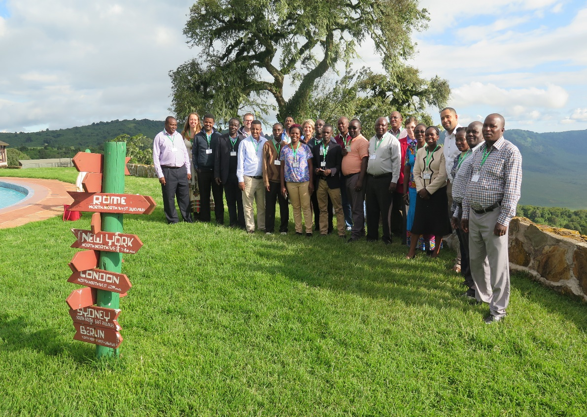
Building the Country and Region Driven Bean Business Investment Case & Strengthening PABRA Demand Led Breeding Approach
Workshop held May 25-26th , 2018
Equally focus on yield and market value traits

Slide 13
COUNTING ON BEANS:
Beans count because their products deliver the following benefits:
  Social inclusion through wealth creation, women and small holders empowerment
  Nutritional benefits, especially for women and children (e.g. iron and zin )
  Health benefits by preventing non communicable disease (obesity)
  Employment opportunities , all along the value chain, especially for youth
  Environment – less fertilizer use; sustainable agricultural systems
  Industrialization- processing to develop value added products e.g. differentiated products/market types or processed beans e.g. canning and precooked beans
  Trade /foreign current earning through export and national/regional trade- expanding bean products for domestic, regional and international markets

Slide 14
Services investment areas along the bean value chain development in the corridors
Production Hub
Postharvest/storage
Processing
Marketing
Demand led Variety development
Seed system
Soil fertility
Input supply services
Weeding
Irrigation
Harvesting
Threshing
Winnowing
Cleaning
Drying
Warehousing
Transport
Precooking
Grinding
Caning
Packaging
Transportation
Distribution services
Information services
Financial, information, insurance services, hotel

Slide 15
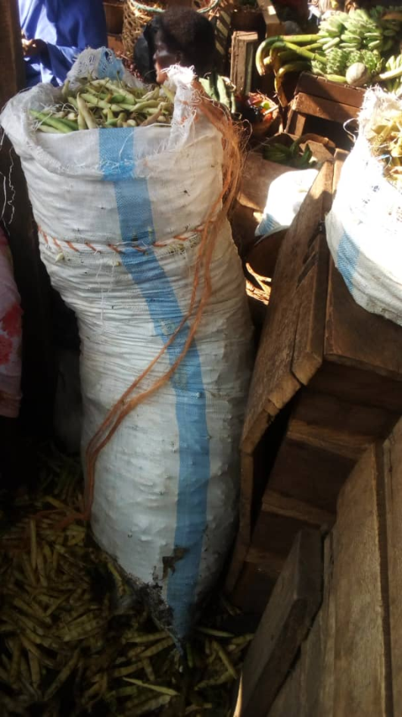
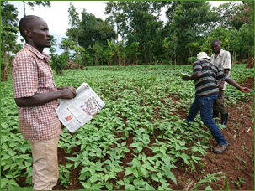
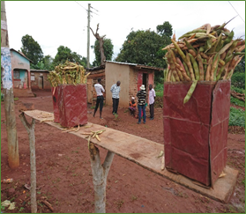
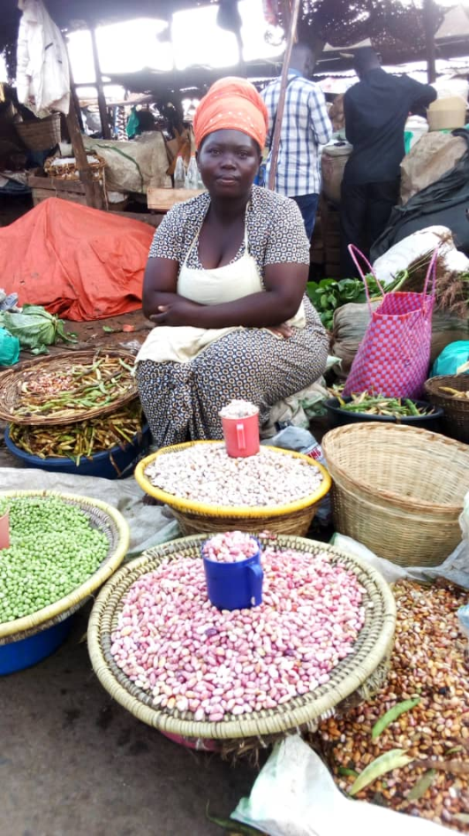
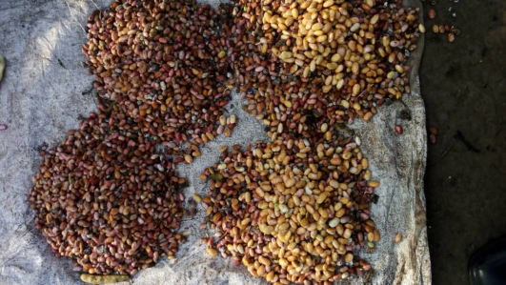
Fresh pod bean market in Uganda- DLB
Potential
  Total 7,560 –(90-100)kg of green beans per week in Kampala alone = 39,312 bags per year 3,931.2 tons of green pod beans per year @ kilo is sold at USD 0.6= USD 2,358,720 –Business case
  How to we tap into the export market?
Sources of Green bean pod
  Mbale, Sironko, Mpigi, Zirobwe, Kiboga, Mityna, Kabale, Kisoro, fortportal Mbarara, Rwanda –Mapping Green pod bean corridor required
Varieties,
  Nabe 12C (Masavu), NAROBEAN 1; Kayebwa (Nabe 15, 20, 23); Red mottled (Kaduli, NABE 16, NABE 17, NAROBEAN 2) –Which is the most suited?
  Issues- interventions needed
    Seed availability
    Bronzing/oxidation of grain after threshing/storage
    Packaging and presentation
    Pesticides/fungicides
    GAP

Slide 16
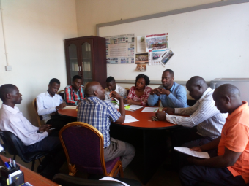
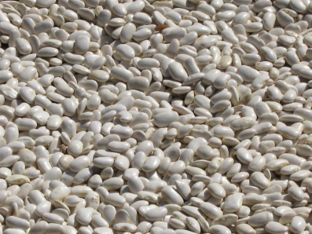
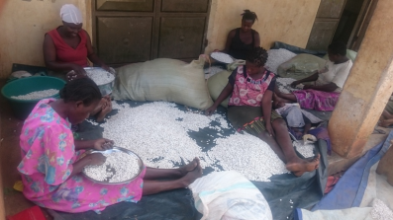
How do we become dynamic?
Following trends or grabbing opportunities
  Flat white bean - Jay fortunes
Already signed an agreement with Jay fortunes to undertake training and mobilizing of farmers for increased productivity of bean. –Ready market available in Italy
Evaluation of Flat white and ensure its release
Conduct NPT trails to identify other locations apart from Eastern Uganda where this bean can be grown and for official variety release.

Slide 17

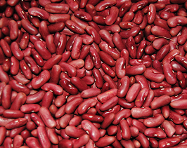
Penetrating new corridors?
Red Kidney- Savanna commodities
  Initiated the production of large quantities of seed for red kidney-
  Discussion to amalgamate farmers for production was been initiated
Issue: -Intervention
Poor colour retainment both doing production and processing
  Breed for better colour retainment or identify better red kidney bean variety to replace NABE 14

