Slide 1
Demand led plant breeding workshop
for Crop Program Leaders and Senior Crop Breeders
Ethiopian Institute of Agricultural Research
2-3 May 2019, Addis Ababa, Ethiopia
Shimelis Hussein
University of KwaZulu-Natal
African Center for Crop Improvement (ACCI), South Africa

Slide 2
Highlights
Crop genetic improvement is one of the strategies for transforming African agriculture
There is low adoption of modern crop varieties in Africa (<35%)
Many new plant varieties not adopted. Why?
Plant breeding education, research and development should emphasise demand-led approaches

Slide 3
Objective
Education
To strengthen postgraduate education and professional development training for plant breeders on demand-led variety design using best practices from public and private sectors in Africa and internationally

Slide 4
Demand-led plant breeding education module

Slide 5
Module development
Pan-African educators group have developed a training module in partnership with private/public sector experts
African educators workshop started designing education programme (November, 2014, Nairobi, Kenya)
Module devolvement at WACCI, University of Ghana,
27-29 April 2015
First testing of the training module with breeders (21-23 October 2015)

Slide 6
Module units
Unit 1. Principles of demand-led breeding
Unit 2. Visioning and foresight for setting breeding goals
Unit 3. Clients’ needs and value chains
Unit 4. Variety design and setting standards
Unit 5. Variety development strategy and planning
Unit 6. Breeding investment decision-making
Unit 7. Monitoring, evaluation and learning

Slide 7
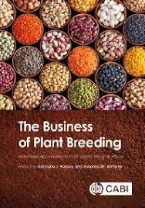
Audiences of demand-led plant breeding education
Postgraduate plant breeding students
Educators
Professional breeders and
R&D managers
Module duration
    Block based 2-3 days
Education resources
Teaching manual
Text book
PowerPoint slides
Web (e-learning)

Slide 8
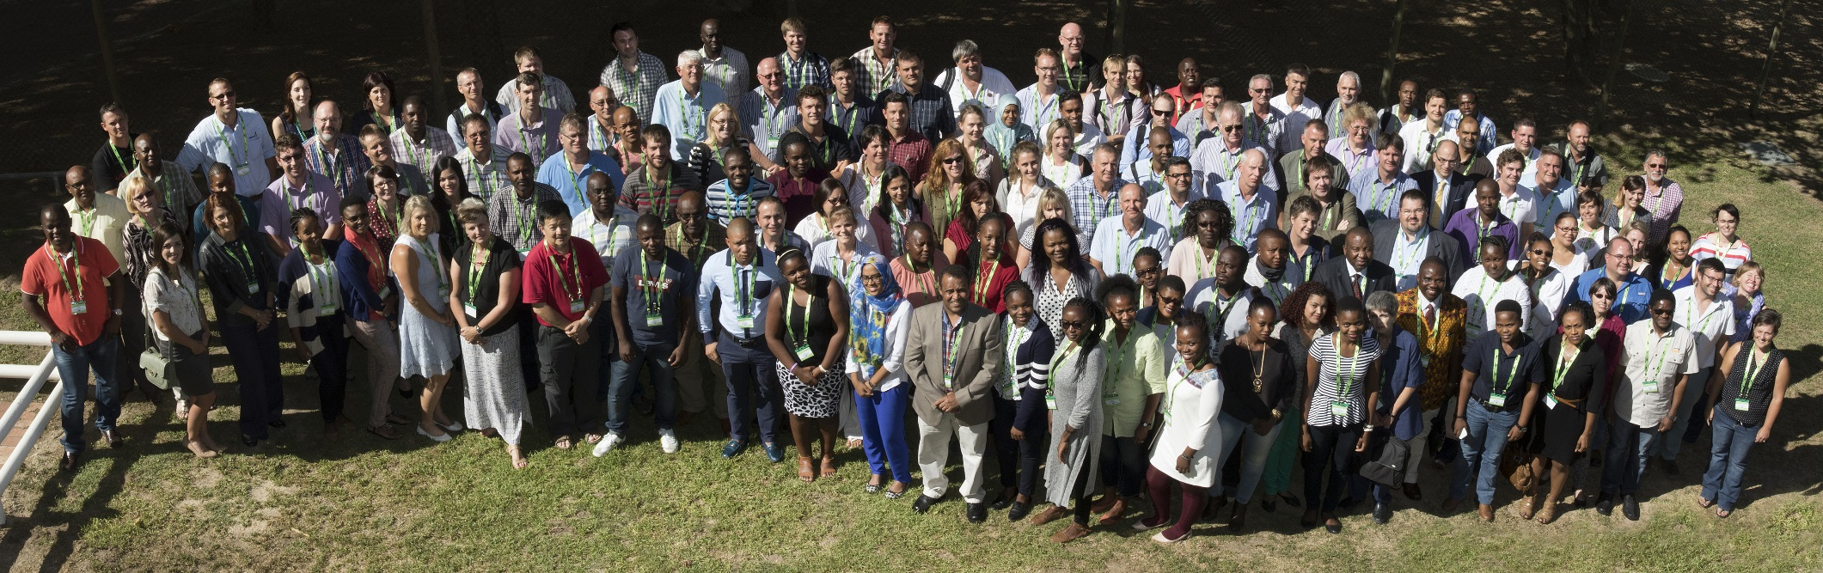
Major activities
Presentation: 11th Southern Africa Plant Breeders Association symposium, Stellenbosch, South Africa during March 8-10, 2016

Slide 9
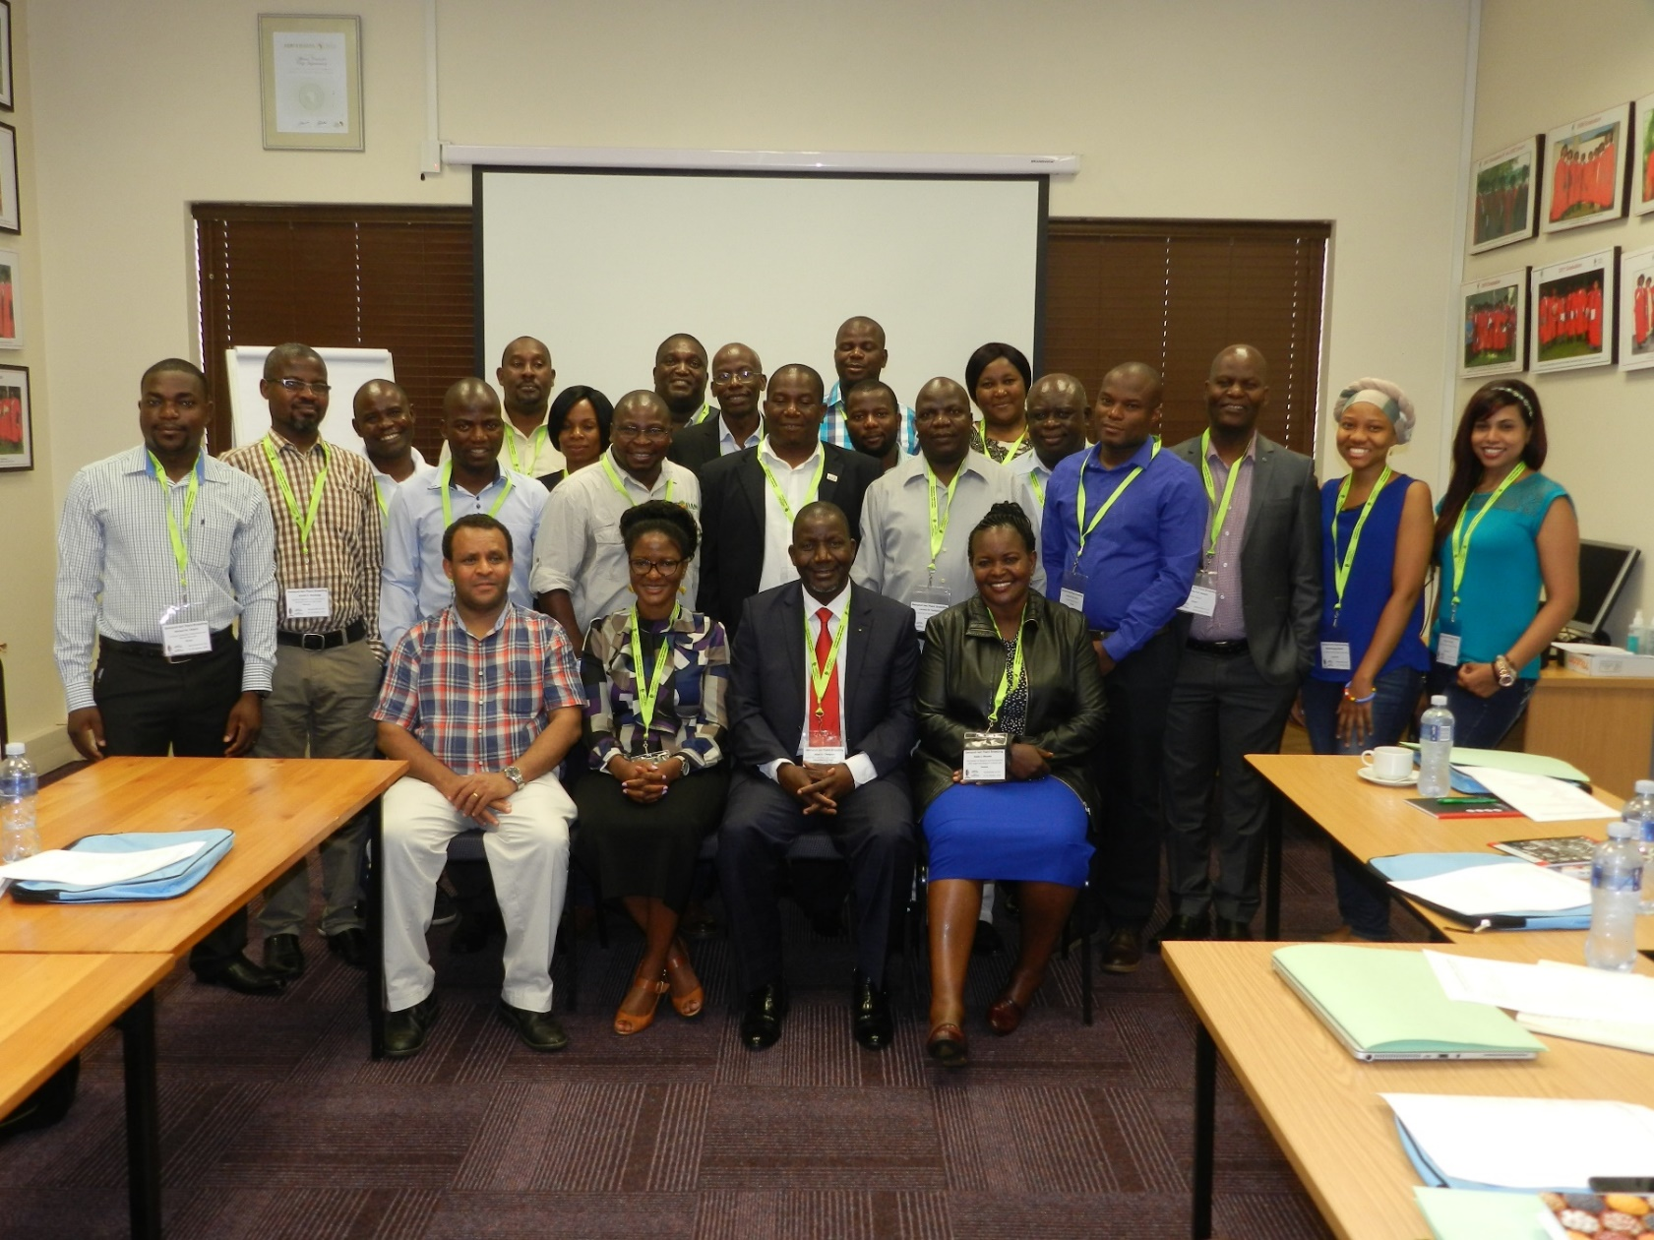
ACCI alumni workshop (22 to 25 January 2018)

Slide 10
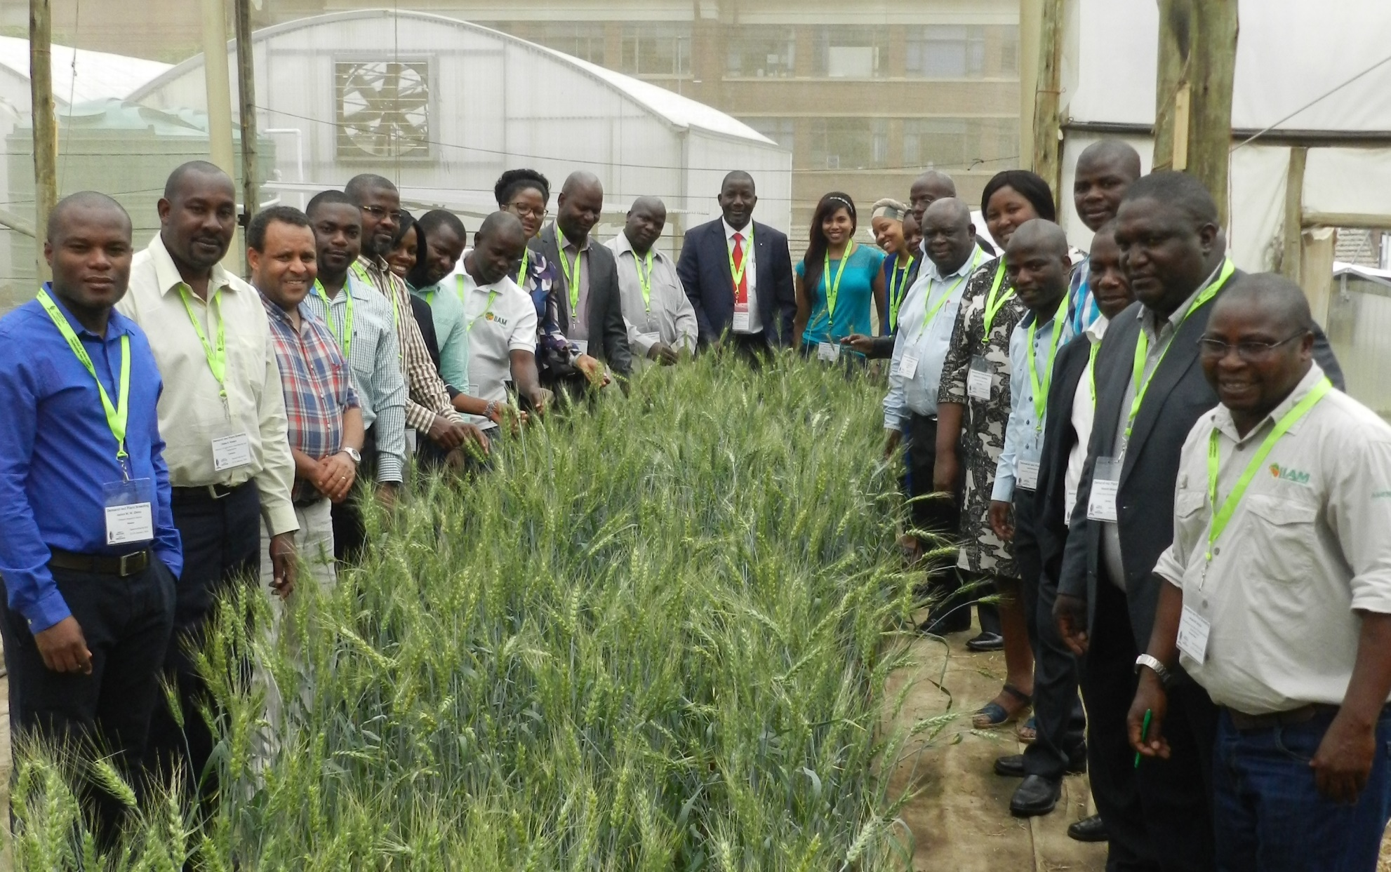

Slide 11
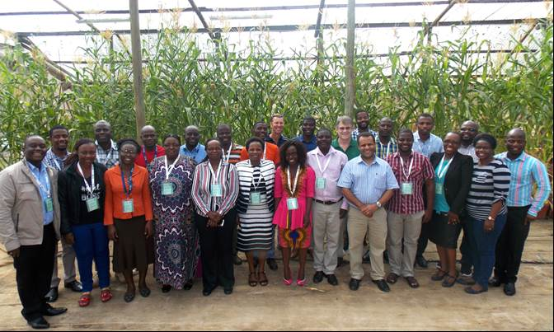
Zimbabwe Plant Breeders Association (ZPBA)
9-22 February 2018

Slide 12
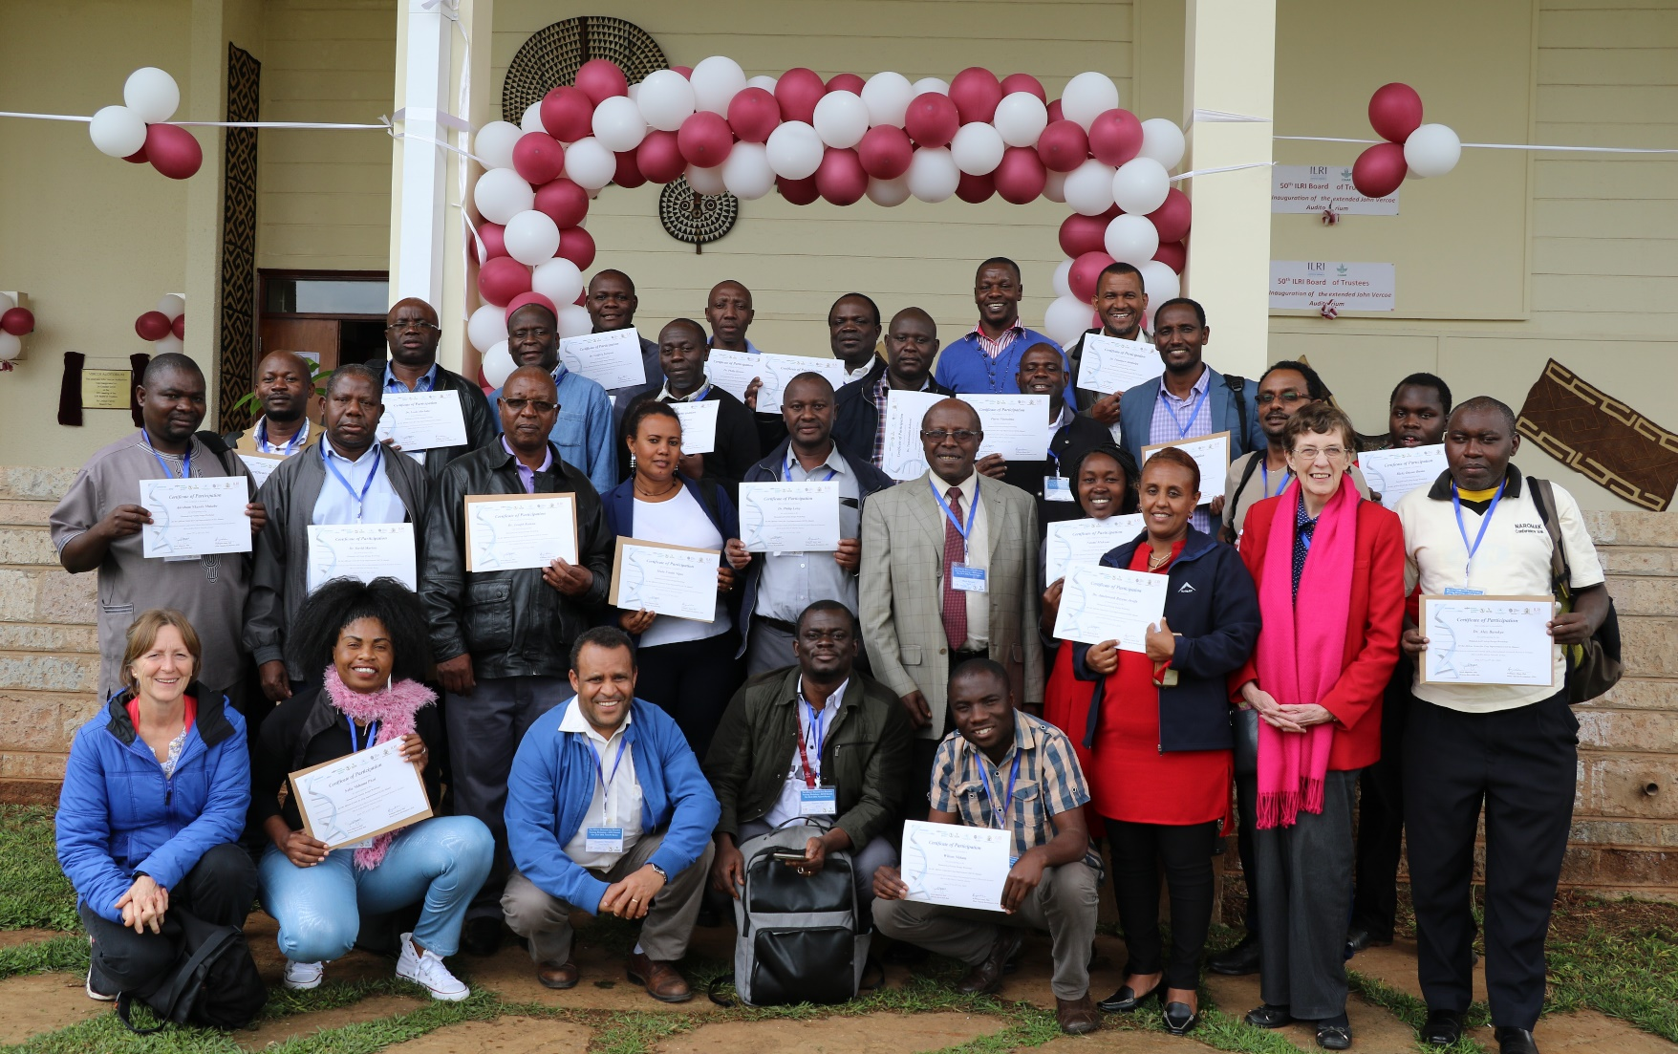
ACCI alumni and Demand-Led Plant Breeding team during the BecA/ILRI Nairobi training Workshop, 22 to 24 October 2018

Slide 13
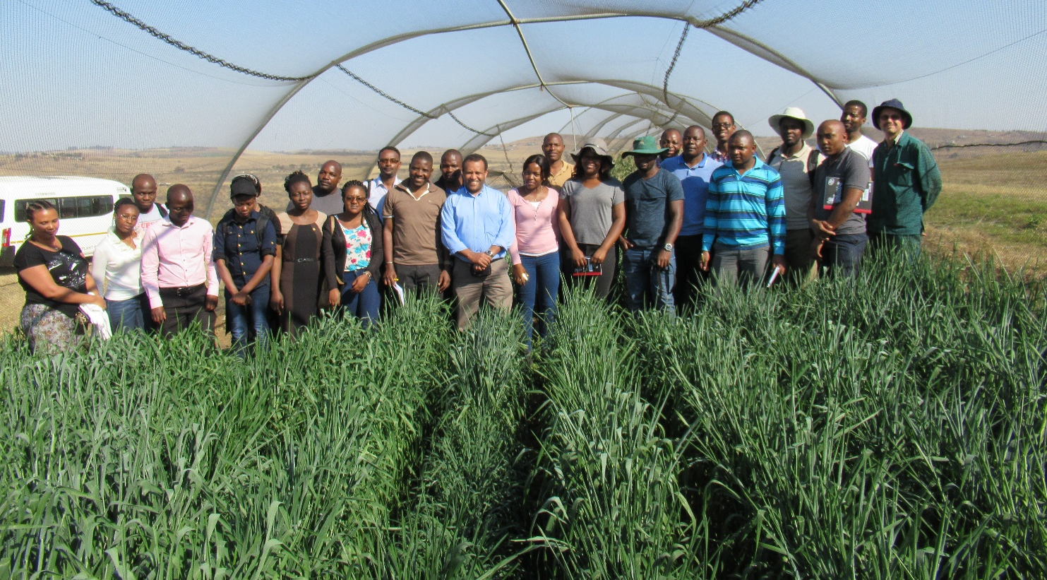
Postgraduate training
Curriculum development:
Advanced Plant Breeding (AGPS 730)

Slide 14
Feedback from the workshops:
Useful for our ongoing breeding work
We have been overlooking many issues in our breeding programs
Must be taught to every breeder
Training should be given to all stakeholders and beneficiaries soonest possible
Must be incorporated in Plant Breeding curriculum
On the right time when we needed guidelines in releasing our varieties
Market research is crucial

Slide 15
Summary
Demand-led Plant Breeding approaches follows the principles and processes of stakeholder involvement during cultivar design, development and commercialization
Integrating the demand-led breeding approach in plant breeding curricula promotes improved variety adoption in SSA

Slide 16






