Slide 1
DLB capacity building in PABRA
PABRA team

Slide 2
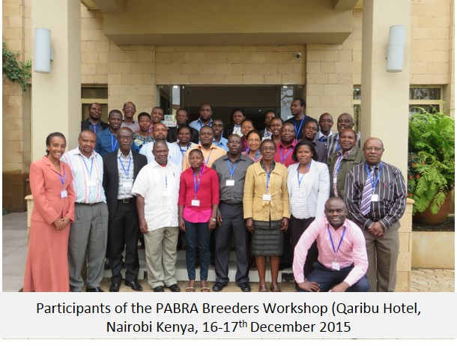
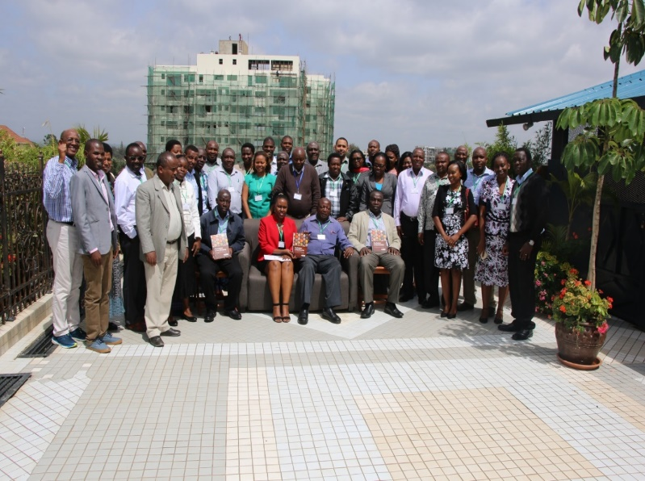
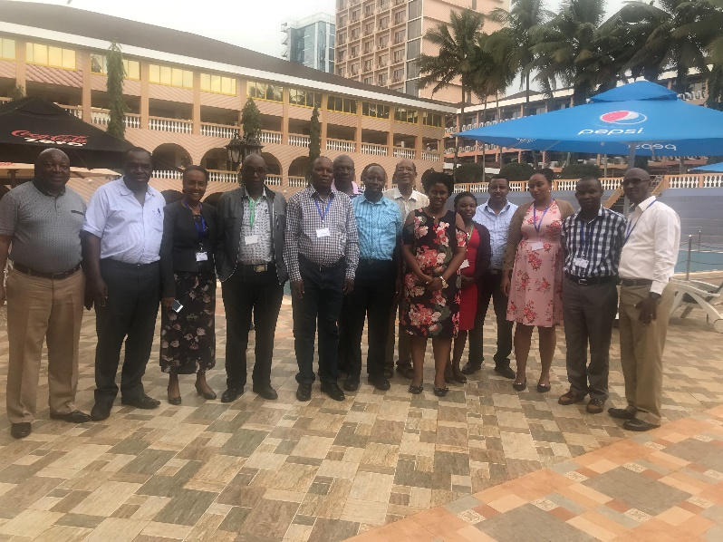
Trainings conducted
1st training-December, 2015 (28 participants; breeders only)
2nd training- December, 2017 (40 participants; breeders, regulatory authorities, private sector)
3rd review workshop –September, 2018 (14 participants; Breeders)
Mainstreaming DLB principles within ongoing projects e.g. TL3, AVISA, PABRA, TAAT

Slide 3
Planned trainings
Conduct atleast one annual breeding network meetings to review progress, share and learn from each other/pigbagged with private sector/breeders business interactions
Business to business meeting focus on private sector interactions across countries
Continue mainstreaming DLB principles (AVISA, Corridor approach etc)
Product profiling (Ethiopia, Uganda, Tanzania, Rwanda, Burundi, Kenya)
Market research focus on consumer traits particularly cooking time in partnership with Makerere University /GREAT
Trait prioritization
Market segmentation
Developing business cases (Ethiopia, Uganda, Kenya, Tanzania, Burundi, Rwanda)
Collaboration with the Cornell University in GREAT program (“Setting priorities of plant breeding programs: Concepts, research tools and examples for gender responsiveness”)
NARS/PABRA breeders capacity in efficient/optimized breeding in partnership with UWA-Cooking time)
Other trainings planed for Zimbabwe and Burundi (PABRA SDC project focus)

