Slide 1
DLB for Ethiopia: Justification, regulatory frameworks and the way forward
Firew Mekbib (PhD)
Chair. NVRC Ethiopia

Slide 2
Importance of Agriculture in Ethiopia
Ethiopia: has a population of 110 million people
Agriculture contributes
  50% of GDP,
  85% of employment (the rural population of Ethiopia),
  90% 0f earnings from export, and
  70% of raw material requirements for large and medium industries which are agro-processing
Over 80 million people in the agriculture value chains

Slide 3
History of Plant Breeding in Ethiopia
Farmer breeding since crop domestication
  Some of the crops (orphan) still left for farmer breeding
Formal Breeding began in 1950
Done by
  Federal Research Organizations
    EIAR
    Universities
  Regional Research Organizations
Closer to 1200 varieties released

Slide 4
Existing Enabling Regulatory Frameworks

Slide 5
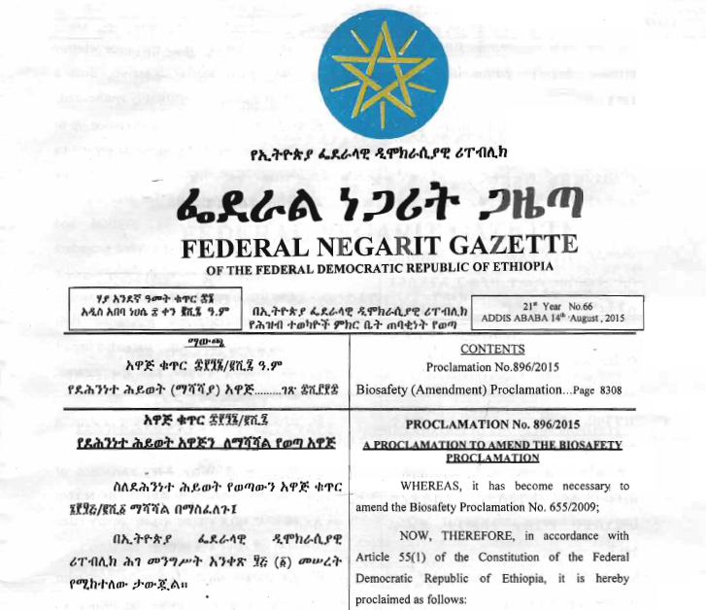

Slide 6
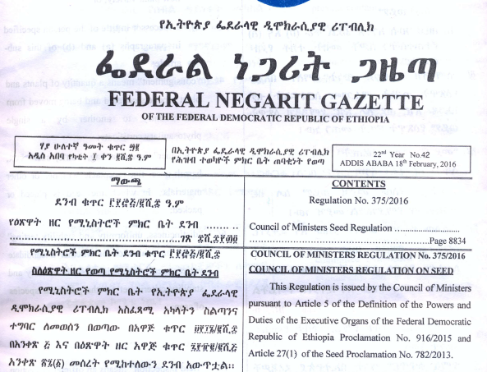

Slide 7
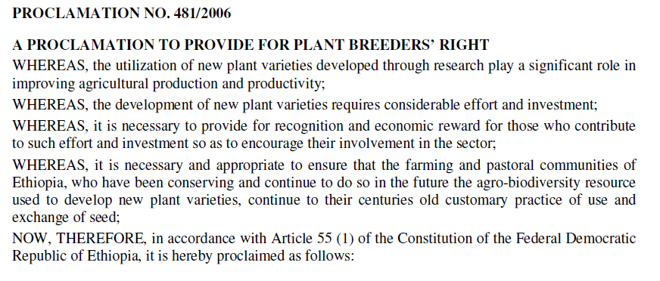

Slide 8
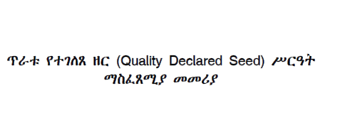

Many directives are in place:
For example

Slide 9
NVRC has two sets of committee members
Standing Committee (SC) Members
Technical Committee (TC) Members

Slide 10
National Variety Release Standing Committee Members
Name | Institution | Role
1. Daniel Mekonnen | MoANR | Secretary
2. Million Eshete (Dr.) | EIAR | Member
3. Getcahew Ayana (Dr.) | EIAR | Member
4. Alemayehu Assefa (Dr.) | ARARI | Member
5. Berhanu Ararisa | TARI | Member
6. Tesfaye Letta (Dr.) | OARI | Member
7. Agdew Bekele (Dr.) | SARI | Member
8. Esayas Lemma | MoANR | Member
9. Getachew Tabor (Dr.) | EIAR | Member
10. Hussein Mohammed (Dr.) | Hawass U | Member
11. Firew Mekbib (Dr.) | Haramaya U | Chairman

Slide 11
Members do represent
Federal Institutions
  Academia-
  Research-
  Ministry of Agriculture and Livestock Resources
Regional Research Institutions
  Oromia Agricultural Research Institute
  Tigray Agricultural Research Institute
  Amhara Regional Agricultural Research Institute
  Southern Agricultural Research Institute
Diverse Professional background
  Plant Breeding
  Plant Protection (Pathology, Entomology, )
  Socioeconomics
  Extension

Slide 12
Procedure for Release/ Registeration of varieties in Ethiopia

Slide 13
Variety Release
For varieties that are not released anywhere

Slide 14
Step 1
Step 2
Variety Verification Trials for TC evaluation
Plot size of 100m²
Step 3
TC will submit the report to NVRC and decision will be made by May of the next year based on:
National or Regional Variety Trials
6 locations: 3 on-station and 3 on-farm
VCU and DUS
Variety Trial Performance data evaluation
Recommendation/Decision
Farmers’ evaluation
Variety Verification evaluation
3-5 locations over 2-3 seasons

Slide 15
Variety Registry
Varieties released somewhere and validated for performance and adaptation in Ethiopian context

Slide 16
Step 1
Variety Verification Trials for TC evaluation
Plot size of 100m²
Step 2
TC will submit the report to NVRC and decision will be made by May of the next year based on:
6 locations: 3 on-station and 3 on-farm
Variety Trial Performance data evaluation
Recommendation/Decision
Farmers’ evaluation
Variety Verification evaluation

Slide 17
Ethiopia’s NVR system
  DUS and VCU
  Fast-track registration
  Trait based release
  Customer driven
  Accommodate requests from both private and public organizations

Slide 18
Ethiopia has almost harmonized the COMESA Seed Regulatory Framework

Slide 20
Chapters
PRELIMINARY
ADMINISTRATION AND ENFORCEMENT
COMESA CERTIFICATION SYSTEM
COMESA VARIETY RELEASE SYSTEM
QUARANTINE AND PHYTOSANITARY MEASURES FOR SEED

Slide 21
COMESA Variety Release System
COMESA Variety Release System
Variety Tests
Denomination of Varieties
Reference Sample
Maintainer
Payment of Fees

Slide 22
7. Variety Catalogue Content
8. COMESA Variety Database
9. Registration of New Varieties
10. Registration of Existing Varieties
11. Prohibition of access to Markets
12. Genetically Modified Varieties
13. Withdrawal of Varieties

Slide 23
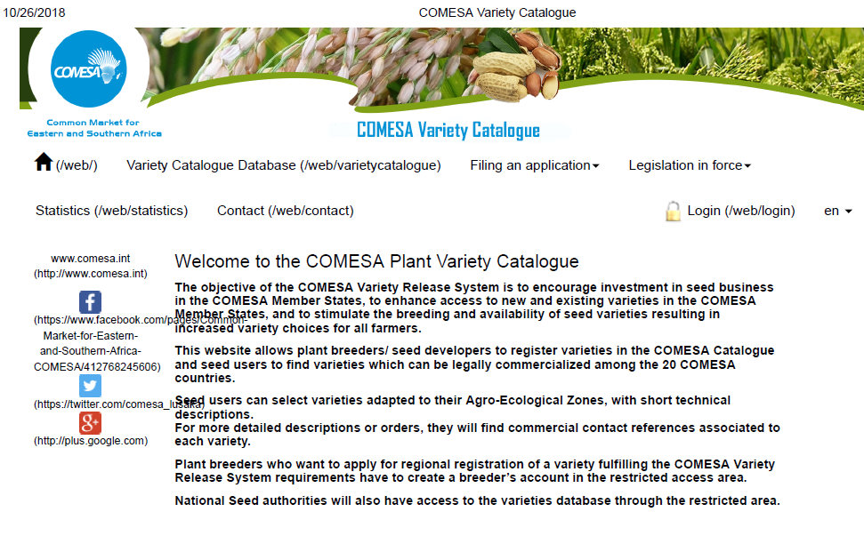

Slide 24
Adoption of Improved Varieties

Slide 25
Summary of Released/Registered Varieties until 2017 in Ethiopia
Crops | Released/Registered Varieties
Cereals | 421
Pulses | 224
Oil Crops | 111
Tubers, Roots and Vegetables | 233
Condiments and medicinal plants | 49
Fruit Crops | 44
Forage and Pasture Crops | 47
Fiber Crops | 30
Stimulant Crops (Coffee) | 39
TOTAL | 1198

Slide 26
No. | Crops | Number of Released Varieties
 |  | New varieties Released in 2018 | Released before 2017 | Total
VIII | Fiber Crops | - | 30 | 30
1 | Cotton | 2 (JCH) | 29 | 31

Slide 27
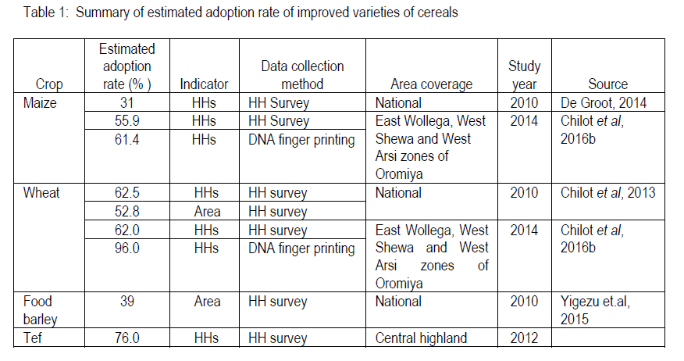
Adoption rate of improved varieties of cereals

Slide 28
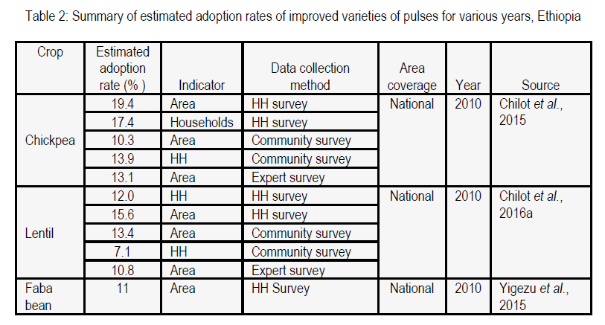
Adoption rate of improved varieties of pulses

Slide 29
The two most FAQs in Variety Release in Ethiopia
Why released varieties are not adopted?
Why we need to release more if the PREVIOUS ONES are not adopted?
One of the solutions:
DLB in upstream of the value chain

Slide 30
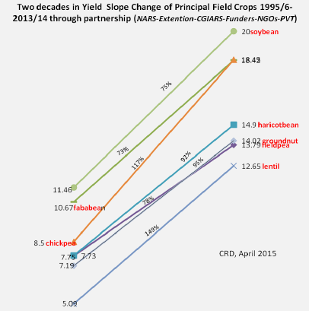
Genetic gains from the released varieties

Slide 31
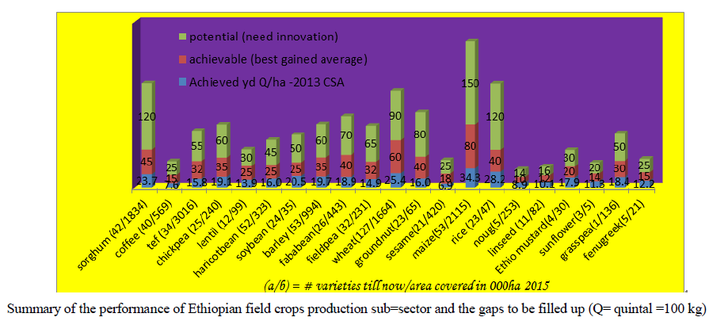
Have the genetic gains moved to farmers fields?

Slide 32
Seed System in Ethiopia

Slide 33
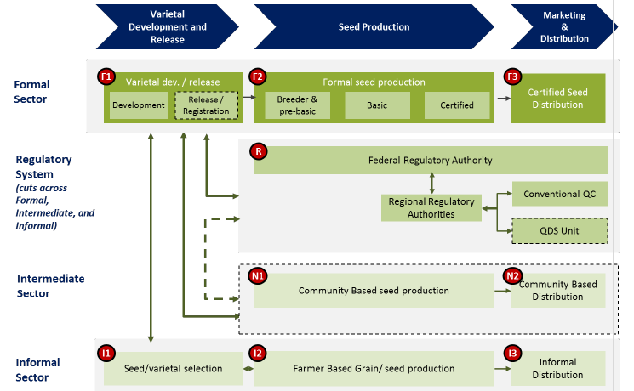
DLB can fit into the three seed system

Slide 34
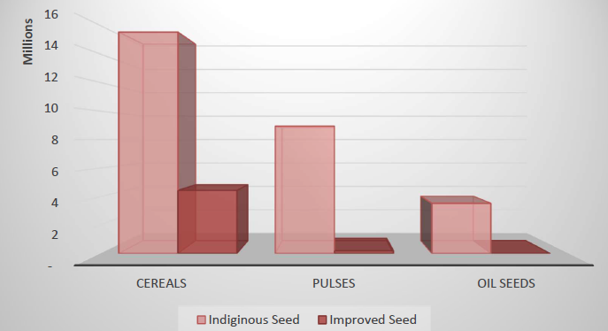
Number of holders by seed type and grain crop category, main season 2016/17

Slide 35
DLB enhances Stakeholders and Innovation Platforms (SIP) functionality
SIP Platform
Research
Development
(MoA, Input suppliers, Extension)
Policy
Academia
Farmers (organization)
Food and Beverage Processors
Feed Industry
Exporters
Distributors

Slide 36
NARS of Ethiopia

Slide 37
NARS
MoANR
EIAR
MoE
Universities
RBoA
RARI

Slide 38
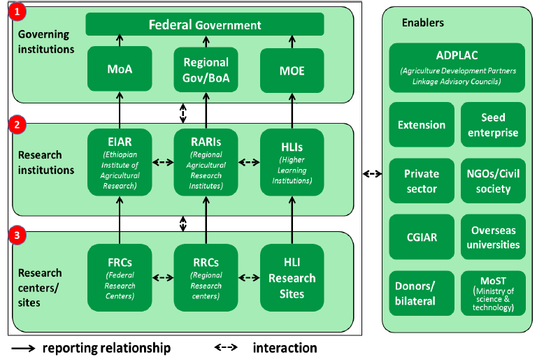

Slide 40
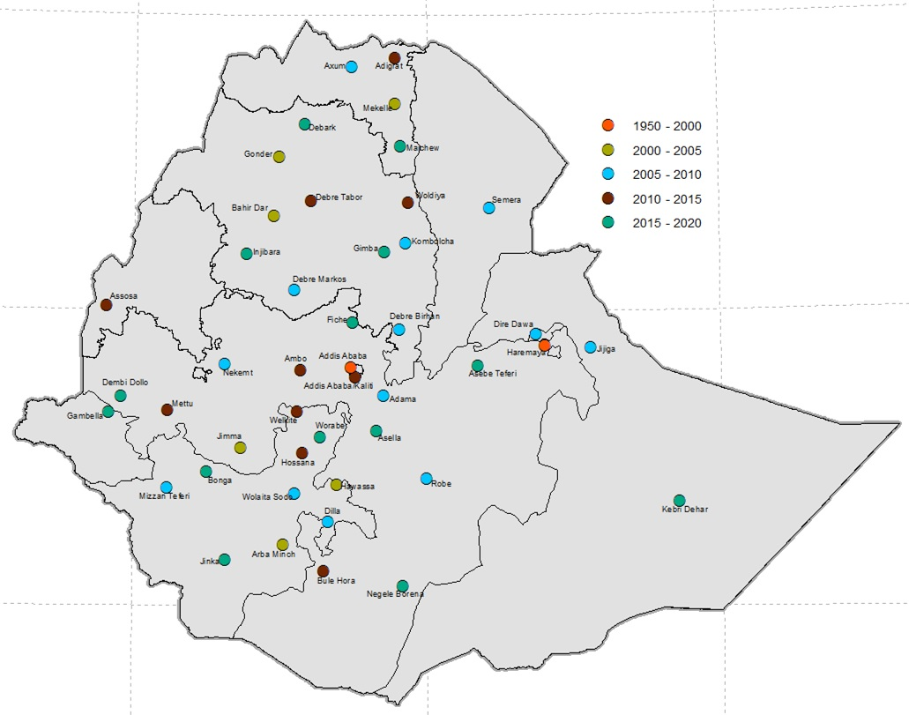
54 universities

Slide 41
DLB is the deriver of the whole value chain
Research and Technology
Inputs production and supply
On farm production
Postharvest Processing
Market access and growth
Inputs distribution

Slide 42
Corridor approach
Production
Processing
Distribution
Consumption
Research
DLB Products

Slide 43
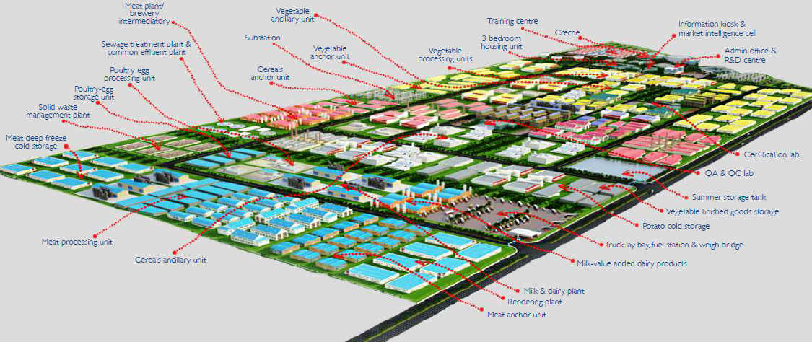
Meeting the need of AgroIndustrial Parks (AIP)
through DLB value added traits

Slide 44
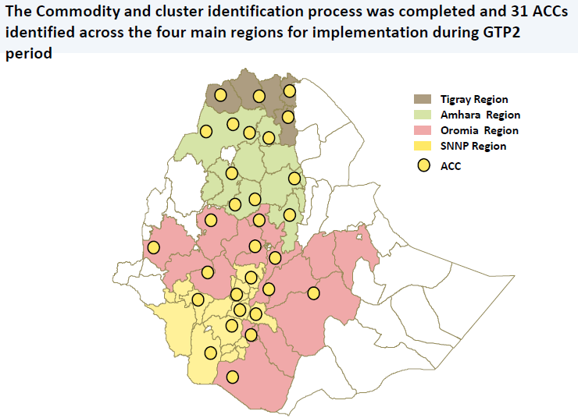
Agricultural Commercialization Cluster

Slide 45
DLB is key for deorphaniaztion of neglected crops
Minor
Local
Underutilized
Neglected
Under researched
Under funded

Slide 46
Species name | Common name
Abelmoschus esculentus | Okra
Aframoum Koririma | False cardamon
Amorphophallus abyssinicus | Bagana (sidama)
Brassica carinata | Ethiopian mustard
Carthamus tinctorius | Safflower
Carum opticum | White azmud
Catha edulis | Chat
Cicer arietinum | Chickpea
Coccinia abyssinica | Godere/Taro
Coffea arabica | Coffee
Colocosia esculenta | Anchote
Cordeauxia edulis | Yeheb-nut
Coriandrum sativum | Coriander
Dioscorea spp. | Yam spp
Eleusine coracna | Finger millet
Ensete ventricosum | Ensete
Eragrostis tef | Tef
Guziotia abyssinica | Noug
Hygenia abyssinica | Kosso
Lathyrus sativus | Grasspea

Slide 47
Ipomea patatas | Sweet potato
Lens culinaris | Lentil
Lepidium sativum | Crested grass
Linum usitatissimum | Linseed
Lupinus albus | White lupin
Moringa stenopetala | Cabbage tree
Nigella sativa | Black cumin
Opuntia ficus-indica | Cactus pear
Plecthranthus edulis | Ethiopian potato
Pisum sativum | Field pea
Rhamnus prinoides | Buckthorn
Ricinus communis | Castor bean
Sesamum indicum | Sesame
Sorghum bicolor | Sorghum
Sphenostylis stenocarpa | African Yam Bean
Trigonella foenum-graceum | Fenugreek
Vernonia galamensis | Ironweed
Vicia faba | Faba bean
Vigna unguiculata | Cowpea

Slide 48
Gender disaggregation and mainstreaming in DLB

Slide 49
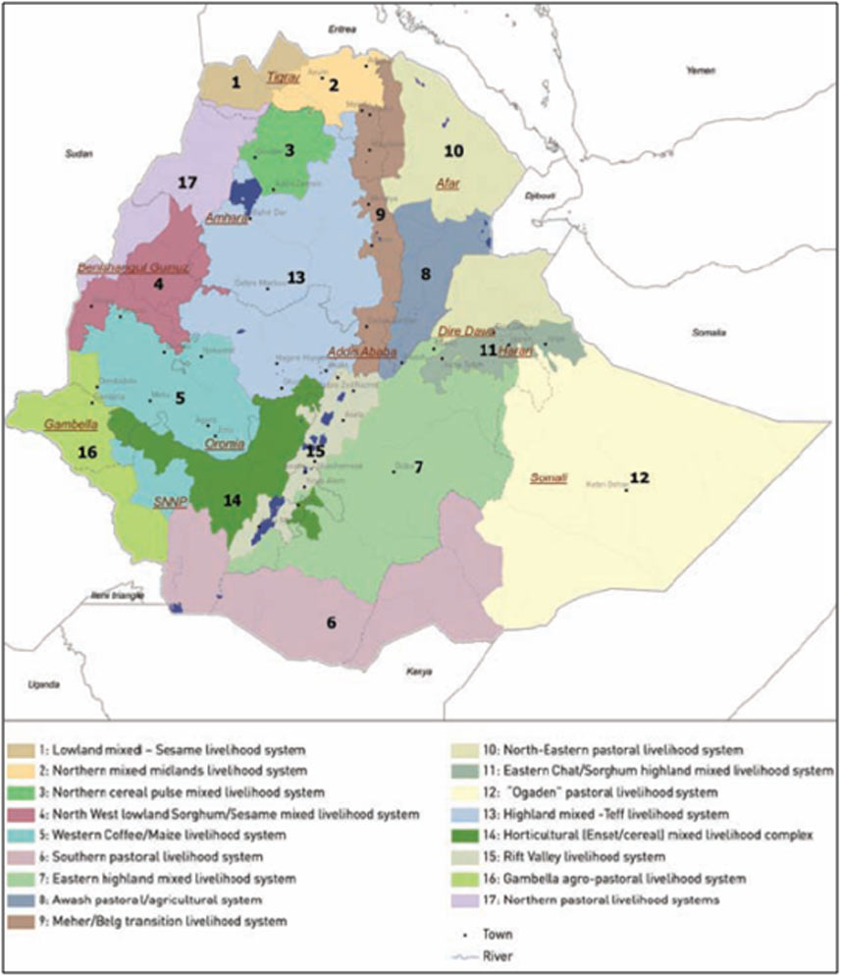
DLB develops varieties that fits into the different livelihood

Slide 50
The Way Forward

Slide 51
  Policy platforms
    Awareness seminars to State Ministers and Directors
    Variety Release Board Members (End of Feb 2018 with DNA barcoding for DUS)
  Implementation of recently ratified Plant Breeders Right

Slide 52
  Institutionalization of DLB
    Research and Development
      Research System
      Research strategy
      Product development approach
      SI platforms
    Academia
      Integrating in the plant breeding curricula at BSc, MSc and PhD
      Short-term training on DLB at HU
      Integrating DLB in MSc and PhD thesis research

Slide 53
DLB and the seed sector
Integrated and Responsive Seed System to accommodate DLB
PPP
Increased amount of seed produced by ESE, RSE and Universities

Slide 54
  The STARTERS
  STEWARDSHIP through the product cycle
  MERCI coordinated by UQ (Product approach in variety development)
  Common bean

Slide 55
  Scaling up:
    To others crops
  Integrating DLB into Orphan Crops Improvement

Slide 56
Establishment of DLB and Regional Hubs
  Haramaya University: National hubs and Regional Hub for Oromia Region
Regional hubs
  Amhara Region
  Oromia Region
  Tigray Region
  Other regions hub (Somali, BGZ and Gambella)

Slide 57
Training
Motto: DLB is a NECESSITY not a LUXURY
NARS
(120-150)
All women breeders
+
MoANR
EIAR (20-30)
MoE
Universities
(50)
RBoA
RARI (50)

