Slide 1
“Crops to End Hunger”
Strategy and Options for CGIAR support for Plant Breeding
October 0218

Slide 2
Purpose
Increase the effectiveness of CGIAR supported breeding programs
Strengthen partnerships with national breeding programs
Develop and deliver more productive, resilient, nutritious varieties of staple crops, in demand by both farmers, consumers, and markets
Identify target crops of importance in various geographic regions

Slide 3
IFPRI Prioritization studies on 20 crops
Modelling of what would be the benefits of accelerating crop productivity through plant breeding to 203
Compares 20 staple crops, globally and regionally
Benefits on increasing income, reducing poverty,nurtion benefits, climate resilience
Evidence base to build the case for investments in crop breeding

Slide 4
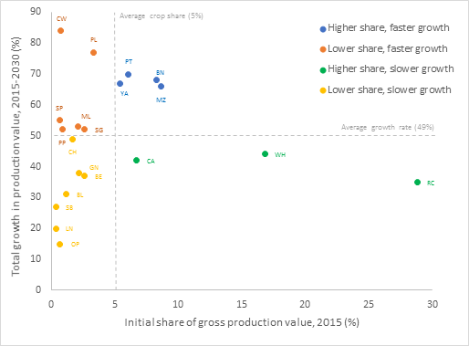
Global prioritization of 20 crops 2015-2030
X

Slide 5
Crop priority categories- global data
Super stars - higher share of production 2015, faster growth to 2030
Rising stars – lower share production 2015, faster growth to 2030
Steady stars – high share of production 2015, slower growth to 2030
Twinkling stars – lower share of production 2015, slower growth 2030

Slide 6
Global prioritization of 20 crops 2015-2030
X

Slide 7
Implications for CGIAR breeding programs
Focus on agreed set of priority staple food crops in specific regions
Develop series of priority product profiles, in conjunction with NARS, famers , consumers and others along the value chain
Implement CGIAR breeding programs in partnership with national breeding programs
Develop stronger regional plant breeding networks (eg PABRA)

Slide 8
Measures of success of breeding programs
Genetic gains: Annual rate of genetic gain in productivity delivered in farmers fields by new varieties preferred by farmer and consumers
Rate of new varietal adoption and replacement: Average area weighted age of varieties in farmers’ fields.

Slide 9
Modernization of plant breeding programs
Promote use of best practices in plant breeding - e.g.
Stronger partnerships with NARS to co-design product profiles
CGIAR-NARS joint decisions on testing from stage 1, joint selection of parents, joint decisions on advancement and dissemination strategies
Institutional accountability for delivery of genetic gains from new varieties
Continually optimised breeding pipelines
Upgrade phenotyping, data management systems, breeding information management systems

Slide 10
Future challenges to the CGIAR system
Stronger research culture, leadership and accountability for the delivery of genetic gains from new crop varieties
Continuous professional development of plant breeders (currently 150 breeders in 10 Centres, working on 20 crops globally)
Financial resources – more efficient use of current resources and mobilising new resources for CG/NARS for priority crops/regions
Current CG investment USD 120 m pa, with about 50% in Africa.

