Slide 1

A journey towards meeting African farmers’ needs, the IBP perspective
Jean-Marcel Ribaut
Demand Led Breeding meeting
Nairobi
27th October, 2018
Enabling the Plant Breeding Revolution

Slide 2
Our main drivers
  Ongoing focus:
The IBP provides software and expertise to breeding programs in public, academic and private organizations to optimize their crop improvement capacities and outputs. It builds on local, regional and international networks to connect people, knowledge and resources that will strengthen the delivery chain of staple food crops in targeted regions
Desired impact
Breeding programs that meet demand-led objectives, taking into account agro-ecological, production and consumer imperatives
Enabling the Plant Breeding Revolution

Slide 3
Our core activity so far
We are enabling and supporting national programme breeders to play a leading role in R4D (R4 investment) by offering them access to modern breeding technologies, breeding materials and related information in a centralised, integrated and practical manner
Improve breeding effectiveness and efficiency (Data management, MB)
Increase quality control (data, seed, pipelines)
Enable data sharing and analysis across teams/projects/institutes (Meta analysis)
Establish institutional data memory and ownership (staff turnover, IP)
Institutional visibility, facilitate networking and fund raising
A must have to start with good practices along the value chain
Benefits and added value
Enabling the Plant Breeding Revolution

Slide 4
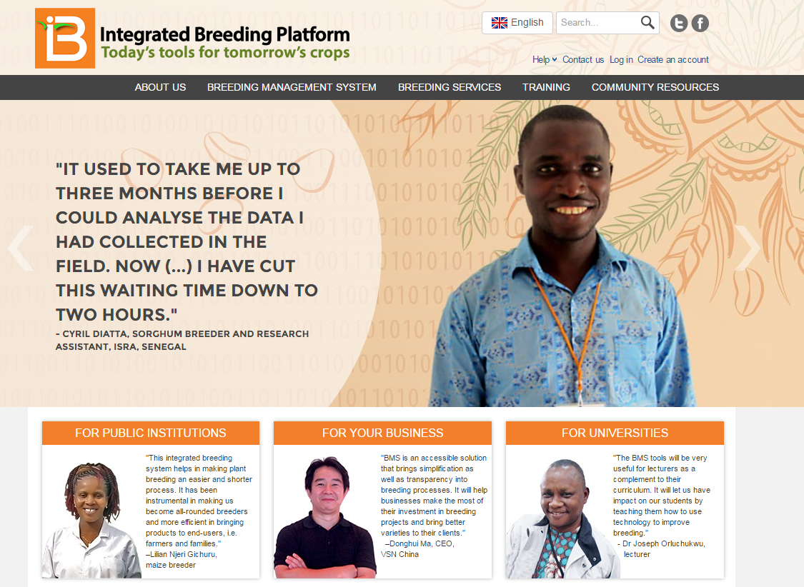
Today 4500 people as registered on the IBP portal
https://www.integratedbreeding.net

Slide 5

The core product of the IBP:
The Breeding Management System (BMs)
BMS core
system
Web services
API
)
Today about 500 BMS users including 27 Institutional deployments
Meta Information
e.g. GIS, weather, etc
BMS Users
(e.g. Seed trial management)
Shared File Storage
e.g. Seed catalogue
Users of other
systems

Slide 6
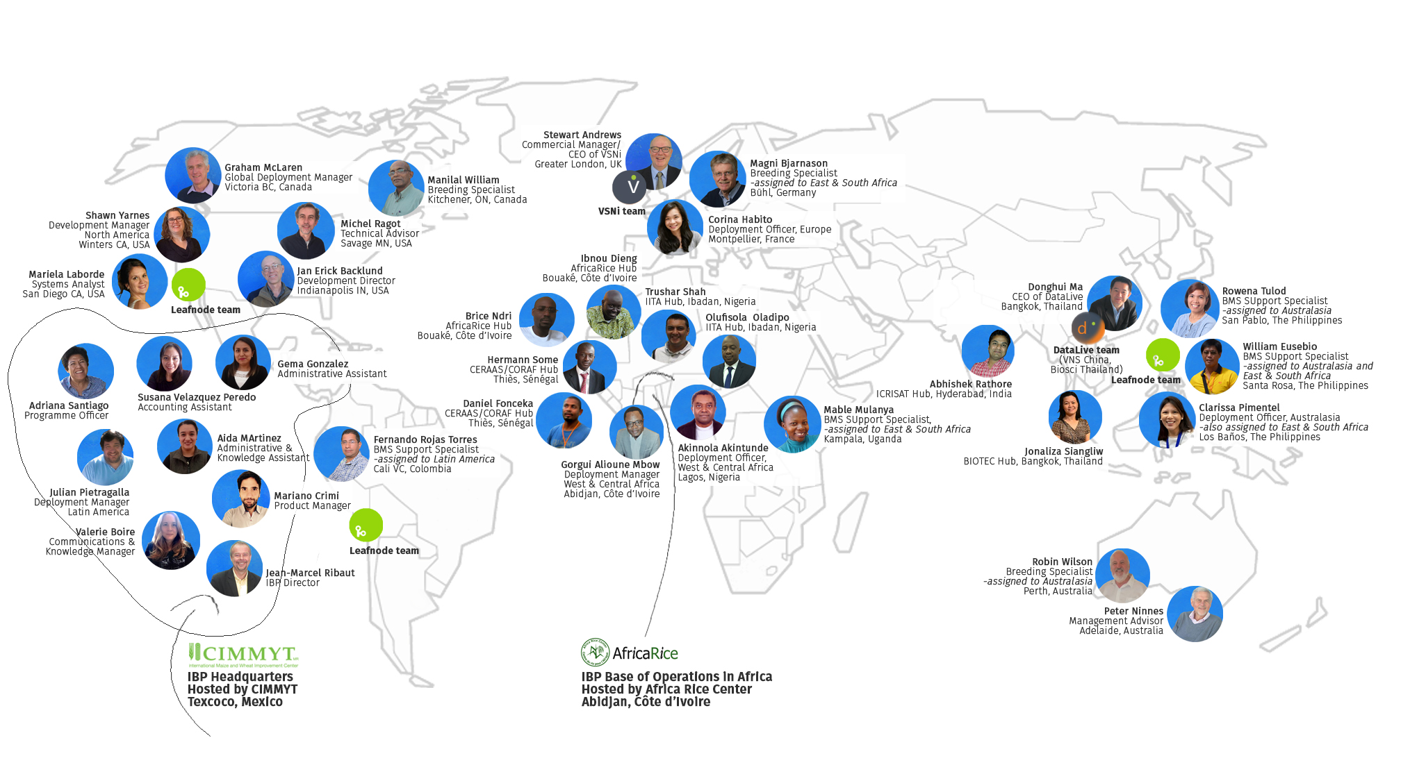
In transfer of technology the technical part is the easiest one, sustainable adoption is the most challenging one!
Enabling the Plant Breeding Revolution

Slide 7
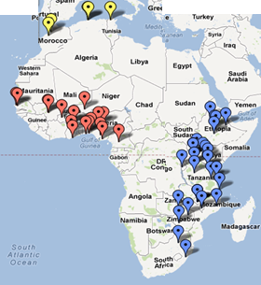
BMS as a support tool for education
  Specific BMS “Education” version
  Installation on a local or web server
  Concomitant use by multiple users/students
  Implementation of academic learning
  Tutorials and practical exercises available
  Simulate/compare breeding programme approaches
  Added value to students and universities:
  Exposure to modern and comprehensive analytical pipeline
  Facilitate integration into private companies
  BMS installation can include a production version for:
  Breeding activities (teachers and Student practical work)
  Adoption
  A dozen universities and schools of agriculture adopted the BMS (accreditation)
  “Improved MSc Cultivar Development for Africa” (BMGF) Ghana, Makerere-Uganda, UKZN- South Africa under leadership of ISU
Enabling the Plant Breeding Revolution

Slide 8
Evolution of the BMS
Food productivity and security
Enabling the Plant Breeding Revolution

Slide 9
IFAD project: Enhancing institutional breeding capacity in Ghana, Senegal and Uganda to develop climate resilient crops for African smallholder farmers
Led by NARS under the facilitation of IBP and AfricaRice (2018-2021)
Core crops: Groundnut, rice plus bean, cowpea and sorghum

Slide 10




Broadening of our scope:
Linking actors along crop value chains from a data/knowledge management perspective
PRA - market demand (general traits ) value)
PVS – product evaluation (adapted to demand)
Evaluation
Breeders (national programmes)
Farmers
(local market and environment)
research & breeding
create Foundation seed
Extension workers
(seed business)
seed multiplication certification and distribution

Slide 11
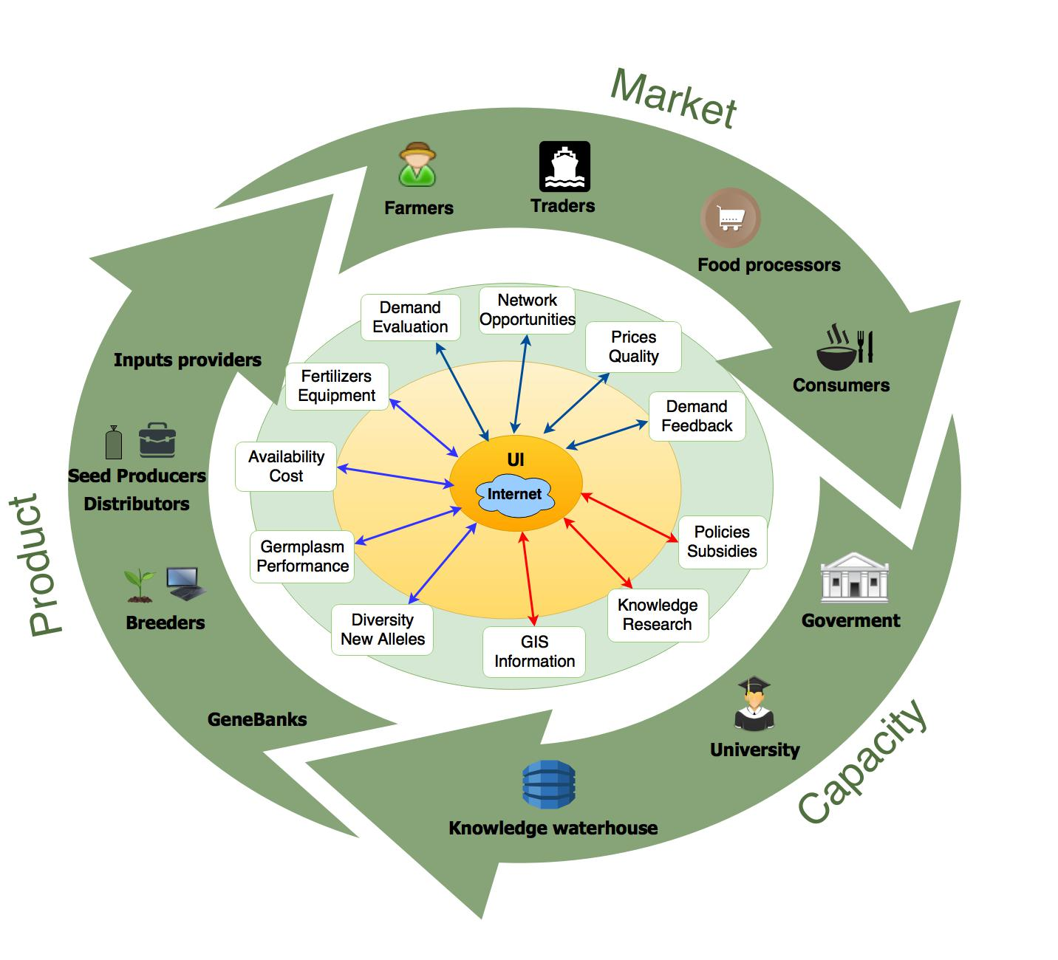

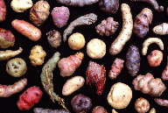
Food Productivity value chain: the BMS/IBP

Slide 12
Food Productivity value chain: the BMS/IBP

Slide 13
Food Productivity value chain: the BMS/IBP

Slide 14
Conclusions and Perspectives
The IBP will continue to focus on:
leading and supporting the digitalization of breeding programs in Africa as our primary target;
coordinating the modernization of breeding activities by building on our existing network and initiatives; and
contributing to the implementation of data/information integration along the crop – and ultimately, the food – value chain
Our Role:
“Goods and Services” in data - information - knowledge management to support effective DLB
Building on partnership and existing initiatives in the arena

Slide 15
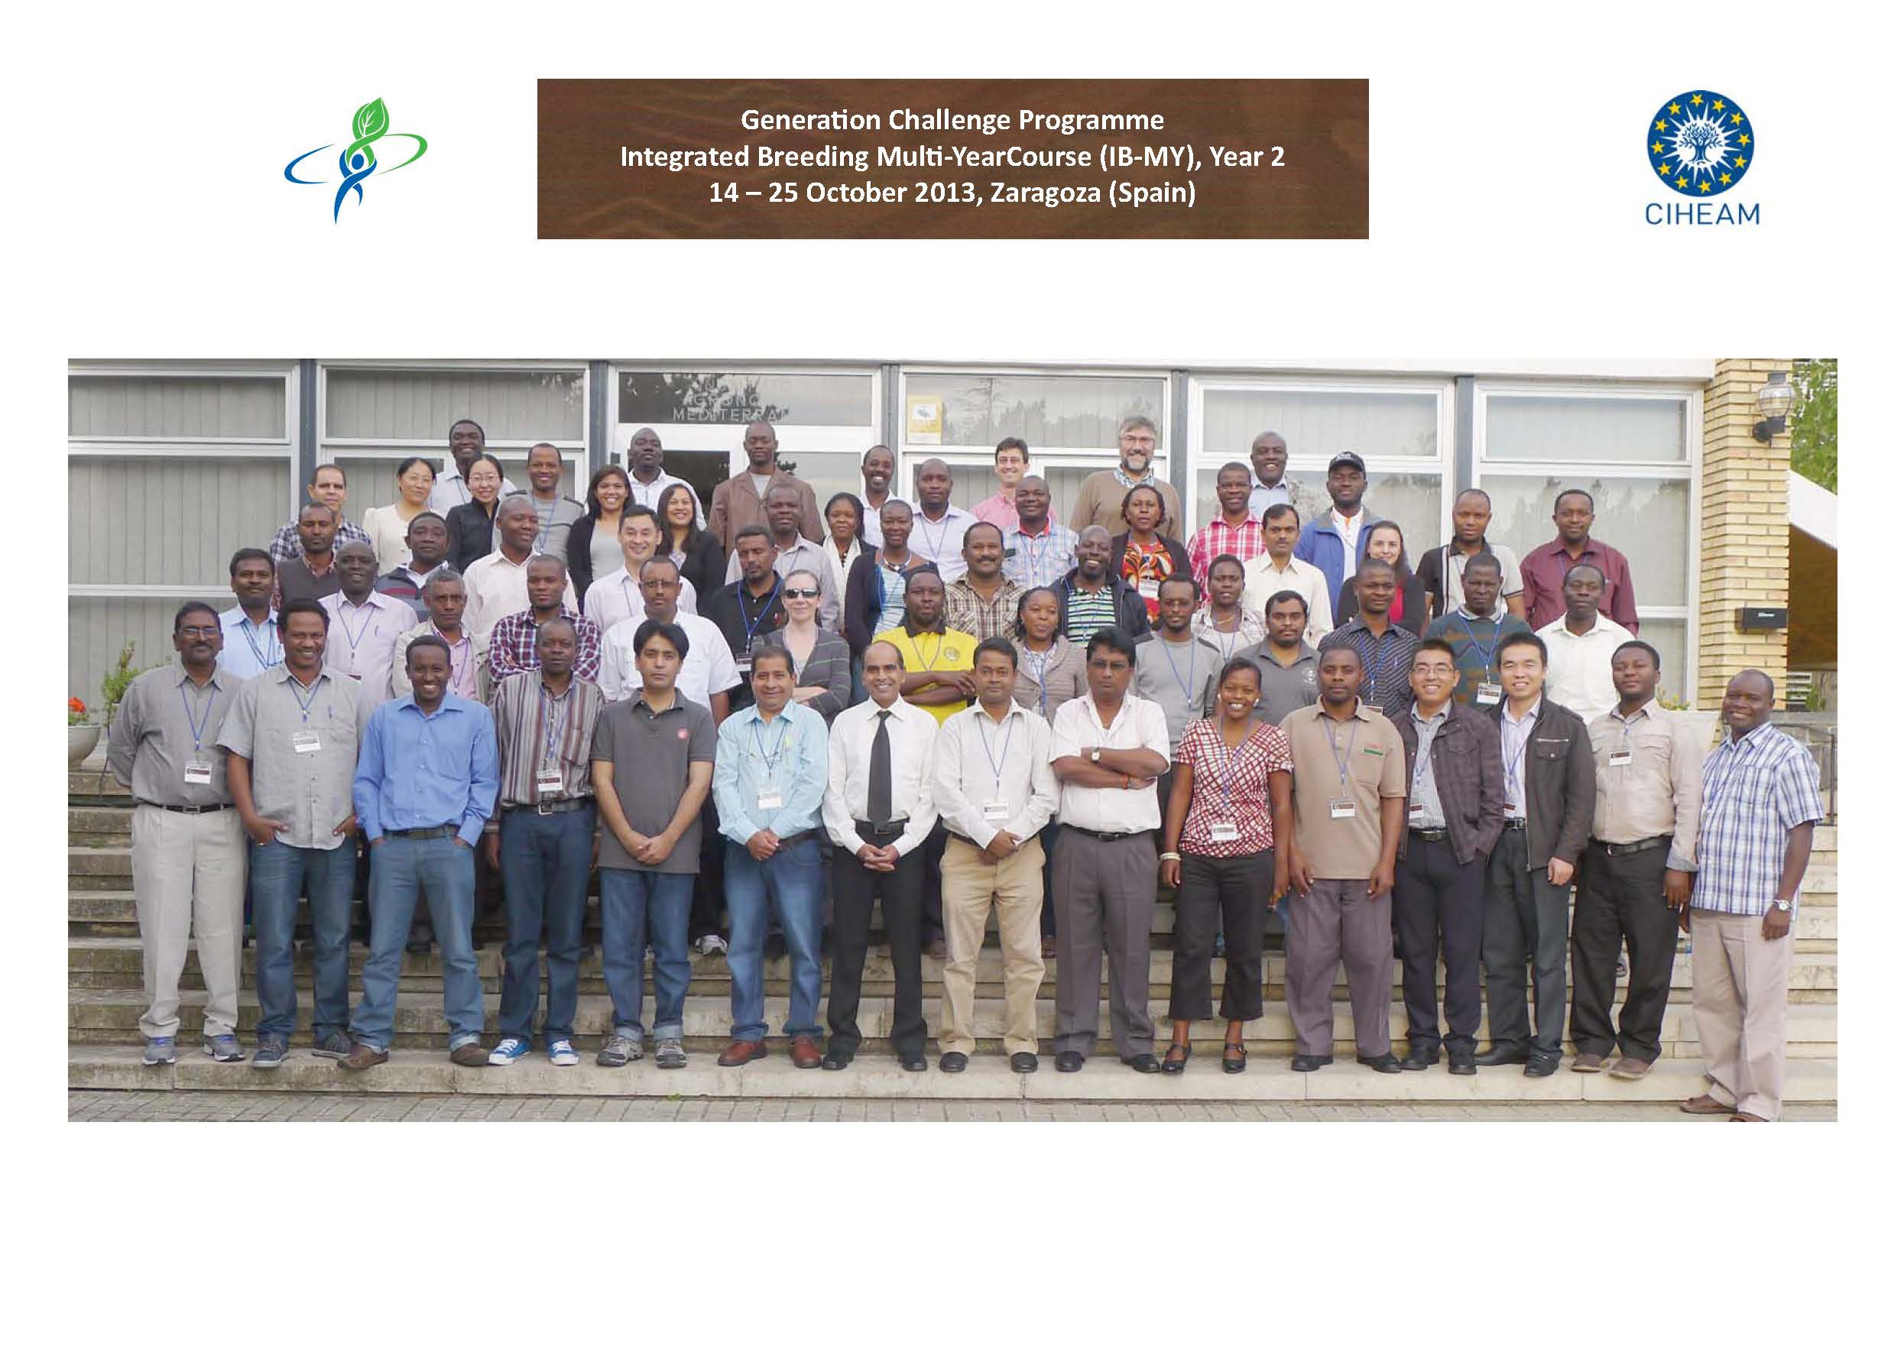
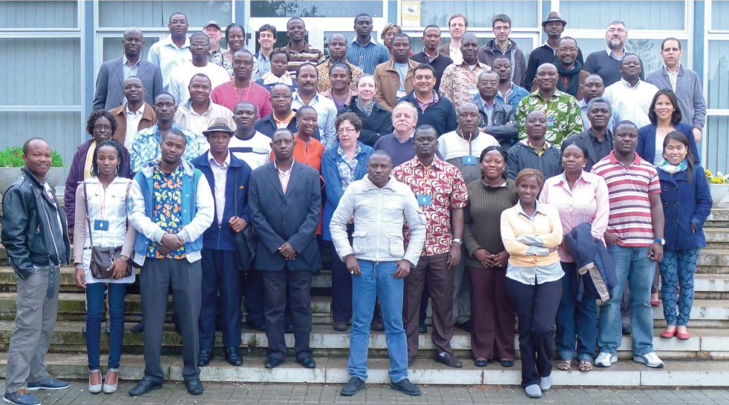
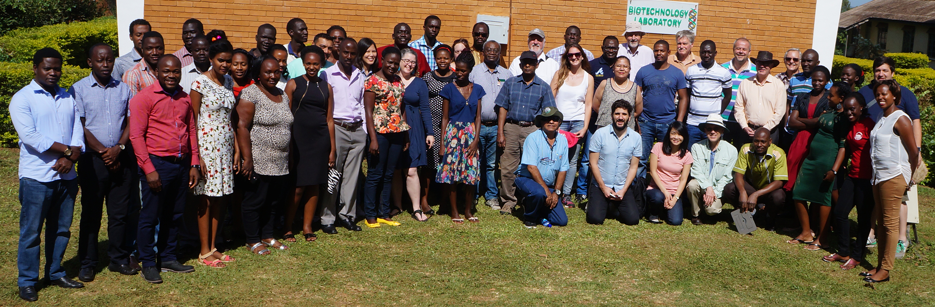
https://www.integratedbreeding.net
Thank you!
BMS
Trainees

