Slide 1
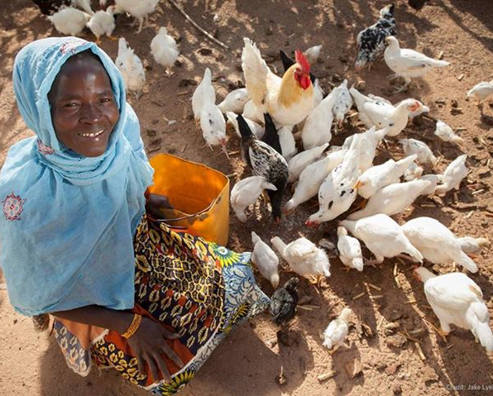
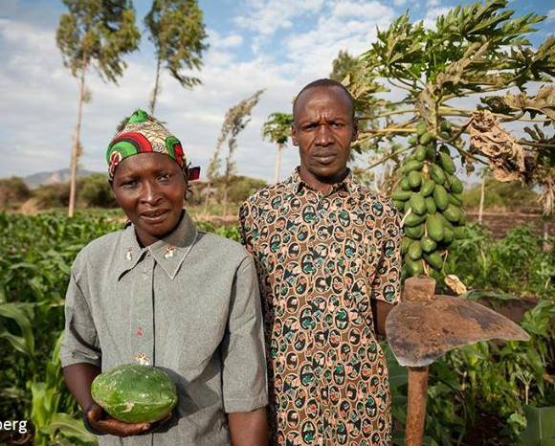
DLB Alumini outreach and building prospects for phase 2
Nasser Yao
Scientist, Molecular Breeder
BecA-ILRI Hub, Nairobi, Kenya
http://hub.africabiosciences.org/
Consultation and DLB phase 2 kick off meeting
October 26th -27th , 2018
Windsor hotel, Nairobi, Kenya

Slide 2
Snapshot of DLB alumini outreach
Outcomes
390
DLB alumini trained
1
Handbook published
285
Active breeders

Slide 3
Snapshot of DLB alumini outreach
DLB Alumini from 28 African Countries
Country | Number | %
Kenya | 69 | 22.5
Ethiopia | 47 | 15.4
Zimbabwe | 39 | 12.7
Ghana | 23 | 7.5
Tanzania | 24 | 7.8
Uganda | 27 | 8.8
Nigeria | 17 | 5.6
Malawi | 17 | 5.6
Mali | 11 | 3.6
DR Congo | 9 | 2.9
South Sudan | 9 | 2.9
Niger | 8 | 2.6
Rwanda | 11 | 3.6
Zambia | 9 | 2.9
Burkina Faso | 5 | 1.6
South Africa | 8 | 2.6
Burundi | 4 | 1.3
Cameroon | 3 | 1.0
Mozambique | 5 | 1.6
Sierra Leone | 3 | 1.0
Senegal | 2 | 0.7
Egypt | 1 | 0.3
Eritrea | 1 | 0.3
Guinea Conakry | 1 | 0.3
Liberia | 1 | 0.3
Madagascar | 1 | 0.3
Namibia | 1 | 0.3
Togo | 1 | 0.3
Crop | Nber of alumini | %
Maize | 93 | 33.1
Bean | 53 | 18.9
Not known | 41 | 14.6
All crops | 22 | 7.8
Sorghum | 19 | 6.8
Cowpea | 14 | 5.0
Cassava | 12 | 4.3
Rice | 16 | 5.7
Bean and other pulses | 12 | 4.3
Wheat | 13 | 4.6
Sweet potato | 9 | 3.2
Groundnut | 6 | 2.1
Tomato | 5 | 1.8
Pearl millet | 5 | 1.8
Barley | 2 | 0.7
Cotton | 2 | 0.7
Soybean | 2 | 0.7
Tobacco | 2 | 0.7
Bambara | 1 | 0.4
31 crops of interest
Crop | Nber of alumini | %
Chickpea | 2 | 0.7
Deciduous fruit | 1 | 0.4
Eggplant | 1 | 0.4
Eucalyptus | 1 | 0.4
Finger millet | 3 | 1.1
Grasspea | 1 | 0.4
Legumes | 2 | 0.7
Potato | 4 | 1.4
Shea | 1 | 0.4
White lupin | 1 | 0.4
Yam | 1 | 0.4
Coffee | 2 | 0.7
Grape | 1 | 0.4
Faba bean | 1 | 0.4
Sesame | 1 | 0.4
Vegetables | 2 | 0.7
Banana | 2 | 0.7
Forage | 1 | 0.4

Slide 4
Update on questionnaire development
Introduction and purpose
Questionnaire will be used by the DLB leadership team to support the alumini with the mission to gain the maximum reach for their new and prospective varieties to farmers by achieving scaling and distribution and to advocate for more resources for breeding and trait discovery in and for Africa
Questionnaire framed around 7 sections
- Section 1: Participant information
- Section 2: Status and development timelines of the promising varieties
- Section 3: Users and benefits of the improved varieties
- Section 4: Increasing adoption of new varieties
- Section 5: Increasing awareness and promoting new varieties using Demand-Led best practices
- Section 6: Plant breeding capacity, dependencies and challenges
- Section 7: Plant breeding skills and professional development
-

Slide 5
Section 1: Participant information
Name:
Job title:
Institution:
Locality/site:
Country:
Email:
Contact phone number:
DLB workshop (venue and date):
Signature:
Plant breeder
Research manager or plant breeding manager (supervising plant breeding or other projects but without own breeding programme)
Pre-breeder/trait discovery
Agronomist
Plant pathologist
Entomologist
Molecular biologist/geneticist
Seed technologist
Farm manager
Other – please specify
Public sector National R&D institute
International R&D institute (CGIAR)
International R&D institute (IARC)
University
National Government
Private sector seed company
Private sector company (other)
NGO
Other

Slide 6
Section 2: Status and development timelines of the promising varieties
Crop breeding program
Active breeder
Variety release and development timelines
- released last 1-3, next 1-3 and submission into a national trial in the next 3-5 years
Promising advanced lines/varieties or New varieties recently released or expected soon (year of release or expected)
National variety release procedure and timeline

Slide 7
Section 3: Users and benefits of the improved varieties
Advantages of the new variety(ies)
Target farmers and value chain beneficiaries
- Numbers of farmers the variety can serve
- Numbers and types of value chain actors
Approximate area coverage
- Regions in the country the variety can be used
Pan-African potential of the varieties/advanced lines
- Use of harmonisation scheme?

Slide 8
Section 4: Increasing adoption of the new varieties
Scaling and distribution strategy for the promising varieties
- Use of private sector seed partnership?
Licensing framework for partnerships
- Creating licensing arrangements to deals with private sector organisations for the promising new varieties?
Seed availability
- Type (breeder seed, foundation seed, certified seed) of seeds available
Seed production strategy
If NO to indicate the main reason of the lack of production strategy

Slide 9
Section 5: Increasing awareness and promoting the new varieties using Demand-Led best practices
Prepare compelling technical datasheets/prospectus for the promising varieties to attract scalers and investors and/or
Work further on the product profiles and the design of new varieties to create demand from farmers/crop value chain stakeholders and increase interest from private sector organisations
Connect with private sector seed scaling organisations to broaden the use of varieties by farmers

Slide 10
Section 6: Plant breeding capacity, dependencies and challenges
Aim: to seek information about the breeding approach, dependencies on other partner institutions for germplasm and core challenges faced at their home institution.
Plant breeding programme capacity
– line selections and crossings
Access to excellent germplasm and sources of essential germplasm for the breeding programme
Important germplasms/traits for ongoing programme for future success
Capacity building requirements to enable parental crossings
- Access to germplasm, Field trials capacity, Laboratory space, Lack of technicians, Plant breeder training required, Seed storage facilities, Statistics support, Genetics support, Molecular biology support, Lack of funds

Slide 11
Section 7: Plant breeding skills and professional development
Aim: to connect plant breeders within Africa, support development of skills and outputs from using best practices in Demand-led breeding and develop a professional development curriculum that will address needs for further training
Professional development and training experience or needed
- Status of skills in the following crop improvement and related disciplines?
 | < 6 months | 6 mths-1year | 1-2 year | 4 years | > 4 years | NA
Breeding technical and scientific skills
Market approaches and demand-led breeding
Understanding variety release regulation
Breeding resources and budgets
Breeding investment management
Verbal communication skills
Scientific writing and publication skills
Grant writing application skills
Computer applications and IT
Project management and planning
Understanding and connecting with private sector organisations
Intellectual property and licensing arrangements
Partnership management
Leadership training
Team-building
Innovation and entrepreneurship
Other relevant training (please specify)

Slide 12
THANK YOU
Mobilizing biosciences for Africa’s development

