Slide 1
3. What standards are used on variety performance?
DUS (Distinctiveness, Uniformity and Stability)
VCU (value for cultivation and use): Nutritional value, yield, market, disease resistance etc
4. Type of Data base are available?
Regional organizations
COMESA data base
ECOWAS
National
Eg. Kenya, Ethiopia, Uganda, Tanzania , Ghana, Nigeria, Burkina Faso, Senegal, Malawi and Zimbabwe

Slide 2
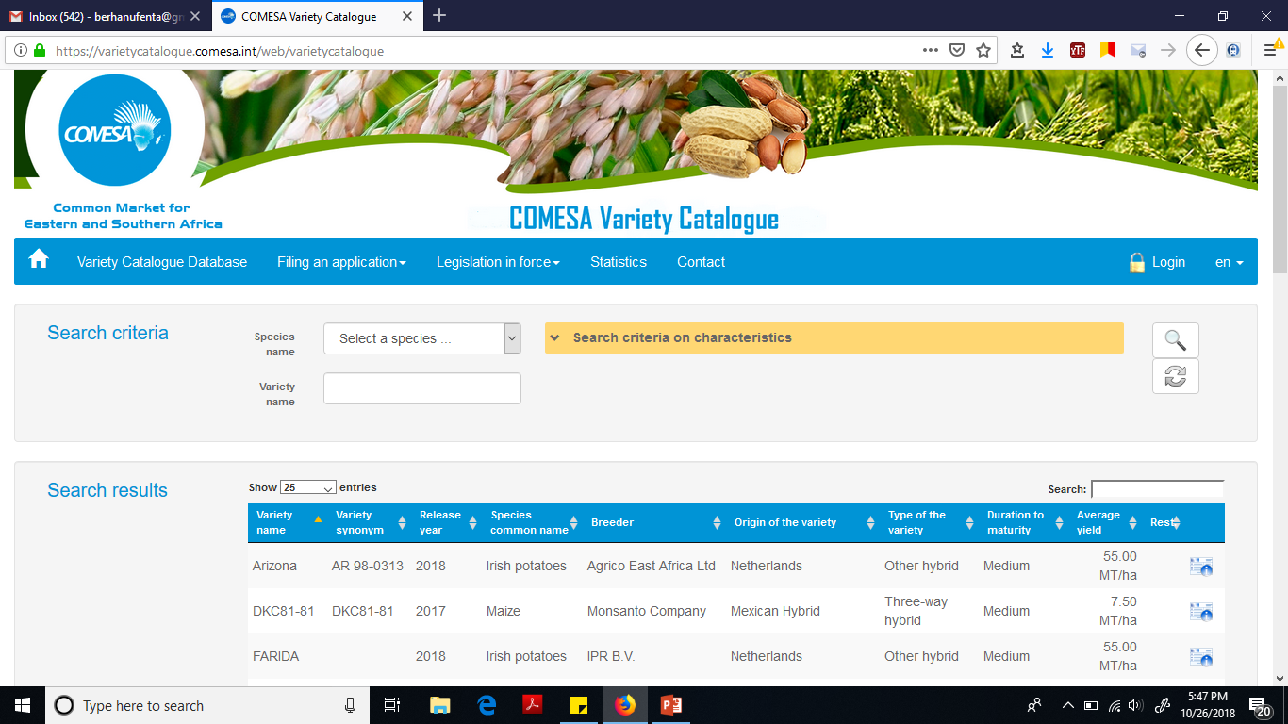
What does the data base contains

