Slide 1
Plant Variety Registration and Licensing Agreements
AFSTA Congress Special Interest Groups Meeting
Date: 5th March 2019
Place: Mombasa, Kenya
Katrin Kuhlmann, President and Founder, New Markets Lab

Slide 2
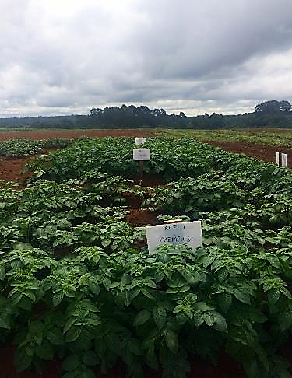
The New Markets Lab
Non-profit center for law and development that houses comparative expertise and an international team of lawyers focused on leveraging law and regulation as a tool for sustainable economic development and providing thought leadership and legal capacity in an evolving global market
House a innovative set of legal and regulatory tools
Benchmark national systems against international rules and good regulatory practices
Highlight regulatory tradeoffs and options that will result in improvements in implementation
Use scenario-based planning to customize reform efforts
NML works to build legal capacity through our legal tools, stakeholder consultations, ongoing partnerships, and scenario-based regulatory models
Improve the design and implementation of economic laws and regulations,
Address regulatory bottlenecks as they arise
Support local efforts to strengthen the feedback loop between regulators and local communities

Slide 3
NML’s Partnership with SFSA Under Seeds2B
NML has a longstanding partnership with the Syngenta Foundation for Sustainable Agriculture (SFSA) and its Seeds2B project, which is designed to help farmers access quality, affordable seeds of improved varieties for the crops they need
Partnership focused on:
Capacity Building: Increase awareness of regulatory aspects of seed systems among private sector actors, breeders, lawyers, and other stakeholders
Case Studies: Assess the implementation of regional seed initiatives at the national level (countries covered include Ghana, Kenya, Nigeria, Zambia, and Zimbabwe)
Test Cases: “Stress test” regional regulatory systems and determine how they work in practice
NML and SFSA have facilitated regional registration of nearly 30 seed varieties across 7 crops in East Africa, COMESA, and SADC

Slide 4
NML-SFSA Collaboration Under PASTTA
The Partnership for Seed Technology Transfer in Africa (PASTTA), is a USAID funded partnership among Seeds2B, NML, and the African Agricultural Technology Foundation (AATF) that aims to enable the transfer of best-bet seed-based technologies
PASTTA addresses some of the main bottlenecks in the market to improve:
Promotion and dissemination of new varieties, in particular those selected by the public sector
Involvement of the seed private sector in multiplication, commercial development, and dissemination of seed varieties
Demand for new varieties
Harmonization of seed regulations

Slide 5
NML-SFSA Collaboration Under AVISA
The Accelerated Varietal Improvement and Seed Delivery of Legumes and Cereals in Africa (AVISA) project is funded by the Bill and Melinda Gates Foundation and involves several partners, including the International Crops Research Institute for the Semi-Arid Tropics (ICRISAT), the International Institute of Tropical Agriculture (IITA), International Center for Tropical Agriculture (CIAT), National Agricultural Research Organizations, and SFSA and NML
Project partners are working towards establishing a robust seed system that:
Increases the quantity and quality of performance data substantiating varietal superiority;
Boosts the availability of EGS seed by strengthening the technical and business acumen of the public EGS systems through technical, management and business capacity building;
Establishes a clear path and handover process from the research system to the private sector; and
Enables private sector multipliers to seize opportunities to capitalize on the commercialization of the targeted crops
NML and SFSA will contribute through:
Practical regulatory interventions to improve implementation of harmonized rules
Development of fair and equitable licensing models
Hands-on learning modules to build regulatory capacity

Slide 6
Introduction & Background – Elements of Seed Regulatory Systems
Seed Variety Release and Regulation
Most countries have a formal process for seed variety release and registration that includes testing for Distinctness, Uniformity, and Stability (DUS) and Value for Cultivation and Use (VCU) before new varieties can be released; number of seasons of testing varies by country and region
Seed Certification
Most countries require that seed go through a formal process of certification before commercialization (seed must be formally released and registered before certification); also covered under regional rules (e.g. COMESA)
Seed Trade
National and regional seed rules govern the importation and exportation of seed, including sanitary and phytosanitary (SPS) controls
Plant Variety Protection (PVP)
Legal framework for ownership of varieties (aligned with UPOV); underpins licensing and commercialization of seed
Arusha Protocol includes provisions on compulsory, exclusive, and non-exclusive licensing of regional varieties

Slide 7
Status of Regulatory Domestication
Level of Implementation for COMESA And SADC
*In Tanzania and Zambia the Legal Structure is in place, but some revisions are pending
*
No Legislation
*
COMESA
SADC
National Legislation Fully Aligned with COMESA
Draft National Legislation Aligned with COMESA
Existing National Legislation Not Aligned with COMESA
No Legislation
Basic Legal Structure
Legal Structure in Draft Form
Legal Structure in Draft Form Awaiting Approval
Legislation in Place Aligned with SADC HSRS
Source: New Markets Lab (2018)
Notes:
Note that NML/SFSA have worked in seven of the top COMESA implementers, and 2 of the top SADC implementers. Of course this does not tell the whole story for implementation, but it does provide some interesting data on what further engagement might produce

Slide 8
NML Regulatory Systems Map: Variety Registration in Kenya
1. Variety identified by the registered breeder
2. Registered breeder conducts multi-locational trials for each variety
Between 1st December and 15th February in the long rain seasons or between 15th July and 31st August for testing in the short rain season; and at least 30days before the planting date for varieties testing under irrigation
3. On-farm data from breeder (initial field performance evaluations and variety testing) shared
4. Submit application for exemption of variety evaluation with KEPHIS
4 Submit the application for variety evaluation with Kenya Plant Health Inspectorate Services (KEPHIS)
Authorized private sector persons may undertake NPTs
Exemption may be claimed for: (i) food security, (ii) national interest, or (iii) that the variety has been released in two countries within the economic blocks to which Kenya is a member and has harmonized regional plant variety release regulations and procedures
5. KEPHIS carries out National Performance Trials (NPTs) and distinctiveness, uniformity and stability (DUS) tests for at least 2 seasons
If a plant variety has been officially released in any country within the regional blocks to which Kenya is a member, that variety only undergoes performance trials for at least one season in similar agro ecological zones
6. KEPHIS submits draft report on performance trials to the National Performance Trials Committee (NPTC) for assessment
NPTC meets at least twice a year and gives 14 days notice before meeting
7. KEPHIS convenes the NPTC meeting, where NPTC evaluates the draft report and makes recommendations on whether the variety be approved for full-release, pre-release or rejected
Appeals of the NPTC decision lie to the NVRC
5. NPTC and National Variety Release Committee (NVRC) review the application for exemption and make a recommendation for approval or rejection
NVRC meets at least once a year
8. KEPHIS submits final report with NPTC recommendations to the (NVRC)
Appeals lie to the Seeds and Plants Tribunal
9. NVRC reviews the report and NPTC recommendations and approves the variety
Key:
10. Varieties can now be multiplied and marketed
6. Cabinet Secretary grants the exemption
- Application
- Evaluation
- Appeals
- Exemptions
- Approvals
11. Variety is now entered on the national variety catalogue within 21 days of NVRC approval
Source: New Markets Lab, 2018

Slide 9
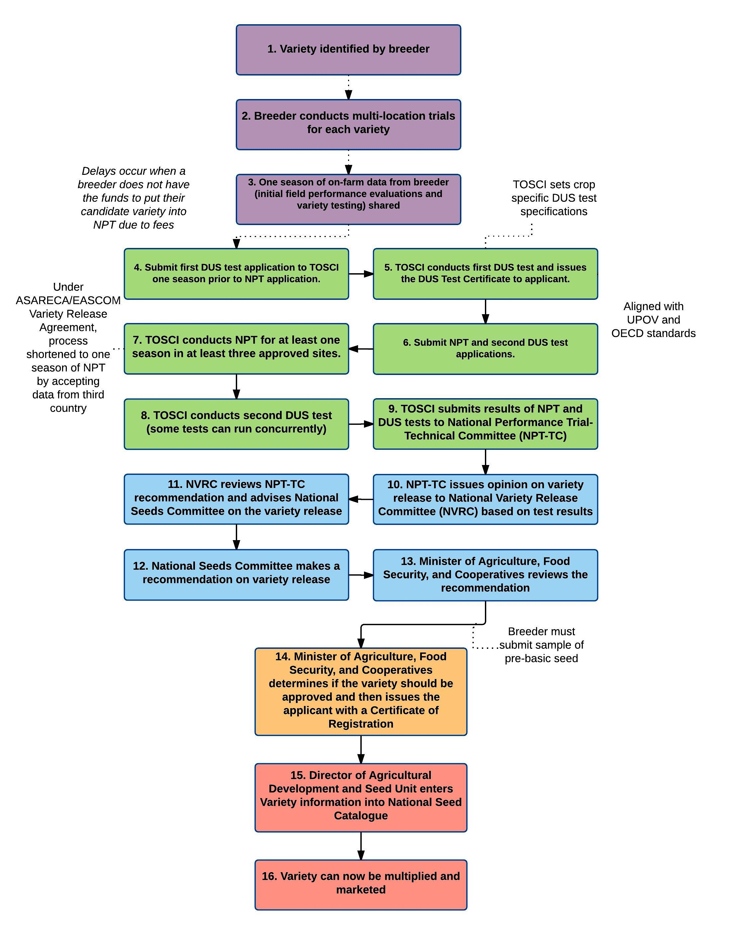
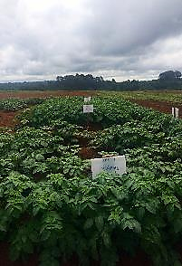
NML Regulatory Systems Map: Seed Variety Release and Registration Process in Tanzania (with SAGCOT/AGRA/USAID)

Slide 10
COMESA Variety Release and Registration Requirements
Notes:
The process for variety release and registration in the COMESA Variety Catalogue is set forth in Chapter 4 of the COMESA Seed Regulations. Within COMESA, ACTESA coordinates regional variety applications. New and existing seed varieties are entered into the COMESA Variety Catalogue provided that certain conditions have been met; requirements fall within three tiers according to the COMESA rules on variety release and registration: (1) new varieties that have not been registered and released in any COMESA country; (2) a variety that was registered and released in one COMESA country prior to launch of the COMESA Variety Catalogue in 2015; and (3) varieties that were registered and released in at least two COMESA countries prior to launch of the COMESA Variety Catalogue in 2015.
In all cases, varieties must show proof of satisfactory testing for:
Distinctness, Uniformity, and Stability (DUS) in accordance with the guidelines of the Union for the Protection of New Varieties (UPOV); and
Value for Cultivation or Use (VCU) or National Performance Tests (NPT).
New varieties (tier 1) must show results of two seasons of testing for both DUS and VCU and proof of release and registration in two COMESA Member States. Registration applications for new varieties must also include the suggested variety name (or “denomination”) and a reference sample provided to the relevant National Seed Authority. National Seed Authorities may set minimum requirements for: germination, species and analytical purity, health, and moisture content of seed submitted as a reference sample.
Varieties that have been registered and released in one COMESA Member State (tier 2) are eligible for an expedited or “fast track” process, where only one season of DUS and VCU testing is required (confirmation test), along with DUS and VCU information from the original Member State. Proof of release in a second Member State is also required.
If a variety has already been registered and released in at least two COMESA Member States (tier 3), no additional testing is required, and an application can be made for immediate entry in the COMESA Variety Catalogue, provided that the application contains the necessary DUS and VCU data. Table 2 below provides a comparison of each process.

Slide 11
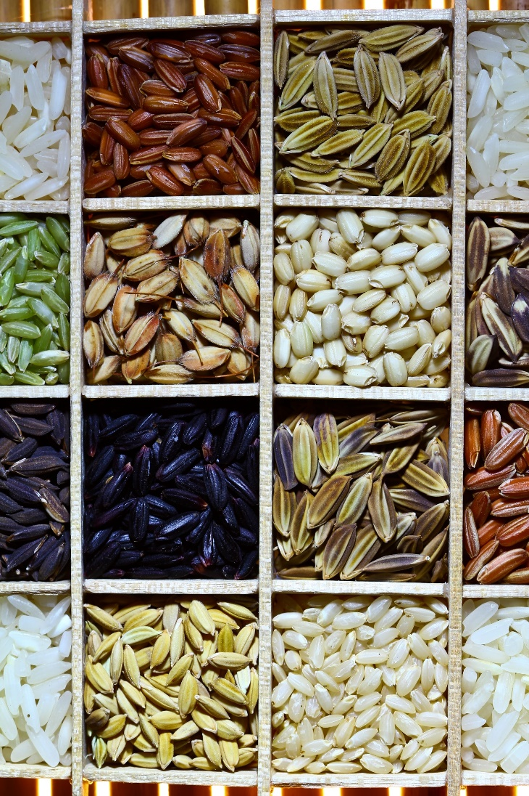
IP Licensing - Background
A licensing agreement is essentially a contract between two entities, or “parties”
Licensing allows for the transfer of technology from the inventor to the user, while still maintaining control of how the variety is used
Why enter into a licensing agreement?
If you are a seed company…?
If you are a research institute…?
This Photo by Unknown Author is licensed under CC BY-SA-NC

Slide 12
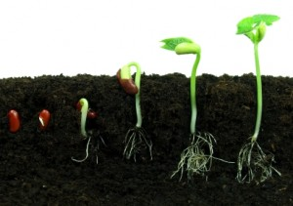
IP Licensing – Rationales
Transfer seed technology and increase opportunities for commercialization
Improve farmer access to diverse, high quality seed varieties
Allow variety owners the option to try new geographical markets with relatively low upfront risk
Provide possible source of funding for public research institutions
This Photo by Unknown Author is licensed under CC BY
This Photo by Unknown Author is licensed under CC BY-NC-ND

Slide 13
Contractual Considerations
The specific terms, or parts, of the licensing agreement depend upon the international, regional, and national legal frameworks of the relevant country
The legal/regulatory framework:
Impacts the strategies the licensor/licensee chooses to protect the variety
Governs should there be a dispute or breach of rights
Some countries in Africa follow a common law system and others a civil law system
Some common practices exist in both systems, like the need to agree upon and carefully defining terms contained in the contract; this kind of information should be reflected in a licensing agreement (typically in the introductory section)
However, there are key differences between the two systems is that in a civil law system defines a greater number of contractual terms by law (contracts are shorter as a result), while common law systems allow more freedom for the contracting parties to define their own terms

Slide 14
IP Licensing – Elements of a Licensing Agreement
Definitions (Parties, Terms, etc.)
License Type/Exclusivity
Territory/Scope
Compensation/Royalties
Termination and Dispute Resolution
Other Considerations
Sublicensing
Reporting
Flexible Clauses
Compulsory Licensing
This Photo by Unknown Author is licensed under CC BY-NC-ND

Slide 15
Elements of a Licensing Agreement - Exclusivity
Three Types of Licensing Agreements:
Exclusive
LICENSOR grants to the LICENSEE the exclusive and non‑transferable right to produce, market and sell seed of the following crop variety(ies) in [Insert Territory]
Limited Exclusivity
LICENSOR grants to the LICENSEE the exclusive and non-transferable right to produce, market, and sell seed of the following crop variety(ies) in [Insert Territory] for a period of [insert time limit].
Non-Exclusive
LICENSOR grants to the LICENSEE the non-exclusive and non‑transferable right to produce, market and sell seed of the following crop variety(ies) in [Insert Territory]. The licensor remains free to exploit the same IP and allow any number of other licensees to exploit the same.
Example: KALRO – Kisima Farms Case Study (non-exclusive license)

Slide 16
Case Study – KALRO and Kisima Farms
Agreement to license potato seeds in Kenya
National research institute (KALRO) had been doing licensing agreements for years, but with no royalties
KALRO wanted to find a way to get its research out onto the market, while also increasing access to quality seed
Seed company (Kisima) wanted to make the latest variety of seeds available to its customers
Solution: Non-exclusive license with royalties and smallholder-friendly provisions
Takeaway: Well-designed licensing agreements can help public breeders and research institutions generate needed revenue through royalties, while holding true to public purpose and expanding access to seed

Slide 17
Elements of a Licensing Agreement – Exclusivity Cont’d
Another element of exclusivity is defining the material to be licensed
Depends upon several factors and interests of both the licensor/licensee (experience, market viability, existing portfolios, and work with other breeders)
For seed, the material usually falls within three main categories:
Single varieties
Selected crops/species
All varieties

Slide 18
Elements of a Licensing Agreement - Territory/Scope
Territory defines where the seed can be commercialized/sold
“This License is granted for the territory of [location, region, etc.]”
Most often the territory will be a country, but it could also be a region
Regional scope might be desirable in locations with well harmonized rules on PVP
Duration of the contract is also part of scope – how long will the licensing agreement last?
Factors to consider: length of time it takes to negotiate, the type of crop covered, level of exclusivity
Note: Longer contract terms may mean less flexibility to renegotiate royalty prices

Slide 19
Elements of a Licensing Agreement - Royalties
A royalty is the fee a licensee pays the licensor
This can also include fees related to the use of licensed varieties
Should be at an acceptable market rate to ensure both access and profitability
When and How royalties are paid should also be included:
Exact method depends upon needs of particular parties
Payment might specify a date, or it could be more flexible (e.g.: 6 months after the end of the financial year of licensee)
BUT NOTE – National laws may have restrictions on when and how royalties can be paid (e.g.: for farm saved seed)

Slide 20
Elements of a Licensing Agreement – Royalties Cont’d
Royalties are typically done on a case-by-case basis, but there are some “models” or “formulas”
Fixed royalty rate
Royalties connected to seed price
Minimum royalty rate
Royalty intervals and sold quantities
Multiplication acreage and end-point royalties
Example: In the case study example (KALRO – Kisima Farms), there was a fixed royalty rate that was a percentage of the yearly seed sales

Slide 21
Elements of a Licensing Agreement - Termination
This part of the licensing agreement outlines what happens: 1) when the contract “naturally” terminates, and 2) if there are any events that would trigger termination (e.g.: a breach of contract)
Example: The KARLO-Kisima Farm case study contains both types of provisions
How to renew the contract should also appear here (upon mutual agreement by the parties, automatic renewal, or other)
Additionally, the agreement should include a provision on the process for resolving any dispute should there be a breach of contract. This should include:
The governing law/jurisdiction
Example: This agreement shall be subject to the laws of Kenya.
The method for resolving disputes
Will there be arbitration?
A set period of mediation?
Will the parties use the local court system of the governing legal system?

Slide 22
Elements of a Licensing Agreement - Other Considerations
Sublicensing occurs when the original breeder has licensed out its seed but then the licensee wants to transfer that right to another company
Example: an original exclusive right with granting of a “right of first refusal” to license
Reporting to Licensor is a way for the licensor to check in on the progress for commercialization
“Use it or lose it” clauses make sure that the variety licensed is marketed by the licensee
Policy Notes
Smallholder friendly clauses:
Waiver of rights to collect smallholder licensing fees
Agreement to make a majority percentage of the seed produced available to third parties
Agreement to establish smaller seed pack sizes
Gender - How to ensure that seed is made available to women growers?

Slide 23
Elements of a licensing agreement – Compulsory Licensing
Under certain circumstances including public interest (enumerated in PVP laws), government authorities may grant a compulsory license
These are non-assignable and non-exclusive
Except in cases of national emergency, the proposed licensee must have made efforts to obtain the license voluntarily under reasonable commercial terms
The rights holder must receive equitable remuneration
A compulsory license is traditionally perceived, under certain conditions, to counterbalance the exclusive rights of the IP holder, but it could also be a way of ensuring farmers’ access to new, important, and improved varieties
The scope and duration of the license will be limited to the public interest reasons for which it was authorized

Slide 24
Questions to Consider
What kind of licensing model best suits the needs of the parties?
What are your “must have” provisions?
What kind of crops would you license based on demand and need in the market/territory?
How would you address the main contractual elements:
Exclusivity
Territory/Scope
Royalties
Terminating the Agreement
Evaluate your sample contract for its sensitivity to some of the policy considerations, e.g. gender, smallholder farmers (for example, would you waive the right to collect smallholder licensing fees? Adjust packaging size?)
How would you propose to resolve potential disputes?
This Photo by Unknown Author is licensed under CC BY

Slide 25
Contact Us
Katrin Kuhlmann, President and Founder, New Markets Lab (kkuhlmann@newmarketslab.org)
Senior Legal Fellow in East Africa Adron Naggayi Nalinya (analinya@newmarketslab.org)
For additional information, please email us at mail@newmarketslab.org or visit our website at www.newmarketslab.org

