Slide 1
Demand-Led Breeding
Introduction
Dr Viv Anthony
EIAR, Addis Ababa - 2 May 2019

Slide 2
Overview
Introduction
Comparative approaches to new variety design
Development of Demand-Led Breeding
Some reflections
DLB team and sessions

Slide 3
Why are we here?
Ethiopia is progressive and changing ......
  Food supply and demand challenge
  100+ million people
  Food and nutrition insecurity
  36 million ha agricultural land
  Diverse range important crops
Strong focus on crop improvement
Large community of Ethiopian plant breeders

Slide 4
Why are we here?
Ethiopia is progressive and changing ......
  The opportunity
  Domestic markets growing
  Understand export markets →
  Unique commodity exchange
  Magnet for investment
  Farmers need access to quality, affordable seed
  Private seed organisations want to enter
  but need contacts, knowledge and access to locally adapted public varieties with commercial potential

Slide 5
Plant breeders can make a difference
  Crop productivity, quality and nutrition, resilience to climate change, food security and livelihoods of smallholder farmers
  But doing more of the same is unlikely to keep pace with...
  1. The accelerating demand for food
  2. The need for varieties with commercial potential to
  support emerging businesses
New thinking and approaches are needed

Slide 6
Product innovation
Technology focused
innovation
New knowledge
Unique products
Paradigm market shifts
Product looks for a customer
High market failure
(customer acceptance)
Market/demand-led
innovation
Serves customers, markets, unmet demand
Market growth
Fewer paradigm shifts
Much higher success rates

Slide 7
Product innovation
Technology-focused
innovation
New knowledge
Novel products
Paradigm market shifts
Product looks for a customer
High market failure
(customer acceptance)
Market/demand-led
innovation
Serves customers, markets, unmet demand
Market growth
Fewer paradigm shifts
Much higher success rates
What is the right balance?

Slide 8
Genome sequencing revolution
500+
2002
2004
2006
2008
2010
2012
2014
2019
Year

Slide 9


Crop breeding evolution
Large-scale
sequencing
Genome editing
12
10
Biotechnology
US corn grain yield (t/ha)
8
Hybridisation
Inbreeding
6
Marker-assisted breeding
“Traditional
breeding”
4
2
Selections,
Crossings
Hybrid
vigour
Gene discovery
Gene insertion
Generation of traits
by gene editing
1940
1980
2020
2060

Slide 10
Supply-led
“Science and technology push”
Plant
breeders
Seed
producers
Farmers
Consumers
Seed
Distributors
Traders
Whole-salers
Markets
Retailers
Consumers
Processors

Slide 11
Demand-led
Plant
breeders
Seed
producers
Farmers
Consumers
Seed
Distributors
Traders
Whole-salers
Markets
Retailers
Consumers
Processors
“Market pull”

Slide 12
Demand-led
Plant
breeders
Seed
producers
Farmers
Consumers
Seed
Distributors
Traders
Whole-salers
Markets
Retailers
Consumers
Processors
“Market pull”

Slide 13
Demand-led
Plant
breeders
Seed
producers
Farmers
Consumers
Seed
Distributors
Traders
Whole-salers
Markets
Retailers
Consumers
Processors
High variety use
“Market pull”

Slide 14
Demand-led breeding
How to accelerate modern improved variety adoption?
What drives variety use?
Private sector seed companies thrive or fail
by desiging and selling new varieties that customers want
Swiss-Australian-African public-private collaboration
formed in 2014
To identify and encourage best practices in variety design
to acclerate the use of improved varieties in SSA
The term ‘Demand-Led Breeding’ was created within
this partnership

Slide 15













Swiss-Australian-African collaboration
African partners
Biosciences Eastern and Central Africa, Kenya (BecA/ILRI)
African crop improvement centre, South Africa (ACCI)
West African crop improvement centre Ghana (WACCI)
University of Makerere, and Ruforum, Uganda
University of Nairobi, Kenya
CIAT/Pabra Tanzania, Malawi
Rwanda Agriculture Board
ASARECA

Slide 16




Swiss-Australian-African collaboration
International partners
Syngenta Foundation for Sustainable Agriculture (SFSA)
Australian International Food Security Research Centre (AIFSRC/ACIAR)
Crawford Fund (CF)
University of Queensland (UQ)
African R&D partners

Slide 17
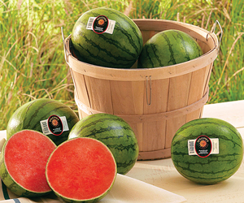
Reflections - 1
Innovative varieties can change and create markets
When provide major benefits for farmers, the value chain
and/or consumers
Consumer preferences
Seedless
1.5-2kgs, family size
Transport and storage
Grew watermelon market
New market segment
‘Pureheart’ personalised
watermelon (USA)

Slide 18
Reflections - 2
Development of ‘Supersweet’ pineapple rapidly took major share of global pineapple market
Farmers buy varieties that are reliable, perform, taste good and they can sell – they do not buy for specific traits on their own
Trait-driven research programmes often overlook the key importance of other buying drivers
Quality and taste characteristics are usually very difficult to introgress late in a breeding programme

Slide 19
Reflections - 3
Long-term agricultural productivity is dependent on smallholder farmers having access to seed, inputs, credit and markets
Occurs when markets and private businesses flourish ...not from intermittent government or philanthropic interventions
Emergence and rapidly growing Indian vegetable seed industry
Indian SMES started-up by accessing public varieties that markets wanted
- insufficient resources to invest in breeding
- need year-round cash flow = portfolio of crops and varieties
Successful start-up businesses require a supportive enabling environment

Slide 20
Demand-led crop variety design for emerging markets in Africa
Core principles and best practice are from both public and private sectors
Continuing professional development module for plant breeders and crop improvement teams
Post-graduate education programmes– MSc/PhD

Slide 21
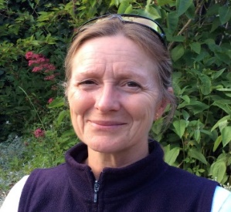
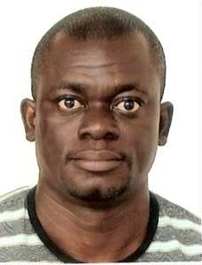



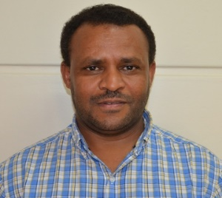
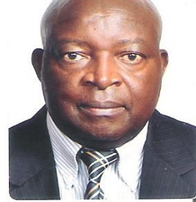
Demand-led team
Dr V Anthony
Dr N Yao
Dr JC Rubyogo
Prof. P Kimani
Uni Nairobi
Kenya
Prof G. Persley
Prof. S Hussein
Dr R Chirwa
Syngenta Foundation
Uni Queensland
BecA, Kenya
ACCI, SAfrica
CIAT Tanzania,
Malawi

Slide 22
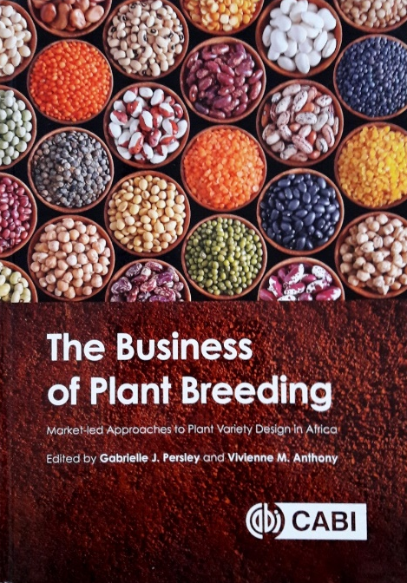
Demand-led programme content
1. Principles of demand-led breeding
2. Visioning and foresight
3. Clients’ needs and value chains
4. Variety design
5. Development strategy and planning
6. Breeding investment decision-making
7. Monitoring, evaluation and learning

Slide 23
Sharing experiences
This is the first time these concepts have been explored at an Institutional level with a leading African NARS management team and senior breeders
Very pleased to have this opportunity with you, discussing our experiences and learning from yours

Slide 24
Thank you

Slide 25



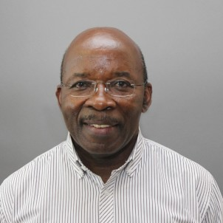

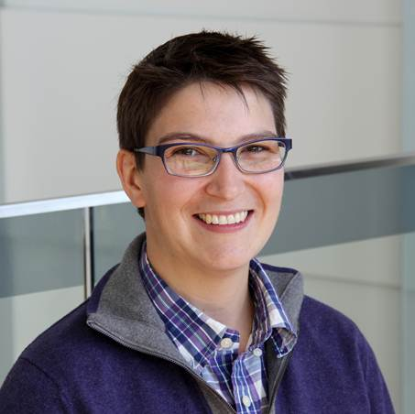

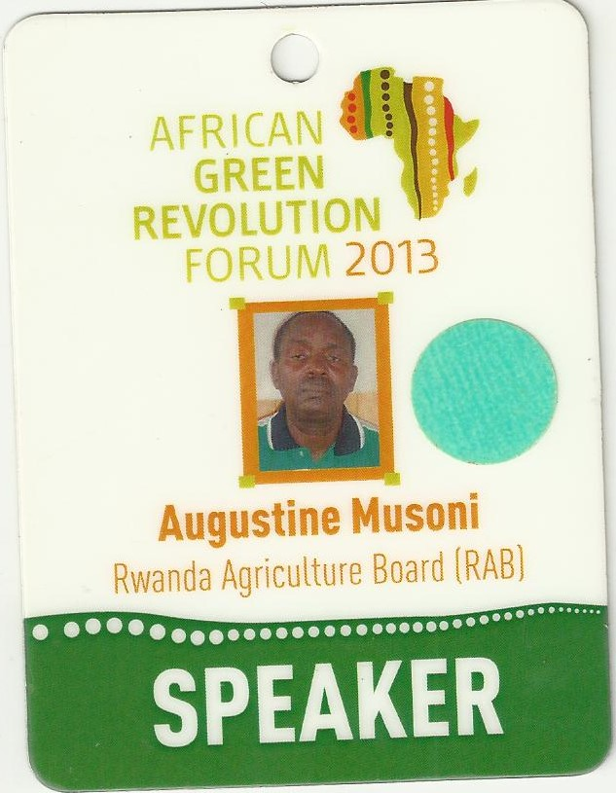
DLB leadership team
Dr V Anthony
Prof. E Danquah
Prof. A Dijking
Dr JC Rubyogo
Prof. R Edema
Prof G. Persley
Prof. P Tongoona
Dr N Yao
Dr R Chirwa
Prof. P Gibson
Dr H. Merk
Prof. S Hussein
Mr A Musoni
Prof. P Kimani
Dr A Danquah
SFSA
Uni Queensland
WACCI
Uni Ghana
BecA, Kenya
ACCI, SA
CIAT Tanzania,
Malawi
RAB Rwanda
Uni Nairobi
Makerere
Uganda

