Slide 1
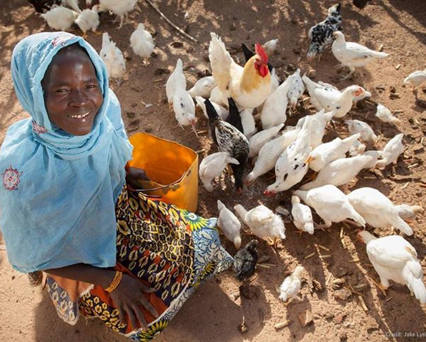
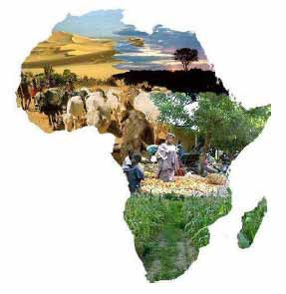

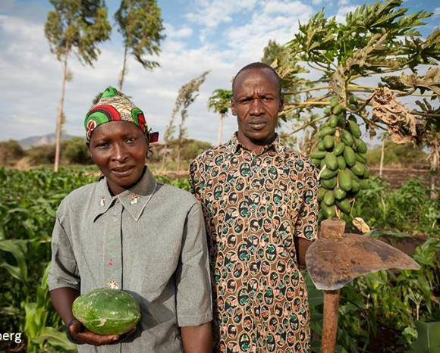




Update from the questionnaire survey on variety promotion: Lessons learnt and way forward
Nasser Yao
Scientist, Molecular Breeder
BecA-ILRI Hub, Nairobi, Kenya
http://hub.africabiosciences.org/
DLB phase 2 core team meeting
ILRI Campus, Addis Ababa, Ethiopia
29-30 April, 2019

Slide 2
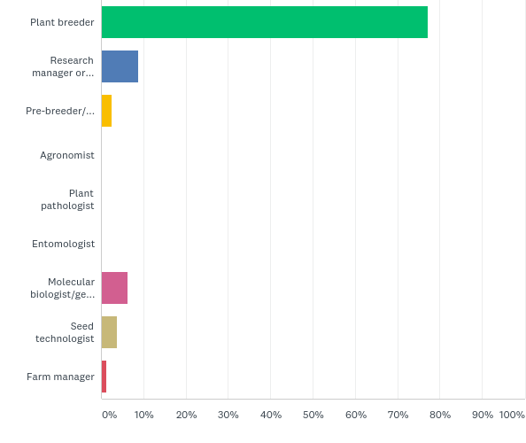
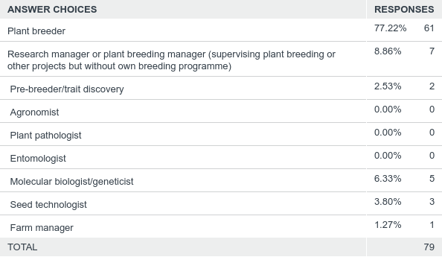
Who are the DLB alumini

Slide 3
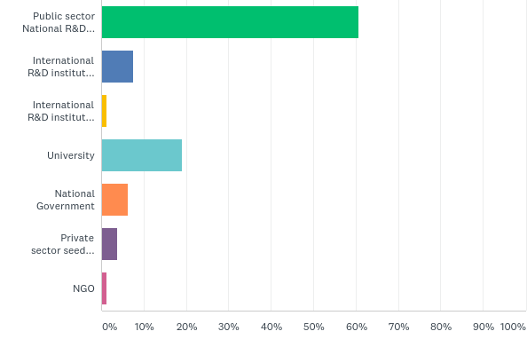
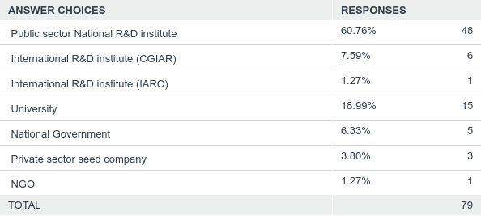
Where are they working

Slide 4
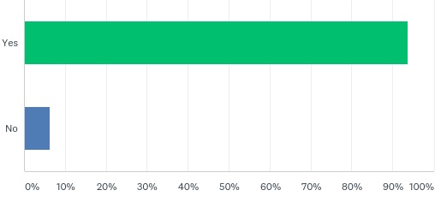
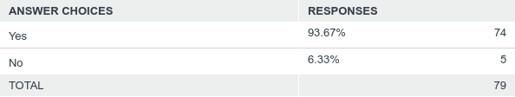
Do they want to be contacted by the DLB team or other DLB representatives to follow up on answers and/or have further discussion with them?

Slide 5
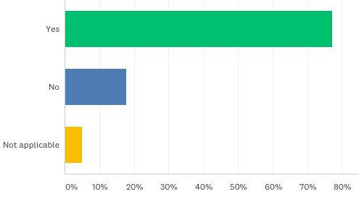
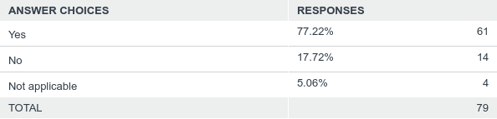
Have they bred, developed lines (for NARS) or been involved with a crop improvement programme or release of a new crop variety for use by farmers in your country in the last 10 years?

Slide 6
Number of Variety released or expected to be released each year from 2010-2025 and in each calendar
Total number of varieties from 2010-2025= 208

Slide 7
Number of Variety released or expected to be released from 2010-2025 per COUNTRY

Slide 8
Number of Variety released or expected to be released from 2010-2025 per CROP

Slide 9
Number of advanced lines to ENTER variety release process (national Variety release trials) in the next 3-5 years

Slide 10
Number of advanced lines to ENTER variety release process (national Variety release trials) in the next 3-5 years per COUNTRY

Slide 11
Year expected to ENTER National variety release and year of release expected

Slide 12
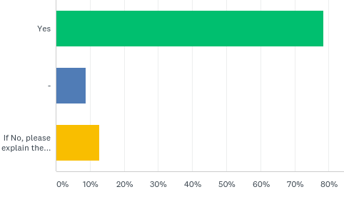
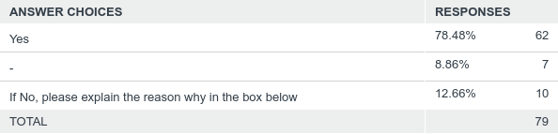
Have they characterised the beneficial characteristics or traits their variety(ies) offers compared with existing germplasm, landraces or varieties grown by farmers?
Answered: 79 Skipped: 15

Slide 13
List of key beneficial traits or performance characteristics of the characterized varieties

Slide 14
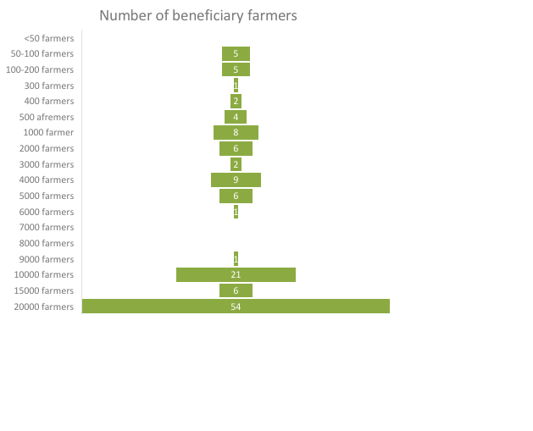
Who their designed variety(ies) will serve, number and potential users and beneficiaries of the variety(ies).
Number of Regions in the countries where the varieties can be used 82

Slide 15
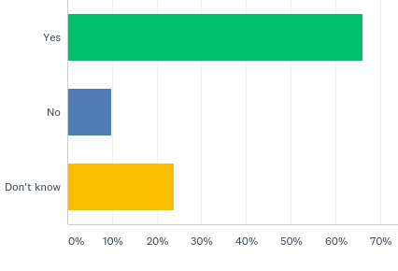
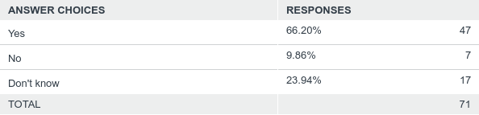
Do any of their varieties/advanced lines have the potential for use by farmers in other countries in Africa?
Answered: 71 Skipped: 23

Slide 16
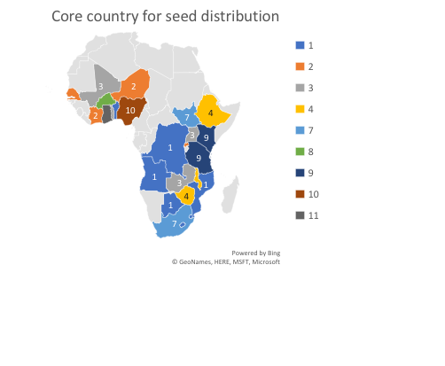
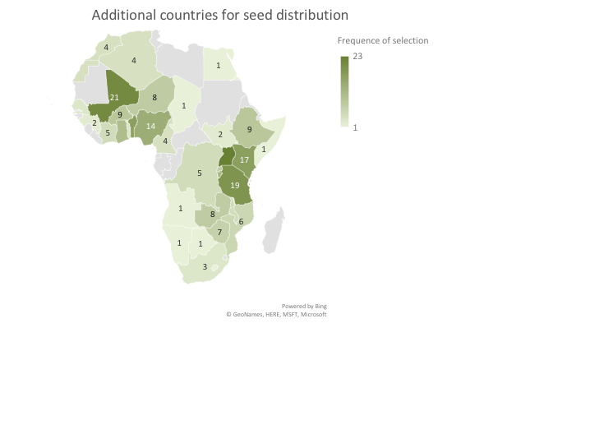
Core and additional countries for seed distribution

Slide 17
Licensing framework

Slide 18
Licensing framework

Slide 19
Scaling up strategy status

Slide 20
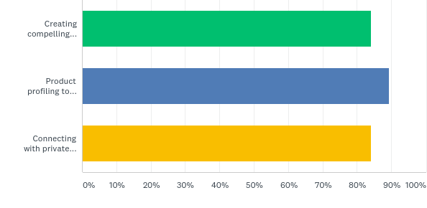
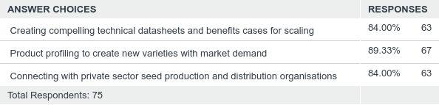
Would they like to take part in the DLB phase 2 programme to the activities below?

Slide 21
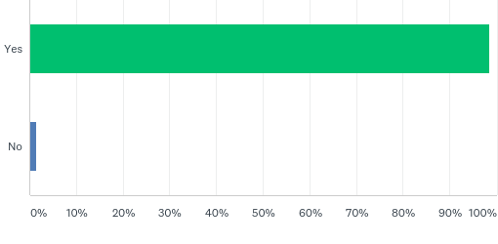
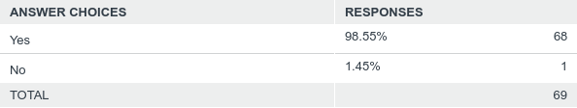
Would They be interested to participate further in a skills-based questionnaire within the next few months on continuing professional development for breeders and related crop improvement disciplines that will inform the development of a training curriculum?

