Slide 1
DLB in Ethiopia
Firew, Berhanu, Shimelis, Nasser

Slide 2
Showcasing DLB in National, Regional and International fora

Slide 3
1. Plant Breeders training in Ethiopia
Host: EIAR
DLB in variety development and commercialization
Number of participants: 25

Slide 4
Origin of the trainees:
  Regional Research Institute
  Federal Research Institute

Slide 5
Crop types of the trainees:
  Cereals
  Pulses
  Fruits
  Coffee
  Spices
  Vegetables
  Oil Crops
Time: May 22, 2018

Slide 6
2. Demand-led plant breeding approaches for enhancing variety adoption and commercialization in Ethiopia
Host: Amharic Agricultural Research Institute
Keynote speaker: Demand creation for DLB
Audience: 423
Participants: research, extension, development and academia

Slide 7
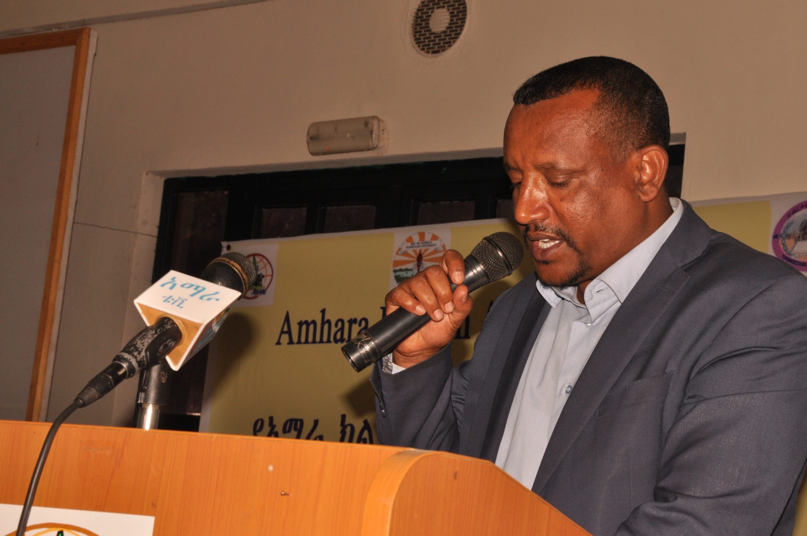

Slide 8
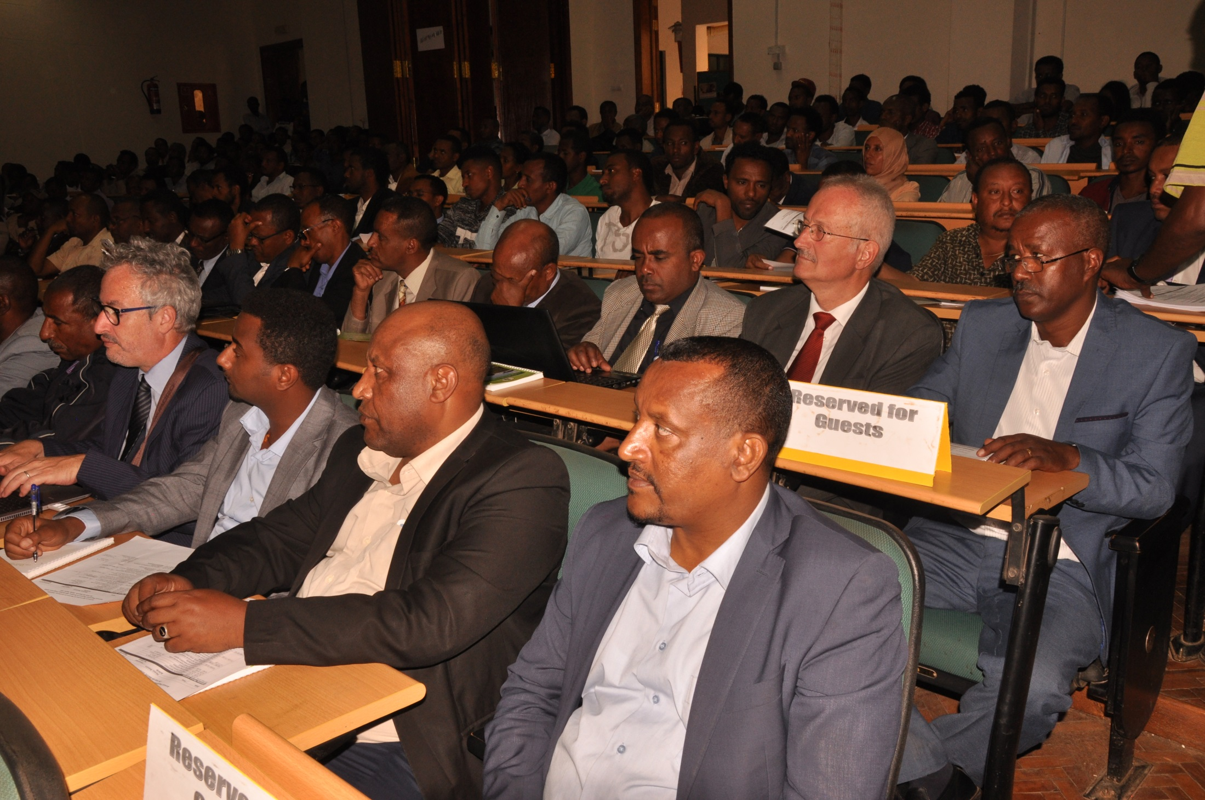

Slide 9
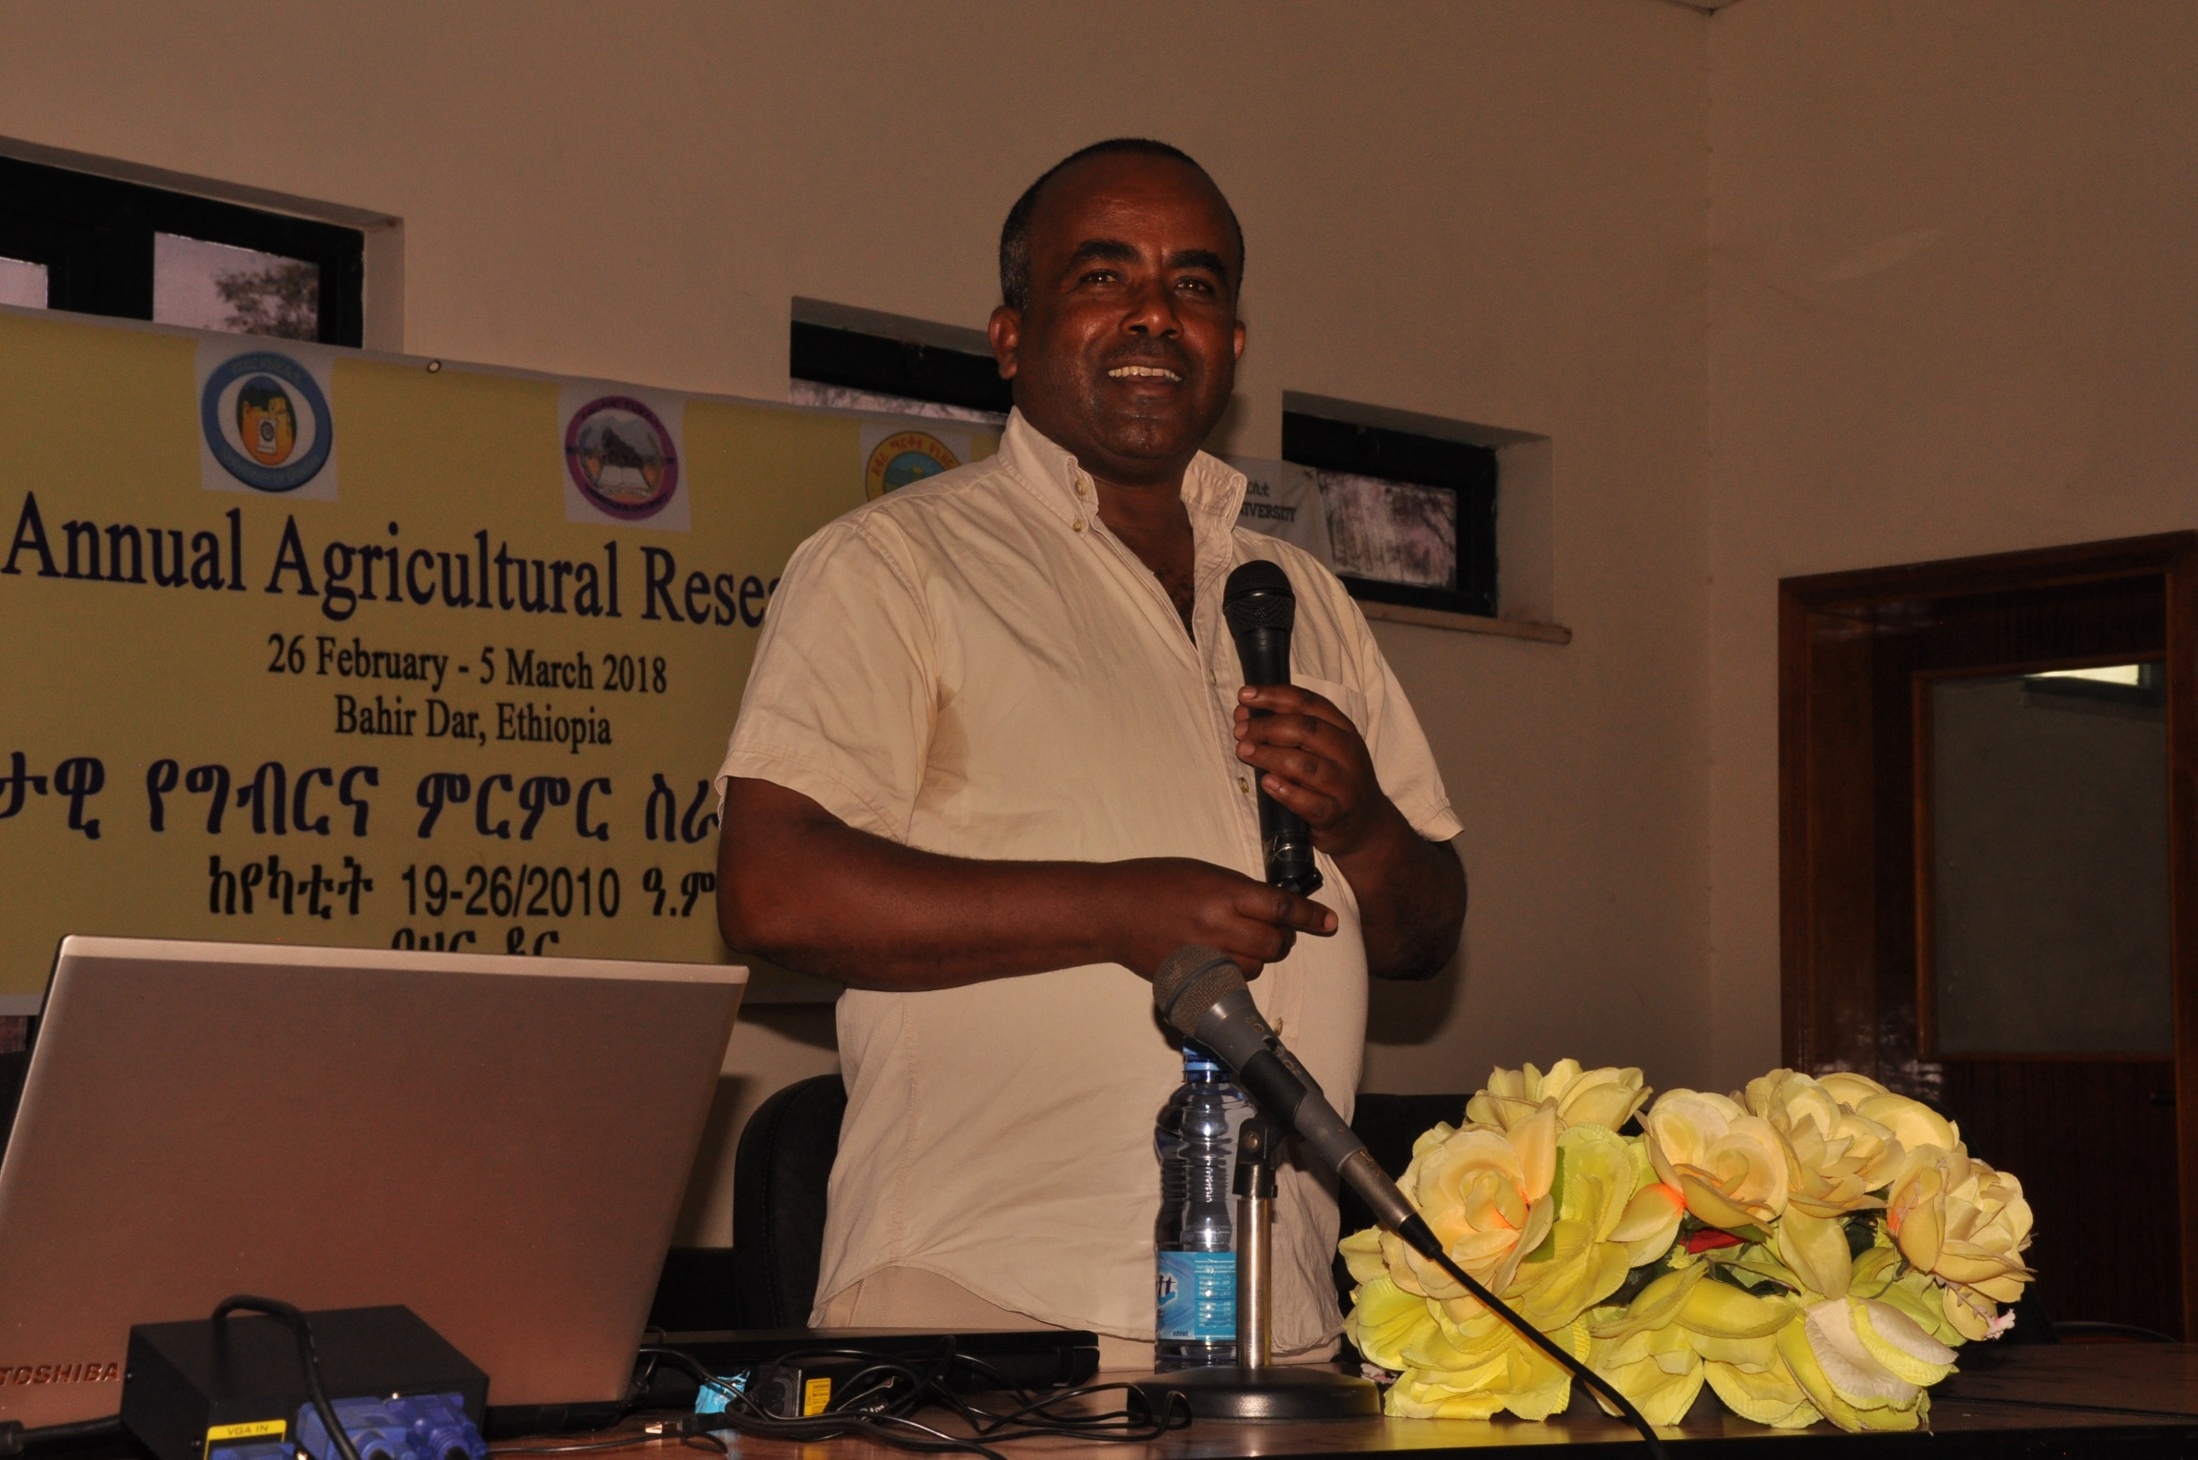

Slide 10
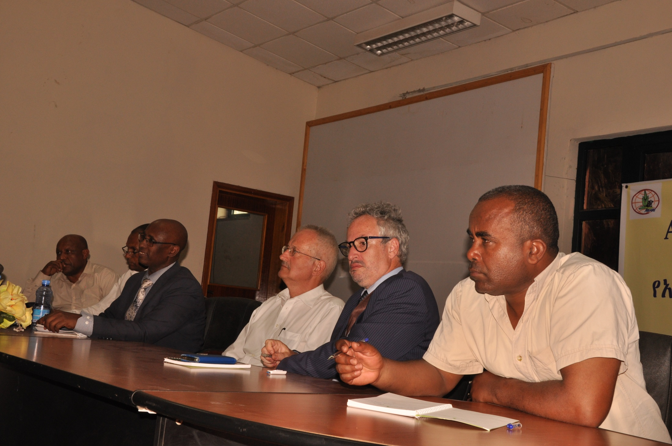

Slide 11
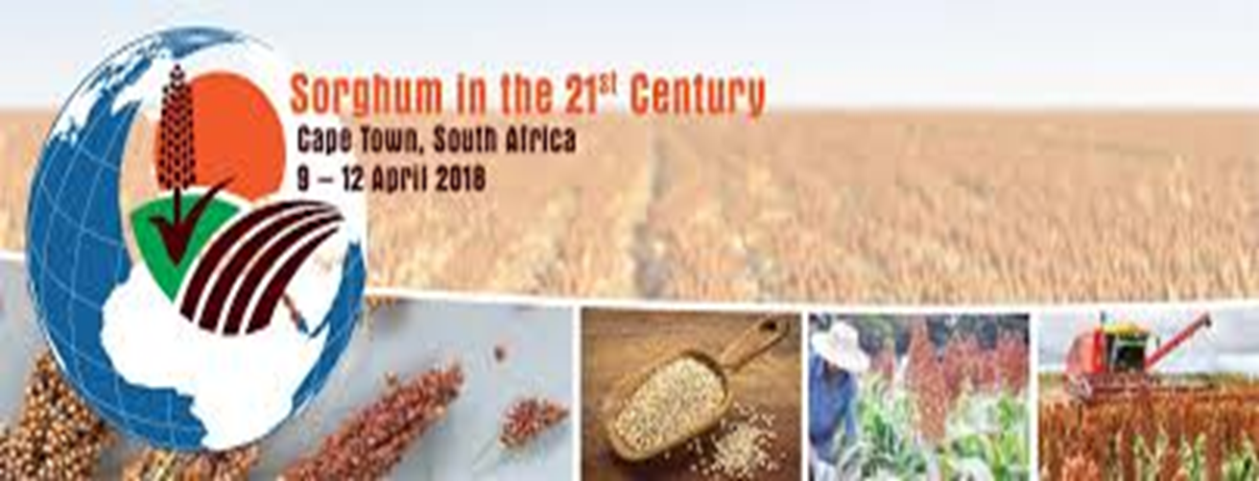
3. World Sorghum Conference

Slide 12
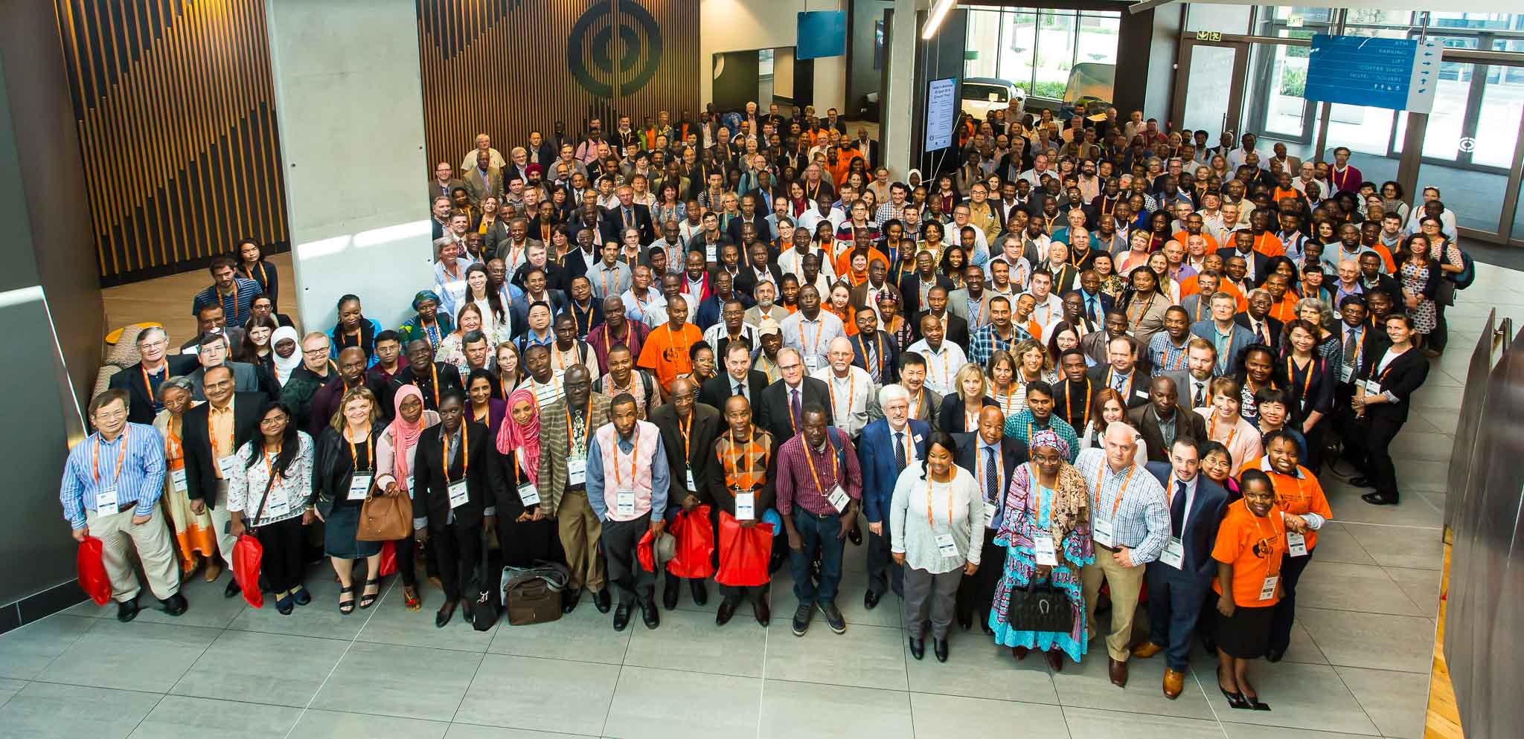

Slide 13
Enhancing Sorghum Research and Development System in Africa through Collaboration: The Case of Ethiopia
April 9-12, Sorghum in the 21st Century Cape town, South Africa
Jordan, D., Dalton T., Ejeta, G.,Tesso T., Mengsite T., Awika J., Kebede Y., Abegaz K., Tirfessa A., Nida H. Ayana G., Seyoum A., Nega, A., Gebreyohannes, A, Tessema T, Tadesse T. Bante, K; Alemnesh B etc., Mekbib F.

Slide 14
Justifying the need for DLB in Sorghum

Slide 15
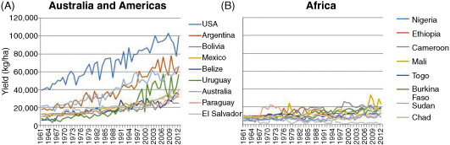
Sorghum Yield in Africa has not improved much over 40 years

Slide 16
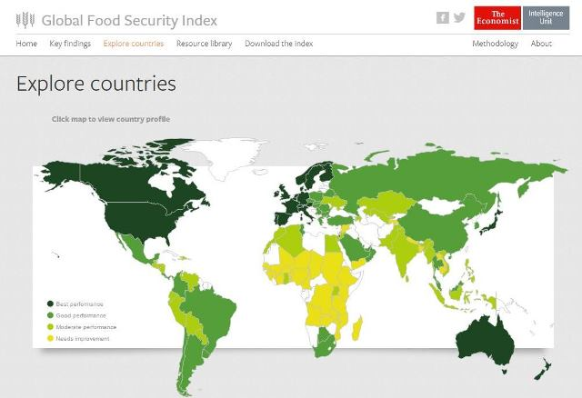
Africa is the main food insecured continent in the world-sorghum is one of the strategic crop

Slide 17
Can sub-Saharan Africa (SSA) feed itself?
Martin K. van Ittersum et al. 2016. PNAS. 113 (52) 14964-14 969
Can sub-Saharan Africa (SSA) feed the world?

Slide 18
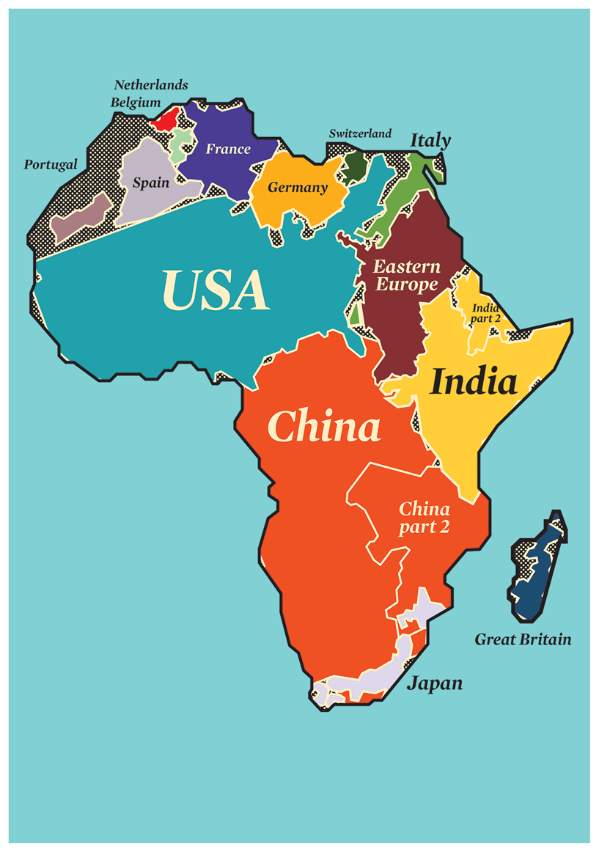
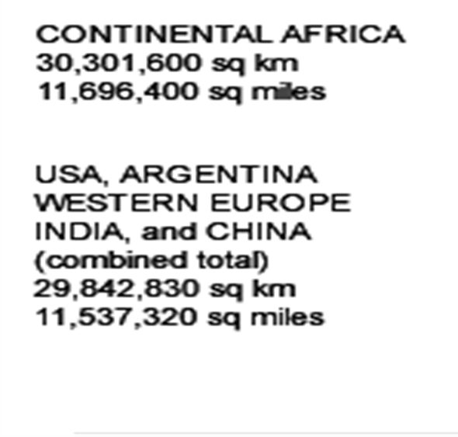
Africa Might Feed the World
Africa holds 60% of the world's uncultivated land. ... FAO

Slide 19
What are the way outs for Africa ?
Collaboration and partnership can be one of the many solutions
Showcasing collaboration to enhance sorghum R&D in Africa

Slide 20
DLB: Impact Oriented Research Strategy
(Product concept in variety development)

Slide 21
Variety development is the deriver of the value chain
Variety Development
Research and Technology
Inputs production and supply
On farm production
Postharvest Processing
Market access and growth
Inputs distribution

Slide 22
What is the level of adoption of modern varieties in SSA?
Diffusion and Impact of Improved Varieties in Africa (DIIVA) project [Walker et al., 2014]
30 countries, 20 crops, 1150 varieties
< 35% modern variety adoption

Slide 23
Crop | Country observations | Total area (ha) | Adopted area (ha) | % MVs
Soybean | 14 | 1,185,306 | 1,041,923 | 89.7
Maize–WCA | 11 | 9,972,479 | 6,556,762 | 65.7
Wheat | 1 | 1,453,820 | 850,121 | 62.5
Pigeonpea | 3 | 365,901 | 182,452 | 49.9
Maize–ESA | 9 | 14,695,862 | 6,470,405 | 44.0
Cassava | 17 | 11,035,995 | 4,376,237 | 39.7
Rice | 19 | 6,787,043 | 2,582,317 | 38.0
Potatoes | 5 | 615,737 | 211,772 | 34.4
Barley | 2 | 970,720 | 317,597 | 32.7
Yams | 8 | 4,673,300 | 1,409,309 | 30.2
Groundnut | 10 | 6,356,963 | 1,854,543 | 29.2
Bean | 9 | 2,497,209 | 723,544 | 29.0
Sorghum | 8 | 17,965,926 | 4,927,345 | 27.4
Cowpeas | 18 | 11,471,533 | 3,117,621 | 27.2
Pearl millet | 5 | 14,089,940 | 2,552,121 | 18.1
Chickpea | 3 | 249,632 | 37,438 | 15.0
Faba bean | 2 | 614,606 | 85,806 | 14.0
Lentils | 1 | 94,946 | 9,874 | 10.4
Sweetpotato | 5 | 1,478,086 | 102,143 | 6.9
Banana | 1 | 915,877 | 56,784 | 6.2
Field peas | 1 | 230,749 | 3,461 | 1.5
Total/weighted average | 152 | 107,721,630 | 37,469,577 | 34.78
Diffusion and Impact of Improved Varieties in Africa (DIIVA) project (2014)

Slide 24
Why released varieties of sorghum are not largely adopted in Africa?
Breeders are not considering farmers’ traits in variety development
Weak popularization and demonstration of varieties
The seed sector is not accommodating the released varieties
Some of the crop varieties are not addressing market/consumer needs
There is weak/disconnected market (domestic and international) chains
Varieties are not meeting the needs of the stakeholders across the value chains
Etc.,

Slide 25
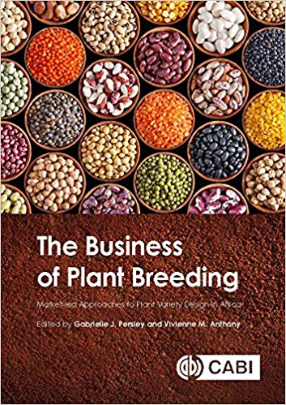

Slide 26
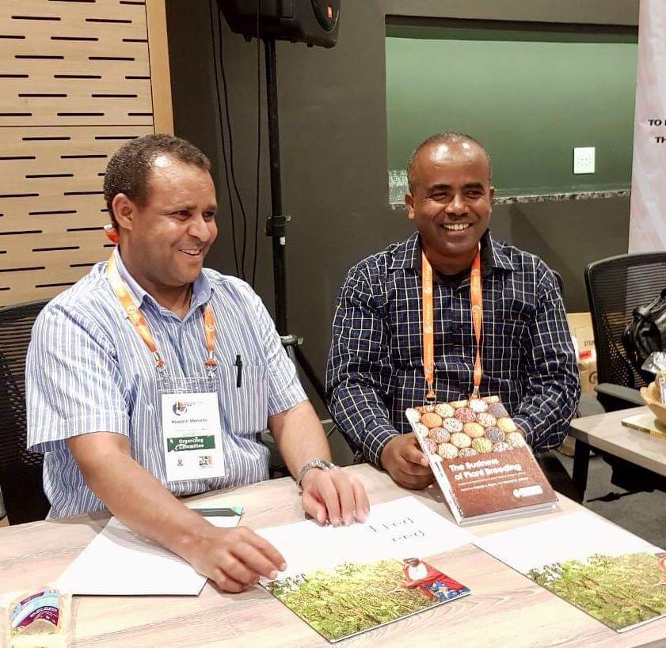
DLB desk in world sorghum conference, Cape Town

Slide 27
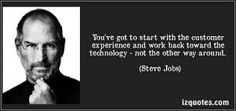
‘You have got to start with the customer experience and work back toward the technology-not the other way around’
Steve Jobs

Slide 28
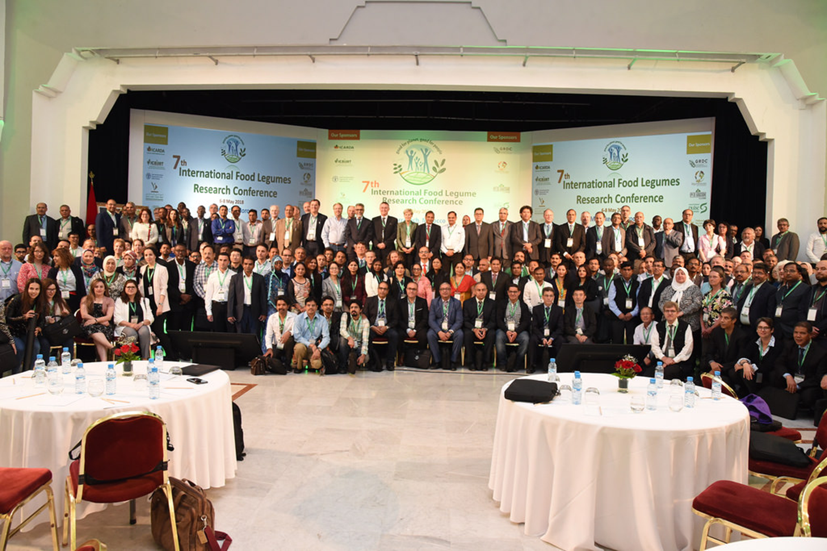
4. International Food Legume Conference

Slide 29
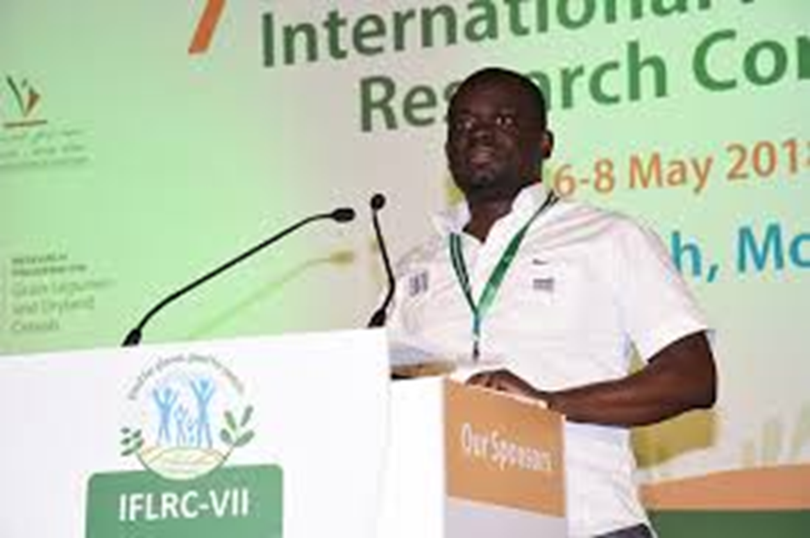

Slide 30
DLB Program in Ethiopia
2018

Slide 31
Resource persons
  Prof. Shimelis Hussein, UKZN
    Dr Nasser Yao, ILRI
    Dr Jaun Claude, CIAT
    Dr Berhanu Fenta, EIAR
    Dr Firew Mekbib, Haramaya University

Slide 32
2. Four tier training scheme
Federal Crop Research Program Leaders and Senior Scientists
Regional Crop Research Program Leaders
Plant breeders (Staff, MSc and PhD students) in the University
Policy makers

Slide 33
Training
Motto: DLB is a NECESSITY not a LUXURY
NARS
(120-150)
All women breeders
+
MoANR
EIAR (20-30)
MoE
Universities
(50)
RBoA
RARI (50)

Slide 34
institutionalization of DLB in Ethiopia

Slide 35
Maize
Common bean
Sorghum
Chickpea
Bread wheat

Slide 36
Example 1: Ethiopian Sorghum product types
Local landraces with Striga resistance and stay green for dry lowlands
Early maturing varieties with acceptable yield, quality and biomass production for dry lowlands
High yielding hybrids with acceptable quality and biomass production for dry lowlands
Long duration OPVs with acceptable grain yield and striga and anthracnose resistance for wet lowlands

Slide 37
Ethiopian Sorghum product types
Local landraces with Striga resistance and stay green for dry lowlands
Early maturing varieties with acceptable yield, quality and biomass production for dry lowlands
High yielding hybrids with acceptable quality and biomass production for dry lowlands
Long duration OPVs with acceptable grain yield and striga and anthracnose resistance for wet lowlands

Slide 38
5. Long duration OPVs with acceptable grain yield and anthracnose resistance for highlands
6. Intermediate maturing OPVs with acceptable grain yield, grain mould and anthracnose resistance for intermediate agro-ecologies with high rainfall

Slide 40
Product Concept 1. Local landraces with Striga resistance and stay green for dry lowlands
Striga pipeline
Inter-cross Pipeline
Stay-green Pipeline
Landraces ~20
x
Striga donors
Landraces ~20
x
stg donors
1
1
F1s
F1s
2
BC1F1
2
BC1F1
BC2F1
BC2F1
3
+
Inter-crossing across backcrossed lines
x
3
+
Inter-crossing across backcrossed lines
BC2F2
BC2F2
BC2F3
IC BC2F1
BC2F3
4
BC2F4
Seed increase and bioassay
IC BC2F2
4
BC2F4
Seed increase
BC2F5
Field testing versus original landrace; 3 locations
IC BC2F3
BC2F5
Field testing versus original landrace; 3 locations
5
IC BC2F4
Seed increase and bioassay
Field testing versus original landrace; 3 locations
IC BC2F5
+ Currently at BC2F2 for ~14 families
This pipeline has a finite life time. Initial introgressions into landraces made in iMashilla will be completed (now at BC2F2) and a small selection of high value landraces that were missed will be started
Marker selection applied

Slide 41
Example 2: Ethiopian Common Bean product types

Slide 42
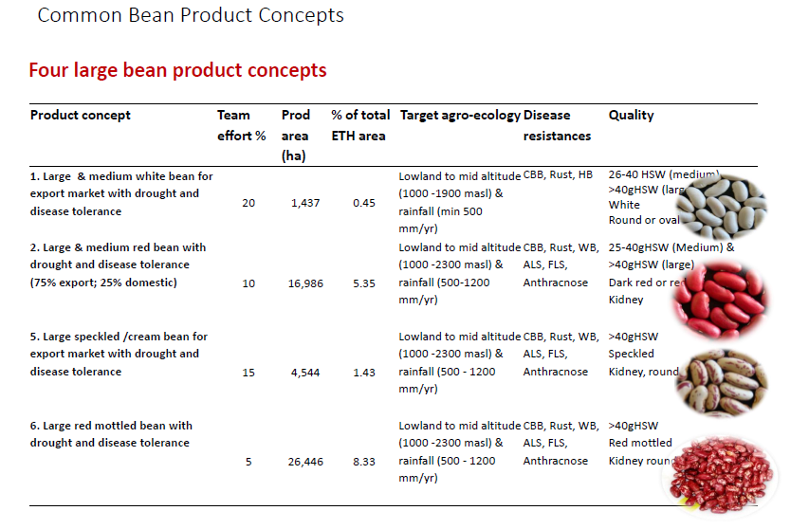

Slide 43
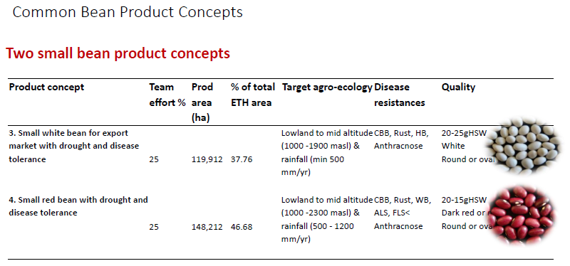

Slide 44
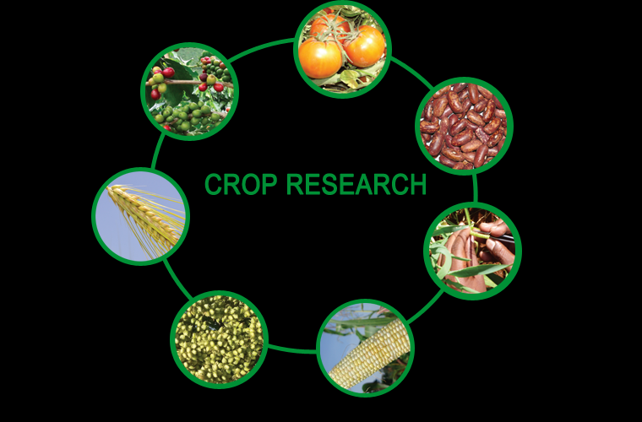
3. Institutionalization of DLB in other Crops Research Programs (32)

Slide 45
4. Institutionalization of DLB in plant breeding curricula
MSc plant breeding
PhD Plant breeding
12 Universities Faculty of Agriculture

Slide 46

Preaching the DLB Gospel

Slide 47
