Slide 1
Advances in Market-oriented Breeding Approaches in Eastern Africa
Paul Kimani,
Dept. of Plant Science and Crop Protection
University of Nairobi, Kenya
DLB Phase Workshop,
Windsor, Nairobi
UNIVERSITY OF NAIROBI

Slide 2
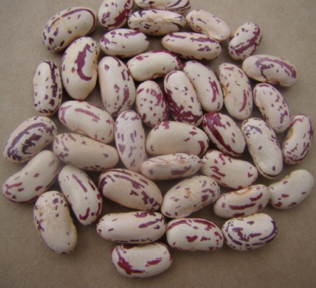
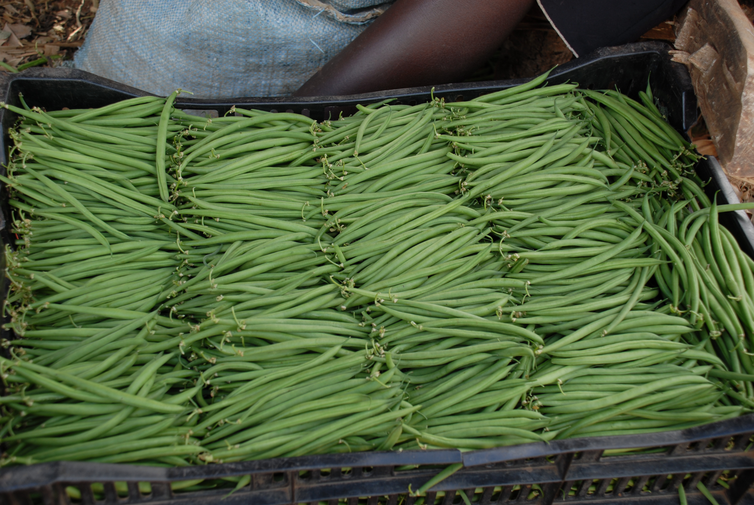
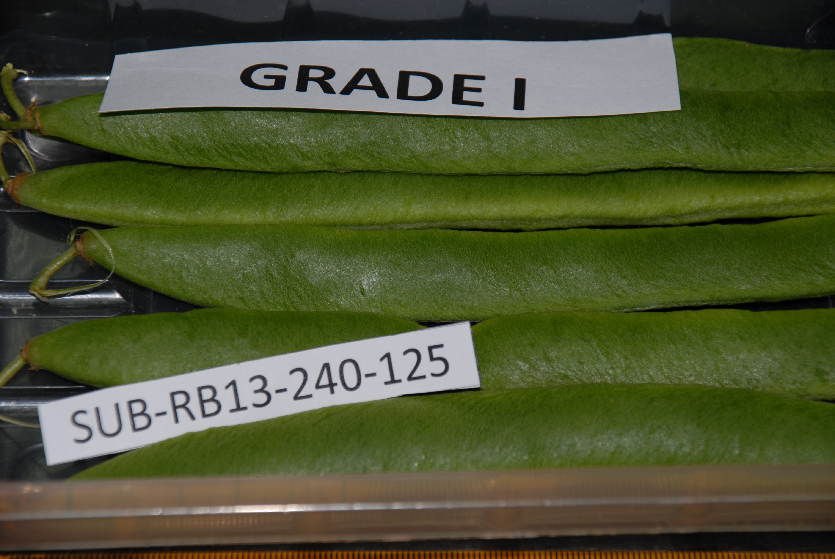
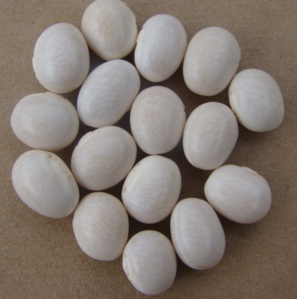
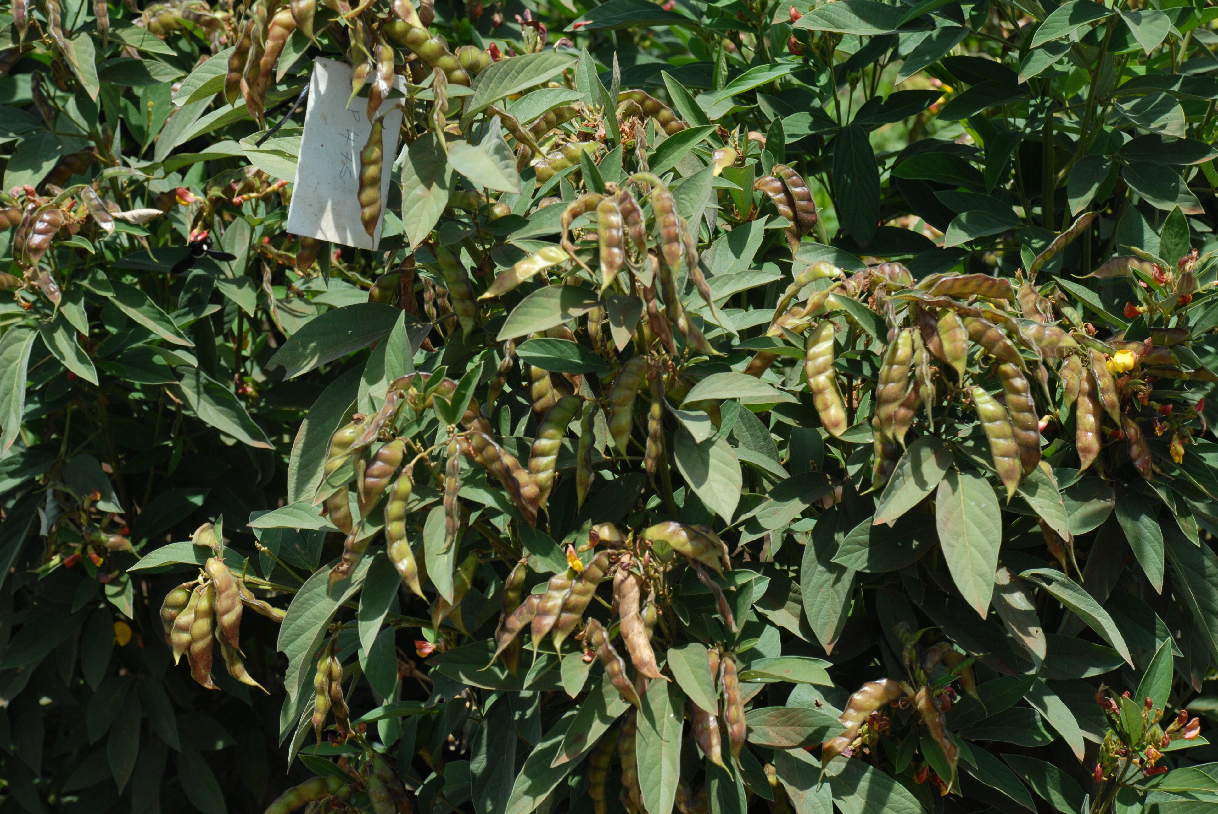
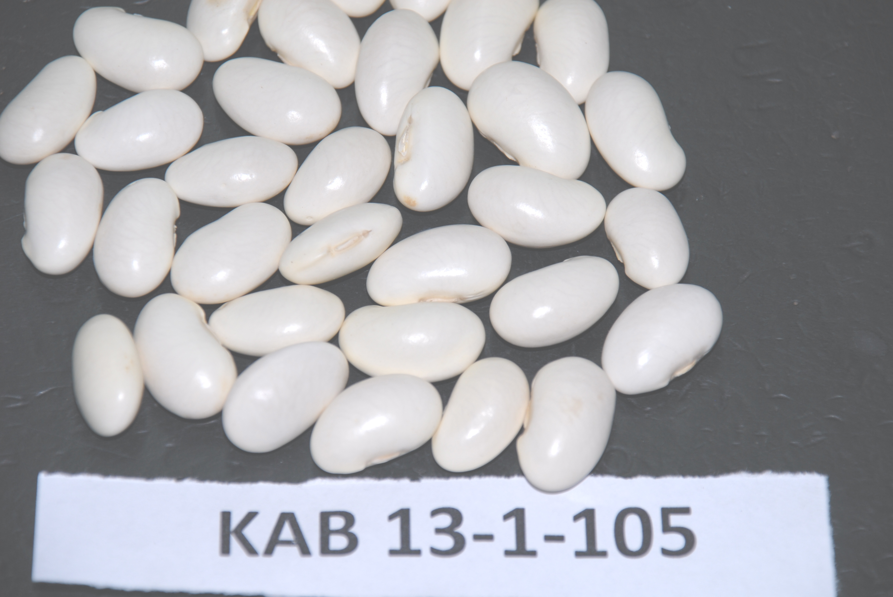
UNISEED KENYA LTD
UNIVERSITY OF NAIROBI
Your preferred supplier of High Quality Certified Breeder Seed for:
Dry beans
Climbing beans
Biofortified beans-iron and zinc rich
Canning beans
Vegetable runner (butter) beans
Dry grain runner beans
Snap beans for fresh produce markets
Snap beans for canning
Runner bean dry grain for canning
Pigeonpea (mbaazi) – early maturing
For further information contact: Principal, College of Agriculture and Veterinary Sciences, University of Nairobi, P.O Box 29053-00625 Nairobi, KENYA
< principal-cavs@uonbi.ac.ke > or <pmkimani@uonbi.ac.ke>

Slide 3
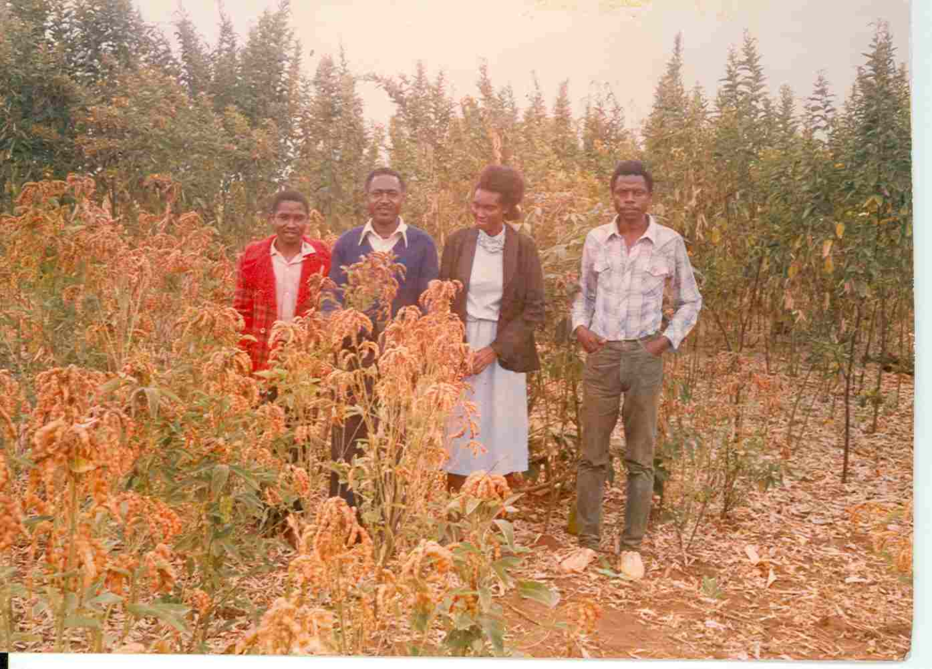
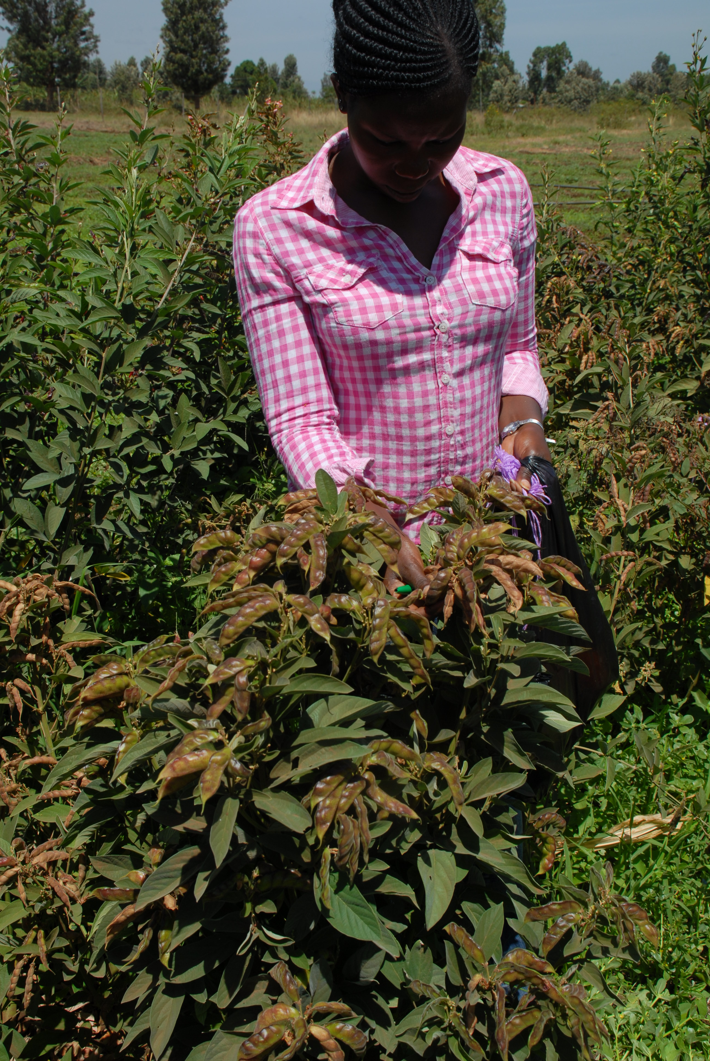
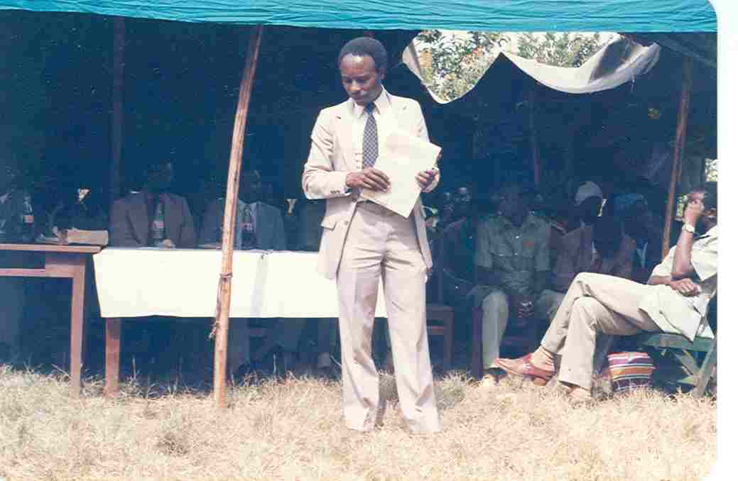
Pigeonpea- NPP670
1986
2016
Adoption rate: >78% (Jones et al Experimental Agriculture, 2001)

Slide 4
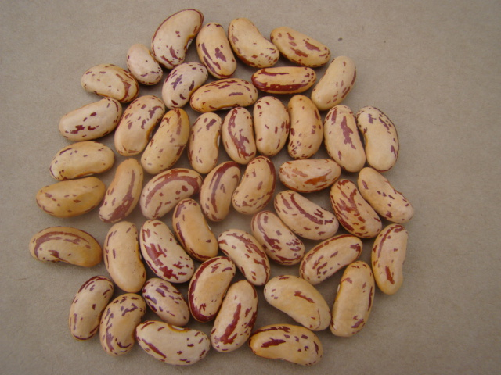
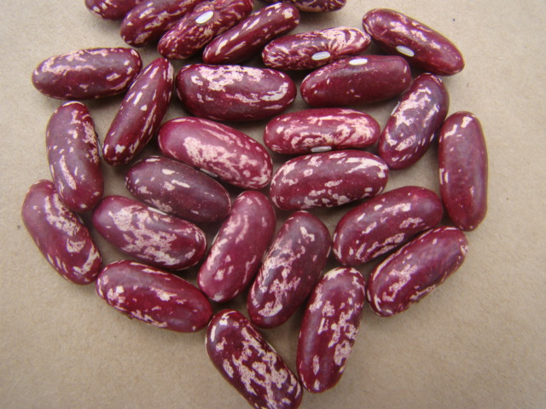
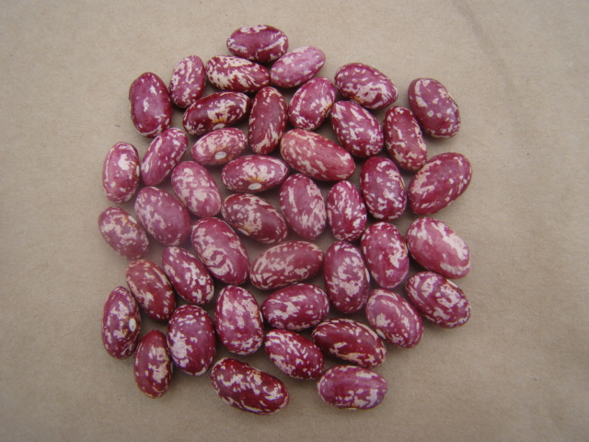
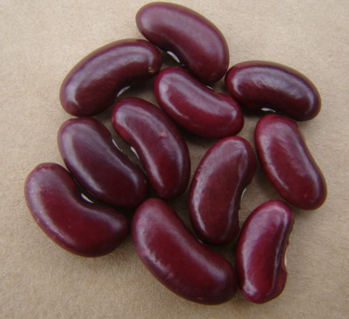
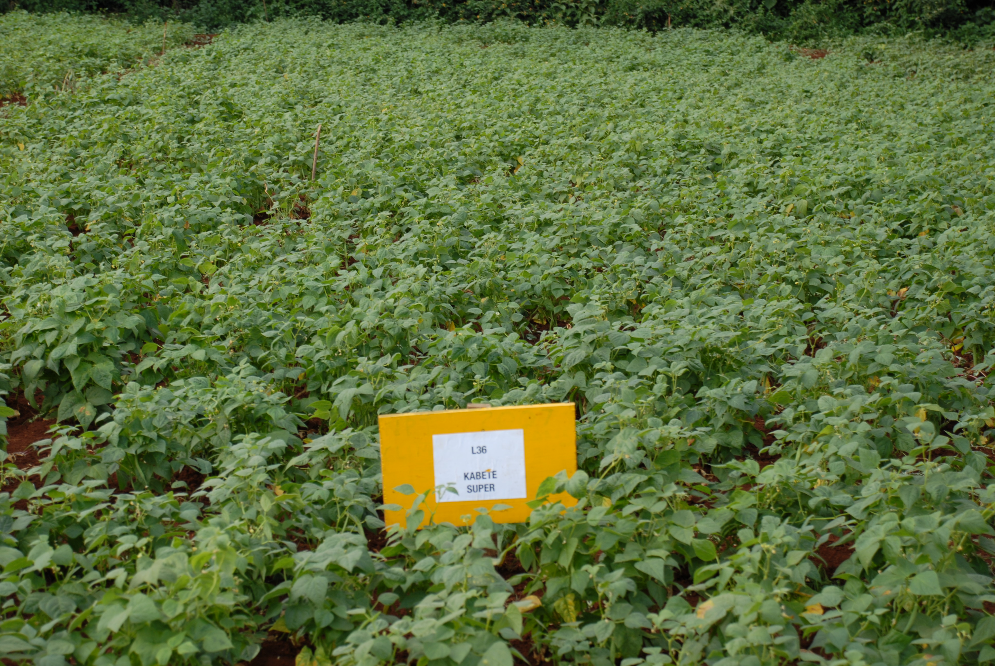
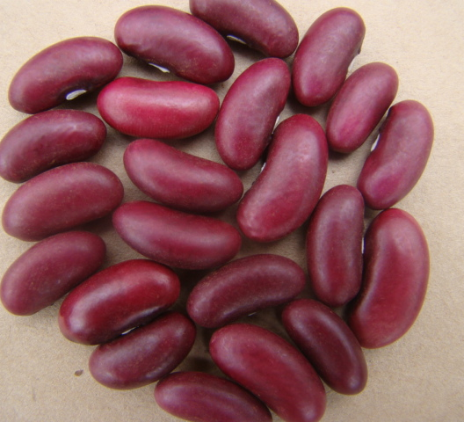
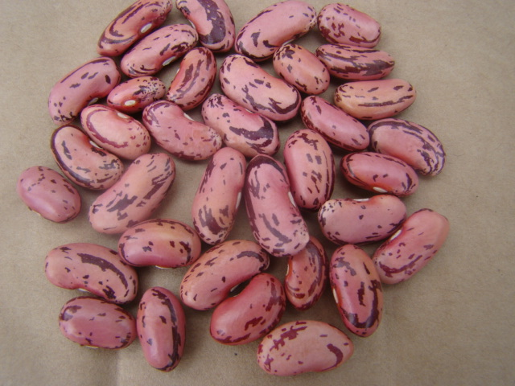
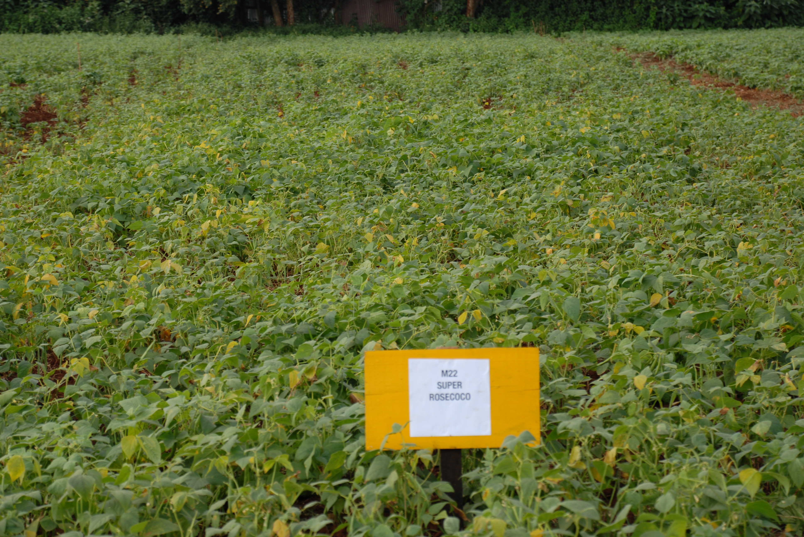
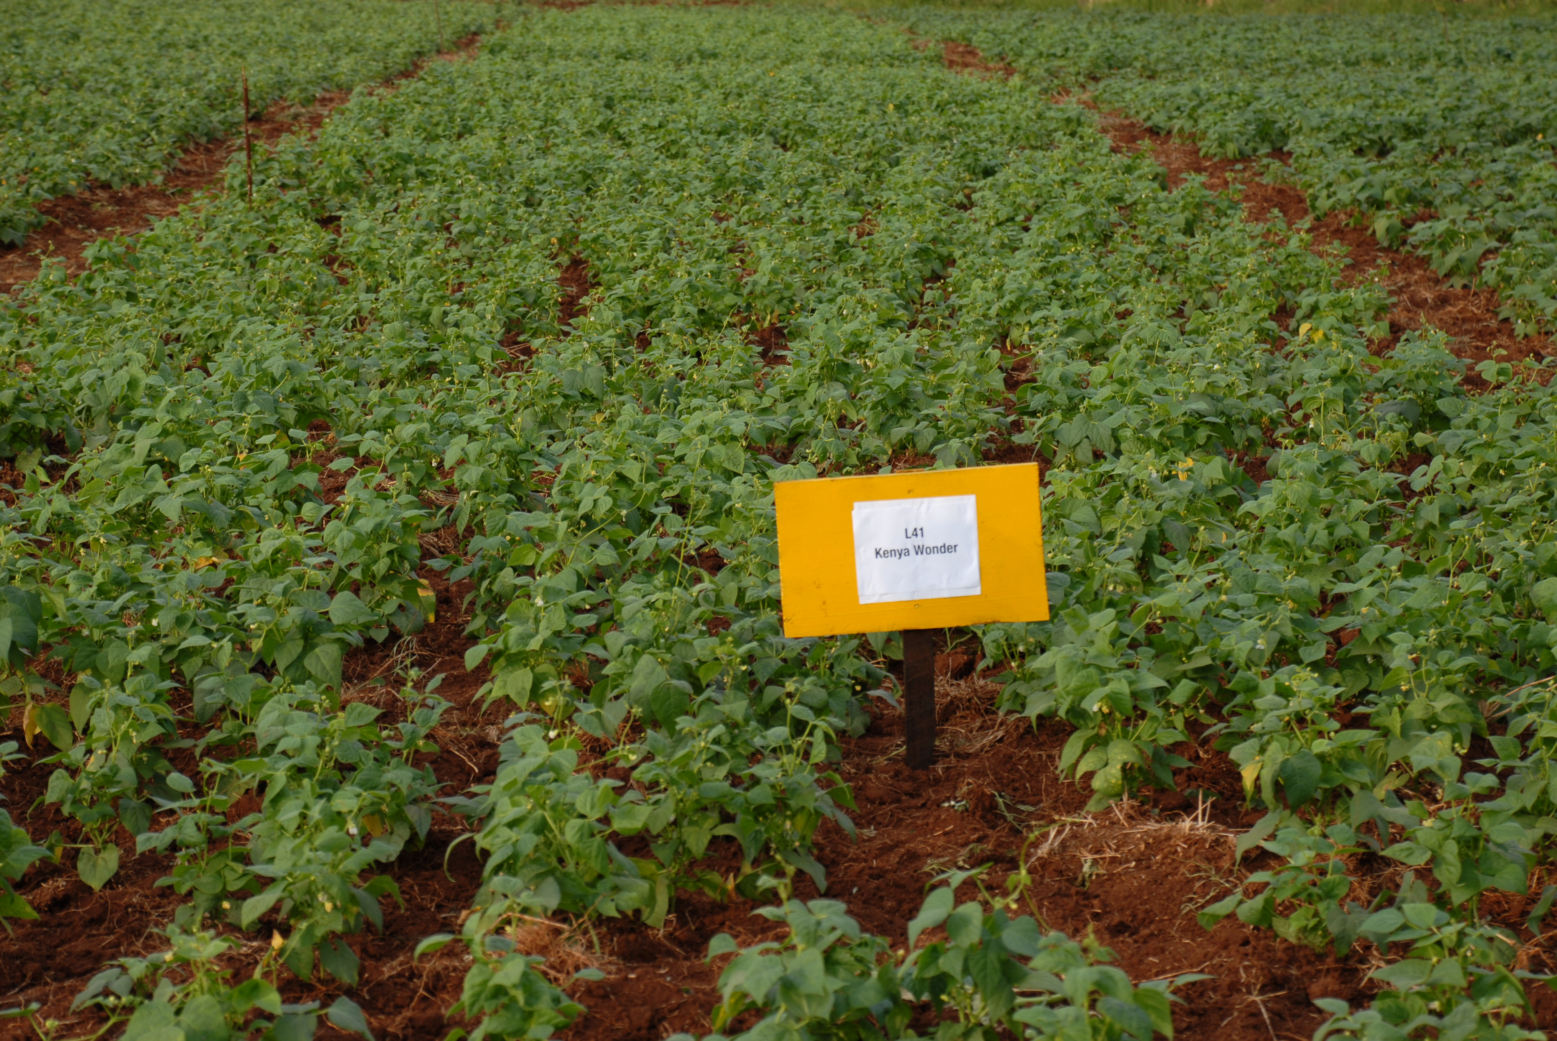
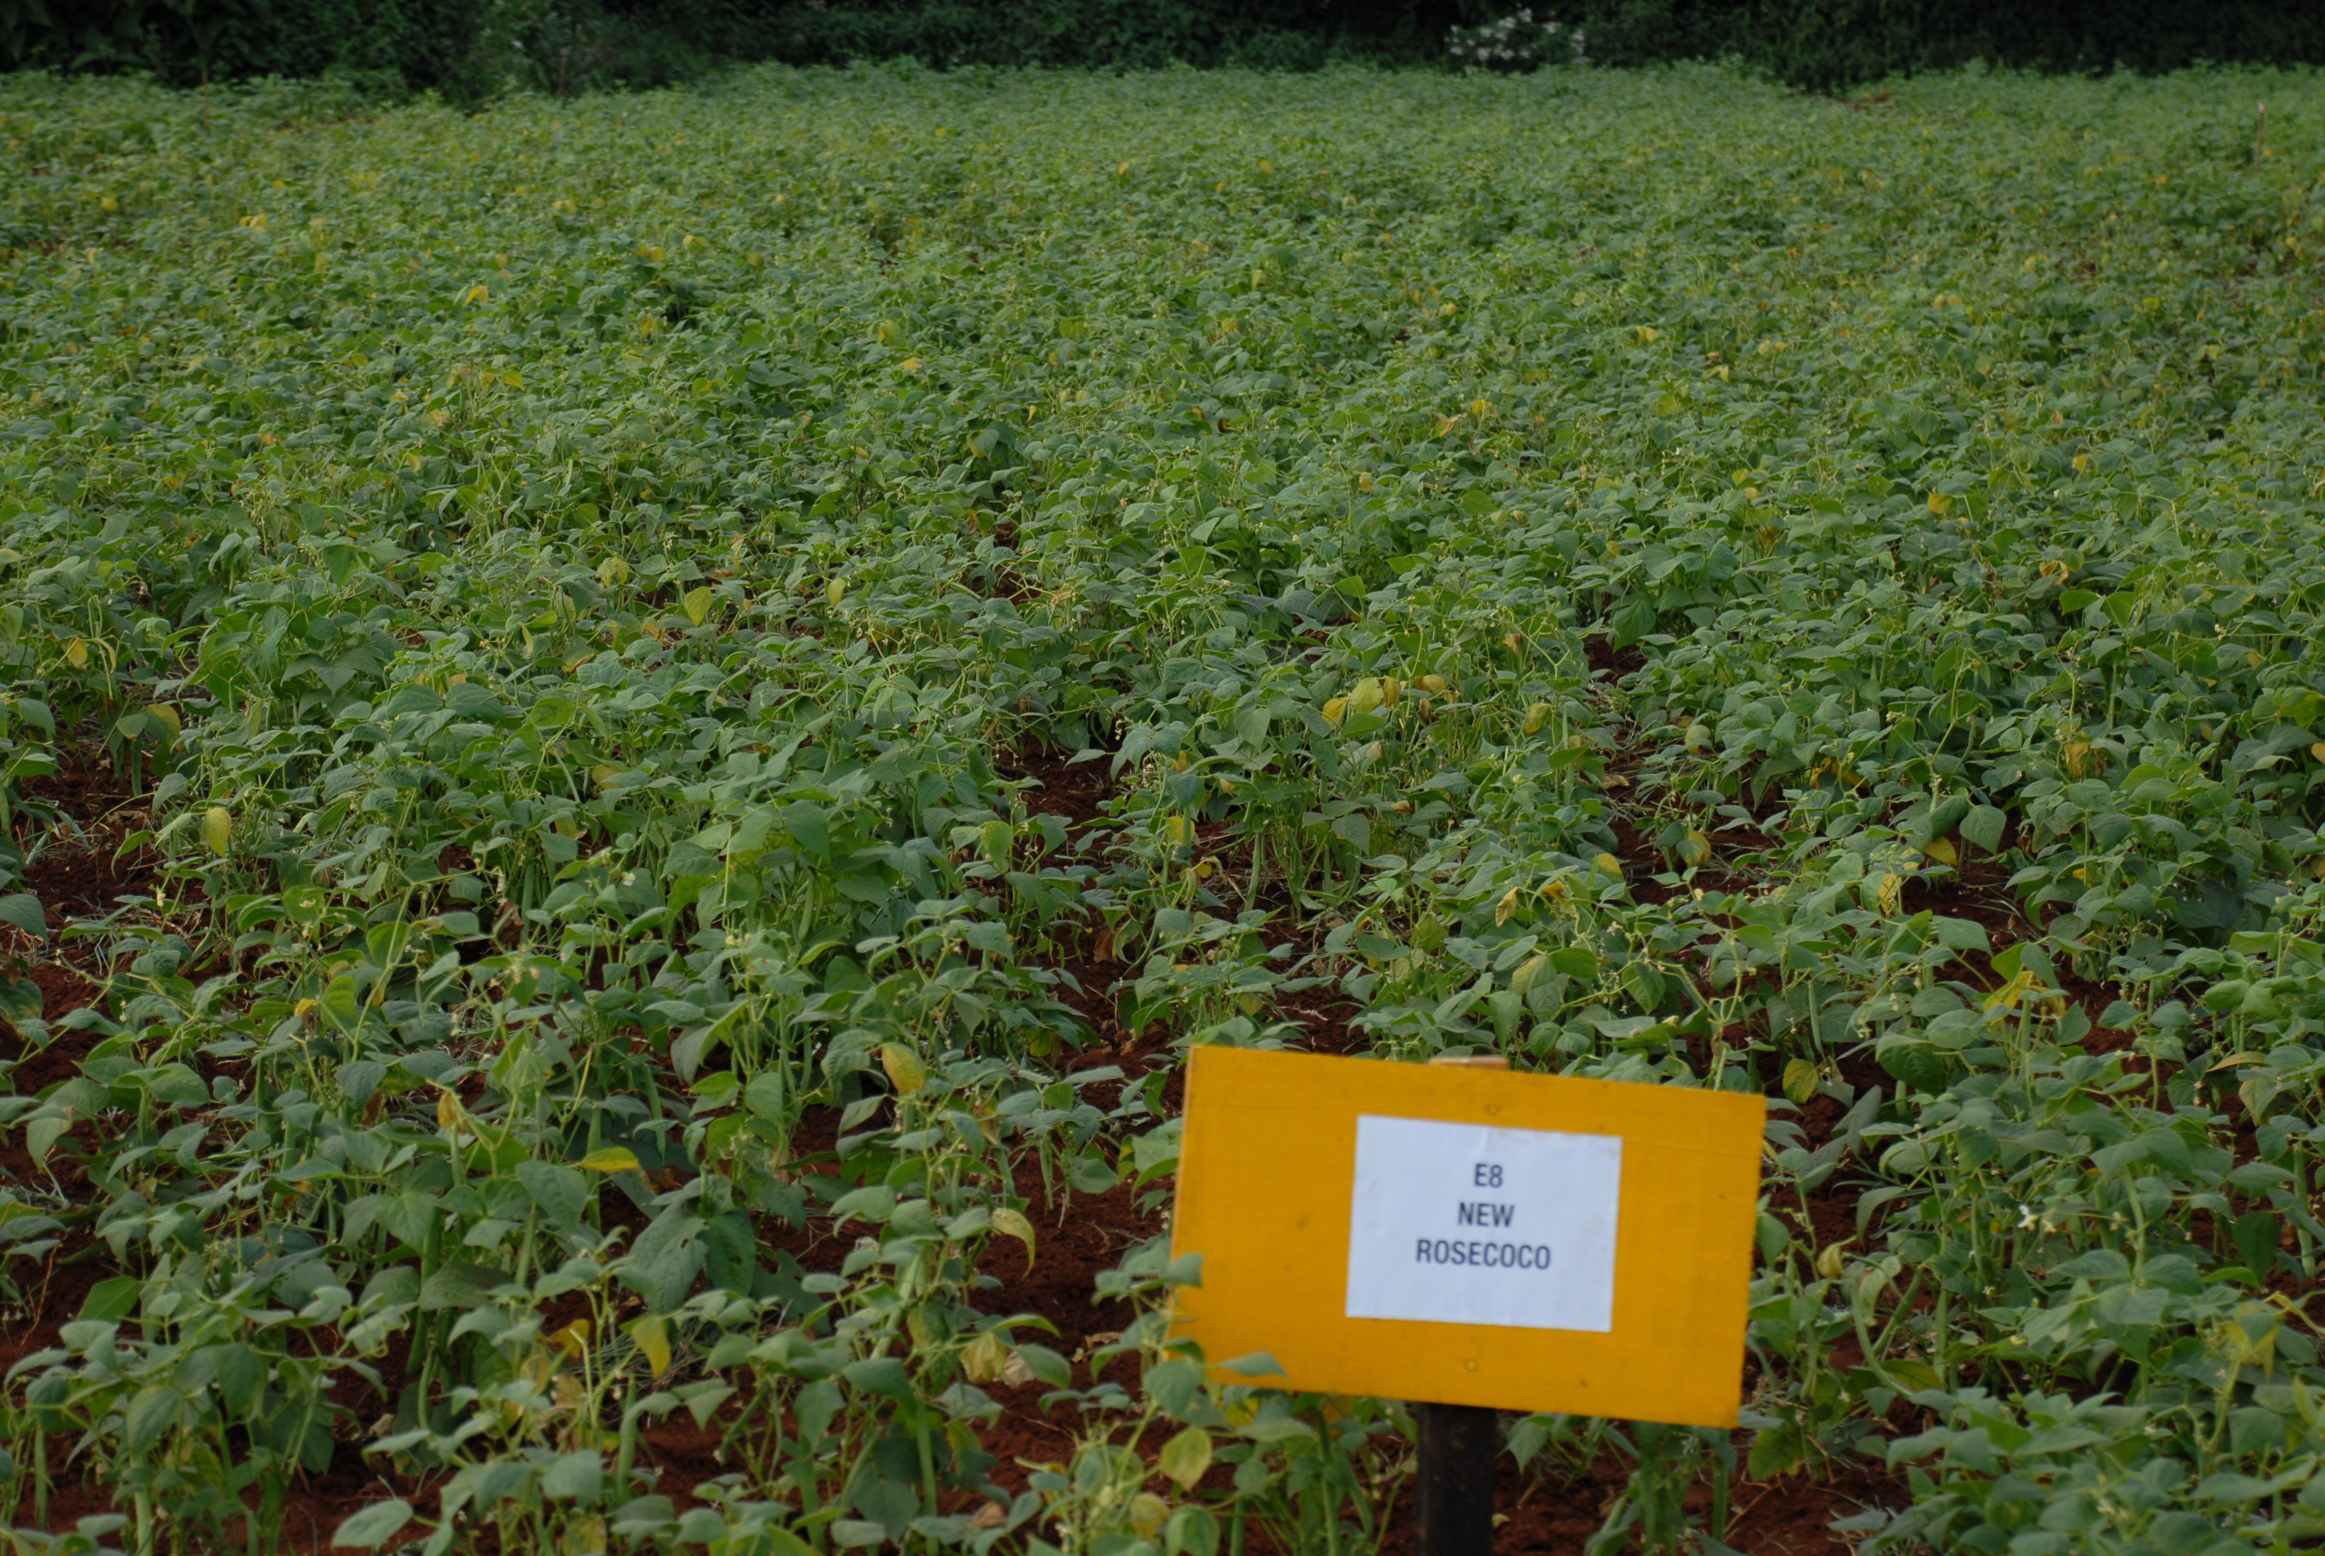
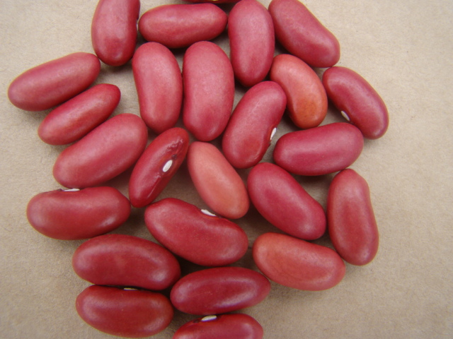
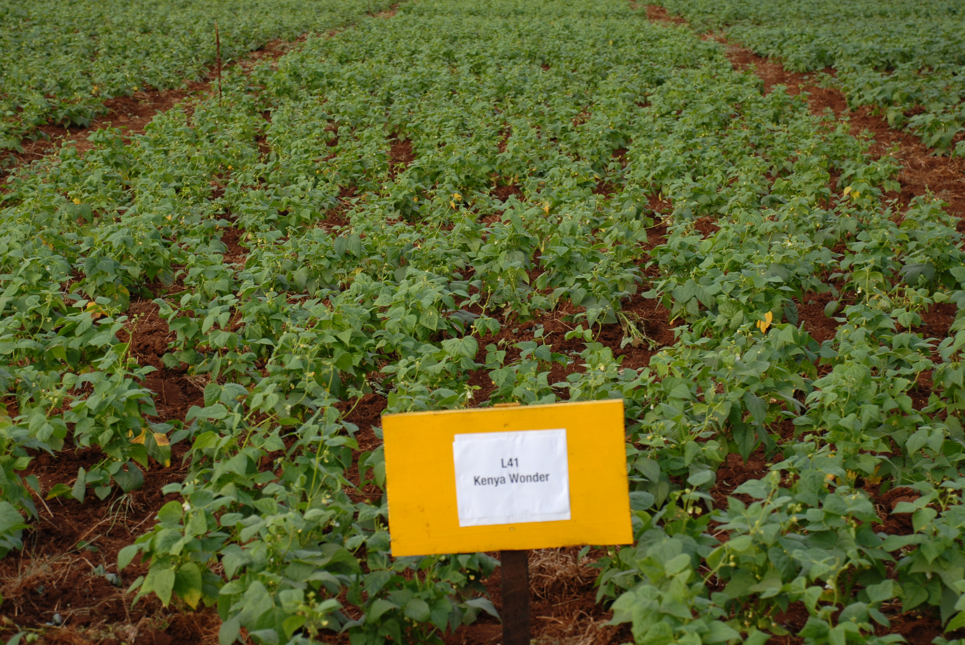
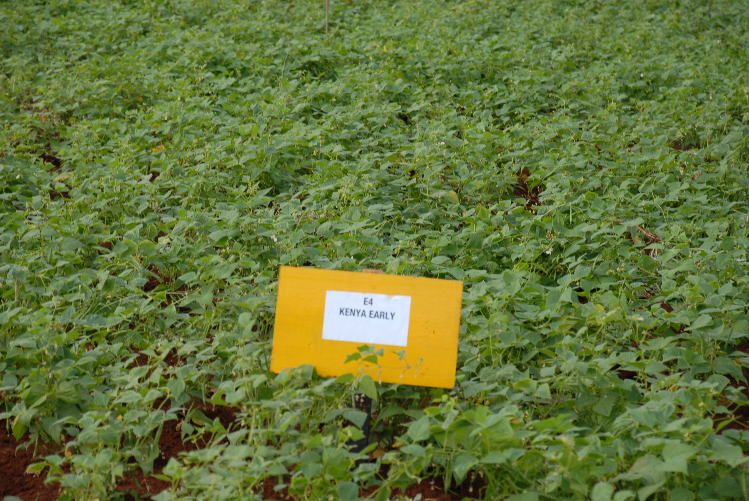
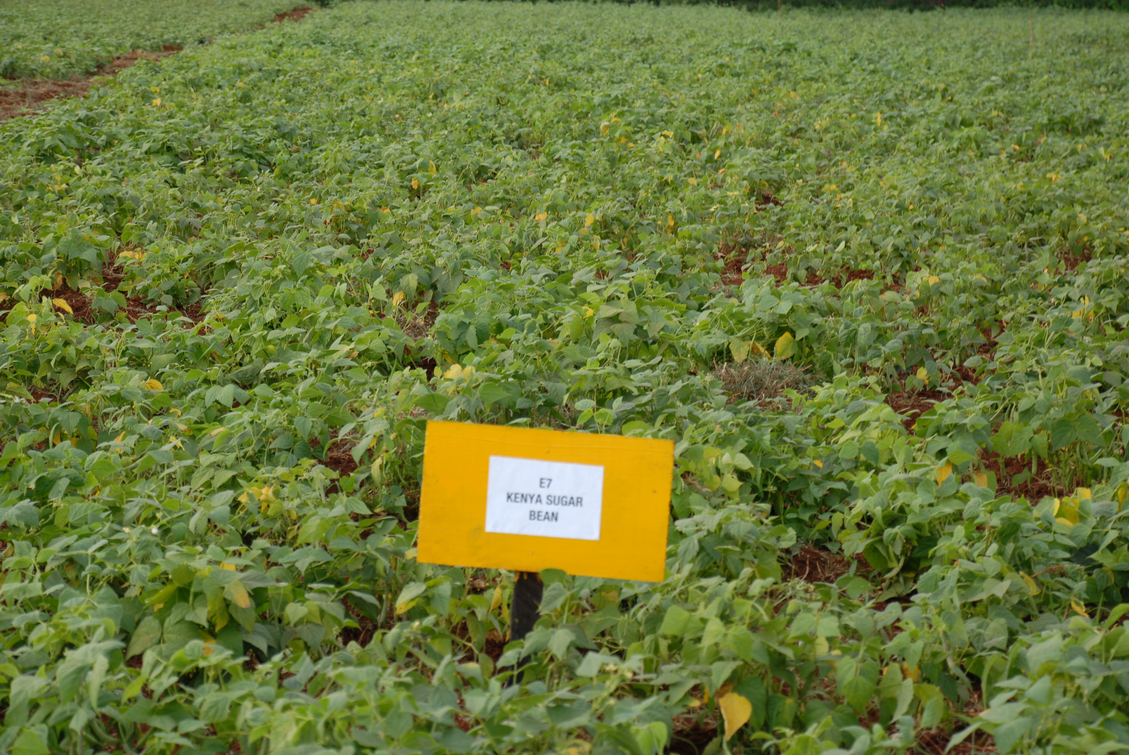
UNISEED KENYA LTD
DRY BEAN PRODUCTS
Your preferred supplier of High Quality Certified Breeder Seed
2
SPECKLED SUGAR PRODUCTS
1
UNIVERSITY OF NAIROBI
RED MOTTLED MARKET CLASS
3
RED KIDNEY BEAN PRODUCTS
Kabete Super
New Rosecoco
Super Rosecoco
Figure 2. Miezi Mbili
FIGURE 1. RED MOTTLED PRODUCTS
Kenya Wonder
2
Why do farmers like these varieties?
High quality commercial grain types
High germination capacity
High yield potential
High demand in local, regional markets
Drought tolerant
Resistant to major bean diseases
Excellent nutritional quality- protein, minerals and vitamins; high fiber content
Anti-cancer properties
Excellent cooking quality- taste, flavour, fast cooking, good swelling ability
Anti-obesity- not fat, no cholesterol
Kenya Red kidney
Fig 3 Kenya Early
Figure 5. RED KIDNEY MARKET CLASS
For further information contact: Paul Kimani <pmkimani@uonbi.ac.ke>
Fig 4. Kenya Sugar bean

Slide 5
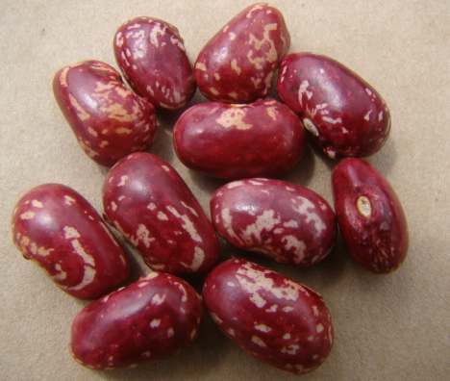
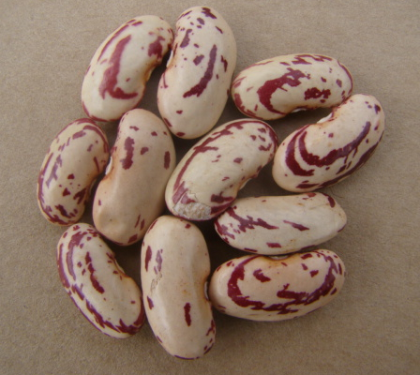
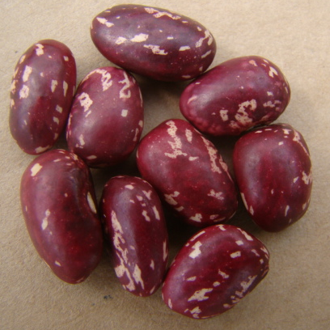
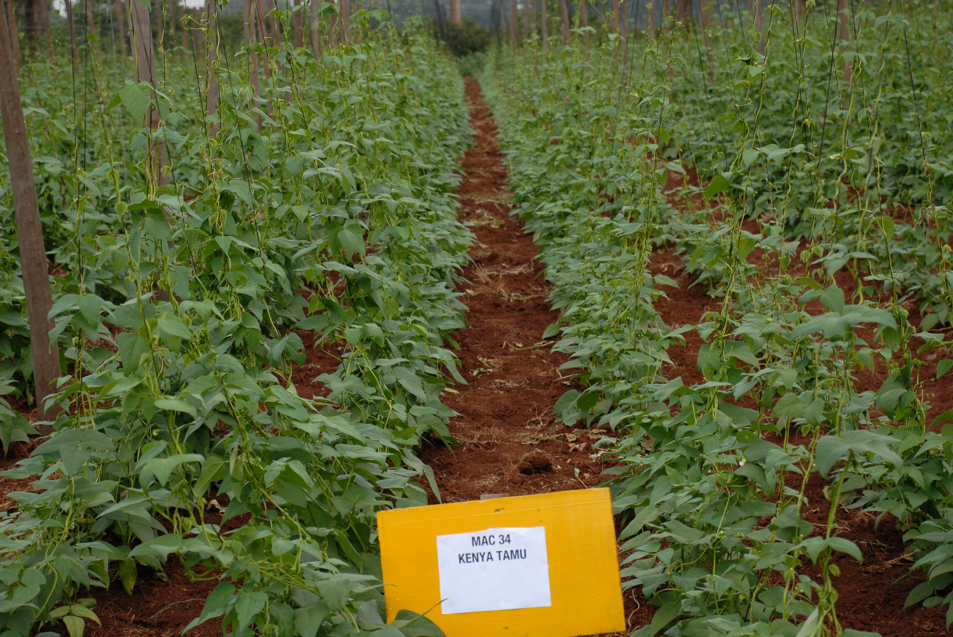
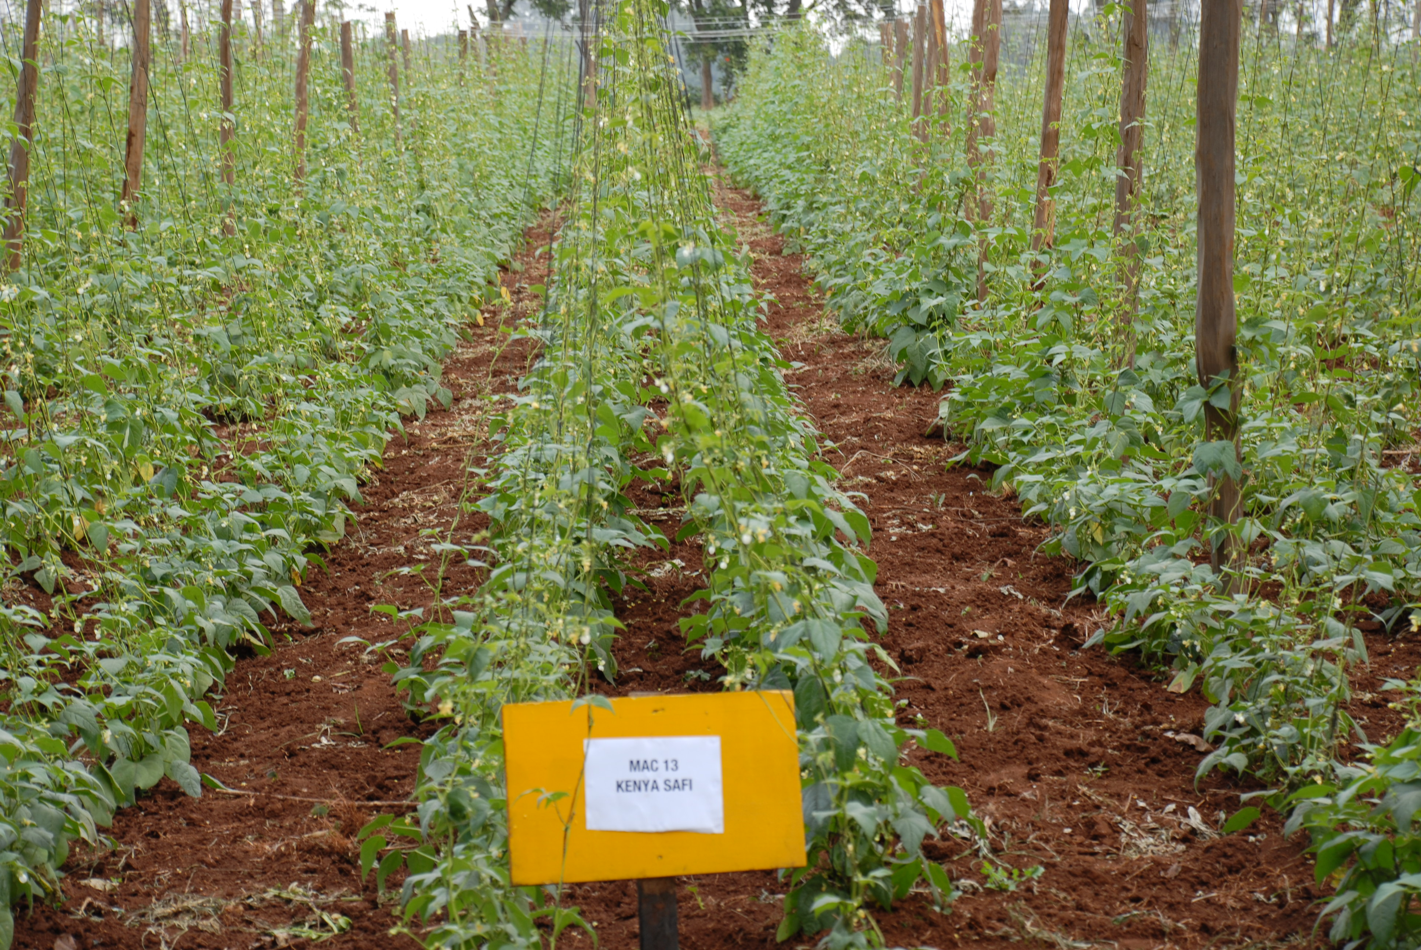
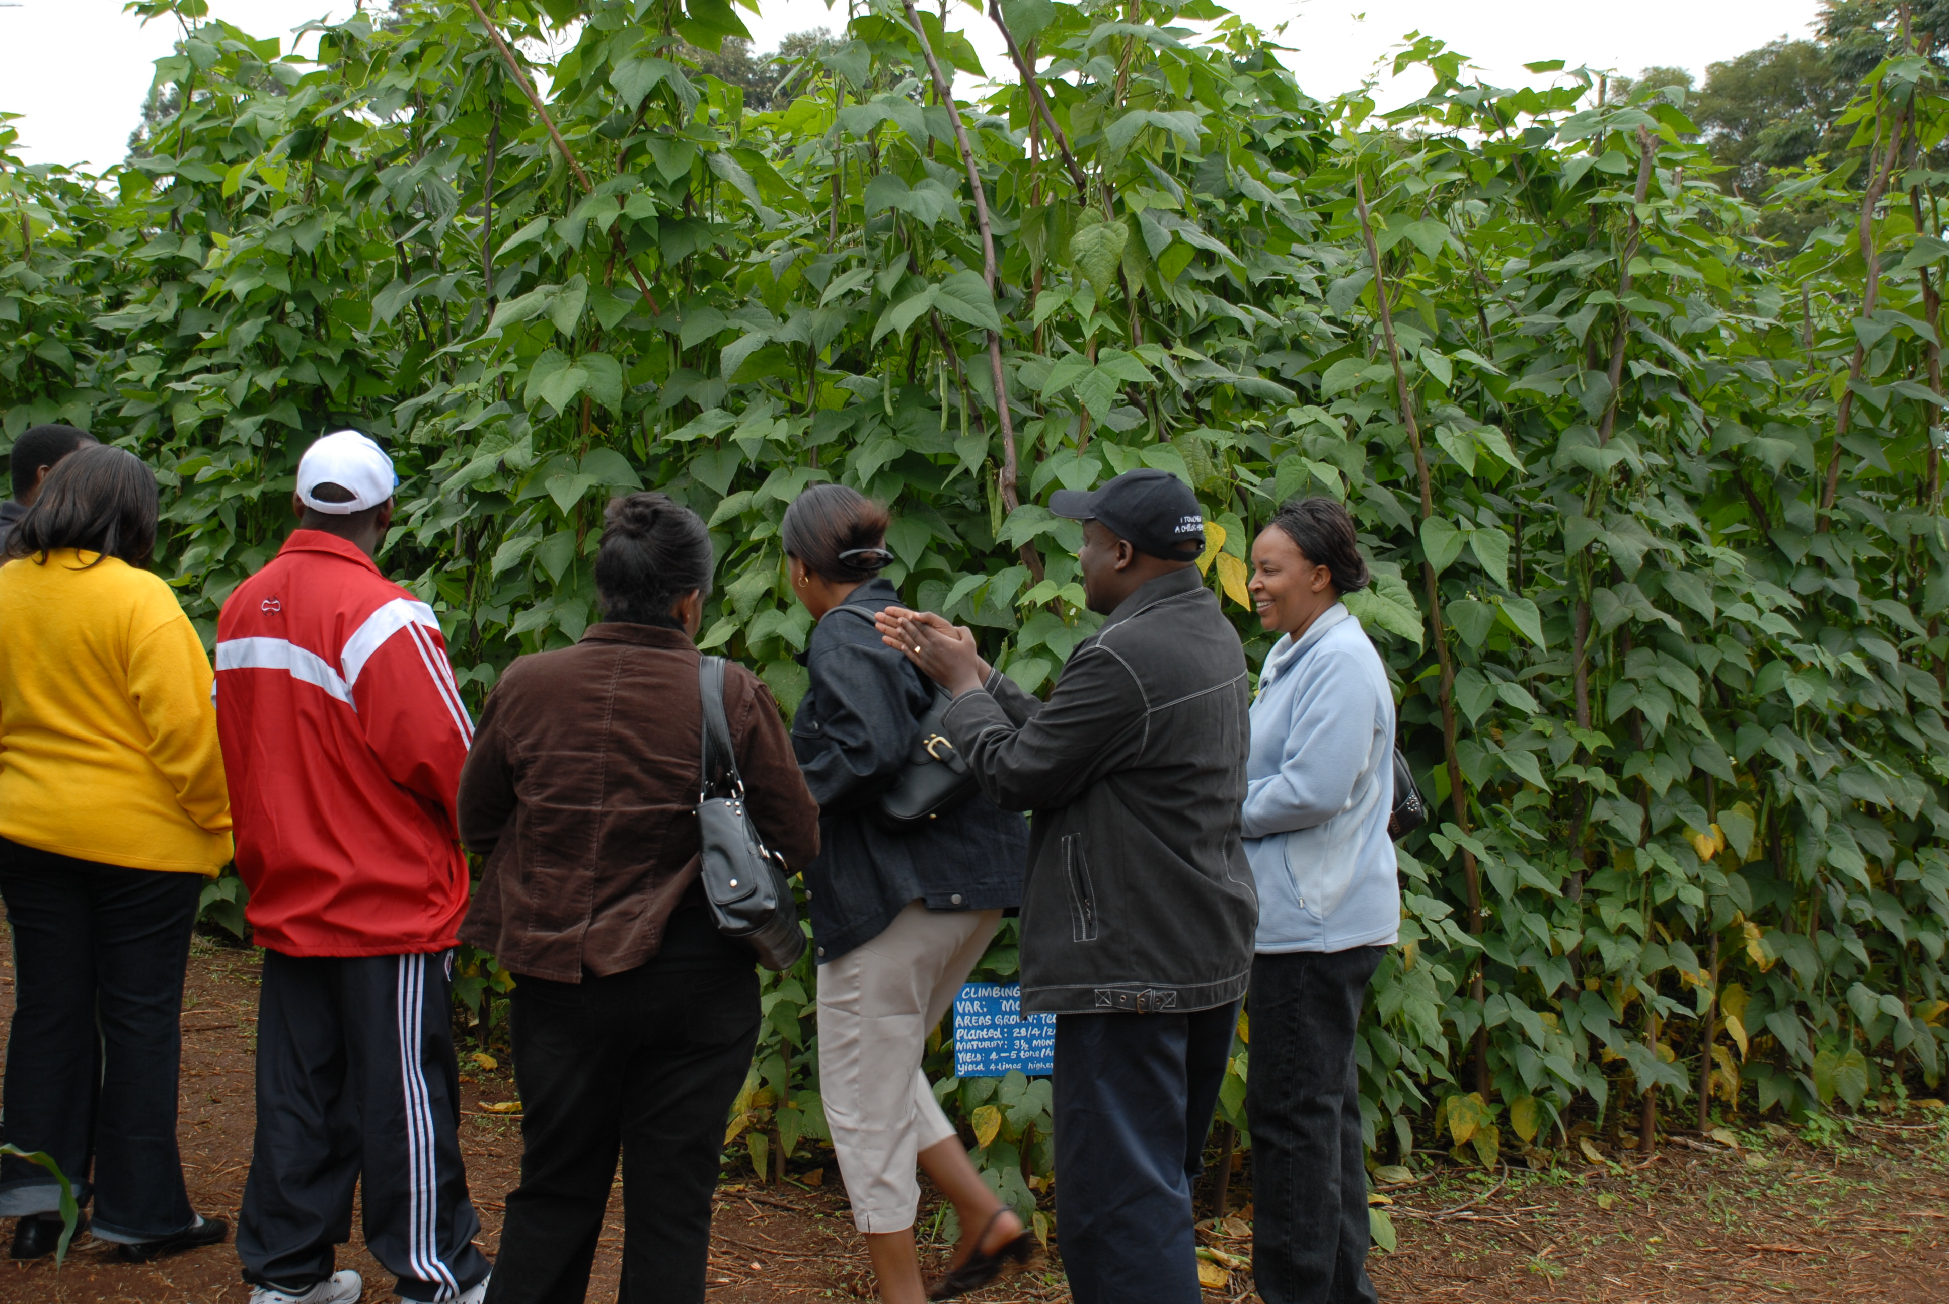
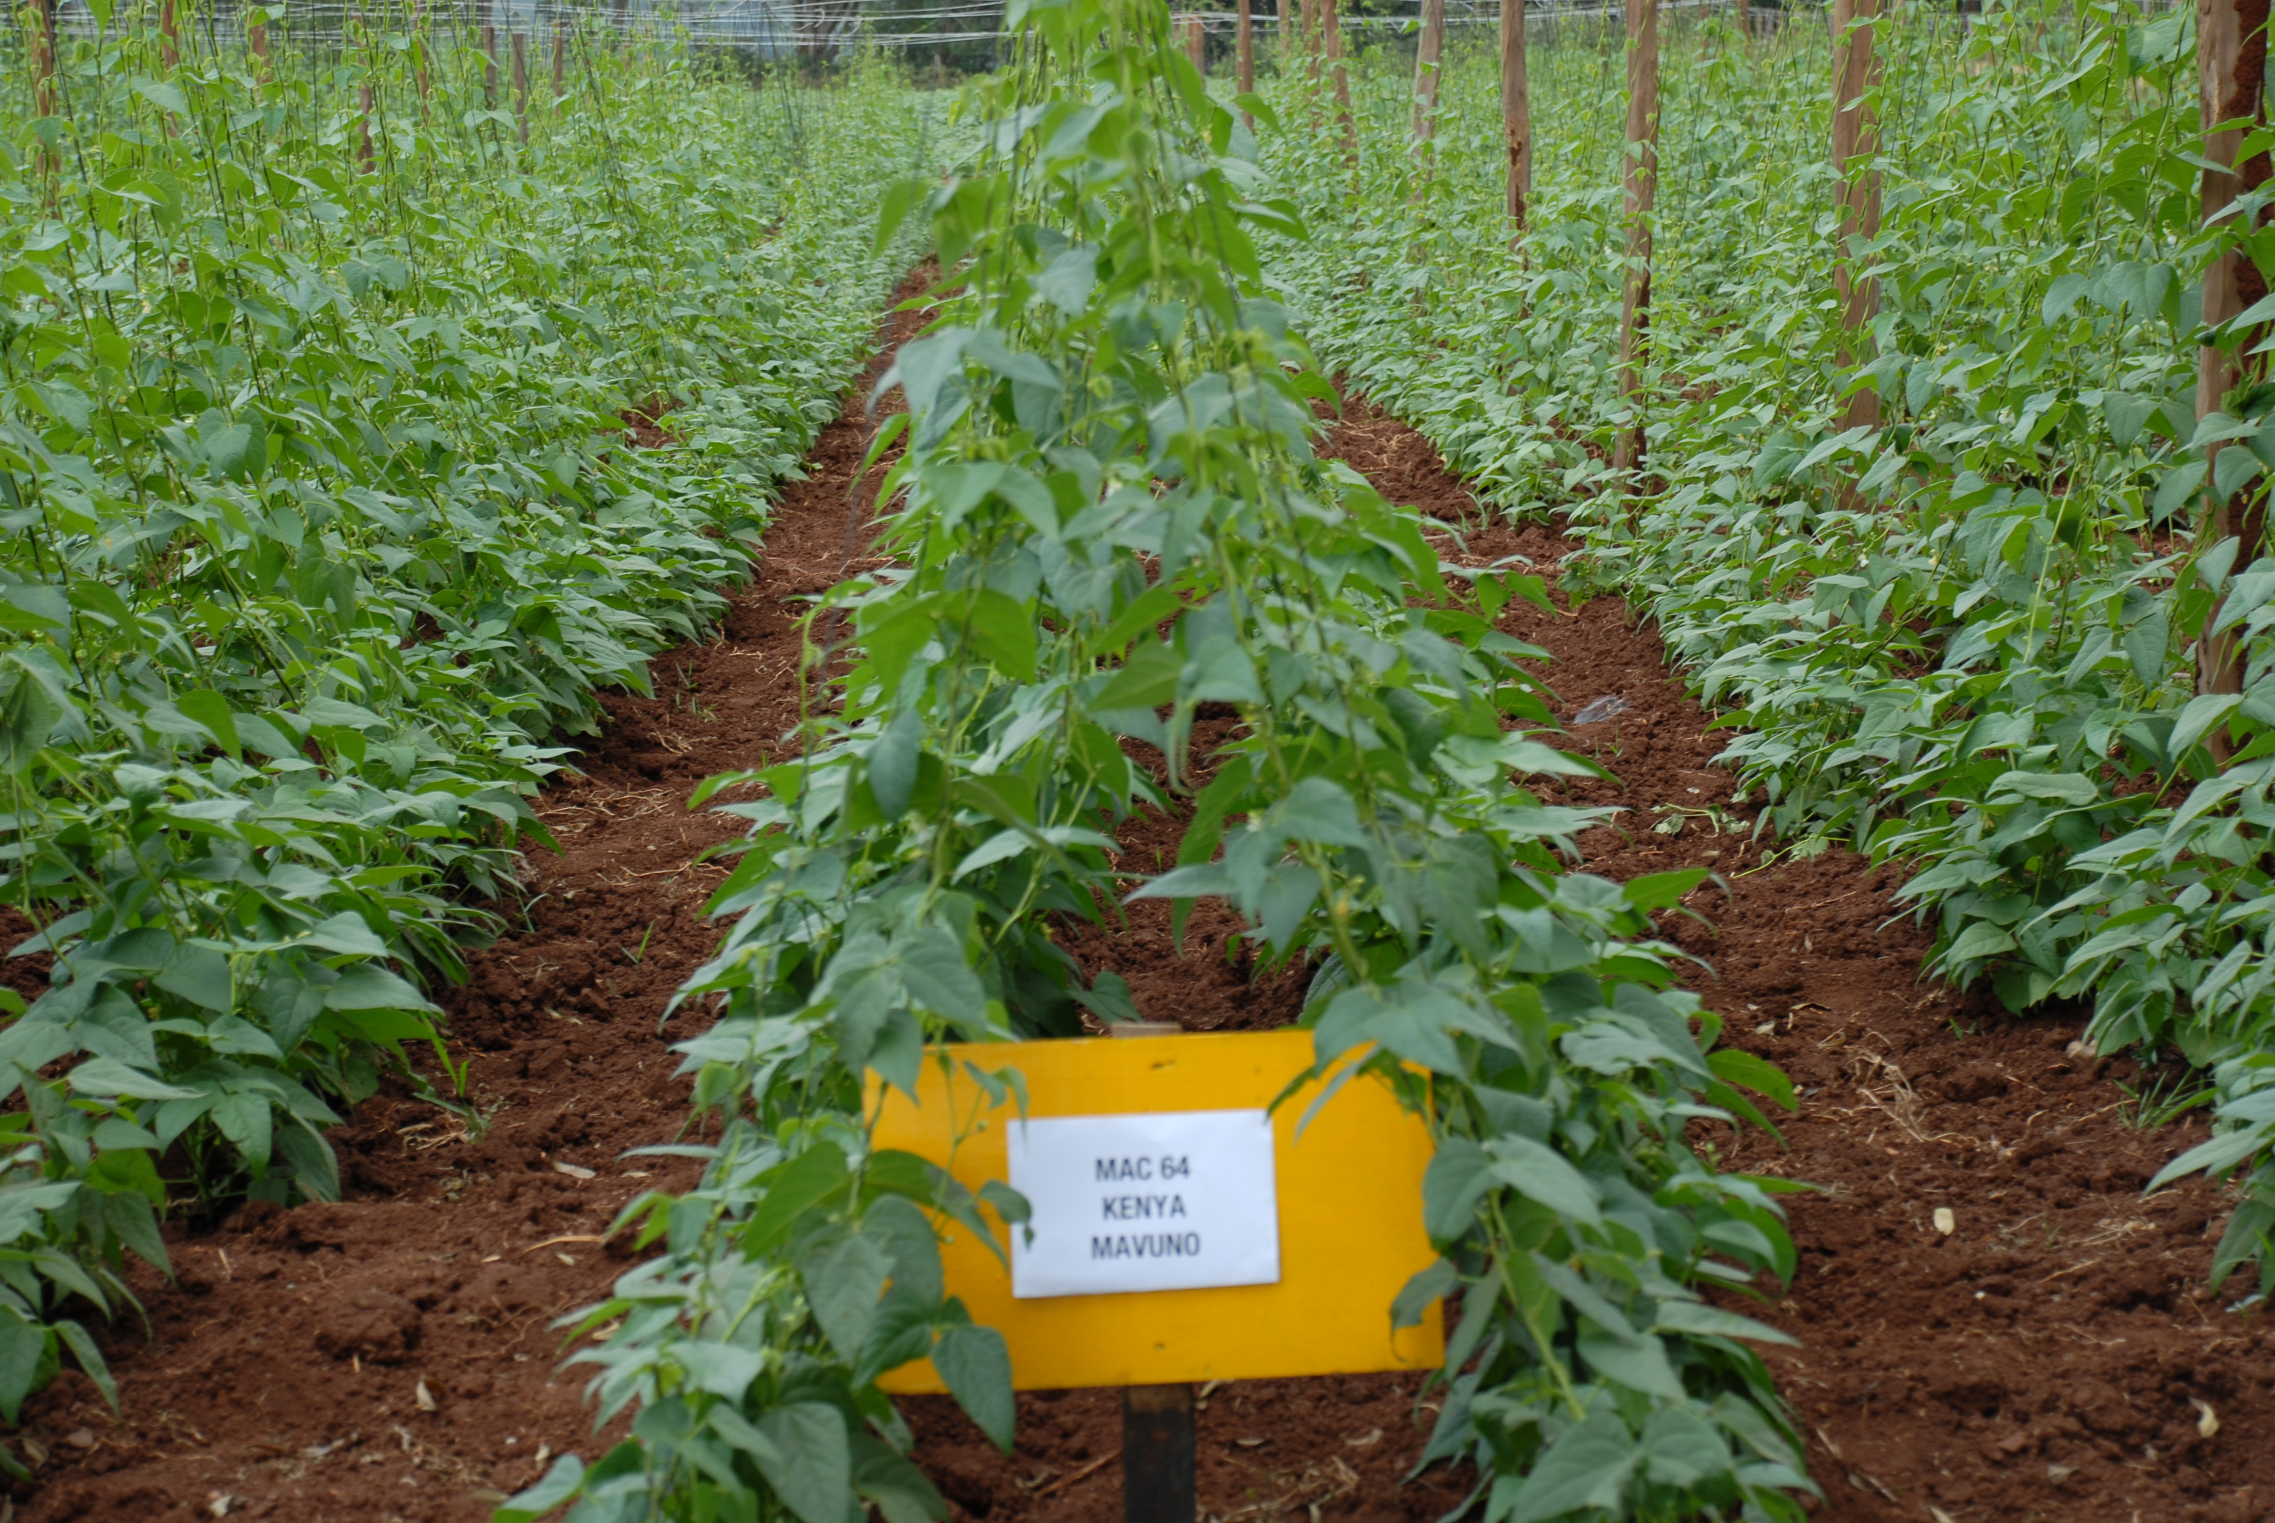
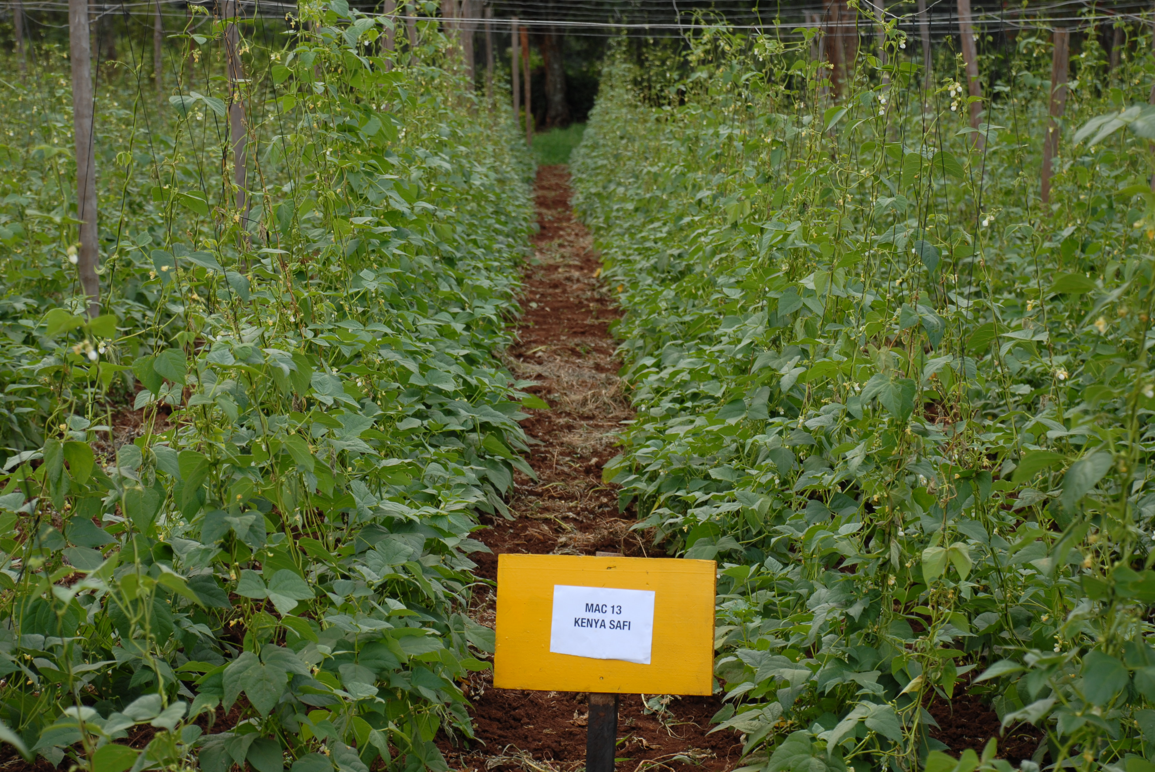
UNISEED KENYA LTD
CLIMBING BEAN PRODUCTS
Your preferred supplier of High Quality Certified Breeder Seed
Lab Logo
2
KENYA TAMU
1
KENYA SAFI
UNIVERSITY OF NAIROBI
3
KENYA MAVUNO
Figure 2. Red mottled MARKET CLASS
FIGURE 1. Speckled sugar grain type
4
High yield potential – 3 times that of bush varieties
Resistant to diseases
Popular commercial grain types
Highly marketable
Excellent cooking and eating quality
Improves soil fertility- good nitrogen fixer

Slide 6
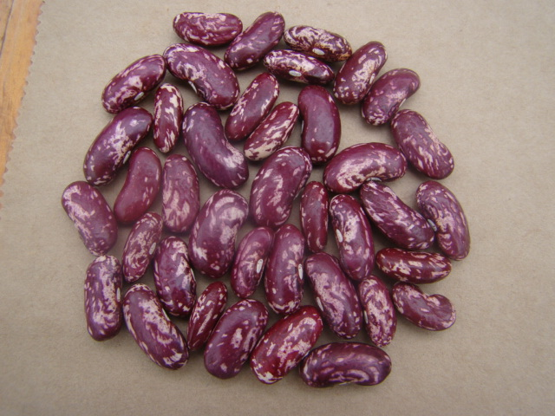
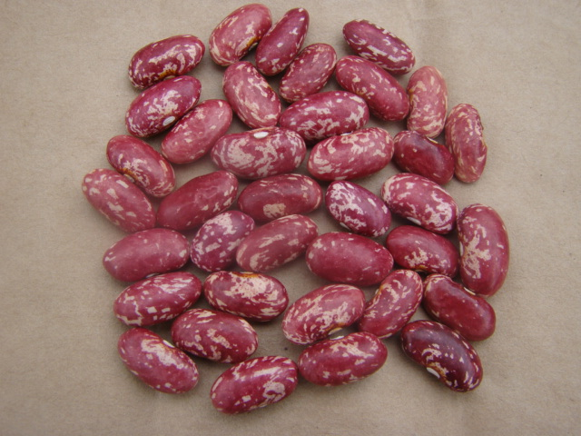

Slide 8
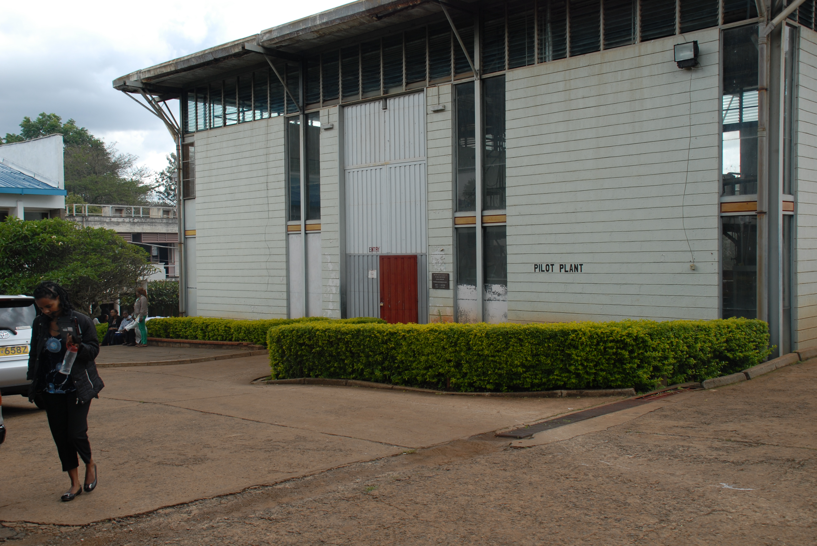
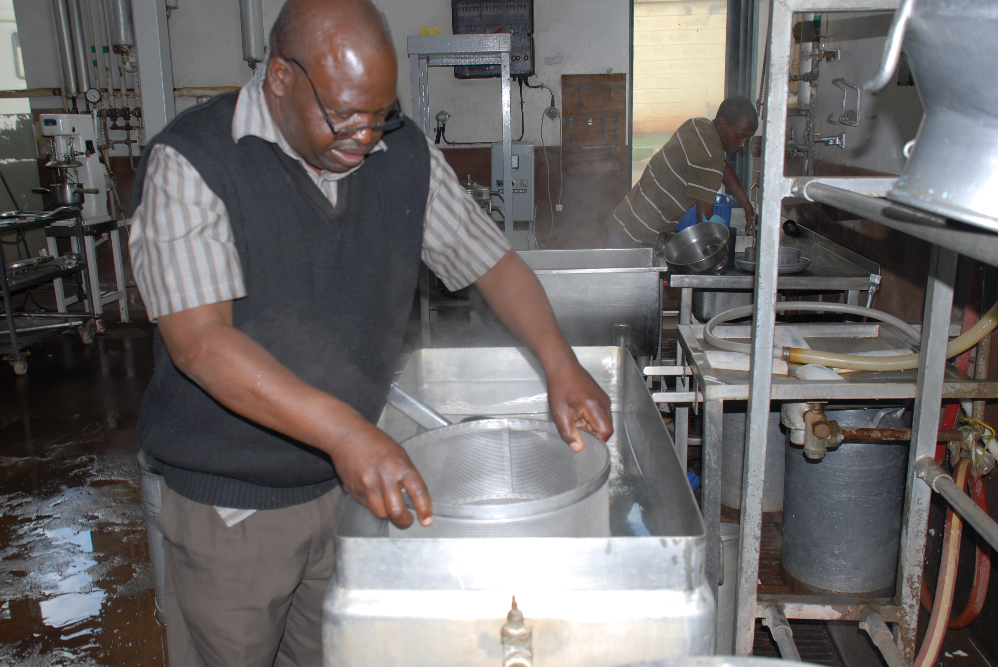
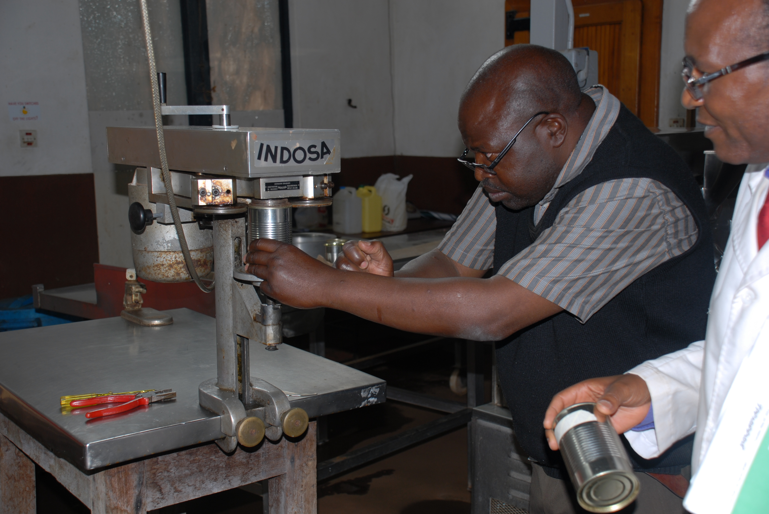
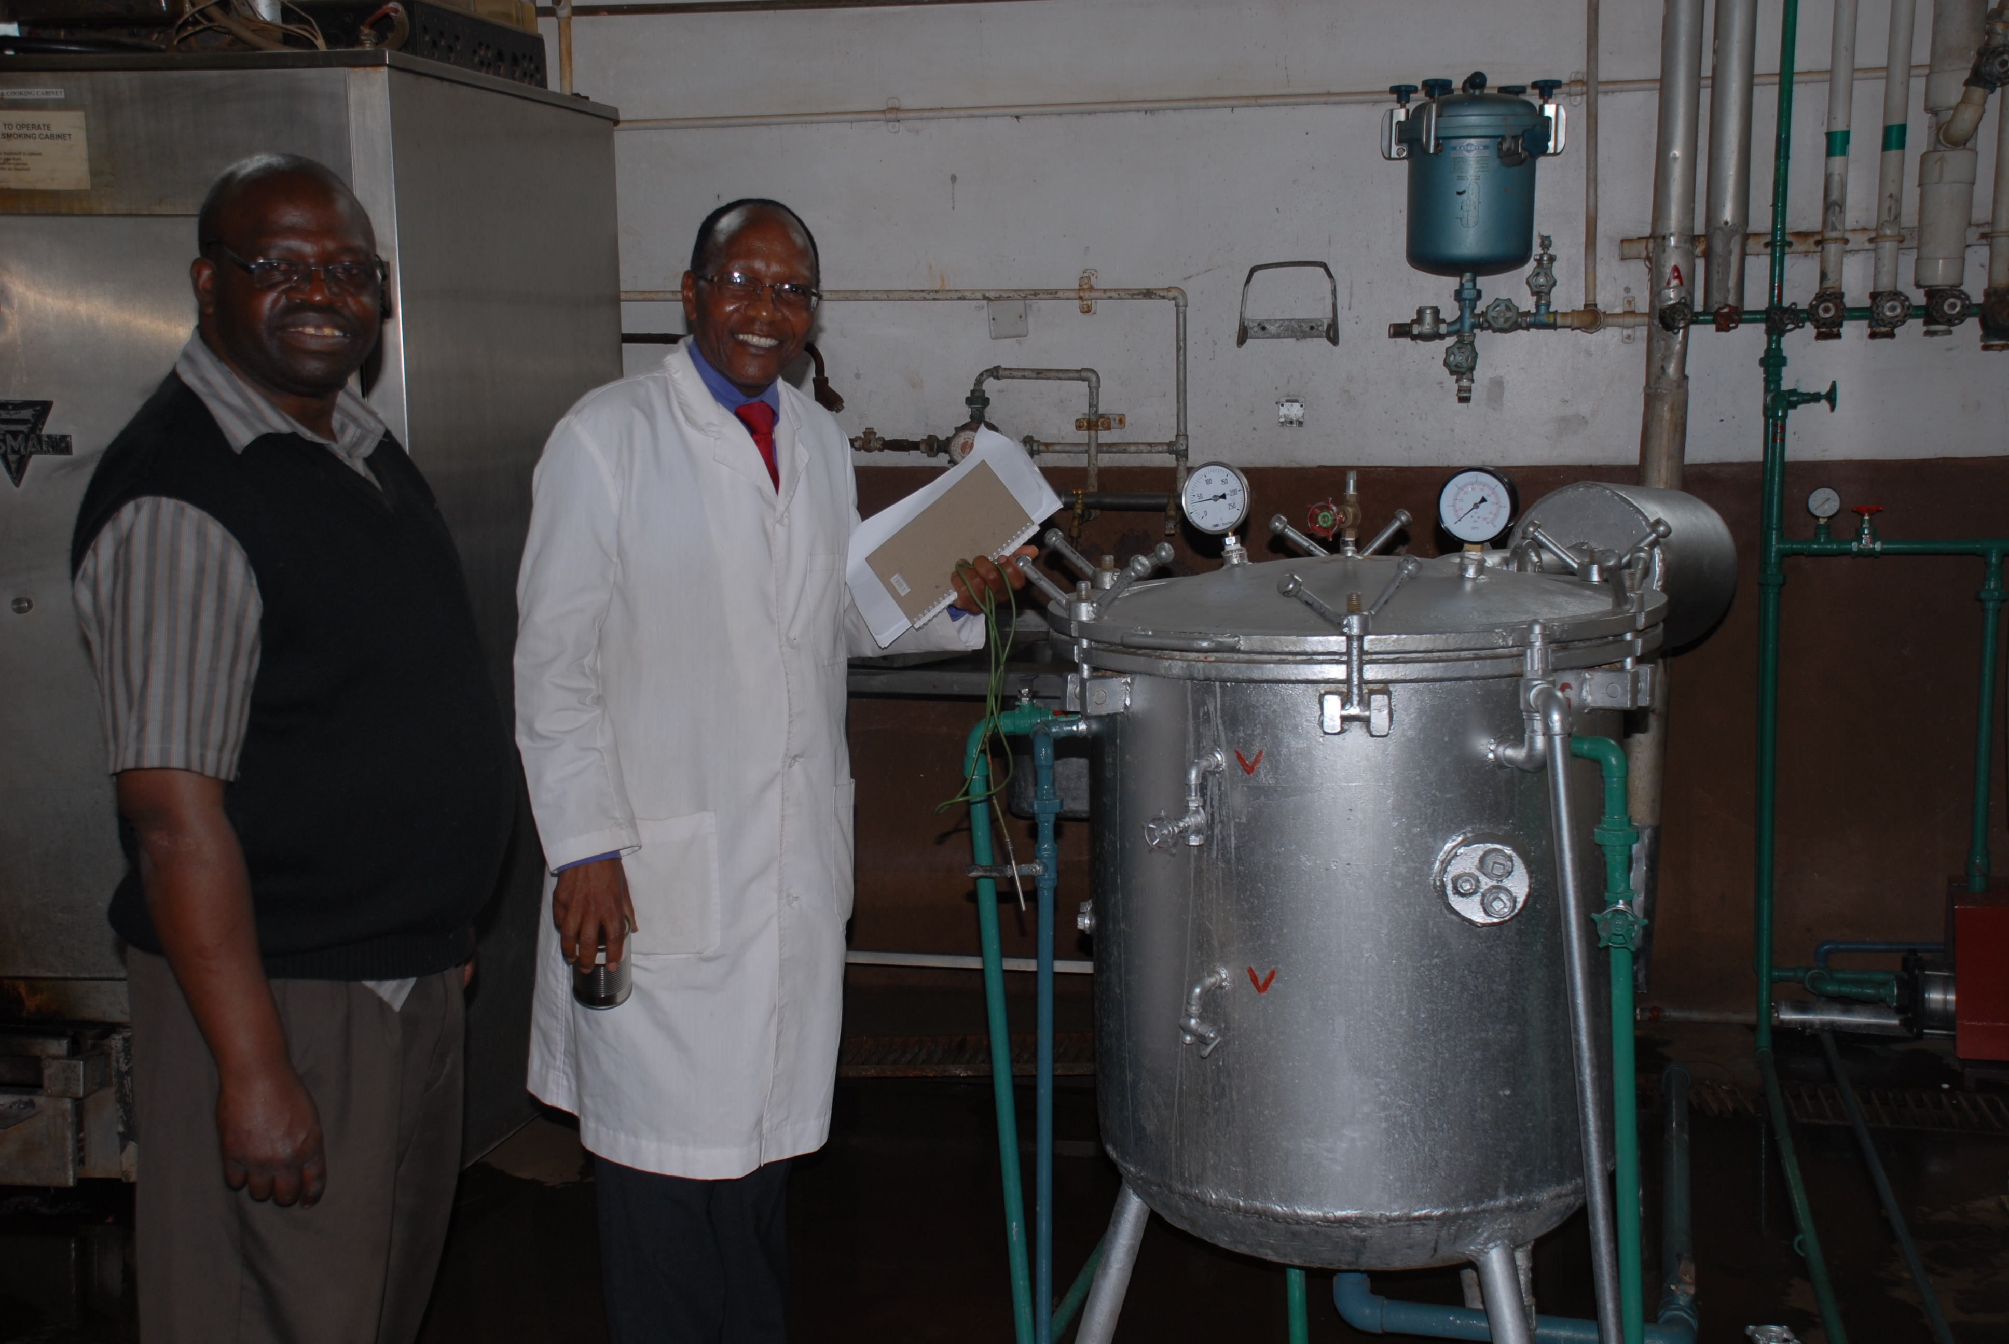
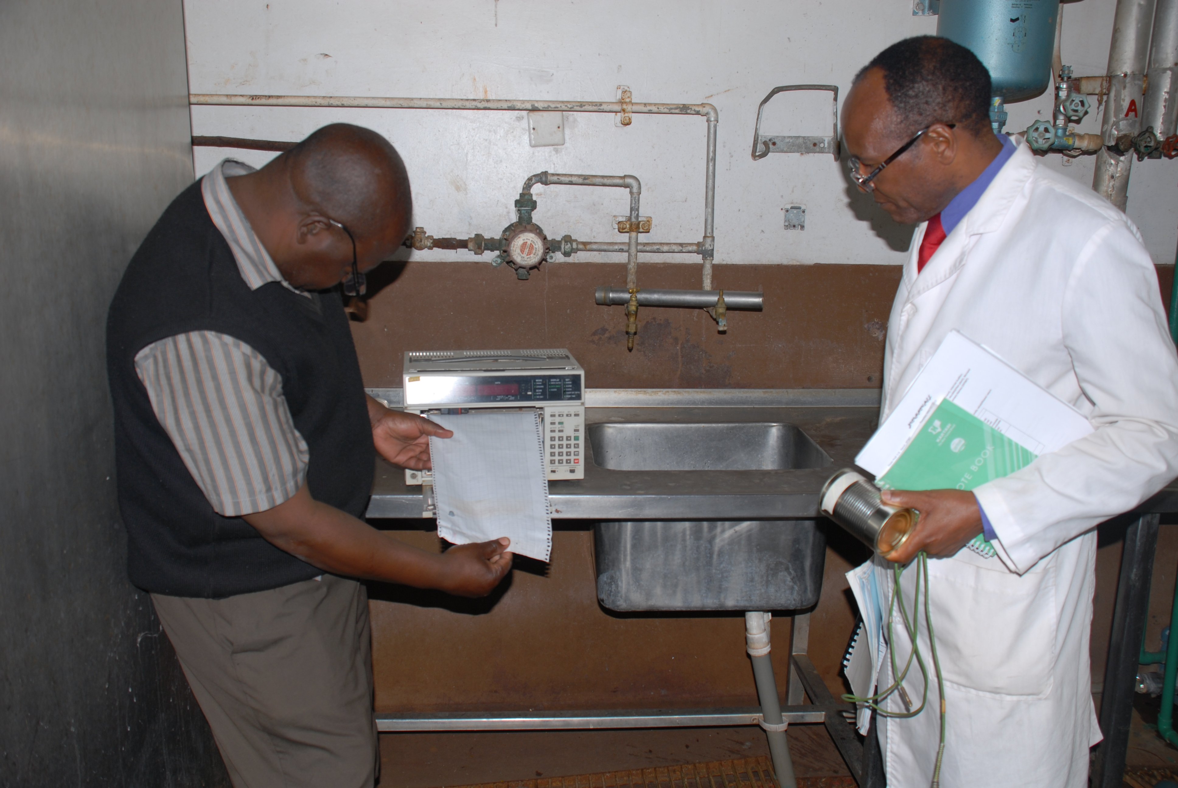
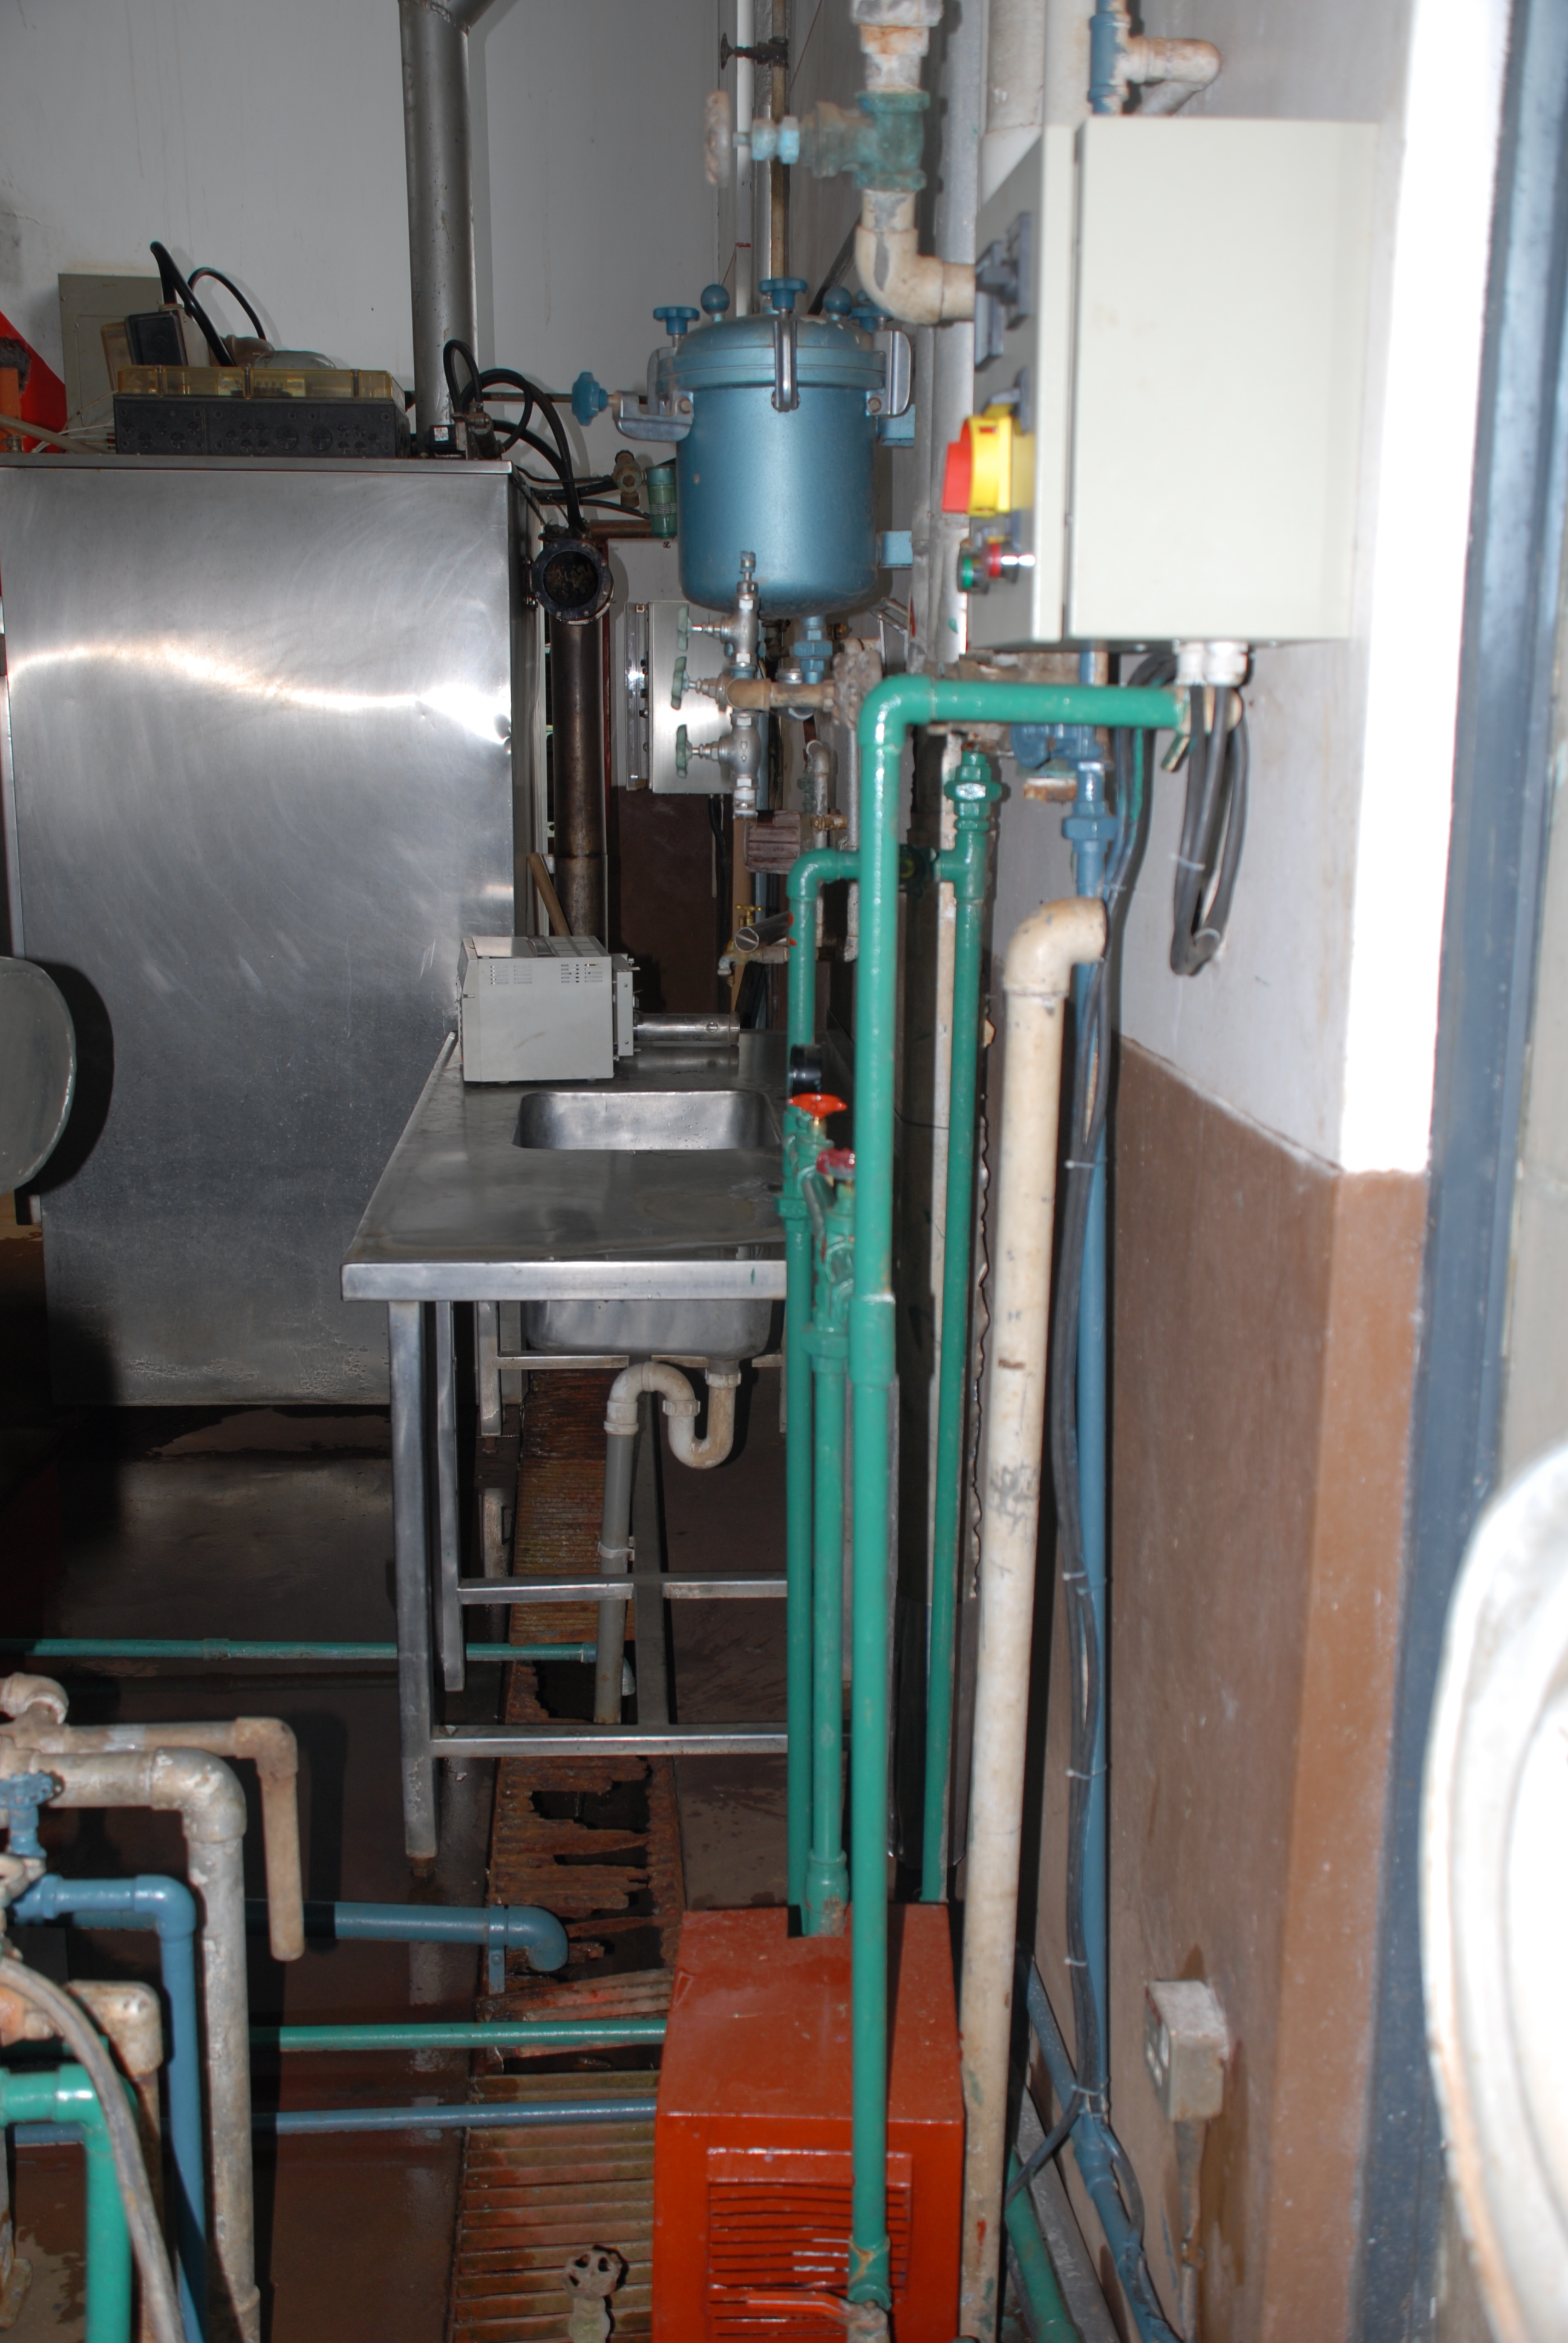
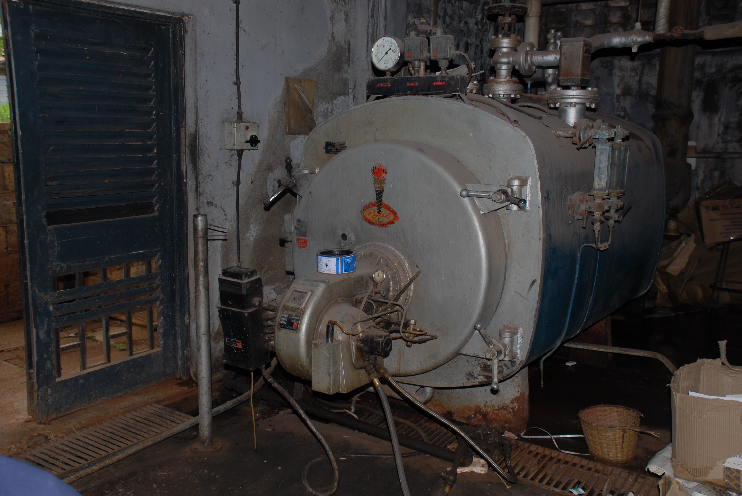
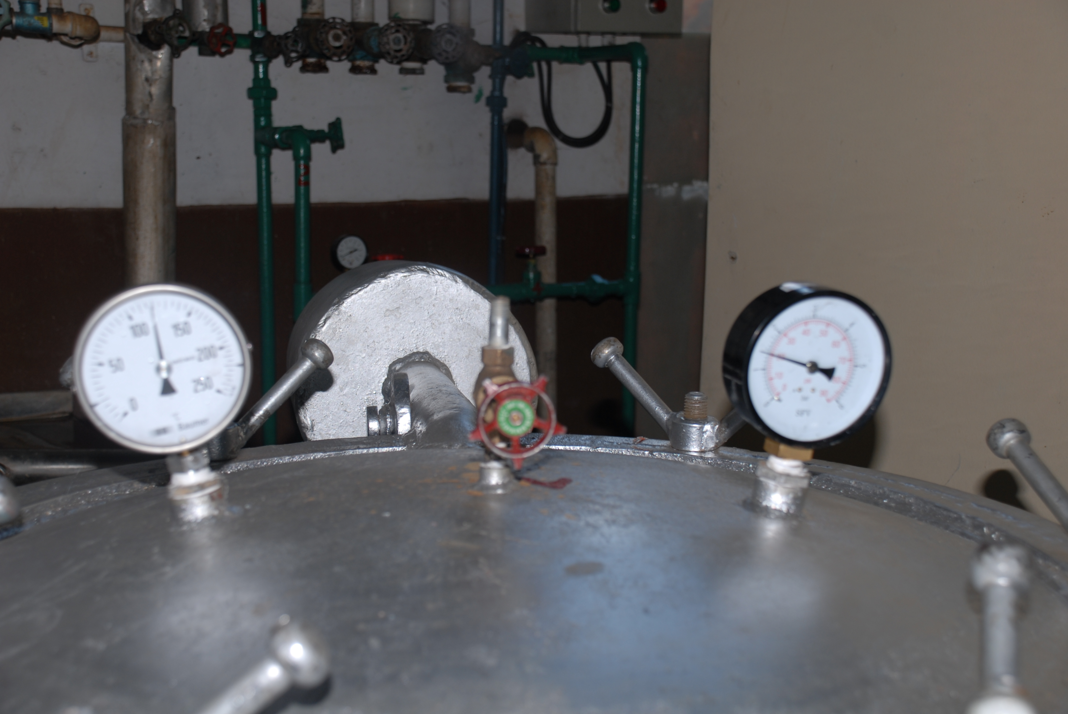
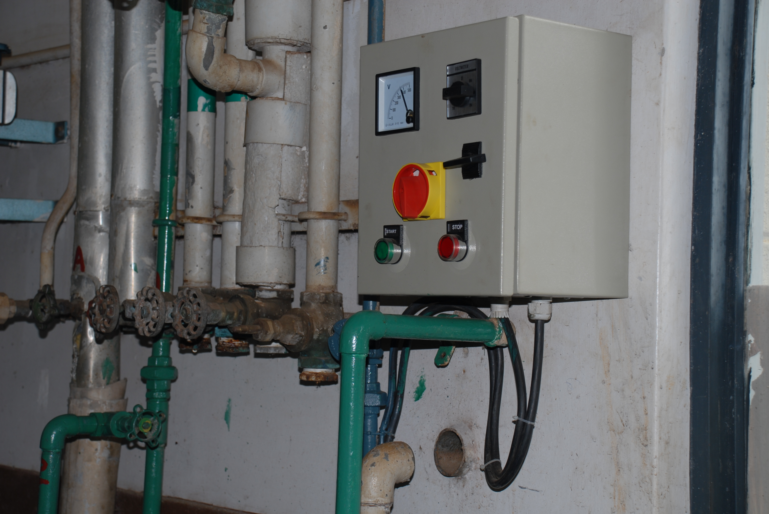
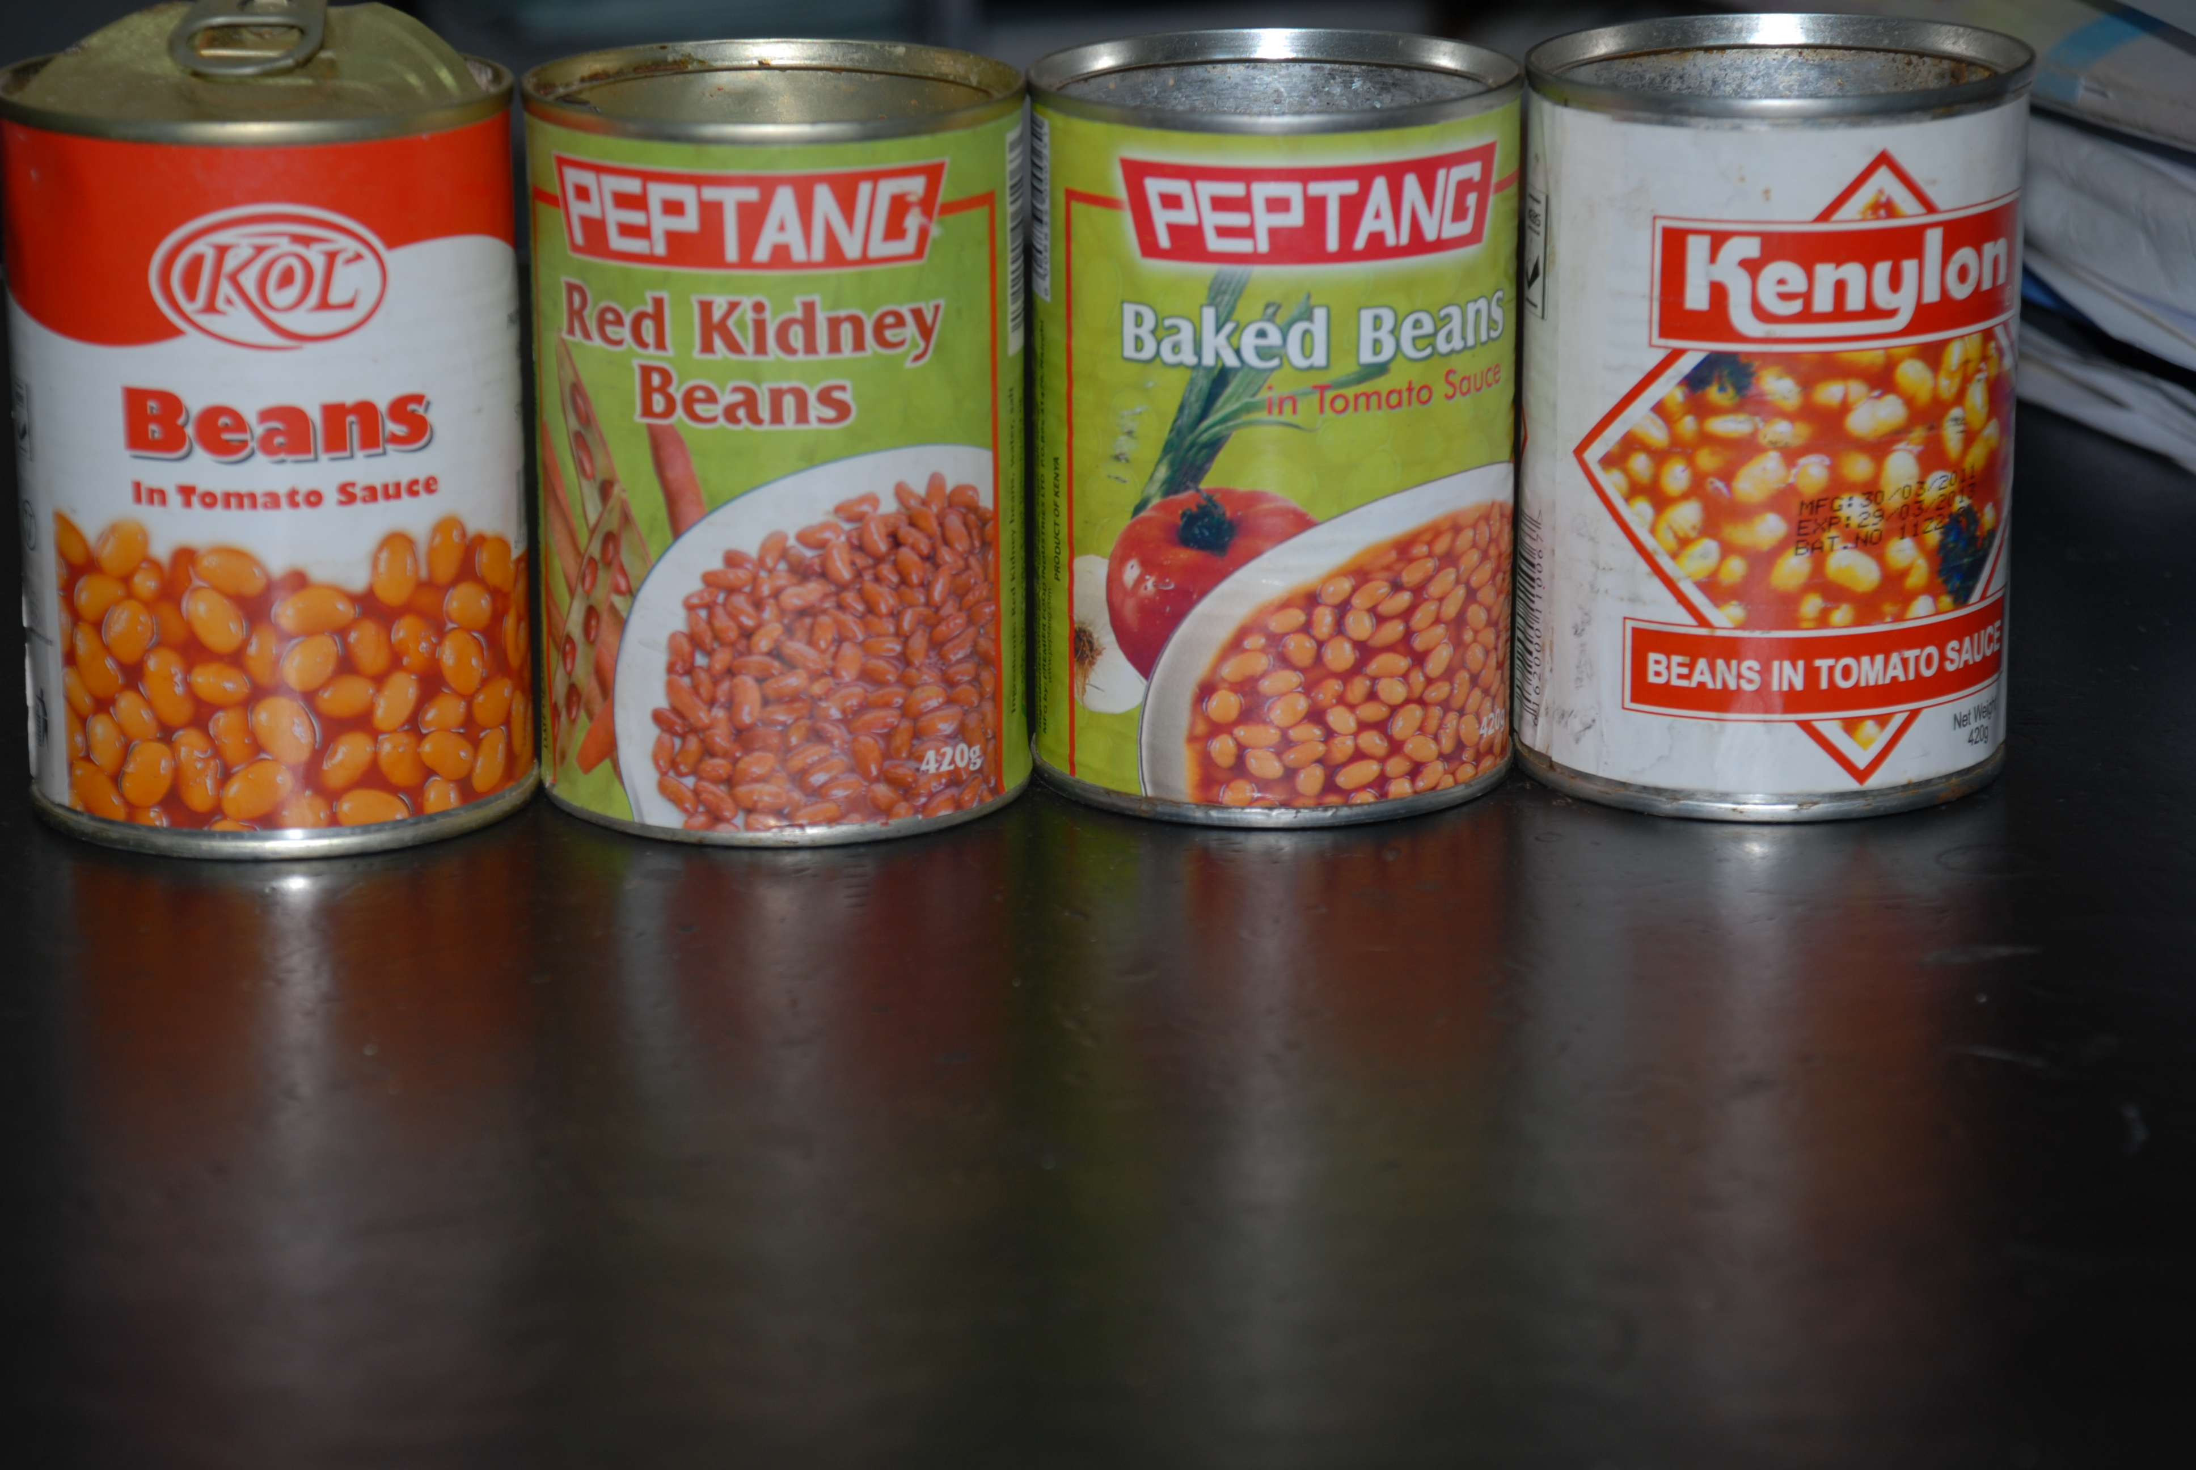
Companies participated in Laboratory testing at Pilot food processing plant at Kabete, and eventually in actual canning in their own factories
Pilot food processing Plant-CAVS
Blanching
Seaming
8 May 2012
Retort
Cooling system
Recorder
Steam generation and regulation

Slide 9
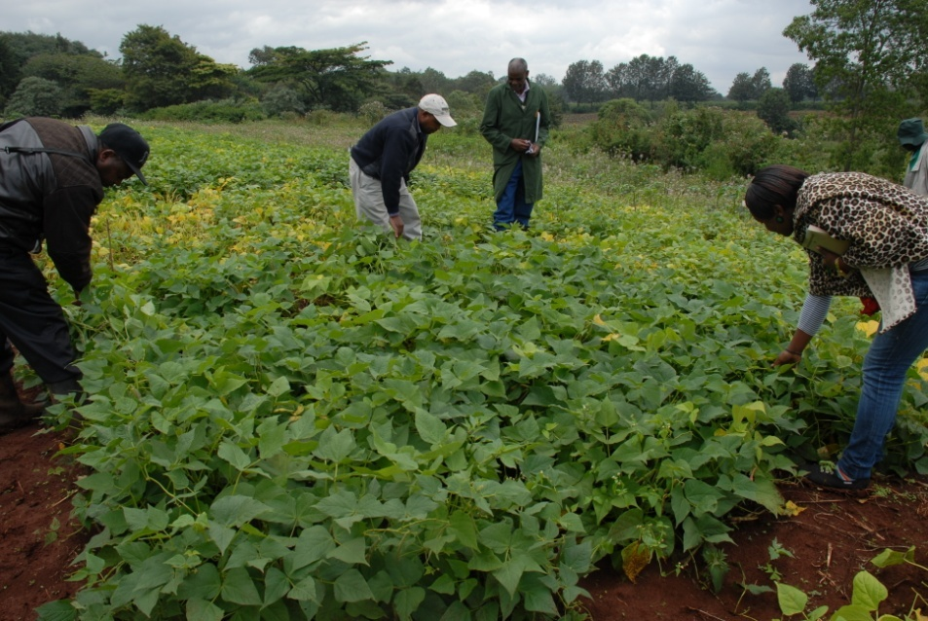
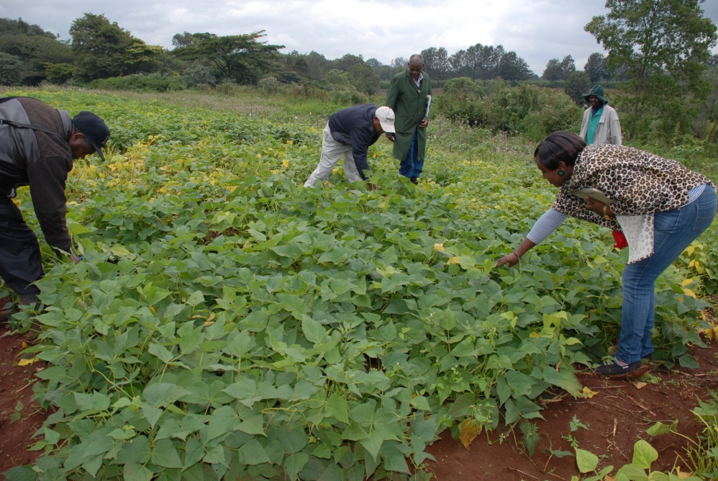
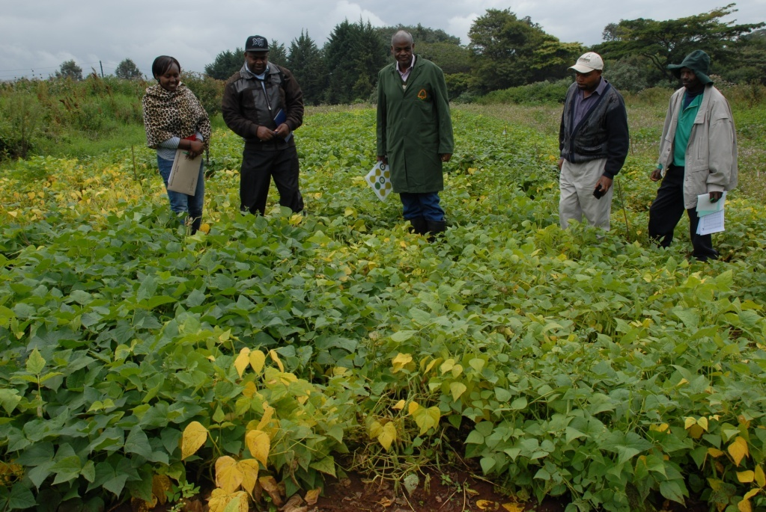
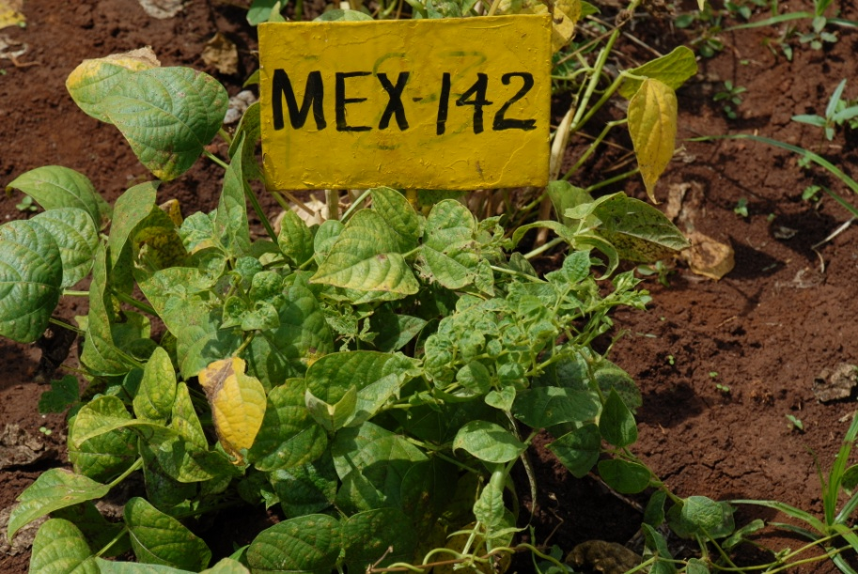
New lines did well in NPT sites
Kabete

Slide 10
Evidence from farmers fields
Short rains: Nov 2014- February 2015- Very severe terminal drought
Variety | Range (kg ha-¹) | Mean (kg ha-¹)
Kenya Cheupe | 1303-1792 | 1537
KCB13-01 | 1111-2135 | 1852
KCB13-02 | 643-1144 | 740
KCB 13-03 | 874-1673 | 1274
KCB13-04 | 607-1739 | 1034
KCB13-05 | (SINGLE FARMER) | 3042
KCB13-06 | 1350-2913 | 1607
KCB13-07 | 1144-2053 | 1599
KCB13-08 | Single farmer | 1260
KCB13-09 | 1068-1978 | 1523
KCB13-10 | 517-1213 | 865
KCB13-11 | 1576-2318 | 1947
KCB13-12 | 1569-3043 | 2309
KAT B1 | (3 ACRES) | 536

Slide 11
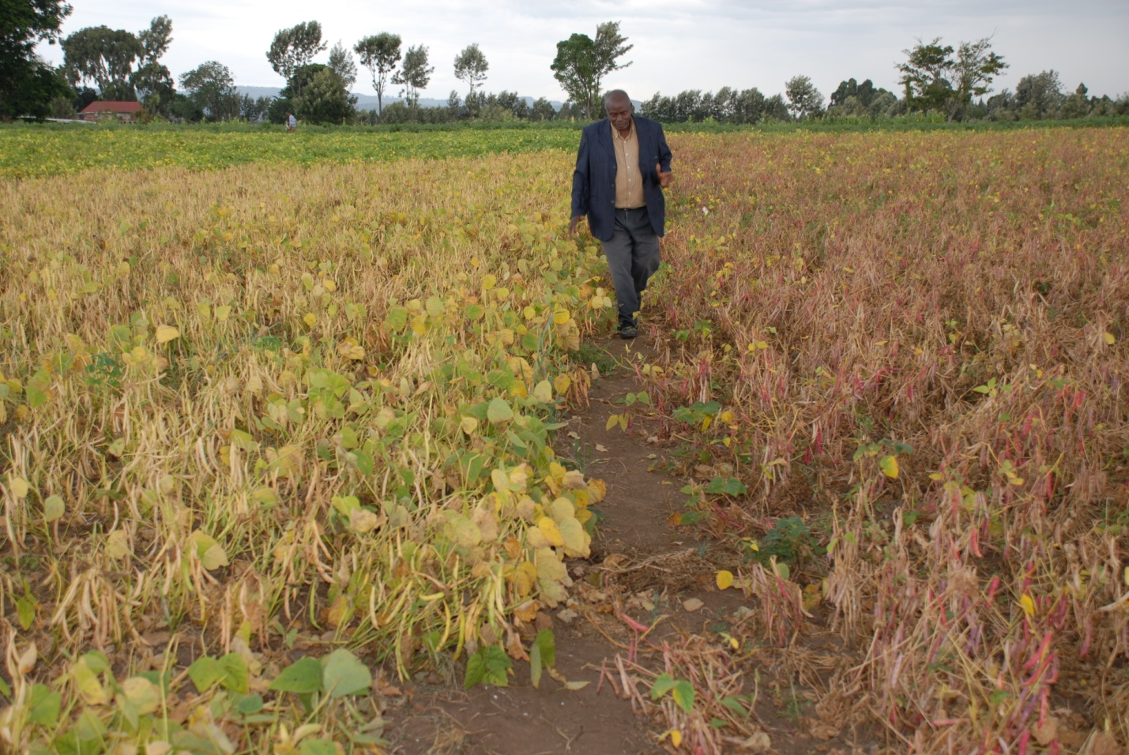
KCB13-08
Farmers in Nakuru says they want the seed
‘Mr Mwaura, when are getting these seeds? We are ready to pay for them!’ James Mwaura, Bean Stakeholders meet at ILRI, Jan 2015

Slide 12
Prototype for up scaling and commercialization tested by processing firms in 2014 and 2015
Two firms contracted farmers to produce grain for processing during SR2014/2015
Bought 3,950 kg for processing from 41 farmers in Feb/March 2015
Njoro Canning Factory: ‘With enough rains and proper crop care, the yield can be very high especially for Kenya Cheupe and the red mottled. It is evident that this varieties can resist drought unless in cases of total lack of rains as experienced in Lare’ –
A total of 1870 kg Kenya Cheupe was received in the factory, we are yet to collect the lot from Solai.
For the other varieties farmers have either consumed or sold the beans and some are maintaining some stocks and we are yet to establish the exact quantities’. (13 April2015)
Truefood Ltd: Company assessment: ‘With optimum weather condition and good agricultural practices the new varieties are better performers than the old varieties in terms of both disease and pest tolerance and higher yields’.
Contracted farmers: ‘The farmers reported of good performance of the new varieties .Reported that the new varieties are drought tolerant. Keen to plant the new varieties during the long rains. With the assurance of a ready market, the contracted farmers are also willing undertake bean production commercially’ (16 April 2015)

Slide 13
New Canning bean varieties
Variety | Market class | Maturity | Yield (t ha-¹)
Kenya Mamboleo | Red mottled | 75-85 d | 2.5
Kenya Salama | Navy | 80-95 d | 2.7
KenStar | Navy | 80-95 d | 3.1
Kenya Cheupe | Navy | 80-95 d | 2.8
Kenya Dark Red Kidney | Red kidney | 80-96d | 2.7

Slide 14
NPT-Kabete, season 2, 24 Oct 2014
This
or
this?

Slide 15
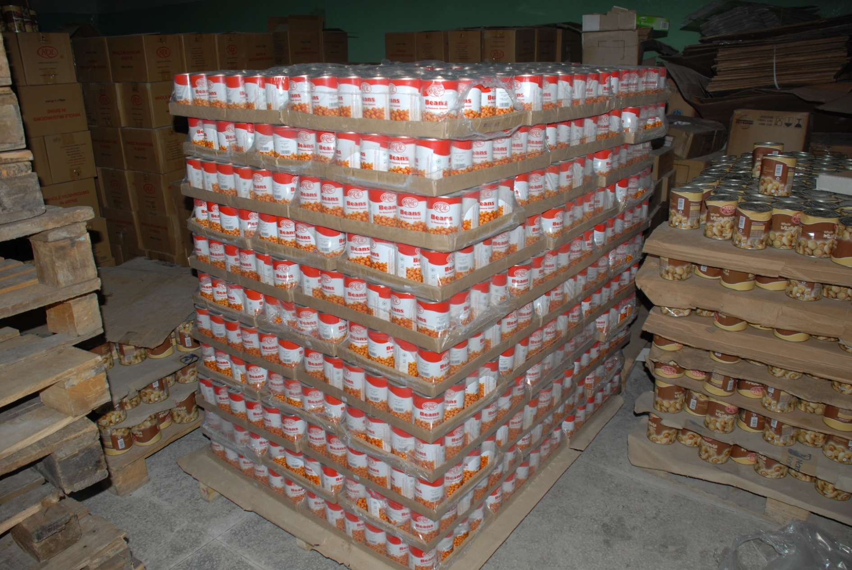
A bean consignment ready for the market

