Slide 1
Module #1
Overview Summary of EiB Module #1 Principles & Work
Tawanda Mashonganyika
Product Manager
27 October, 2018
DLB Phase 2 Consultation Meeting, Nairobi

Slide 2
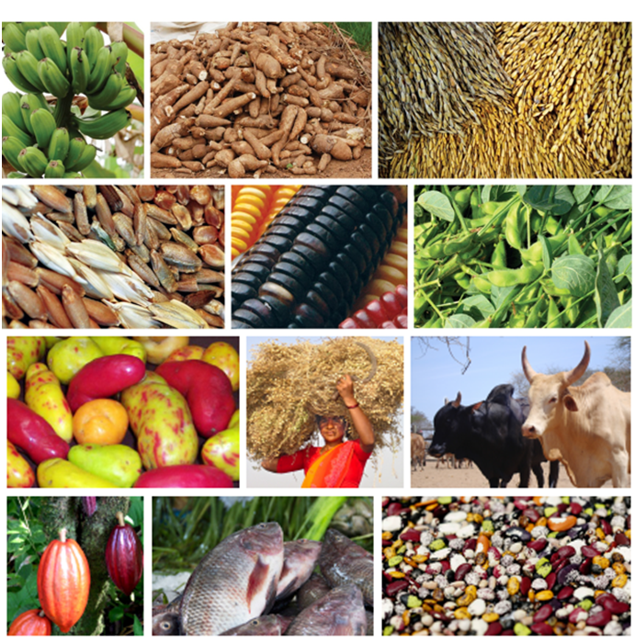
The objective
Accelerate breeding programs’ genetic gains and increase impact for the developing world
Vision of success
Crop and animal breeding programs are delivering high rates of productivity gain to farmers in the developing world through genetically improved cultivars and breeds that are resilient, nutritious, and desired by the market.

Slide 3
Core Ambitions - To enable breeding programs to implement:
Well characterized product profiles as a part of a variety replacement strategy.
A stage-gate process from breeding cross to farm.
Optimized breeding schemes.
Routine assessment of genetic gains.
Lower-cost, better targeted genotypic data supporting larger, more cost-effective programs.
Lower-cost, better targeted phenotypic data supporting larger, more cost-effective programs.
Biometric and Bioinformatics tools that support automation, data integration and decision making.
Identified based on feedback from breeding programs.

Slide 4
EiB Scope
Timelines: Year 1 – 2018, Year 2 – 2019……
Our Clients:
All CGIAR Centers
Selected NARES
Uganda
Kenya
Ghana

Slide 5
Five focus areas = Modules
Module 1
Module 2
Optimizing breeding schemes
Module 3
Genotyping / sequencing
Module 5
Module 4
Phenotyping tools and services
Bioinformatics, biometry and
tools and services
tools and services
& Breeding Strategies
data management
Product Design & Management
Program Metrics
Creating synergies to accelerate genetic gains of breeding programs targeting the developing world
What
How
How
How
How
The Toolbox
How

Slide 6
The Module 1 approach
Understanding Client Needs
Market-driven product profile contracts
Well-designed breeding programs
Well-designed product testing & delivery
Annual Review

Slide 7
Module #1 Thematic Principles
Product Replacement Strategy :Product Profile Contracts
Cross Functional Product Design Team (Subject Matter Experts)
Stage Gate System Approach
RACI Format
Economic Assessment of Traits (AbciousBio)
Plant Breeding Academy

