Slide 1
“Strengthening capacity for safe biotechnology management in Sub-Saharan Africa (SABIMA)”
Stewardship Course – Module 1
Dr. Patrick Rüdelsheim
General Partner, Perseus BVBA

Slide 2
CONGRATULATIONS
You are engaged in one of the most exciting scientific contributions to the improvement of crops, allowing more people to have access to better crops, leading to improved food security and opening new possibilities for crop uses.

Slide 3
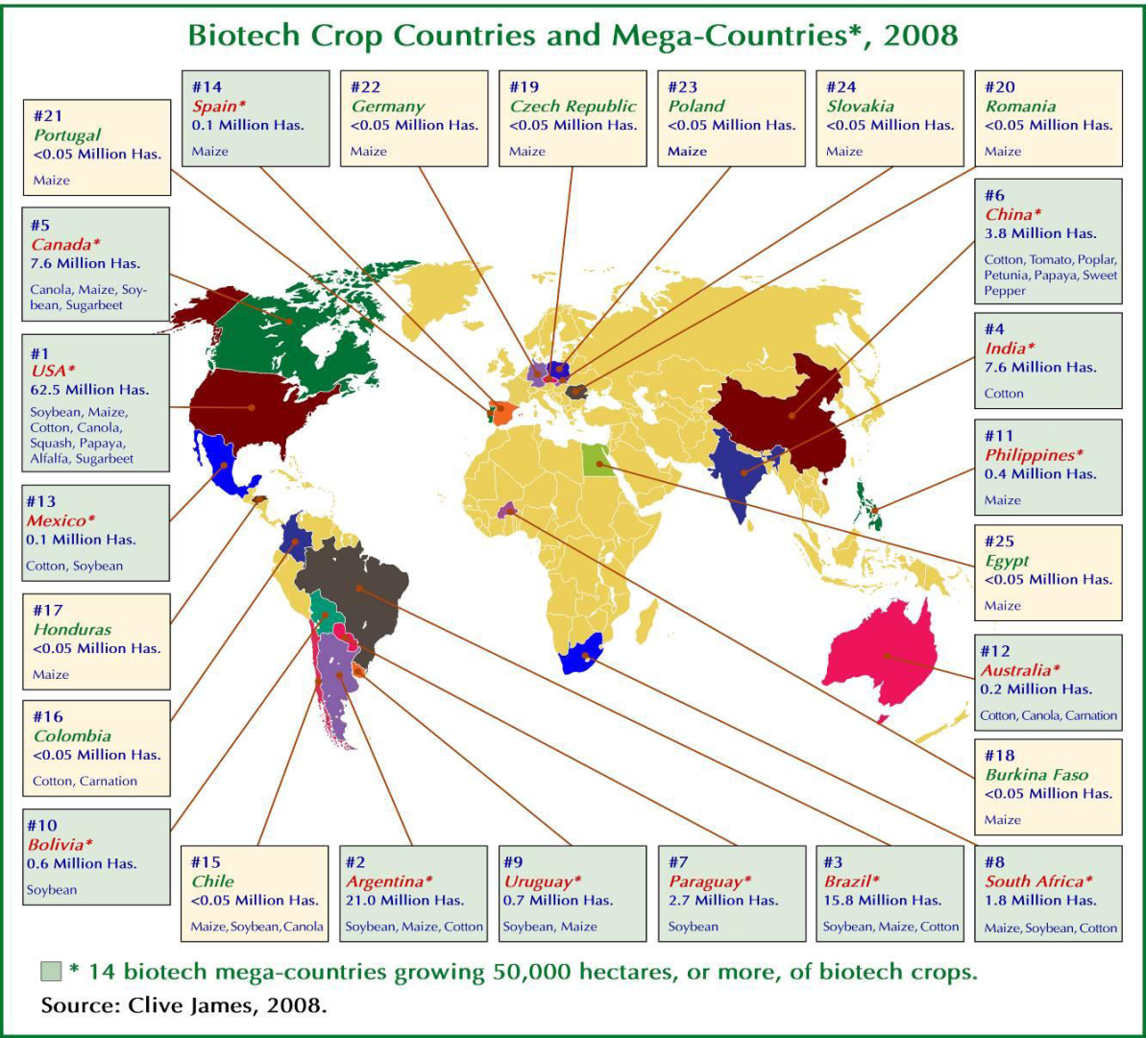
1996 – 2008: cumulative total of over 800 million commercial hectares (source ISAAA, 2009)
In commerce: Soybean, maize, cotton, canola, squash, papaya, alfalfa, sugar beet, tomato, poplar, petunia, sweet pepper, carnation
Large number of field trials (more species, experimental traits)

Slide 4
BUT
The introduction of this technology has been marked by unequaled challenges compared to conventional crops.
  Safety
  Detection
  Regulatory
  Scientific collaboration
  Trade
  Public attention

Slide 5
Non-GMO
Approved
GMO label
GMO
Traces of approved GMO
Traces of unapproved GMO
No GMO
No label
> Threshold GMO label
< Threshold No label
Unapproved

Slide 6
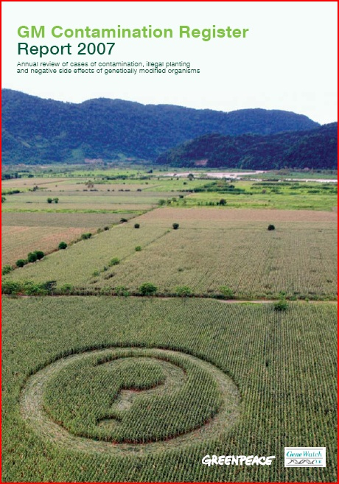
UK Gene Watch & Greenpeace International - GM Contamination Register (10/2009)
192 contamination incidents – where food, feed or a related wild species have been found to contain unintended GM material from a GM crop or other organism
44 illegal plantings or releases of GM organisms – when an unauthorised planting or other release into the environment or food chain has taken place
www.gmcontaminationregister.org

Slide 7
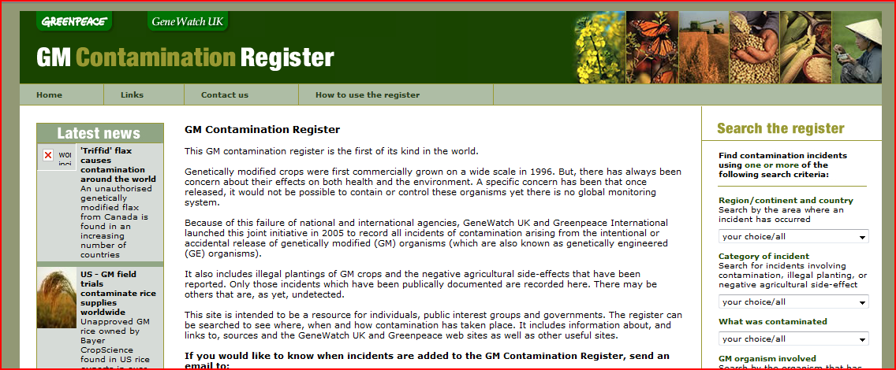

Slide 8
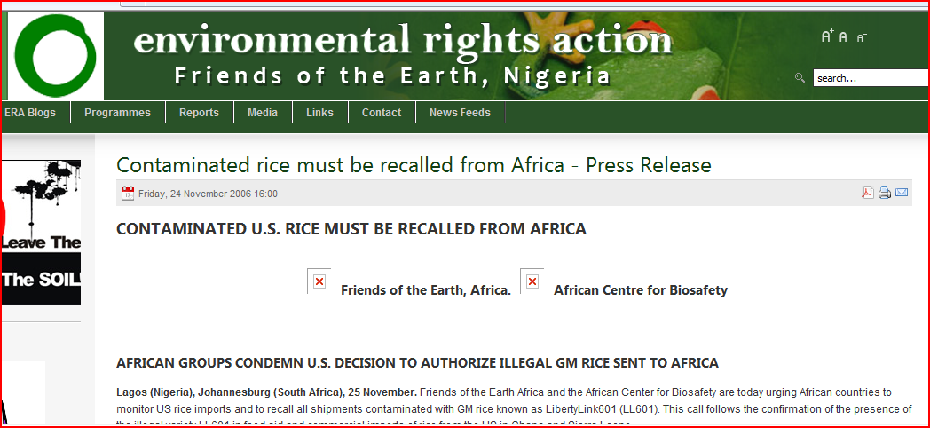

Slide 9
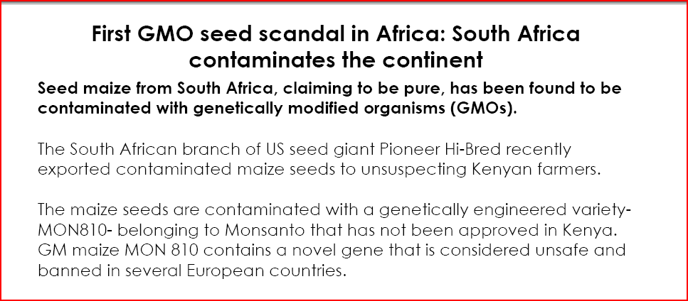

Slide 10
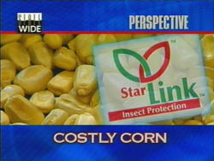
Sales of StarLink seed were discontinued.
The registration for Starlink varieties was voluntarily withdrawn.
Massive buy-back and channeling of any produce that contained traces of StarLink.
28 people reported apparent allergic reactions related to eating corn products that may have contained the Starlink protein.
The US corn supply has been monitored for the presence of the Starlink Bt proteins since 2001. (more than 4 million tests on 4 billion bushels of corn)
In 2008 EPA proposed to lift the monitoring requirement.
StarLink corn
StarLink is a variety of Bt corn developed by Aventis Crop Sciences approved for use in animal feed. In 2000 StarLink corn was found in food destined for consumption by humans.
Public relations disaster for Aventis and the biotechnology industry as a whole.

Slide 11
A good Stewardship Programme can position your organisation to realise the benefits and reduce the risks.
  Limit the liability of the organisation
  Position as a professional partner in collaborations
  Strengthen public confidence
  Avoid introduction of new fields of legislation

Slide 12

SABIMA Project
Capacity Strengthening for the Safe Management of Biotechnology in Sub-Saharan Africa (“SABIMA”).
3 year project
The SABIMA project is oriented to promoting and supporting the need for Africans to develop the skills, processes and capacity for stewardship of biotech products right through the entire value chain from research to product development, seed production, testing and marketing.

Slide 13
SABIMA Project
The specific objectives are to:
  Update information on the current status of agricultural biotechnology and biosafety in the six countries in Africa.
  Identify the capacity building gaps in these countries and the modalities for intervention.
  Provide training in stewardship in FARA, the SROs and the NARS of the selected countries.
  Identify and train stewardship leaders in FARA, the SROs and focal persons/champions in stewardship in selected countries, and advocate and promote national buy-in in biotechnology access and use.

Slide 14
SABIMA Project
Stewardship Background
For people in management and research, who need to understand the importance and implications of stewardship, but who rely on colleagues or staff members for the operational development and implementation of the programme.
Stewardship Leaders
For individuals who will be responsible for developing, implementing and communicating on stewardship inside and outside of their organisation.

Slide 15
SABIMA Project
Module 1
Introduction
Policy, processes & procedures
Module 2
Implementation review
Training/communication
Module 3
Verification/audits
Critical control points

Slide 16
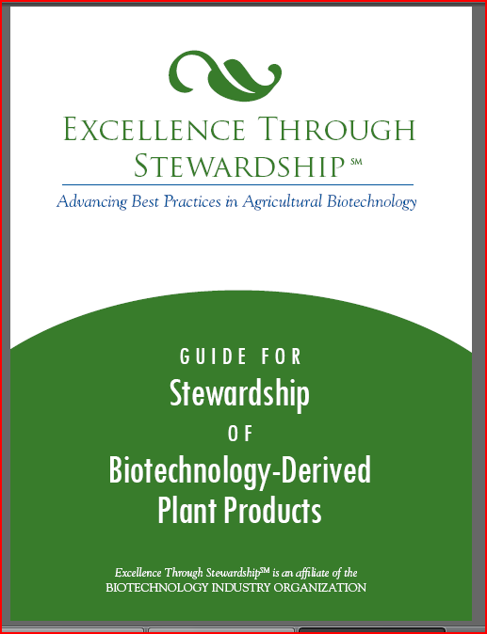
SABIMA Project
Reference documents
  Excellence Through StewardshipSM Guides
    Stewardship of Biotechnology Derived Plants
    Maintaining Plant Product Integrity of Biotechnology Derived Plants
    Product Launch of Biotechnology Derived Plants
    Discontinuation of Biotechnology Derived Plant Products
    Incident Response Management of Biotechnology Derived Plants

Slide 17

SABIMA Project
Reference documents
http://www.excellencethroughstewardship.org/

Slide 18
Module 1
Introduction
  Stewardship programmes
  Life cycle phases of a biotechnology crop product
  Life cycle themes and Stewardship
  Policy, processes & procedures
  Structures & organisation
Establishing the Stewardship programme
  Starting
  Critical control points
  Standard Operating Procedures
  Infrastructure & equipment
  Implementation

Slide 19
1.1 Stewardship Programmes
Stewardship is not a regulatory requirement.
  Stewardship covers a broad range of aspects which should not be subjected to regulatory oversight.
  There is no question that as minimum developers must comply with science-based regulations.
  While a strong regulatory system oversees plant biotechnology, biotechnology product stewardship is the responsibility of each developer and user.
  It is a good way of doing business, supports mutual trust in collaborations, and improves efficiency and strengthens stakeholder and consumer confidence.

Slide 20
1.1 Stewardship Programmes
History
  Ensuring quality control and responsible management of the technology has been central to developing and commercializing new biotech crop varieties.
  Guidance documents summarizing the experience of the developers in specific areas, e.g. Insect Resistance Management, Field Trial Compliance Manual/Workshops, Containment Analysis and Critical Control Point (CACCP) Plan and Product Launch Stewardship Policy.
  In 2007 launch of “Excellence Through Stewardship” (ETS), the first industry-coordinated effort to address product stewardship and quality management.

Slide 21
1.1 Stewardship Programmes
ETS programme
  to promote the responsible management of plant biotechnology, primarily by developing and encouraging implementation of product stewardship practices and by educating the public about those practices
  Three main components include:
    Stewardship Objectives, Principles and Management Practices, which members are required to adopt and abide by to contribute to responsible product management.
    Guides to Understanding and Implementing Stewardship and Quality Management Systems, which promote stewardship and quality management practices for the responsible use of biotechnology-derived plant products globally.
    A Global Stewardship Audit Process.

Slide 22
1.1 Stewardship Programmes
  Stewardship in plant biotechnology
  is the responsible management of a product from its inception through to its use and discontinuation.
  applies across the life cycle of a plant product and includes careful attention to the responsible introduction and use of products.
  Objectives of a Stewardship plan should include:
    Fully comply with applicable regulatory requirements,
    Seek to achieve and maintain plant product integrity, and
    Work to prevent trade disruptions in order to facilitate the flow of goods in commerce

Slide 23
1.1 Stewardship Programmes
  Stewardship, a programme of continuous improvement
  Stewardship is not a goal per se.
  A continuous improvement process is a management process whereby the processes are constantly evaluated and improved in the light of their efficiency, effectiveness and flexibility.
Plan
Do
Check
Act

Slide 24







1.2 Life Cycle phases
E
Seed
Production
Seed Marketing & Distribution
Crop Production
Plant Development
Crop Utilization
Gene Discovery
Product Discontinuation
modelled after the
Guide for Stewardship of Biotechnology-Derived Plant Products
(March 2009 Excellence Through Stewardship)

Slide 25
1.2 Life Cycle phases
Gene Discovery phase
  Activities to identify and evaluate the specific genes and other elements that may be used to produce or construct a new plant product through biotechnology.
  Basic research in contained laboratory, growth room and greenhouse facilities. Occasionally a limited scale research field trial may be required.
  Goal: Proof of concept.
  Material developed during this phase may be suited for further development, however in most cases this basic research material may contain features that are not desired for development and commercialisation.

Slide 26
1.2 Life Cycle phases
  Plant Product Development phase
  activities that occur before a biotechnology-derived plant product can be commercialized.
  Plant transformation targeted to produce products and regeneration, event selection in contained facilities and confined field trials, and event evaluation for agronomic and regulatory studies.
  Goal: deregulated biotech crop

Slide 27
1.2 Life Cycle phases
  Plant/ Seed Multiplication phase
  The continuous process in which plant products are grown according to defined standards and requirements to ensure genetic identity, maintain varietal purity, and meet certain quality standards before distribution to growers.
  In many countries, seed multiplication is part of a legally sanctioned system for quality control of seed production.
  Generally, there are four stages of seed multiplication: breeder seed, foundation seed, registered seed, and certified seed.
  May or may not be grown under confined conditions depending on status of regulatory authorization.

Slide 28
1.2 Life Cycle phases
Commercial Plant/Seed Distribution phase
  Activities related to the introduction and distribution of seed/plants for commercial sale
  All regulatory authorizations that are a prerequisite to market launch will have been obtained
  Often not controlled by one entity

Slide 29
1.2 Life Cycle phases
Crop Production phase
  activities involved in the cultivation for harvest of an authorized, commercially available biotechnology-derived seed or plant.
Crop Utilization phase
  the use of biotechnology-derived plant products for food, feed, fiber or other purposes (e.g., biofuels, industrial applications, etc.).

Slide 30
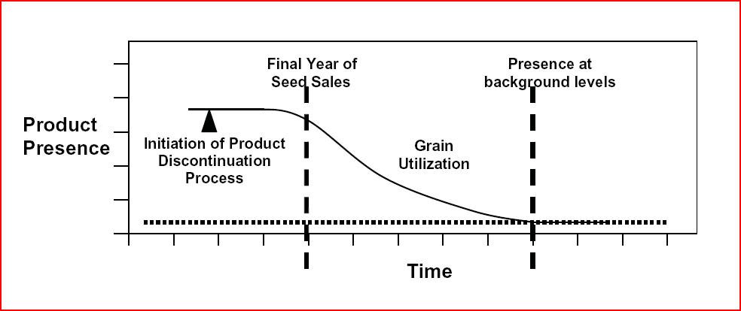
1.2 Life Cycle phases
Product Discontinuation phase
  activities involving products that were authorized for commercial use, but have since reached the end of their commercial life cycle.
  Separate and distinct from product withdrawals and recalls.
  A business decision, and takes into account many factors, including the prevailing regulatory requirements, market forces and product replacement.
  Discontinuation is a normal part of the product life cycle.

Slide 31
1.2 Life Cycle phases
E
Seed
Production
Seed Marketing & Distribution
Crop Production
Plant Development
Crop Utilization
Gene Discovery
Product Discontinuation
modelled after the
Guide for Stewardship of Biotechnology-Derived Plant Products
(March 2009 Excellence Through Stewardship)

Slide 32
1.3 Life cycle themes
Quality & Sustainability
Safety
Regulatory Compliance
Product Integrity
Containment & Confinement

Slide 33
1.3 Life cycle themes
Safety
  Throughout the life cycle the concern for safety is of prime importance.
  The precautionary principle requires a careful evaluation and if necessary management of potential risks.
  From a stewardship perspective an organisation should ensure that:
    During the entire life cycle of biotech products information is accumulated to identify any safety issue.
    Only products supported by state-of-the-art safety demonstration are carried forward through development and eventually to market.
    Systems are in place to react on new findings.

Slide 34
1.3 Life cycle themes
Quality & sustainability
  Product specifications
    Performance criteria & quality parameters
    Quality assurance
    Quality control
  Sustainable use
    Developing and implementing management strategies.
      e.g. Insect Resistance Management, Weed Resistance Management
      Technology User Guides

Slide 35
1.3 Life cycle themes
X
X
Plant Product Identity
Avoid adventitious presence of unintended traits
Containment & Confinement
Avoid creating a source of adventitious presence
Conform to performance criteria

Slide 36
1.3 Life cycle themes
Plant Product Integrity
  the specific identity of a plant and purity of populations of the plant that are established and maintained using appropriate measures.
  the identity and purity of the material need to be controlled at different levels, including genetic elements, constructs, vector organisms, recipient material and transformation events

Slide 37
1.3 Life cycle themes
Plant Product Integrity
  Take care of
    Misidentification & mislabelling
    Inadequate facilities or controls for containment
    Insufficient isolation or other control measures that do not prevent or that limit cross-pollination of plants
    Inadvertent physical mixing of plant material
    Incomplete clean-out of planting, harvesting, transporting, and conveying equipment, and storage facilities
    Errors in evaluating the transgenic purity of plant material to be planted, harvested and/or retained
    Errors in tracking
    Errors in disposition

Slide 38
1.3 Life cycle themes
Containment
  The control of viable seed or vegetative propagating material in a manner that mitigates their release outside of their controlled development in the laboratory, greenhouse, seed-conditioning or -storage facilities.
  Note that also containment during storage and transport deserve proper attention.
Confinement
  The control of viable seed or vegetative propagating material planted in the field in a manner that mitigates the spread of pollen or other propagatable plant parts out of the confined trial area.

Slide 39
1.3 Life cycle themes
Confined Field Trials
  Confined field trials are the first controlled introduction of biotechnology-derived plants into the environment.
  Management of confined field trials requires a significant commitment to ensure that the terms and conditions of authorization of the field trial by regulatory authorities are met.

Slide 40
1.3 Life cycle themes
Containment & confinement
  Containment/confinement measures and proper inactivation of material before disposal are combined to
    Prevent exposure of the public and the environment
    Avoid creating a sources of adventitious presence.
  Keeping track of materials and proper agreements with any third parties that might be involved in control and fate of the materials. (Traceback)

Slide 41
1.3 Life cycle themes
Regulatory compliance
  Countries are at different stages of implementing legislation for activities with biotech products.
  These may cover use in contained facilities, confined field trials, commercial introduction, food and feed use, import, export and internal transport.
  Users observe all the requirements for obtaining the necessary permits as well as all the operational conditions that are imposed on the execution of the intended activity.
  Two specific cases require additional attention: Product Launch and Product Discontinuation.

Slide 42
1.3 Life cycle themes
Product Launch
  Policies for product launch stewardship as well as appropriate processes and plans that manage the commercialization activities
  The goal is to minimize trade disruptions that can occur with asynchronous authorizations of biotechnology-derived products in importing countries.

Slide 43
1.3 Life cycle themes
Product Launch
  Product Launch regulatory strategy is a complete overview of permit requirements and management options.
    Identification of the responsible for product launch stewardship.
    Conduct of a market and trade assessment to identify key import activities prior to commercial launch.
    Development of regulatory and commercialization plans to meet applicable regulatory requirements in key production and importing countries
    Making available of a detection method to stakeholders when and where appropriate

Slide 44
1.3 Life cycle themes
Product Discontinuation
  A Product Discontinuation Plan should be developed that addresses regulatory registration strategies, potential impacts on market licensing agreements globally
  Allow elimination of product inventories and prevent new market exposure for the discontinued product through company research, development and/or commercial activities.
  Integrate the needs of stakeholders in the value chain at the moment that the product will no longer be supported.

Slide 45
1.3 Life cycle themes
Product Discontinuation
  General principles.
    Relevant documentation and records should be tracked and archived as appropriate throughout the product life cycle (i.e., molecular characterization, product information, agreements).
    Appropriate regulatory approvals should be maintained throughout the discontinuation phase.
    Product discontinuation should be openly communicated to value chain stakeholders.
    Discontinued product materials (seed, grain, and derived products) generally should be allowed to move through the usual channels for end use and consumption.
    A technology provider’s internal product-discontinuation process should be properly documented and verified to assist in discussions with regulatory authorities and stakeholders.

Slide 46
1.3 Life cycle themes
Quality & Sustainability
Safety
Regulatory Compliance
Product Integrity
Containment & Confinement

Slide 47
1.4 Policy, processes & procedures
Policy
  a definite course or method of action selected from among alternatives and in light of given conditions to guide and determine present and future decisions.

Slide 48
1.4 Policy, processes & procedures
Process
  a series of actions or operations that results in an end product

Slide 49
1.4 Policy, processes & procedures
Procedure
  a particular way of accomplishing something or of acting.
  Standard Operating Procedures (SOPs) are established or prescribed methods to be followed routinely for the performance of designated operations or in designated situations.

Slide 50
1.6 Structure and organization
Internal organization
Top Management
Endorse Product Stewardship
Trained and mandated by their management to steer the implementation of Product Stewardship in their organisation
Functional Responsible
Involved in daily operations and are key in communication with the involved personnel and in the implementation of the proper practices
Set the objectives
Identify necessary resources
Take note of the regular reports
Communicate
Stewardship Leaders

Slide 51
1.6 Structure and organization
Third parties
  Collaborations
    Include stewardship in contractual obligations
    Offer to provide guidance and references
  Stakeholders
    Value chain
    Special interest groups

Slide 52
To recall….
  Stewardship in plant biotechnology
  is the responsible management of a product from its inception through to its use and discontinuation.
  applies across the life cycle of a plant product and includes careful attention to the responsible introduction and use of products.
  Objectives of a Stewardship plan should include:
    Fully comply with applicable regulatory requirements,
    Seek to achieve and maintain plant product integrity, and
    Work to prevent trade disruptions in order to facilitate the flow of goods in commerce

Slide 53
To recall….
E
Seed
Production
Seed Marketing & Distribution
Crop Production
Plant Development
Crop Utilization
Gene Discovery
Product Discontinuation
modelled after the
Guide for Stewardship of Biotechnology-Derived Plant Products
(March 2009 Excellence Through Stewardship)

Slide 54
To recall….
Quality & Sustainability
Safety
Regulatory Compliance
Product Integrity
Containment & Confinement

Slide 55
Module 1
Introduction
  Stewardship programmes
  Life cycle phases of a biotechnology crop product
  Life cycle themes and Stewardship
  Policy, processes & procedures
  Structures & organisation
Establishing the Stewardship programme
  Starting
  Critical control points
  Standard Operating Procedures
  Infrastructure & equipment
  Implementation

Slide 56
2.1 Starting
Important
  Support from Top Management
  Buy-in from the Operational Staff
Get a complete overview of the scope of activities, projects and organisational structure.
  Identify the different phases & process.
  Map the objectives that have been determined for each project.
  Subsequently for each process a critical control point analysis will be performed.

Slide 57
2.2 Critical Control Point
A Critical Control Point (CCP)
  a step at which control can be applied and is essential to prevent, eliminate, or reduce to an acceptable level an activity that may compromise one of the life cycle themes.
  (Note that the term control as used here means “to have/to bring under control,” and should not be confused with testing, checking or verification).

Slide 58
2.2 Critical Control Point
The concept of CCP is derived from the ‘Hazard Analysis Critical Control Point’ (HACCP)
HACCP describes 7 “principles”:
    1: Conduct a hazard analysis
    2: Determine Critical Control Points (CCPs)
    3: Establish critical limit(s)
    4: Establish a system to monitor control of a CCP
    5: Establish the corrective action to be taken when monitoring indicates that a particular CCP is not under control
    6: Establish procedures for verification to confirm that the HACCP system is working effectively
    7: Establish documentation concerning all procedures and records appropriate to these principles and their application

Slide 59
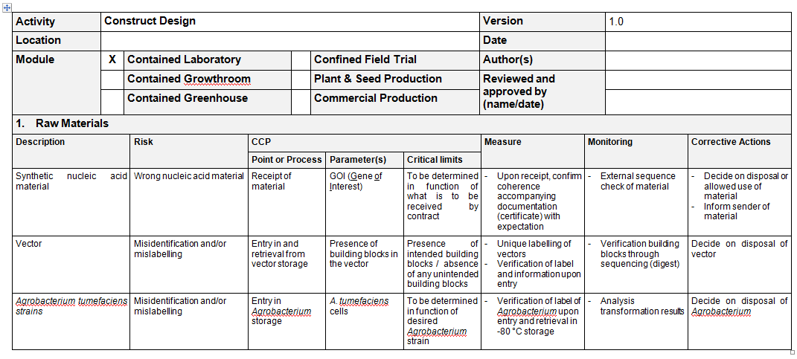
2.2 Critical Control Point

Slide 60
2.3 SOPs
SOPs
  For training
  For recording experience
  For consistency
  For documentation
  For reference
an organisation needs to define clearly the people that will be involved in managing the SOPs and the management processes.

Slide 61
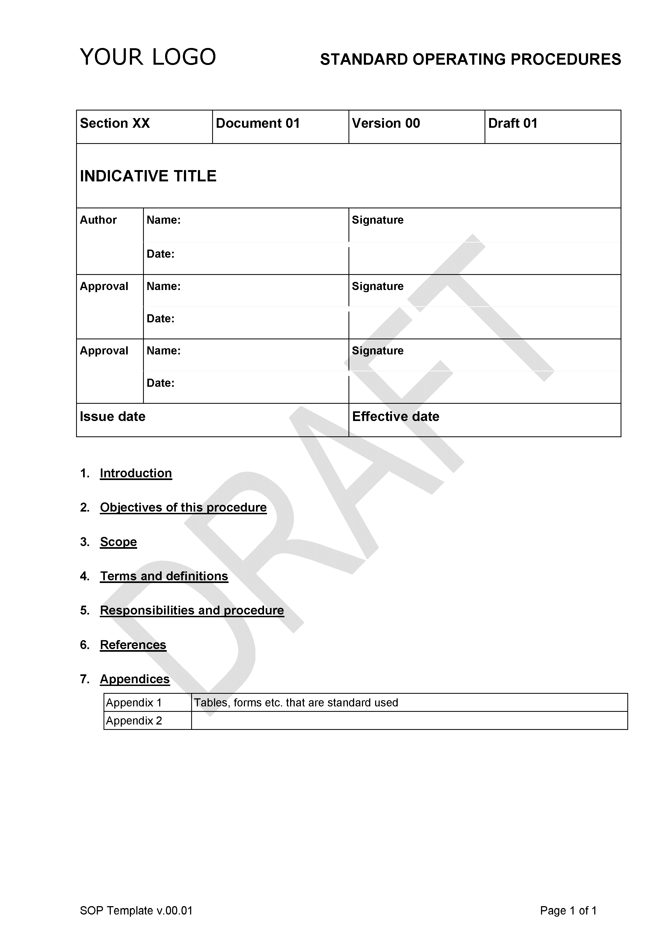
2.3 SOPs

Slide 62
2.3 SOPs
Where appropriate, validation should occur of the procedure subject to the SOP.
Need for communication and training (maybe even condition for performing certain task)
Need to review and update SOPs (and communicate updates)

Slide 63
2.3 SOPs
Inventory
  Pivotal role in managing the integrity of biological material.
  Based on a combination of
    uniform labelling,
    strict acceptance criteria,
    review of entry and retrieval procedures to ensure that all material and relevant information is recorded and accounted for,
    link with information in databases that allows retrievability of information pertinent to the identity of the material.

Slide 64
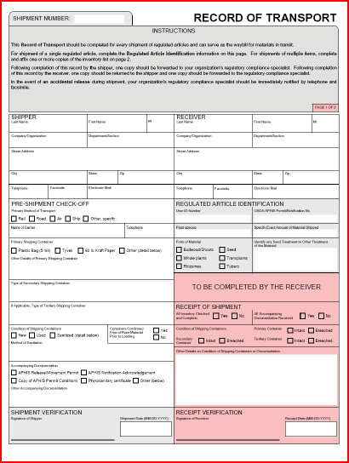
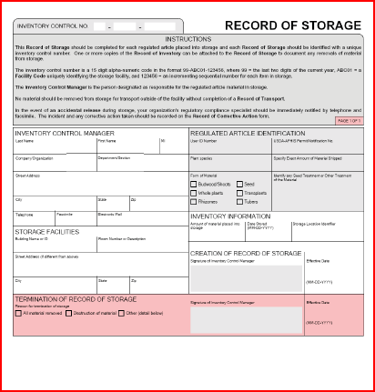
2.3 SOPs
Inventory

Slide 65
2.3 SOPs
Documentation
  Good documentation is the foundation of any system.
  It specifies how the system should work, reflects how the system is implemented in practice and can demonstrate that the system is effective in achieving the objectives.
  Critical information has to be identified based on different perspectives like scientific value, business interest, regulatory requirements and contractual obligations.
  It is necessary to put security systems in place to prevent a loss of or tampering with information based on a technical failure or malicious intent.

Slide 66
2.3 SOPs
Documentation includes
  policy documents, Manuals, SOPs, Work instructions,
  job descriptions, assignment of responsibility,
  meeting records, action plans and lists,
  record keeping for experiments, identity and purity tests, monitoring,
  databases for results and inventory,
  reports on safety studies, regulatory analysis, validation, verification, certification,
  project plans for research and development projects,
  training plan, training records,
  audit and inspection reports, and
  incident reporting, incident response.

Slide 67
2.3 SOPs
Traceback
  is the ability to follow the movement of a biotechnology-derived plant through specified stage(s) of development, production, and distribution of seeds or plants to growers.
  By the way the inventory databases are designed, this should be possible.
  Furthermore fast tracing of relationship between different materials should be foreseen.

Slide 68
2.4 Infrastructure & equipment
Facilities (Lab, Growth Room, Greenhouse, Storage)
  Facilities must have proper containment features functioning, that equipment promoting containment is available and that operations are contributing to preventing release of propagatable material.

Slide 69
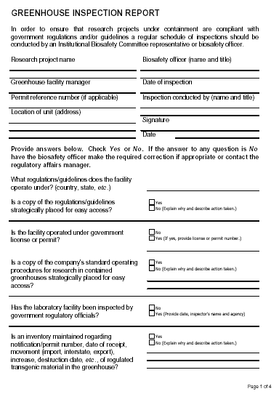
2.4 Infrastructure & equipment
Facilities (Lab, Growth Room, Greenhouse, Storage)
  Some facility features require regular verification of their performance status e.g. ambient factors that could influence the quality of material and containment.
  Routine internal inspections of the facility have to be undertaken to confirm that the appropriate level of containment is maintained.

Slide 70
2.4 Infrastructure & equipment
Facilities (Lab, Growth Room, Greenhouse, Storage)
  Proper operations by trained staff are crucial for ensuring the daily achievement of the Stewardship goals,e.g.
    labelling of materials,
    ensuring reproductive isolation within the facility,
    space assignment within the facility,
    equipment cleaning prior and after use,
    appropriate disposition of plant material, and
    information entry in a unified system.

Slide 71
2.4 Infrastructure & equipment
Field operations
  Deployment of regulated GM crops in the field has to be confined to reduce the potential for exposure and of dispersal in space and in time of propagatable material.
  Special attention
    labelling of materials,
    establishment and verification of reproductive isolation measures around the field trial site,
    verification of reproductive isolation within the field trial site if required for transgenic purity
    equipment cleaning prior to leaving the trial site and sometimes between different seed batches
    appropriate disposition of plant material after harvest
    post-harvest land use restrictions.

Slide 72
2.5 Internal implementation
The actual plan will largely depend on the organisation and the specific activities.
Stewardship is overarching.
Integrate Stewardship into existing processes and procedures.
Create awareness and invite collaboration
Introduce Stewardship in a stepwise fashion.

