Slide 1
Vegetable R&D at World Vegetable Center (WorldVeg) Highlight
Fekadu Fufa Dinssa
Vegetable Breeder
26-27 October 2018
Demand-Led Breeding Meeting, Windsor, Kenya

Slide 2
World Vegetable Center (WorldVeg)
Nonprofit making international research center
Founded in 1971 as Asian Vegetable Research and Development Center (AVRDC), based in Taiwan
Notes:
We’ve been at our work for nearly four decades. We began as the ASIAN VEGETABLE RESEARCH and DEVELOPMENT CENTER, with a focus on tropical Asia.
Over time our geographical focus has shifted...but one thing that has remained the same is that we are NONPROFIT – our research outputs are global public goods and freely available for others to use.
This is our mission: Basically, we help farmers GROW MORE VEGETABLES and GROW THEM SAFELY, because vegetables are high-value crops that generate good income for farmers …. AND, WE WANT PEOPLE TO EAT MORE VEGETABLES, because vegetables have important nutrients we can’t get from any other source.

Slide 3
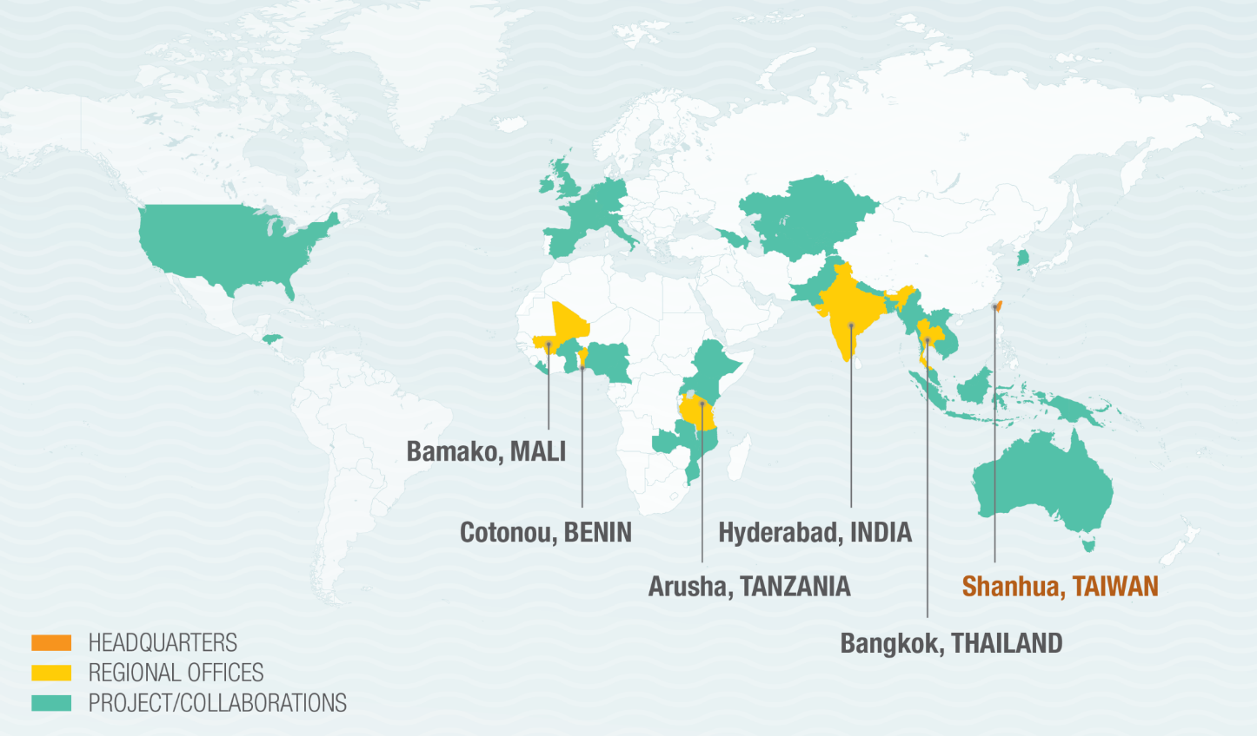
Three of five WorldVeg regional centers are in Africa
Bamako: Western and Central Africa, Dry areas
Cotonou: Western and Central Africa, Coastal and humid areas
Shanhua: Headquarters
Bangkok: East and Southeast Asia
Arusha: Eastern and Central Africa (Established in 1992)
Hyderabad: South Asia

Slide 4
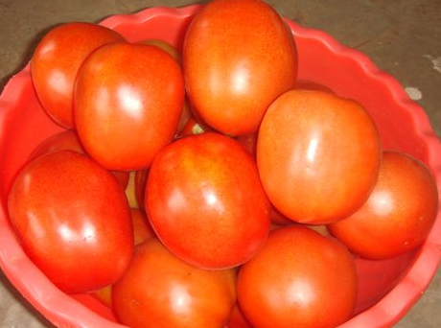
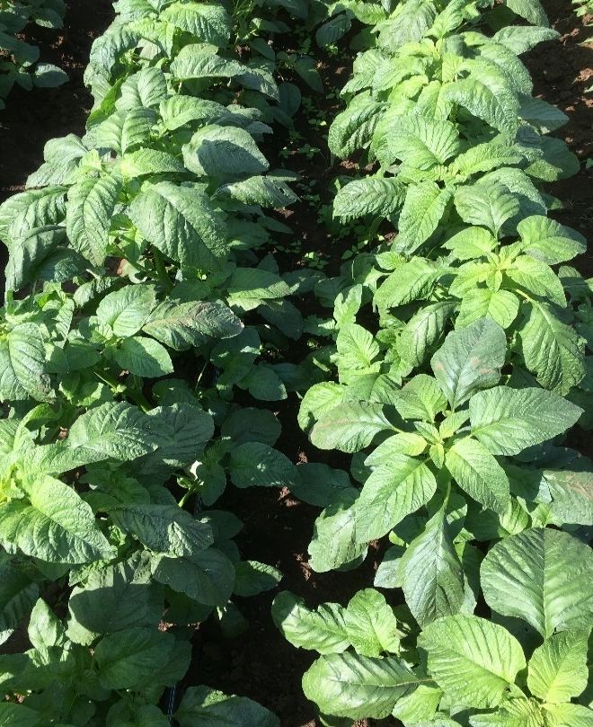
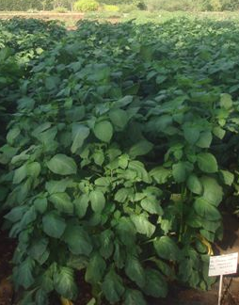
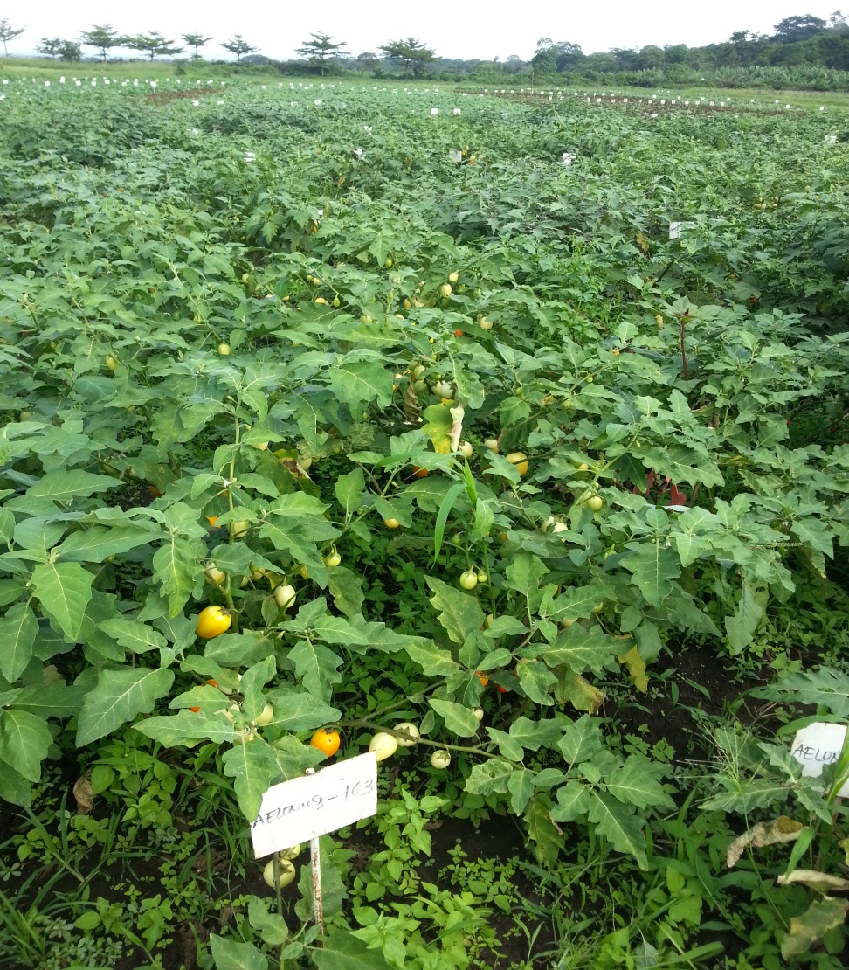
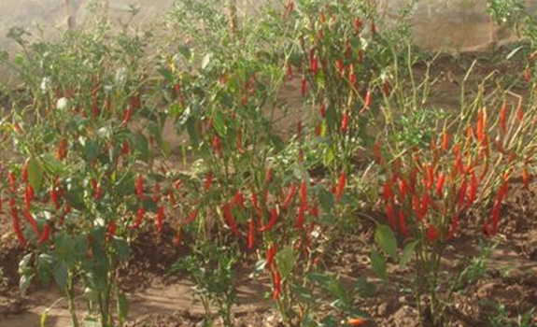
Traditional African Vegetables
Exotic/Global vegetables
Amaranth
Ethiopian mustard
A. Nightshade
African eggplant
A. Nightshade

Slide 5
Focus crops by regional centers
Onion
Tomato
Peppers
Biotic and abiotic stresses
Tomato
Traditional African Vegetables
Amaranth
African eggplant
African nightshade
Ethiopian mustard
Spider plant
Vegetable cowpea
Cucurbits
Bitter gourd
Cucumber
Pumpkin
Vegetable legumes
Mungbean
Soybean

Slide 6
Activities
Discovery
Germplasm development
Piloting
Testing and variety release
Scaling
Seed availability, variety deployment
Germplasm
Collection
Develop breeding lines
Improved germplasm utilized by
Improved varieties released
Improved varieties available to producers
Conservation
Public research institutions
Academic institutions
Breeding/Seed companies
Advanced research institutions
More vegetable available to consumers
Improved nutritional status people
Improved livelihood
Improved food supply
WorldVeg
WorldVeg still supports variety release
WorldVeg supports quality seed availability, and popularization

Slide 7
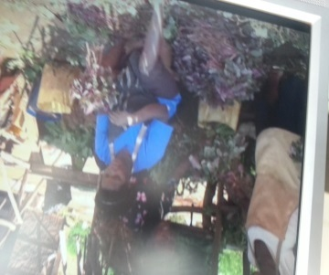
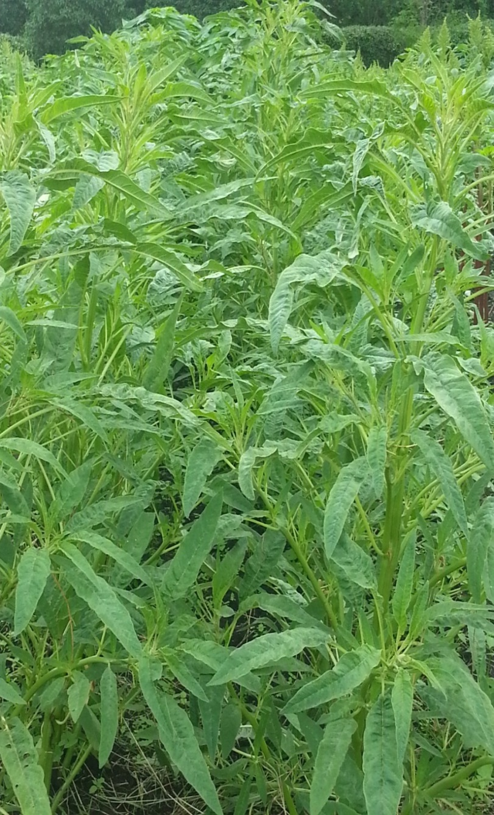
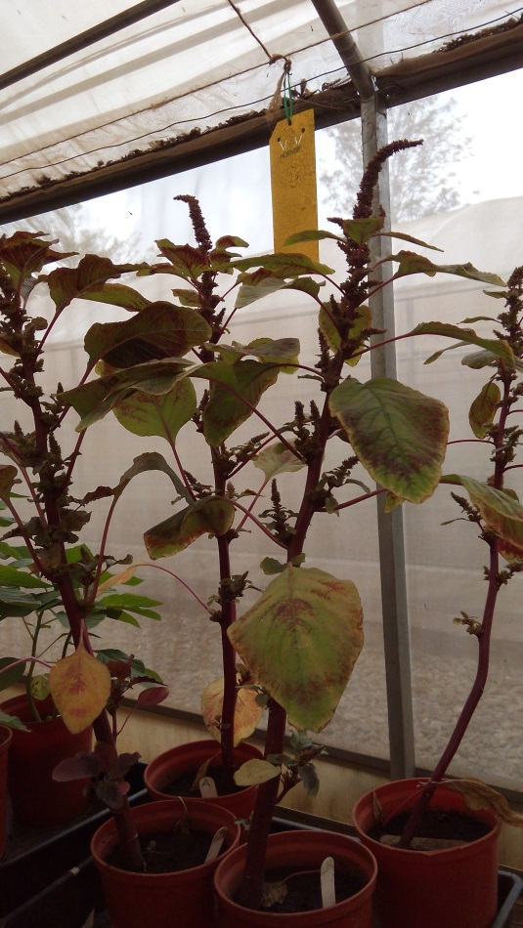
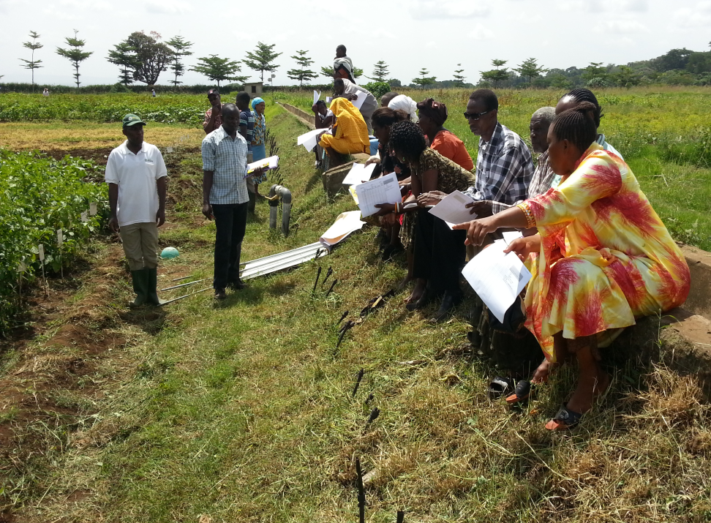
Strategy for Traditional African Vegetables
Identify priority crops for breeding
African eggplant: fruit, leaf types
Amaranth: leaf, grain, dual
Identify product profiles
Characterize selection sites
Define breeding objectives for the different types
Build partnerships and support for traditional African vegetables
Enhance knowledge about the vegetables
‘Participatory plant breeding finds its place in Neglected and Underutilized Crops’
Now DLB too!

Slide 8
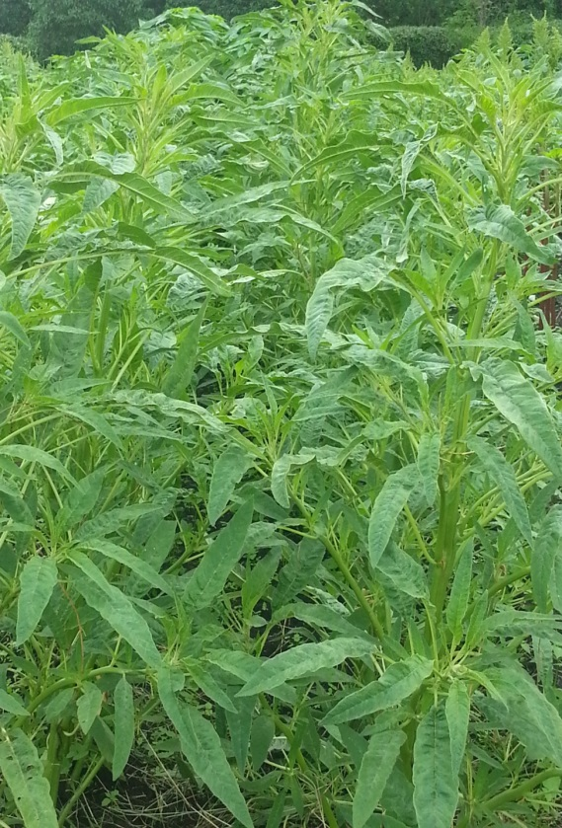
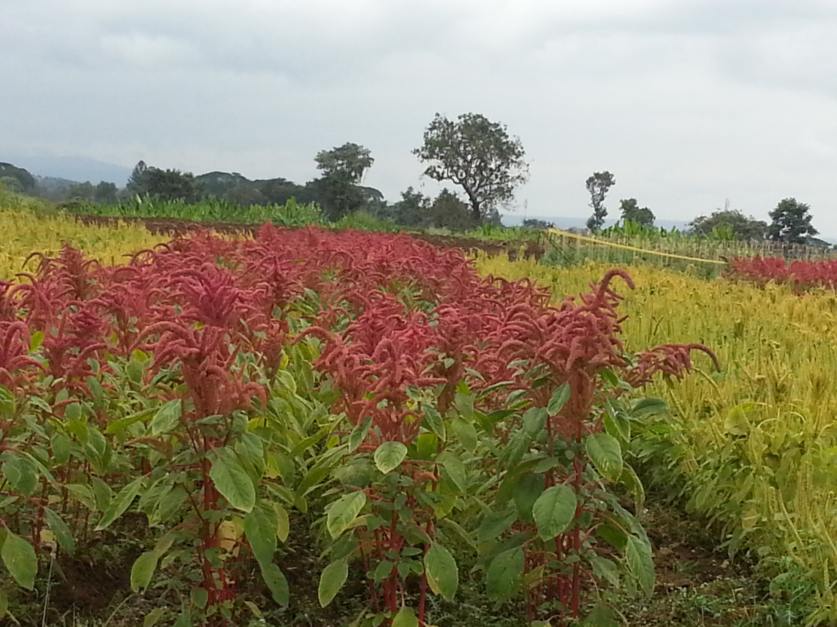
Three types of amaranth (Amaranthus spp.)
Vegetable type
Grain type
Dual type

Slide 9
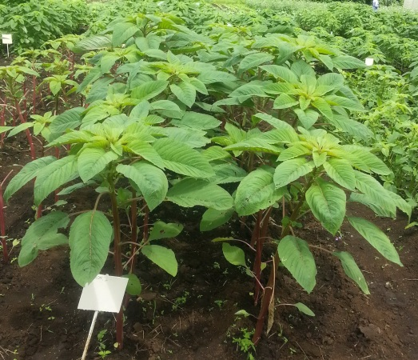
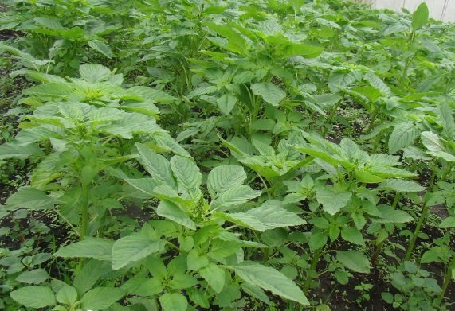
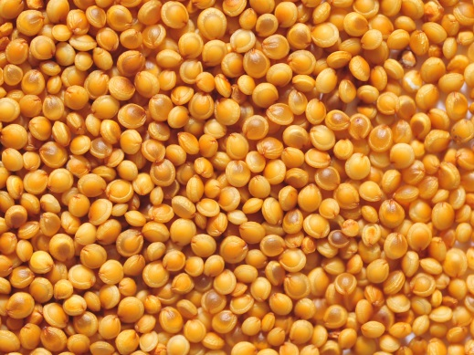
Grain type amaranth

Slide 10
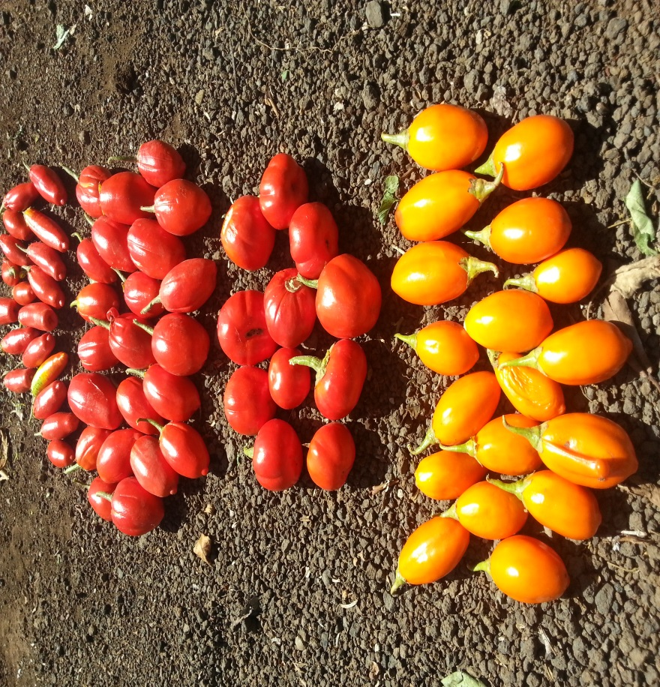
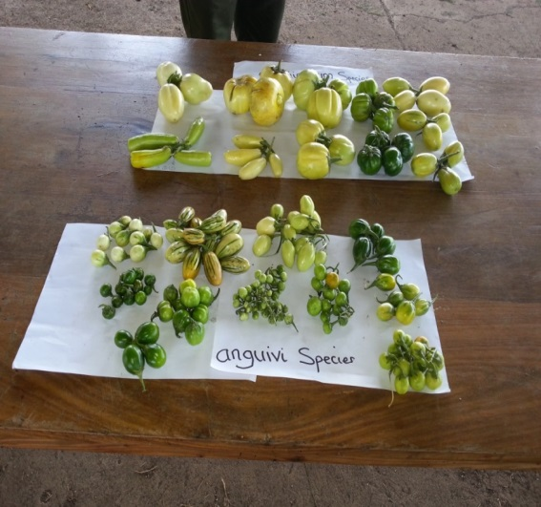
African eggplant (fruit and leaf type)
Leaf type (S. aethiopicum,
Shum group)
Fruit type (S. aethiopicum,
Gilo group)
Fruit type (Solanium spp.)

Slide 11
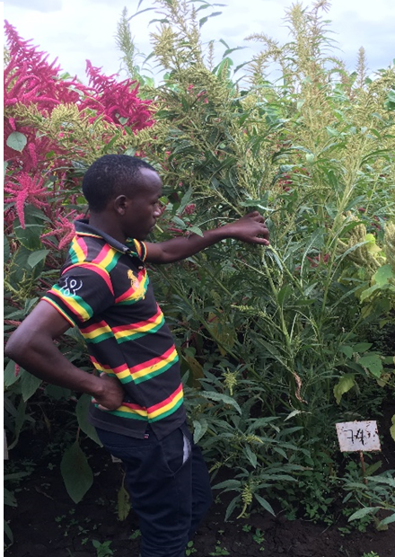
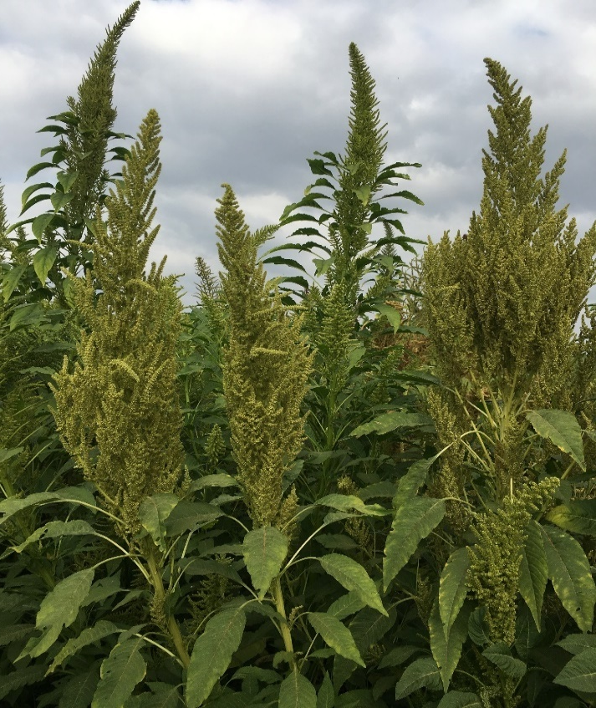
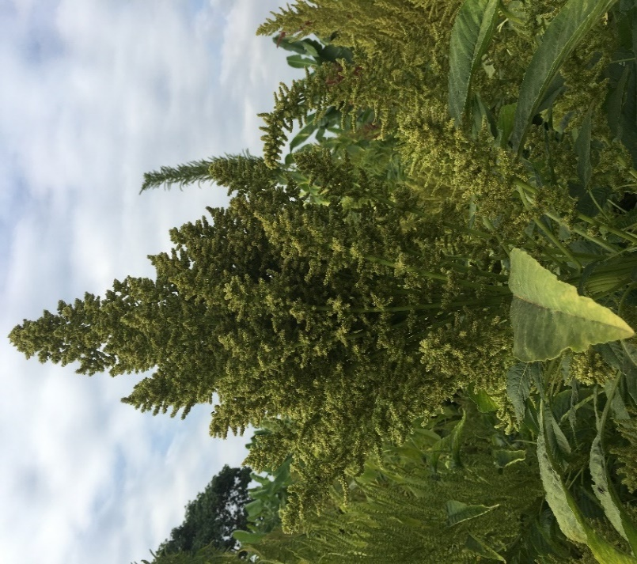
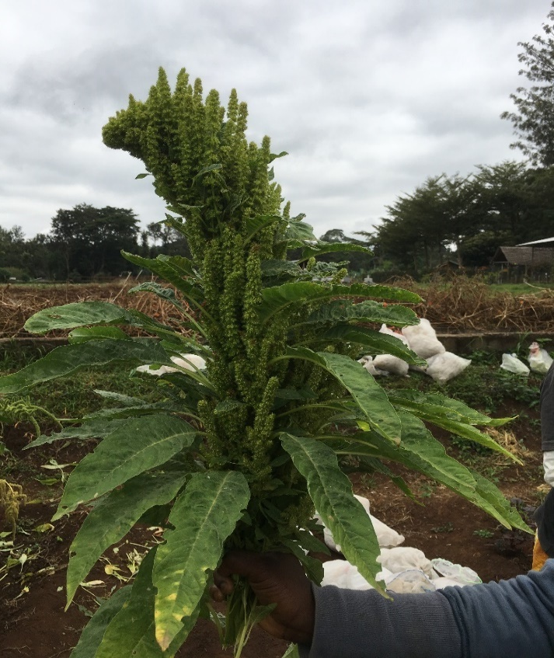
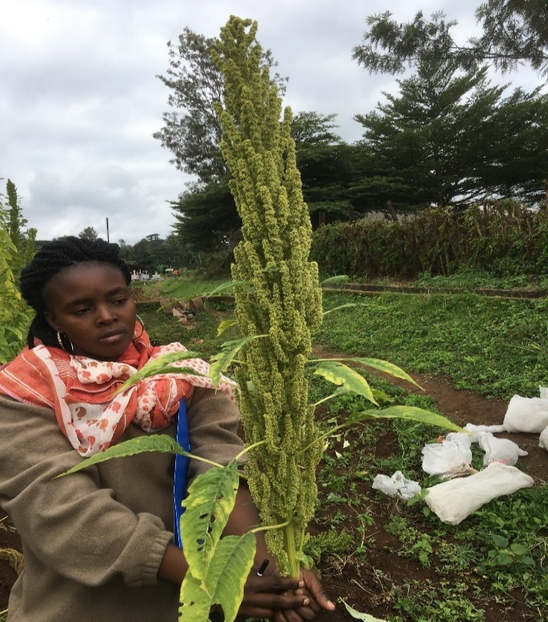
Left: Low seed and vegetable yielding variety but liked for its taste and cooking qualities Below: F3 and F4 plants with improved panicle
F3
F3
F3
F4

Slide 12
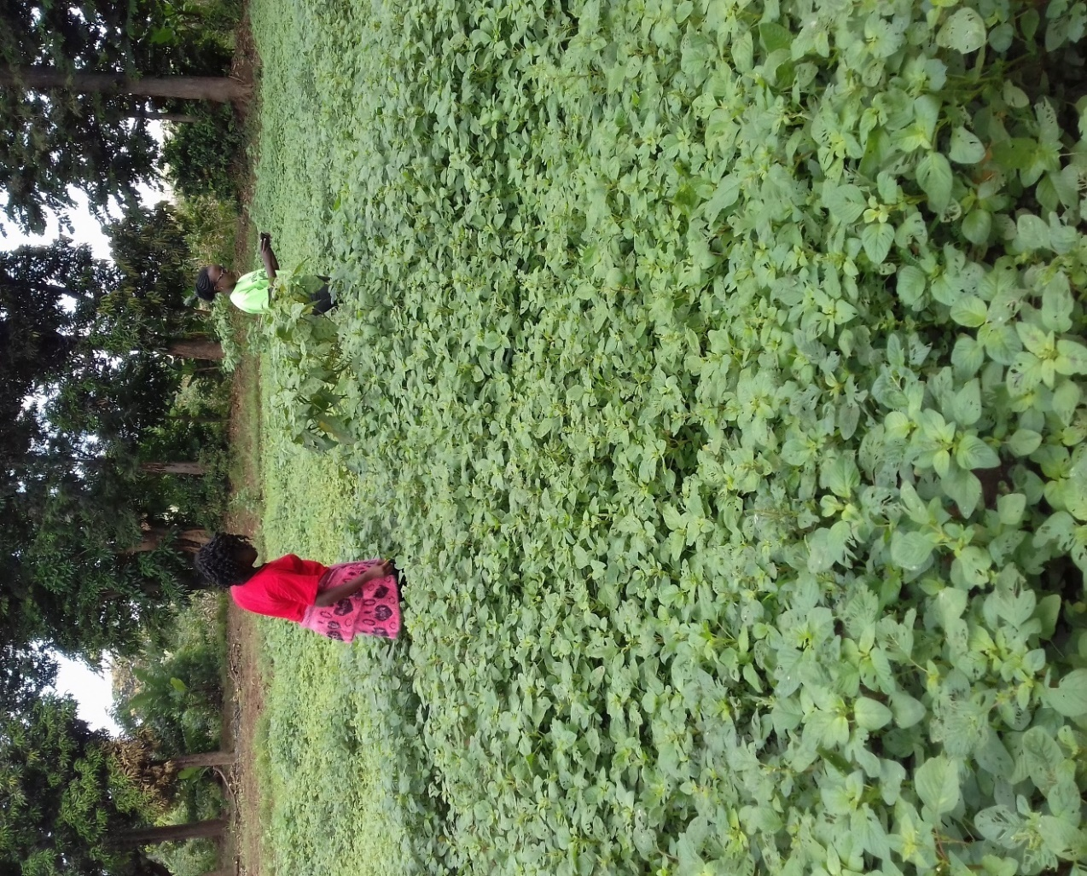
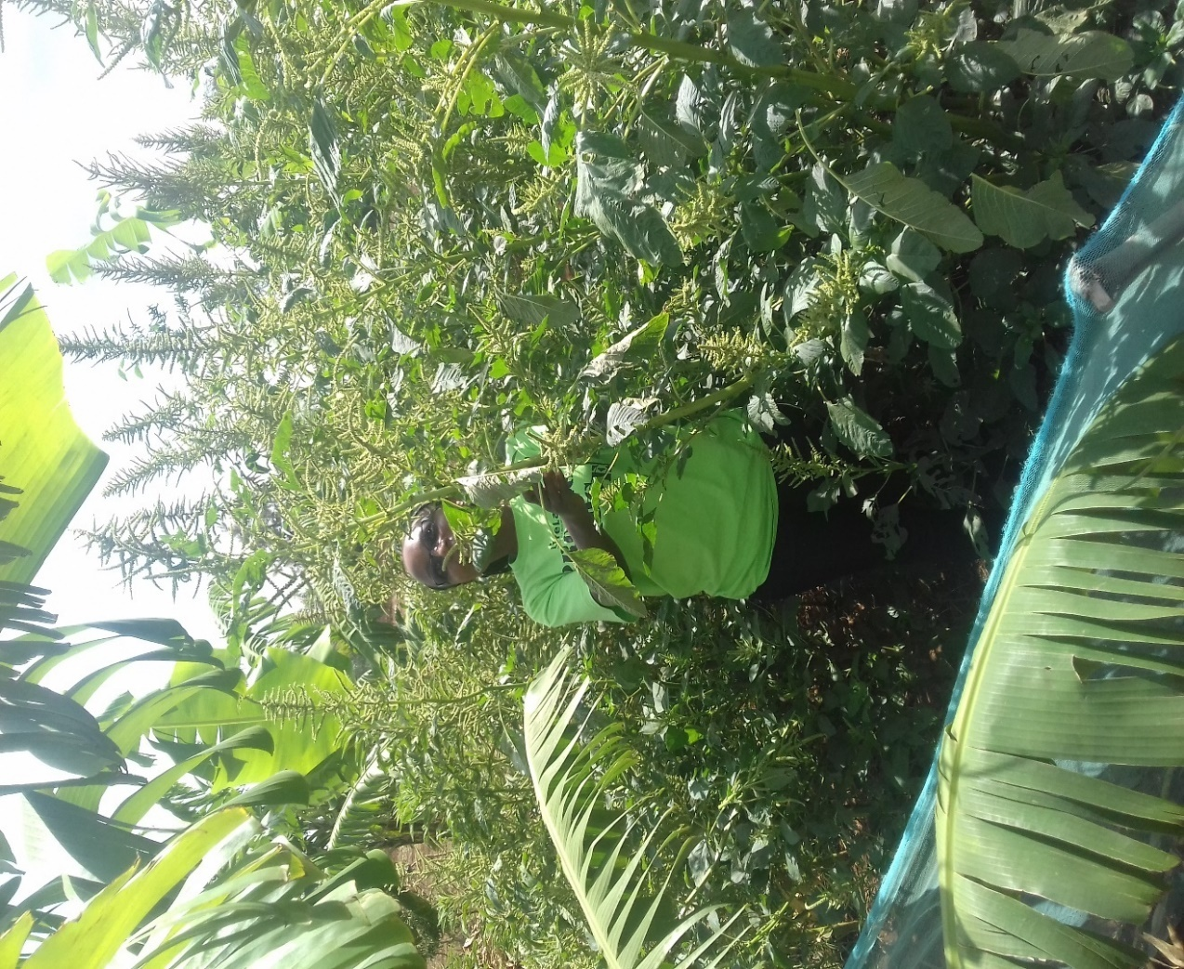
Human resource capacity building
MSc
PhD
Short term: Extension people, seed specialists
Intern students from Mekerere
University participating in variety
scaling activities

Slide 13
Contribution in science through publications
The science world has less knowledge about Traditional Vegetables

Slide 14
A number of varieties released
This year 3 amaranth + 2 African nightshade varieties by Horti-Tengeru in Tanzania
Two amaranth varieties by KALRO, Kenya
Last 3 hybrid African eggplant varieties released by Rijk Zwaan, Tanzania
Last year at least 2 hybrid African eggplant varieties released by East-West, Tanzania

Slide 15
Benefits from WorldVeg improved tomato and African eggplant varieties in Tanzania, 2014 study (Pepijn et al . 2016)
 | Tomato | African eggplant
Proportion of WorldVeg Varieties in commercial seed production in Eastern and Southern Africa | 50% | 98%
Economic gains from investment in improvement (in Tanzania alone up to 2014) | USD 255 million | USD 5 million
Internal rate of return | 26% | 12%
Benefits in other countries not included
Zambia
Uganda
DRC

Slide 16
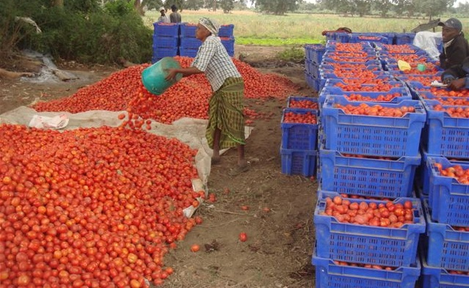
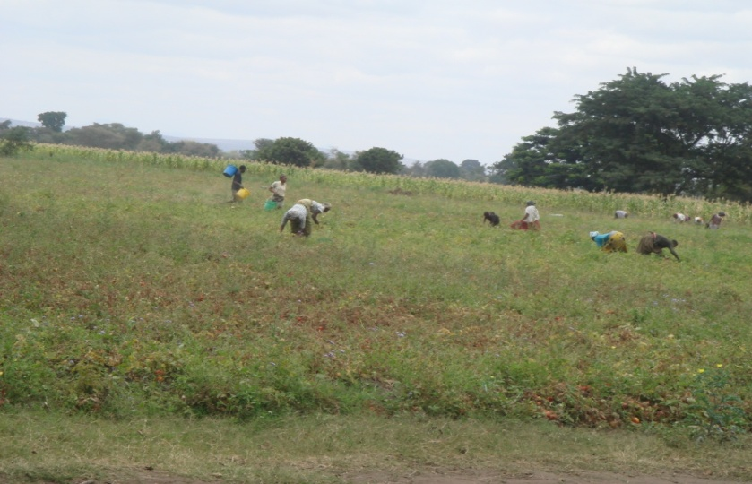
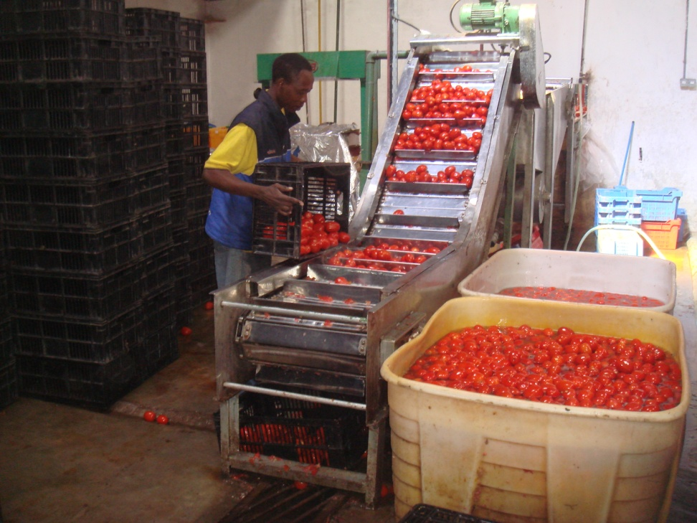
‘Tanya’ harvested for seed by a seed company
About 80% workforce in the field is women
‘Tanya’ used in processing industry

Slide 17
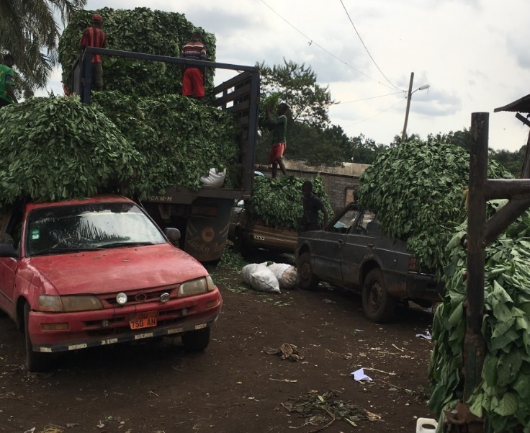
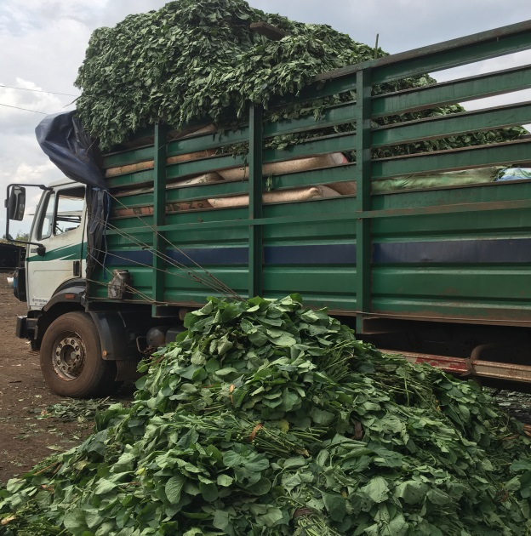
Opportunities for traditional African vegetables come from their importance
Nutrition and food security
important during lean food shortage seasons, in disaster hit areas
Income generation: livelihood improvement
Large number of women and resource poor people in some areas largely depend on them (e.g., African nightshade in Cameroon)

Slide 18
African Vegetable Breeding Consortium (AVBC)
AFSTA (African Seed Trade Association) member breeding/seed companies
Free annual workshop
Access new breeding lines (with desirable traits)
Provide us information
Small annual fee

Slide 19
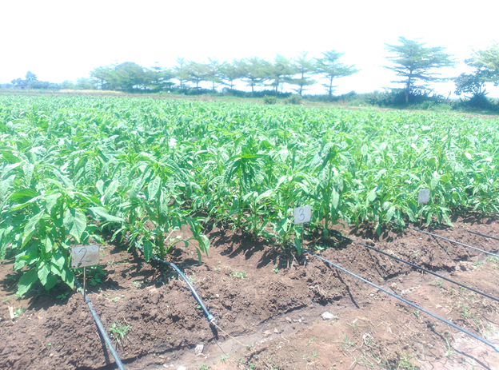
Thanks

