Slide 1

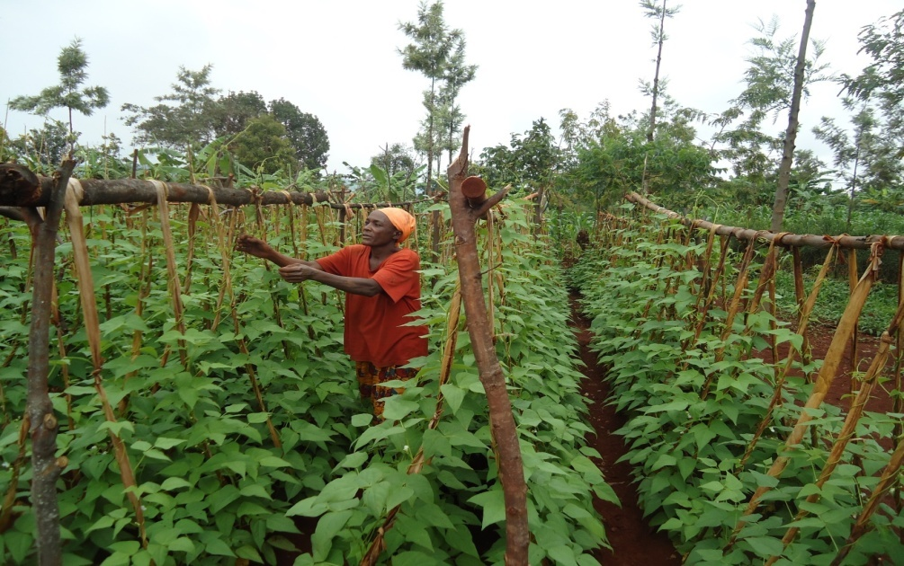
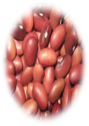




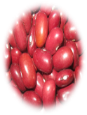

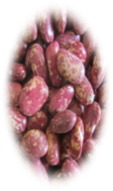

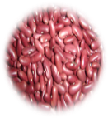
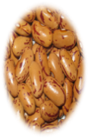
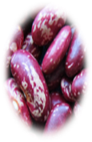
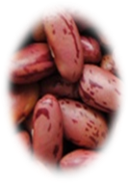

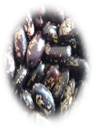


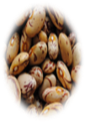
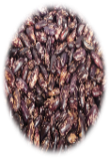
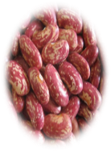

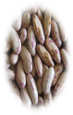
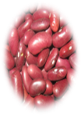
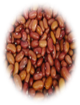

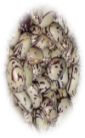
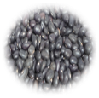
Accelerating Bean Seed Access to Smallholders farmers in Africa through public and private partnership
PABRA Team

Slide 2
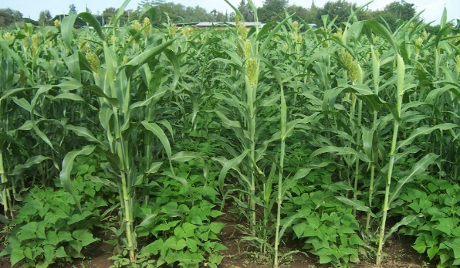
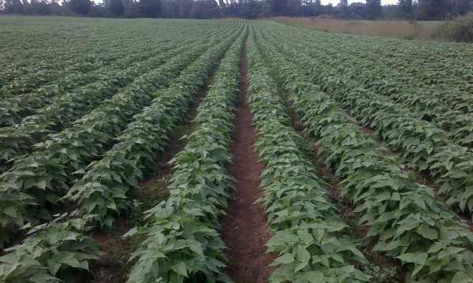
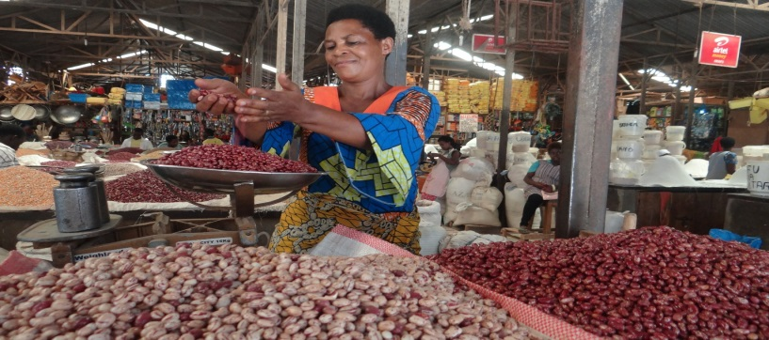
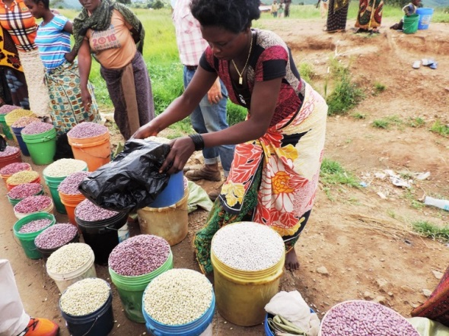
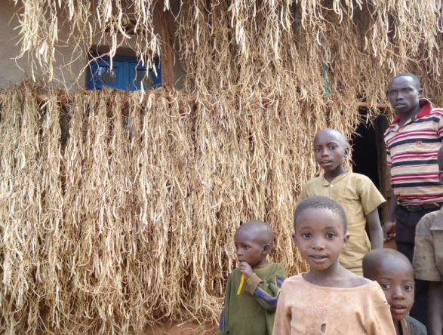
Importance of Beans: smart food/crop
Grown on more than four million hectares annually in Africa by millions of small holders
Staple food (more than 100g /day) in some sub-Sahara Africa countries
Steady and lucrative source of income for many rural households, particularly women
  50-90% of bean harvest commercialized

Slide 3
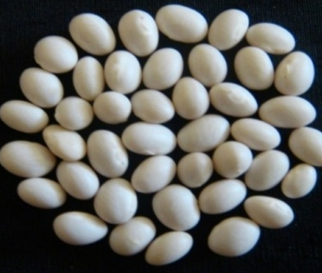
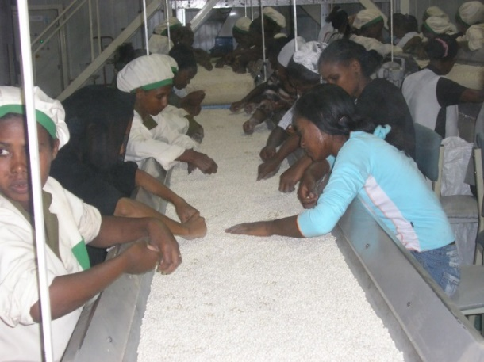
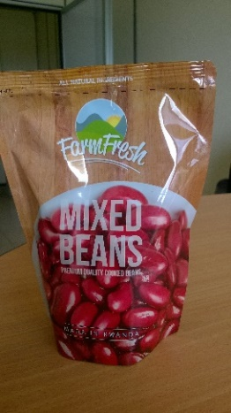
Importance of Beans cont…
Steadily transforming into major export crop (e.g. Ethiopia - white pea beans)
Raw material for local & international processing industries - high potential for value addition
Business opportunities /value addition & employment creation
The private sector is supplying the canning and other local emerging industries
E.g. pre cooked bean in Rwanda
Canning beans in Ethiopia

Slide 4
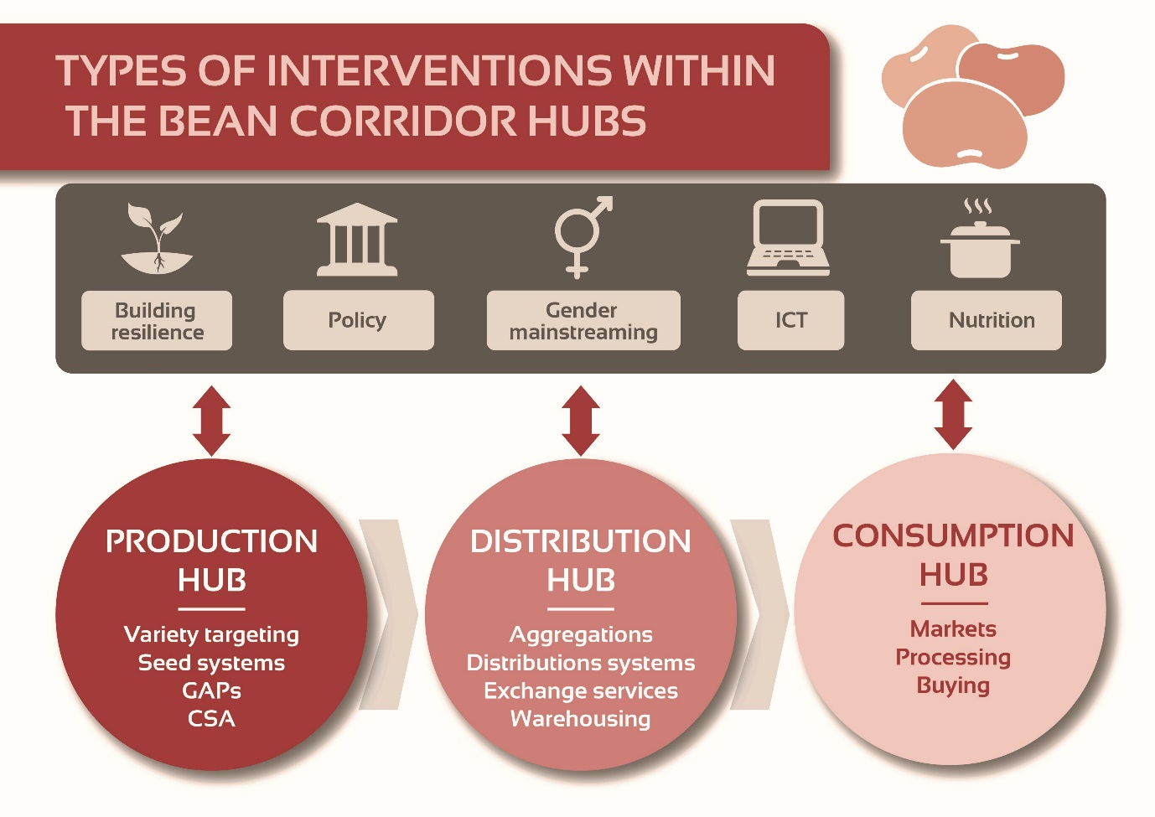
PABRA Bean Corridor Approach

Slide 5
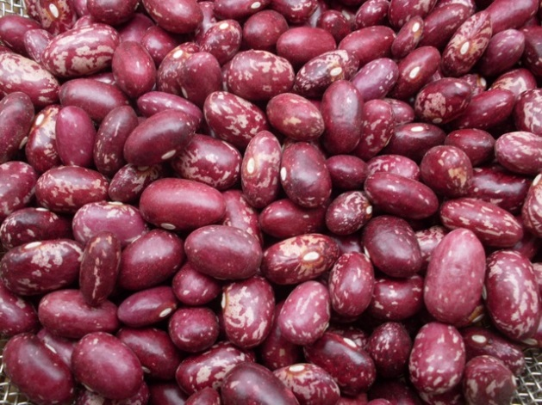
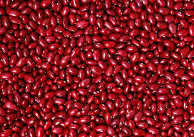
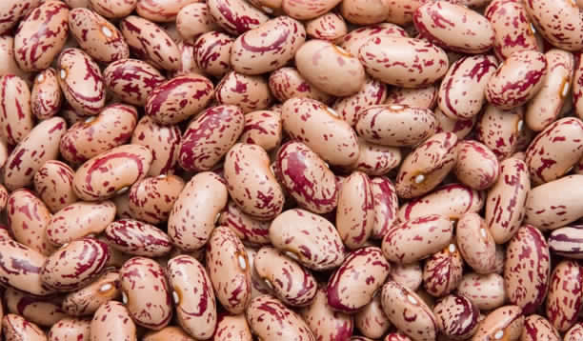
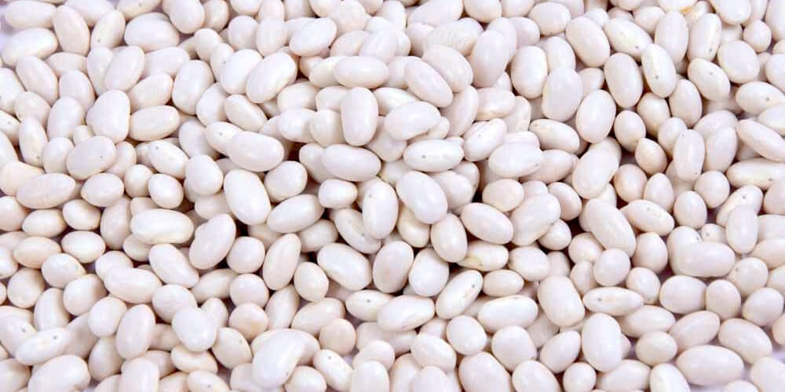
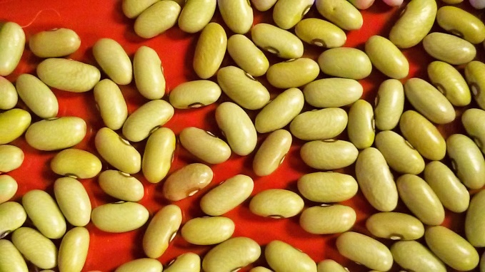
Driving Bean Types in Eastern Africa Bean Corridors
Major bean types/classes

Slide 6
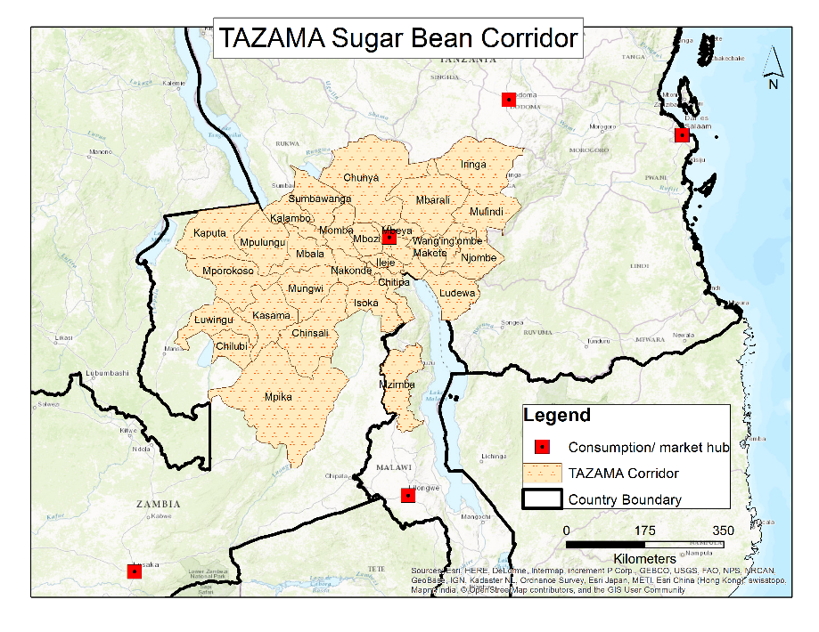
The TAZAMA corridor
Lead Firm: Raphael Group
Tanzania Zambia and Malawi (TAZAMA) corridor
Cross-border bean investments
Product: Sugar bean
Current capacity: 4,000T
Market destination: Tanzania (20%) -South Africa/Malawi, Zambia and Zimbabwe (80%)
Provide a reliable market to small holders :6000 (55% Female farmers )- USD600/tons in 2017 (up to 20% higher than nearest market place)
Yield level: 1 ton /ha
Future capacity : 20,000 tons (2022)- yield increase to 1.5t/ha
Participating households: 30,000 (potential 443,752)
Research: Responsive breeding pipeline/seed systems , efficient production and post harvest managementoptions and favorable policies
regional production areas: 221,876 ha (443,752 hh)

Slide 7
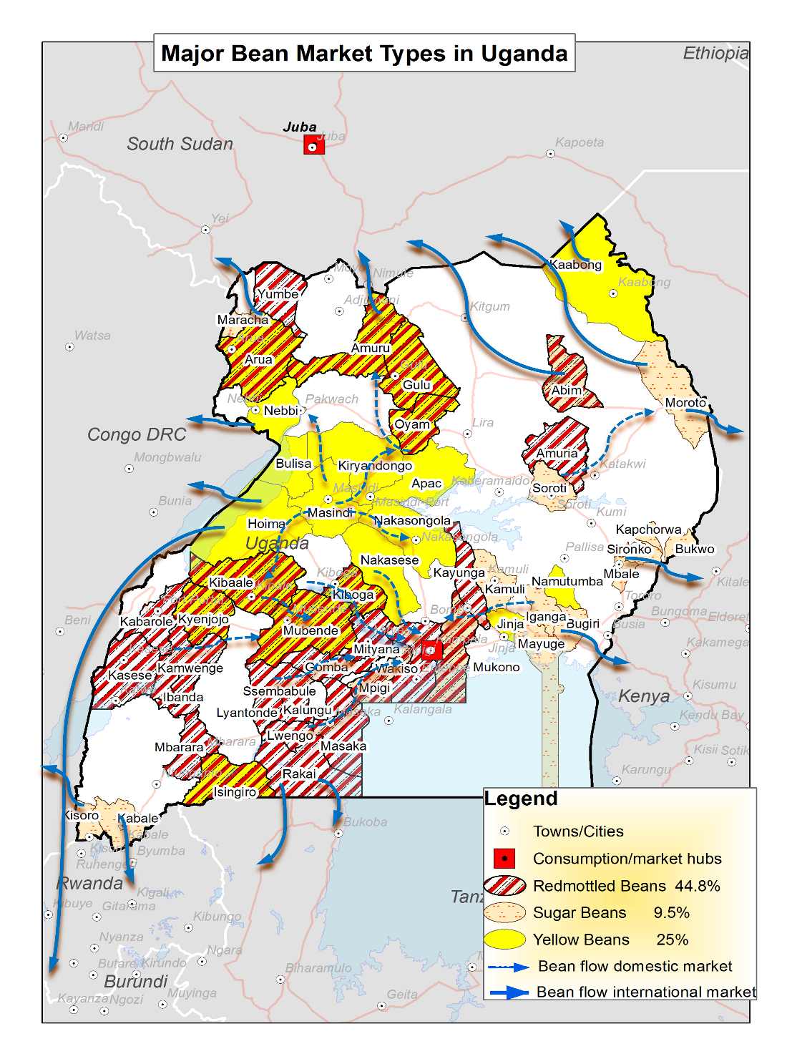
Bean Market types and production hubs in Uganda
Bean production and market data
Bean Types | Production areas (ha) | Number of varieties | Potential seed requirement (T) | Grain market destination
Large- medium Red mottled | 409,255 | 5 | 26,602 | Domestic Market and regional (S. Sudan, DR Congo, Kenya)
Large- medium yellow | 228,369 | 2 | 14,844 | Domestic market and regional (Kenyan, Rwanda, Tanzania, Zambia)
Large- medium sugar | 86,602 | 4 | 5,629 | Local market, canning and export (Kenya, Rwanda, S.Sudan, DRCongo
Large- medium DRK | 76,676 | 1 | 4,984 | Domestic and export (Turkey, Europe, India)

Slide 8
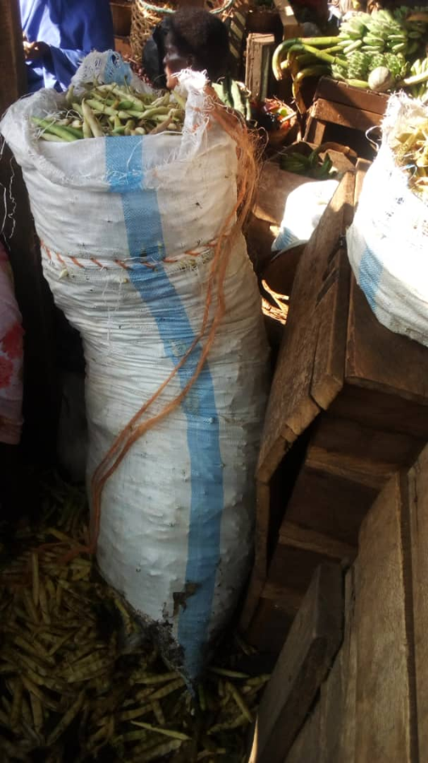
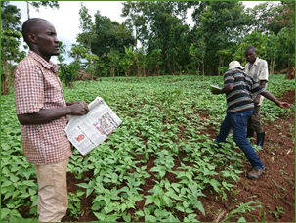
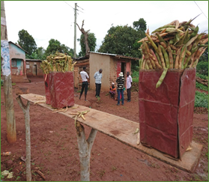
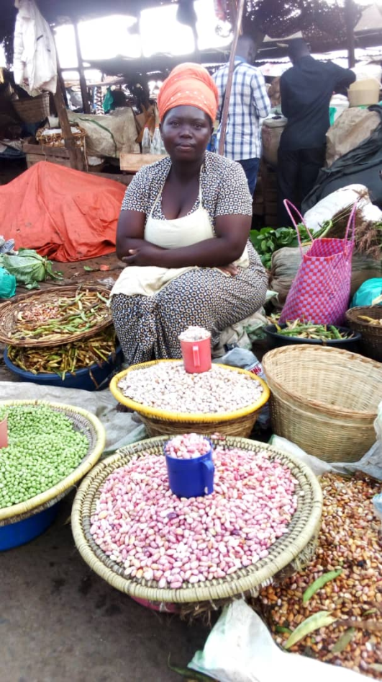
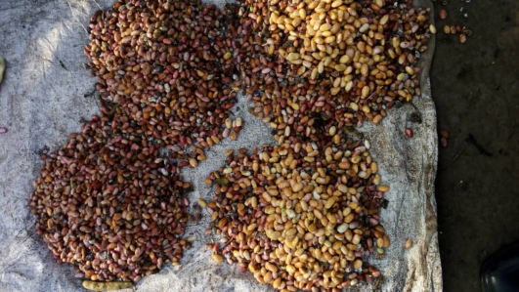
Sneak peek into the green bean pod market in Uganda
5 Major markets
  USAFI, Nakasero, Kalererwe, Nakawa & Owino
Sources of green bean pod
  Mbale, Sironko, Mpigi, Zirobwe, Kiboga, Mityna, Kabale, Kisoro, fortportal Mbarara, Rwanda
Potential
  Total 7560 –(90-100)kg of green beans per week in Kampala alone = 39,312 bags per year 3,931.2 tons of green pod beans per year @ kilo is sold at USD 0.6= USD 2,358,720
Varieties,
  Nabe 12C (Masavu), NAROBEAN 1; Kayebwa (Nabe 15, 20, 23); Red mottled (Kaduli, NABE 16, NABE 17, NAROBEAN 2)
  Issues
    Seed availability
    Pesticides/fungicides
    GAP
    Bronzing of grain after threshing/storage

Slide 9
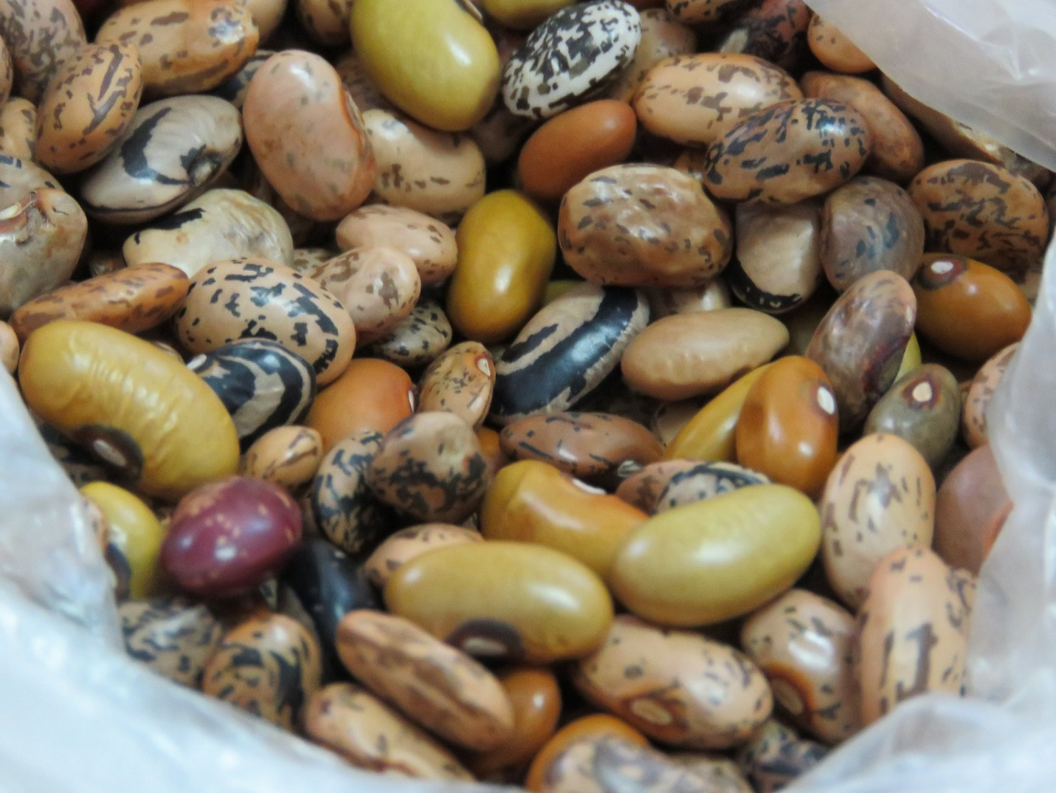
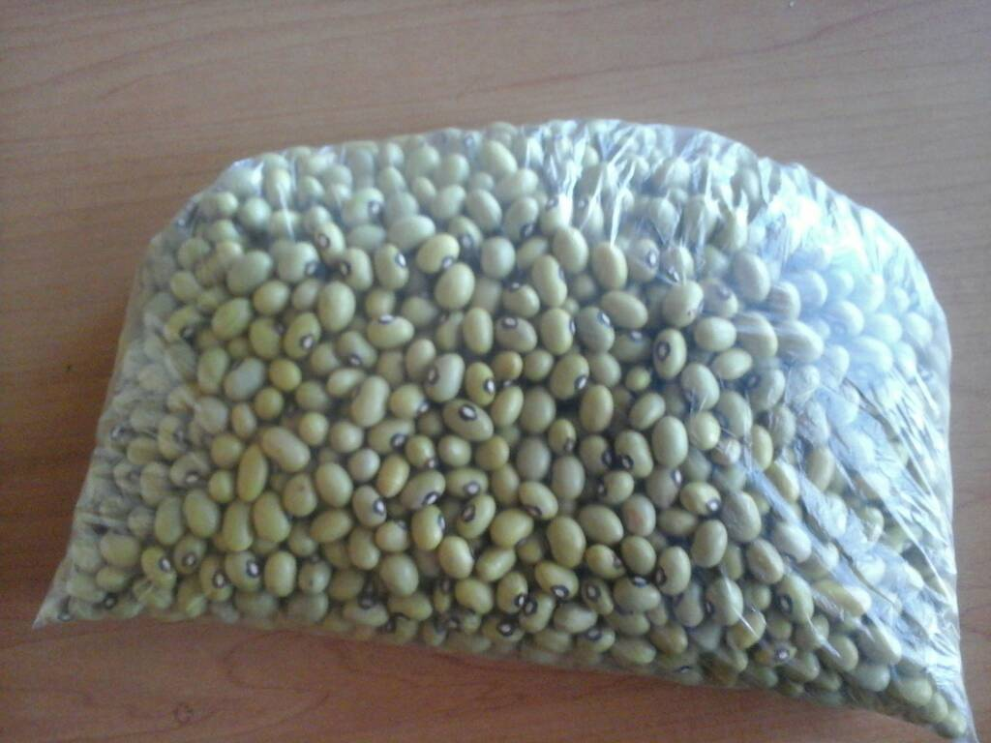
Growing Market requires High Quality Grain – The Need for High Quality Grain & Improved Productivity drives Use of Improved Seed
Price premiums for pure grain
Sorting commonly needed and costly
High quality seed of new varieties delivers quality grain and higher yields for farmers
Thus, both traders and farmers highly incentivized to use improved seed.
Notes:
Tanzania can establish itself as a quality bean exporter to the region and maybe internationally

Slide 10
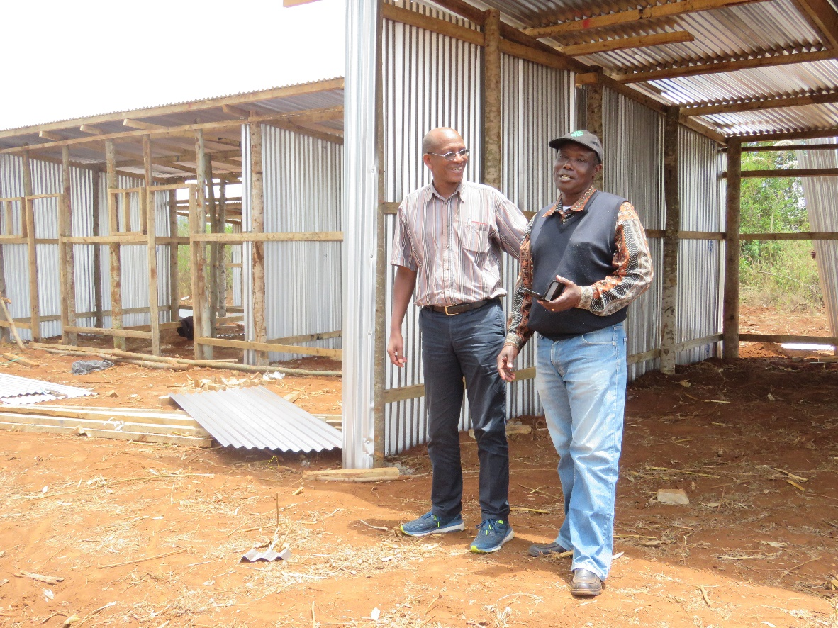
CATALYZE PRIVATE SEED COMPANIES INVESTMENTS
Seed Co and CIAT signed an agreement on varieties testing
Notes:
From Tl-III report: In northern zone, three seed companies namely ASA (276.6t), MERU agro (210t) Beula Seed Company (10t) and QDS farmers (53.38t); this makes total of 549.98t of certified seeds and QDS.
At southern highlands, 410.5t produced as follows; 150t of certified seed produced by Beula seed and Agri seed and whole quantity were supplied to Agro-dealers, farmers and G2L-Makambako Processors who supply to contract farmers. Also, 260.5t of quality declared seeds produced by farmers groups and individual farmers and were supplied to contracted farmers especially those who are being contracted by Raphael Group Limited (LTD).
From Lake/west zone, total of 215t (130 Njano Uyole and Lyamungu 85) tons of quality declared seed were produced by individual farmers and/farmer groups in Missenyi, Karagwe and Kyerwa districts and whole quantity were sold to farmers/farmer groups which operates under KADERES as NGO Karagwe district
Thus total production was 1,175 t of both certified seeds and QDS from all 3 zones was about 10% of the 11,700 ton required for the 50% target.

Slide 11
Bean Seed Producers in Some PABRA Countries
Country | Large Seed Companies e.g. Seed Co, | Small Seed Companies e.g. CEDO, NASECO, Dryland, BEULA | Public seed enterprises e.g. ASA, Ethiopia seed Enter | NGOs | Seed entrepreneurs | Farmer groups
Angola
DRC - South |  |  |  |  |  | 8
Lesotho |  | 2 |  |  |  | 3
Malawi |  | 16 |  |  |  | 6
Mozambique |  | 5 |  |  |  | 140-150
South Africa | 8 | 13
Swaziland |  | 1 |  | 3
Tanzania |  | 6 | 1 |  | 10 | 200⁺
Uganda |  | 13 | 1 |  | 2 | 52
Kenya | 2 | 5 | 3 |  |  | 15
Ethiopia |  | 3 | 8 |  | 3 | 9
Burundi |  |  | 1 |  | 9 | 13
Rwanda |  | 4 | 1 | 3 | 5 | 4
Zambia | 4 | 4 |  |  |  | 50
Zimbabwe | 3 | 7 |  | 2 |  | 20

Slide 12
Seed System Dynamism: Old Variety Replacement Vs New Variety Deployment Since 2004 - Example Of Ethiopia
Market types | Old varieties (year of release) | First replacement (year of release) | Second wave replacement (year release)
White pea bean | Mexican 142 (1973) discontinued 2008 | Awash 1 ( 1990) discontinued since 2016 Awash Melka (1999) discontinued since 2016 | Awash 2 (2013) Going on Awash Meten (2017) Going on
Small red | Red Wolaita (1980) Discontinued in 2007 | Nassir (2003) to be discontinued in 2018 Hawassa Dume (2008) | SER 119 (2014) going
Variety discontinuation beginning of withdrawing from the market starting from breeder seed and engaging the seed value chain actors /heavy promotion of new varieties

Slide 13
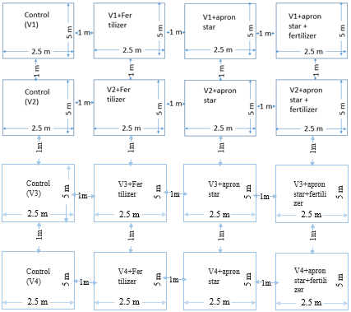
Quality VARIETI TESTIG Data to convince investors (several SITES )
AGRO DEALER BASED DEMOS

Slide 14
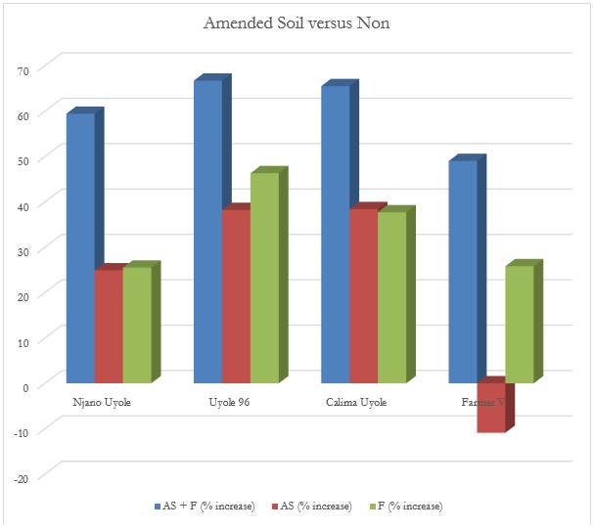
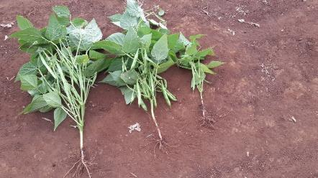
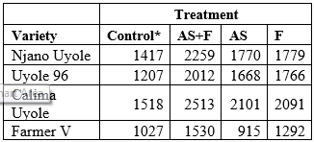
Effect of Apron star+ fertilizers on bean yield (Tons/ha) and percentage increase
No. apron star and fertilizer
Apron star and fertilizer
Apron star alone

Slide 15
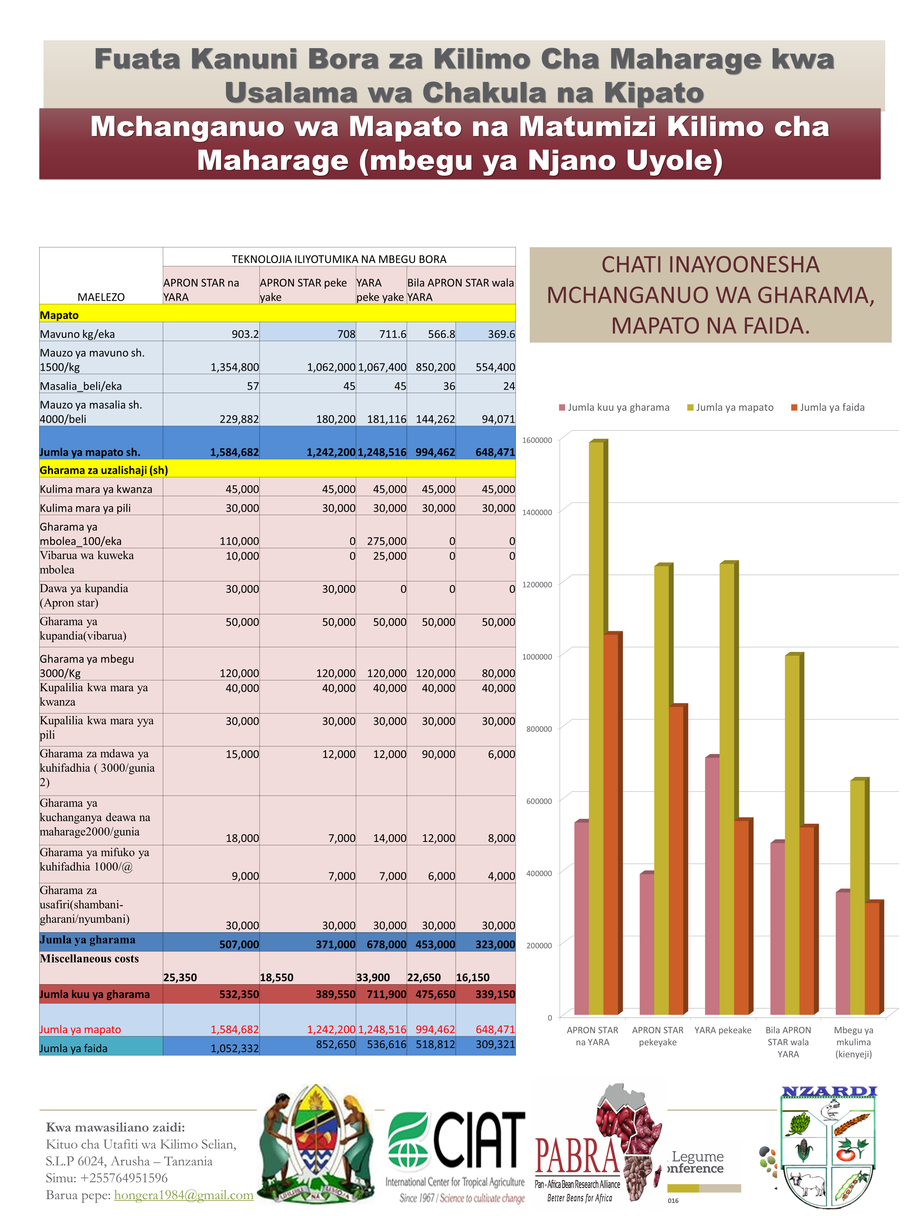
Cost-Benefit Analysis for Uyole-Njano with and without ApronStar and Fertilizer

Slide 16
Variety Branding
Variety brand: name, term, design, symbol or other feature that distinguishes one variety from those of others
Appears on seed packages or printed as flyers/ posters used for marketing
Ensures returns on investments for breeders
Enables breeders to be recognized for their skills and makes breeding a valued profession

Slide 17
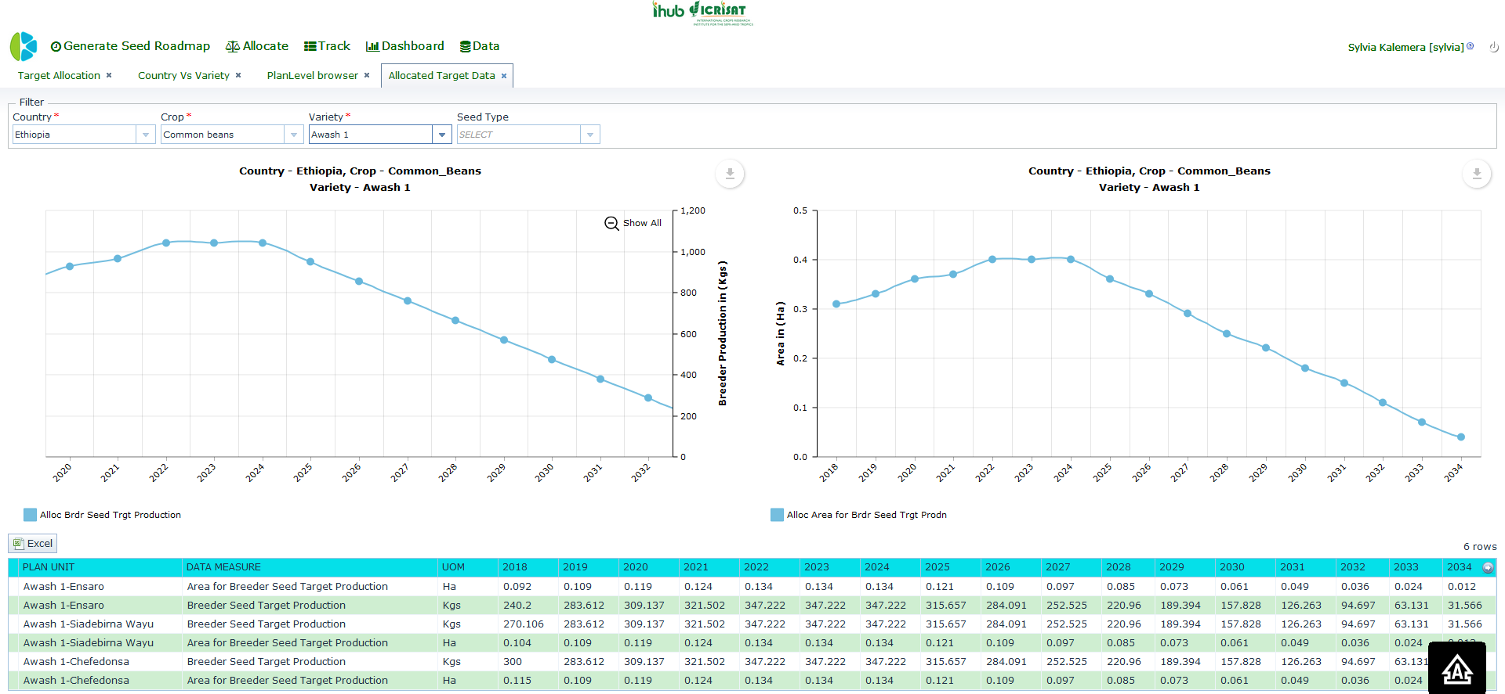
Variety monitoring

Slide 18
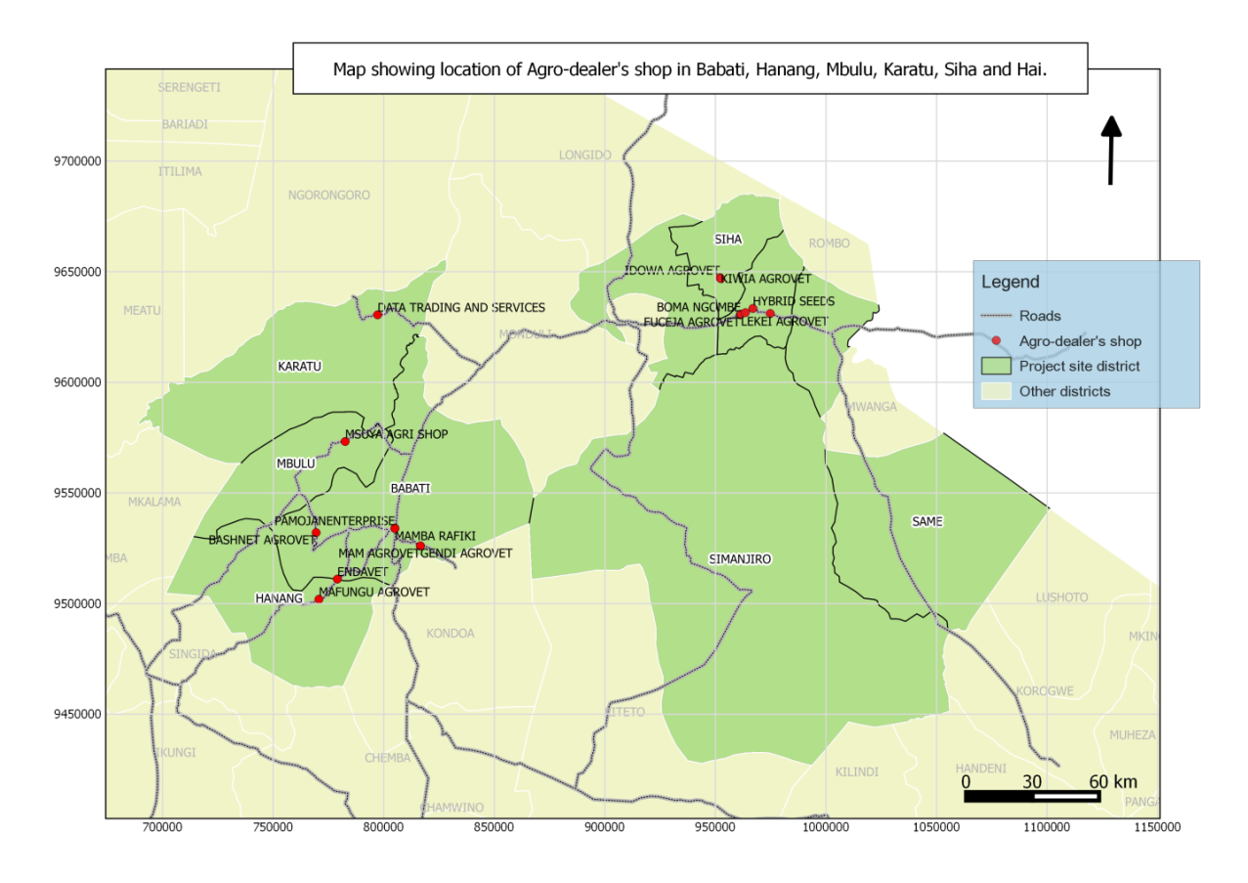
Variety Tracking using GPS Coordinates
Important for breeders to:
  Monitor the movement of their varieties
  Determine if varieties are adopted and being used by the farmers.
  Also include locations of seed sales agencies and their geographical distribution
  New IT can help track seed sales of new varieties (e.g. GPS, mobile phones).
An example of variety tracking using GPS coordinates in six districts of Tanzania

Slide 19

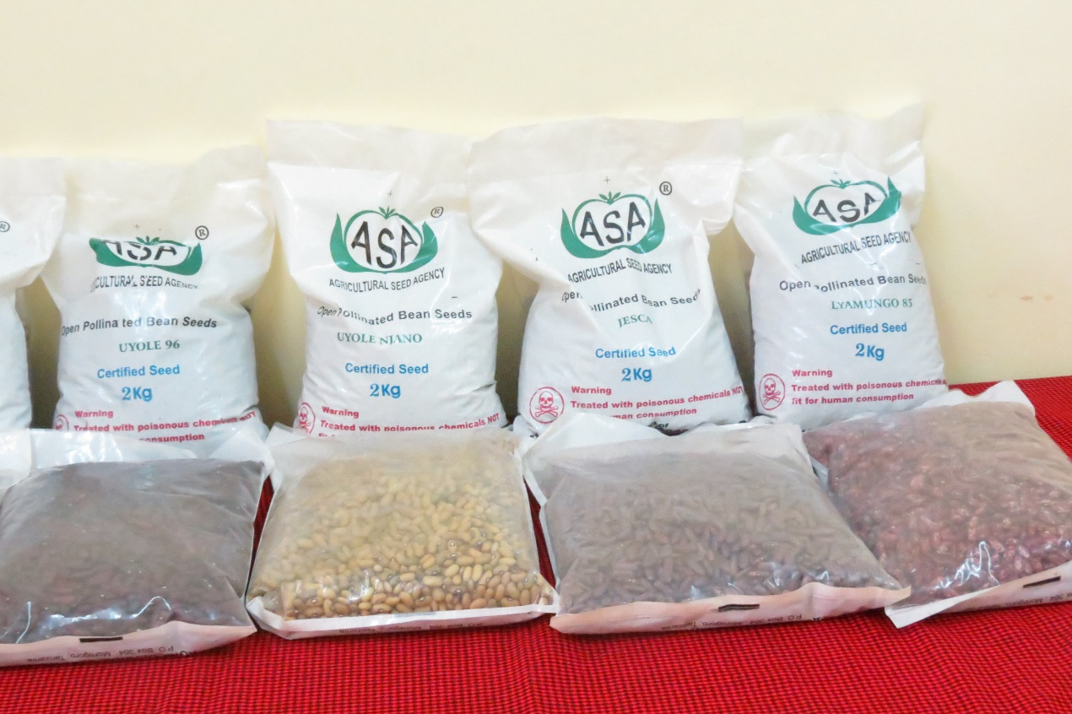
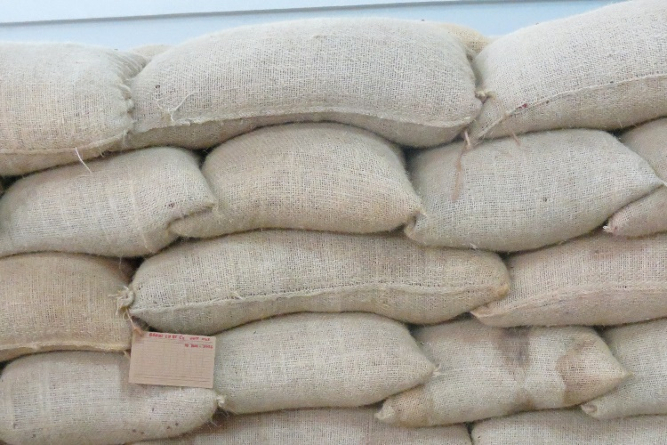
Transformation: Institutional Change within Strategic Organizations in Tanzania (ASA and seed companies )
Before 2014
From 2015
Seed companies increase : 1 8

Slide 20

THANK YOU

